Slide 1
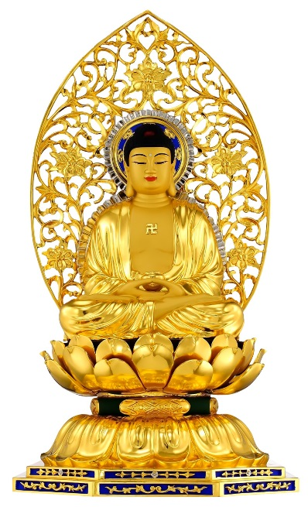
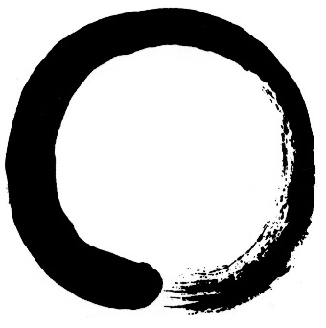
Budd 5: Society
Buddhism in the Far East
Zen Buddhism
Pure Land Buddhism
b) Buddhism in the West
The spread of Buddhism to the West
Buddhism in popular culture
Western ‘inculturation’

Slide 2
Buddhism in the Far East: Content
The distinctive features of Zen Buddhism, including:
zazen meditation, its importance and the attainment of satori (awakening)
Zen attitudes to scripture and transmission of wisdom
key features of and differences between the Rinzai and Soto schools
The distinctive features of Pure Land Buddhism, including:
the person and importance of Amitabha
rebirth in a Pure Land
the practice of chanting, its importance and purpose
key features of and differences between Jōdo-shū and Jōdo Shinshū

Slide 3
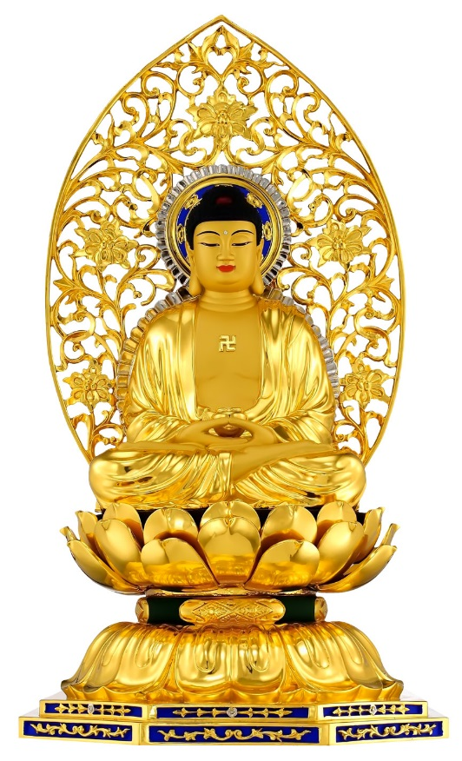
Buddhism in the Far East: To discuss
Learners should have the opportunity to discuss issues relating to Zen and Pure Land ideas, including:
whether Pure Land Buddhism is an ‘easy’ path
how and if Siddhartha’s original teachings can be seen in these two schools
the implications of Zen’s rejection of theory, ritual and the use of language to express truth

Slide 4
Introduction to Zen Buddhism
When Buddhism reached China it merged with Taoist philosophy and the result was Zen Buddhism
Zen also flourished in Vietnam, Korea and Japan
“Zen” derives from “Chan”, which literally means meditation
Zen practitioners use koan and zazen meditation
In Zen, ensō (円相 , "circle") is a circle that is hand-drawn in one or two uninhibited brushstrokes to express a moment when the mind is free to let the body create.

Slide 5
Zen attitudes to scripture and transmission of wisdom
Zen is one the most extreme forms of Buddhism in rejecting the authority of dogma and scripture (as reliance on these is considered a form of attachment)
The stress instead is on meditation – and mindfulness, paying attention to the moment, the act of being
The true nature of things cannot be explained in writings or grasped logically
Everything is ultimately nothing and cannot be expressed in words
Instead the characteristic feature of Zen is special transmission outside of the scripture
Teaching is passed directly, personally, from master to student

Slide 6
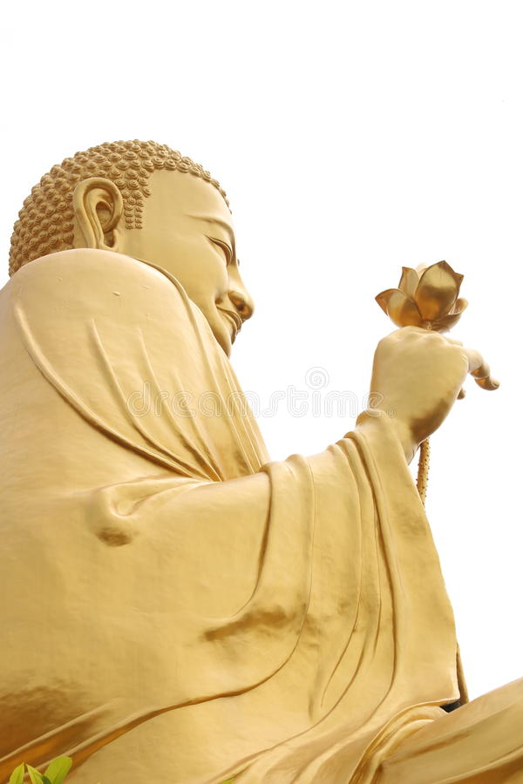
The Flower Sermon is a story of the origin of Zen Buddhism in which Śākyamuni Buddha (Siddhartha Gautama) transmits direct prajñā (wisdom) to the disciple Mahākāśyapa.
In the original Chinese, the story is Niān huá wéi xiào (拈華微笑, literally "Pick up flower, subtle smile").

Slide 7
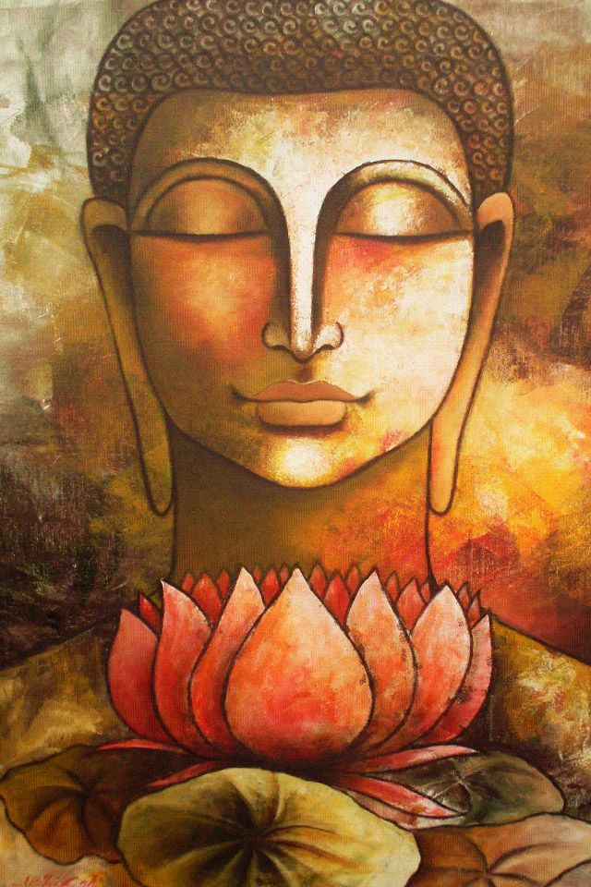
The Flower Sermon
Toward the end of his life, the Buddha took his disciples to a quiet pond for instruction. As they had done so many times before, the Buddha’s followers sat in a small circle around him, and waited for the teaching.
But this time the Buddha had no words. He reached into the muck and pulled up a lotus flower. And he held it silently before them, its roots dripping mud and water.
The disciples were greatly confused. Buddha quietly walked around, displaying the lotus to each of them. In turn, the disciples did their best to expound upon the meaning of the flower: what it symbolised, and how it fit into the body of Buddha’s teaching.
When at last the Buddha came to his follower Mahakasyapa, the disciple suddenly understood. He smiled and began to laugh. Buddha handed the lotus to Mahakasyapa and began to speak.
“What can be said I have said to you,” smiled the Buddha, “and what cannot be said, I have given to Mahakasyapa.”
This sermon conveys the central message of Zen: that it is possible for one to transmit wisdom directly, rather than just through scripture.

Slide 8
Special transmission of wisdom
The Flower Sutra is a sutra in the Zen (or Chan) tradition of Mahayana Buddhism.
Its earliest versions date from the 11th century.
Zen Buddhism stresses wordless insight more than most other types of Buddhism. This sutra exemplifies that very well.
In many versions of this sutra the Buddha doesn't walk around, he merely holds up the Lotus, roots and all, to a group of disciples. Most disciples are confused.
Mahakashyapa smiles.
To Zen Buddhists this sutra shows the origins of the wordless teachings of Zen - its history started with the Buddha himself.

Slide 9
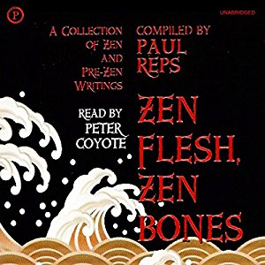
Zen Flesh, Zen Bones
“The Chan-Zen masters, instead of being followers of the Buddha, aspire to be his friends and to place themselves in the same responsive relationship with the universe as Buddha and Jesus.”
Paul Reps, who compiled and writes the foreword to the famous book of Zen koan Zen Flesh, Zen Bones has said…

Slide 10
Zen Flesh, Zen Bones
“instead of being followers of the Buddha, aspire to be his friends”
What do you think he means when he says this?
Paul Reps, who compiled and writes the foreword to the famous book of Zen koan Zen Flesh, Zen Bones has said…

Slide 11
Zen koans
Zen koans are little stories or quotes designed to confuse, to shock the listener/reader out of everyday thinking
They allude to/point towards enlightenment rather than stating it directly, as that is considered impossible
A student might work with one koan for several months or even years, returning to their teacher many times to comment on their koan. Some other students may require only a few seconds to 'understand' the same koan. Neither way of working with a koan is better than the other.
The most important thing about koans is their use as a tool to discover one's own true mind. It is not necessary to know many; one may be enough.
The zen koans often appear surreal or nonsensical...

Slide 12
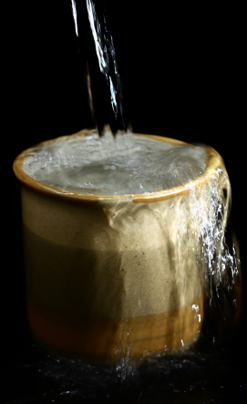
Zen koan: A cup of tea
Nan-in, a Japanese master during the Meiji era (1868-1912), received a university professor who came to inquire about Zen.
Nan-in served tea. He poured his visitor's cup full, and then kept on pouring.
The professor watched the overflow until he no longer could restrain himself. "It is overfull. No more will go in!"
"Like this cup," Nan-in said, "you are full of your own opinions and speculations. How can I show you Zen unless you first empty your cup?"

Slide 13
One koan from Zen Flesh, Zen bones is "In clapping both hands a sound is heard; what is the sound of one hand?"
Koans can't be solved by study and analytical thought.
In order to solve a koan, the pupil must leave behind all thoughts and ideas in order to respond intuitively.
Koans don't have a right answer.
Western pupils often find this very frustrating, since most westerners are used to trying to get the right (and only) answer to a problem.
For the same reason, the truths of Zen can't be learned just by reading a scripture or getting a solution from a teacher or a text book.

Slide 14
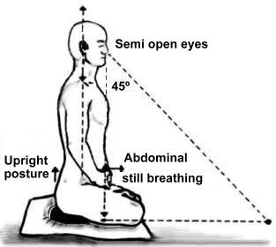
Zazen Meditation
If possible, a statue of Manjushri (remember him?) should be enshrined in the room.
If there is none available, any statue or painting of a Buddha or a Bodhisattva is fine.
Also, when possible, place an offering of flowers on the altar and burn incense.
This instructional video is made by Yokoji-Zen mountain centre. It is only 8 minutes long and provides a really useful (and visual) introduction to zazen meditation.

Slide 15
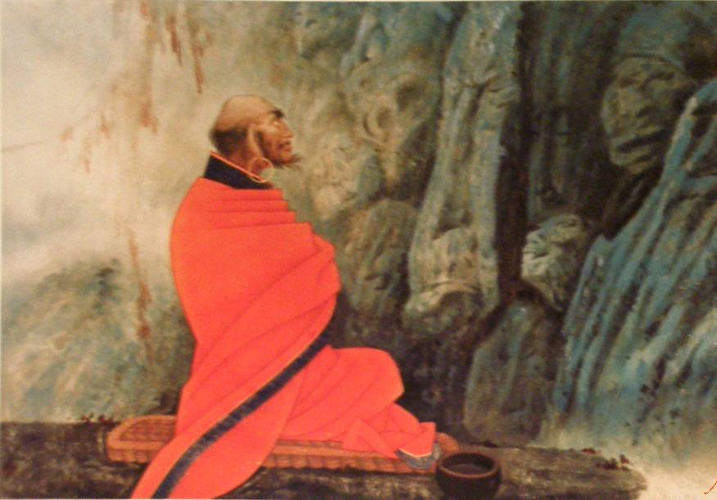
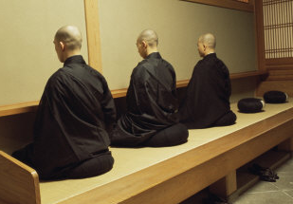
Zazen Meditation
Bodhidharma, the Indian monk credited with having brought Zen to China, is said to have spent nine years facing a wall in a cave a mile from northern China’s Shaolin Temple.
If so, the Zen he originated was a Zen of wall sitting.

Slide 16
Zazen Meditation and satori
This is such a good opportunity for independent learning of an important concept in Zen Buddhism! They will learn more this way than if I spoonfeed them in class!
Satori is the spiritual goal of Zen Buddhism.
Now go and learn the rest.
I see she’s carefully selected hyperlinks. I’ll just do a general google instead.
She must not know it very well.
Why can’t she just give us a hand out? She’s so lazy.

Slide 17
The very first link https://www.britannica.com/topic/Satori takes you to this page. As you can see, it instantly provides you with an excellent introduction to the concept.

Slide 18
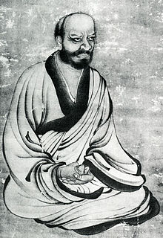
The Rinzai Zen School
Rinzai Gigen
The Rinzai school emerged in China from the teaching line of Linji Yixuan (Japanese= Rinzai Gigen), d. 866, and was first introduced to Japan by the Japanese monk Myoan Eisai (1141-1215).
The writer, John McRae, writes that Linji is reputed for being iconoclastic, leading students to awakening by hitting and shouting.
The time during which Rinzai Zen was established in Japan also saw the rise of the samurai to power. Along with early imperial support, Rinzai came to enjoy the patronage of this newly ascendant warrior class.

Slide 19
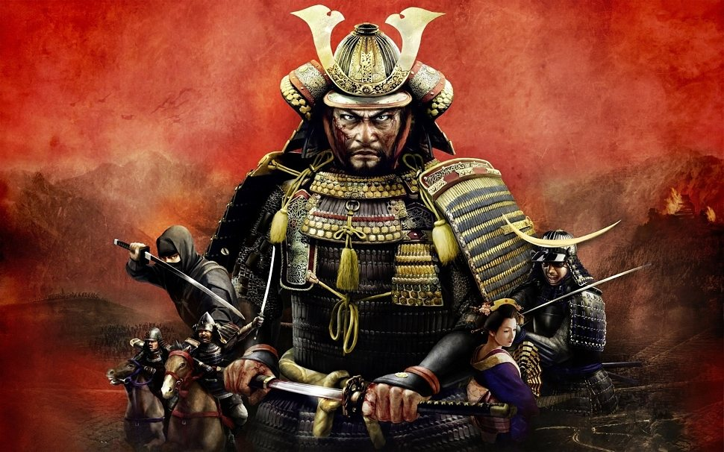

Slide 20
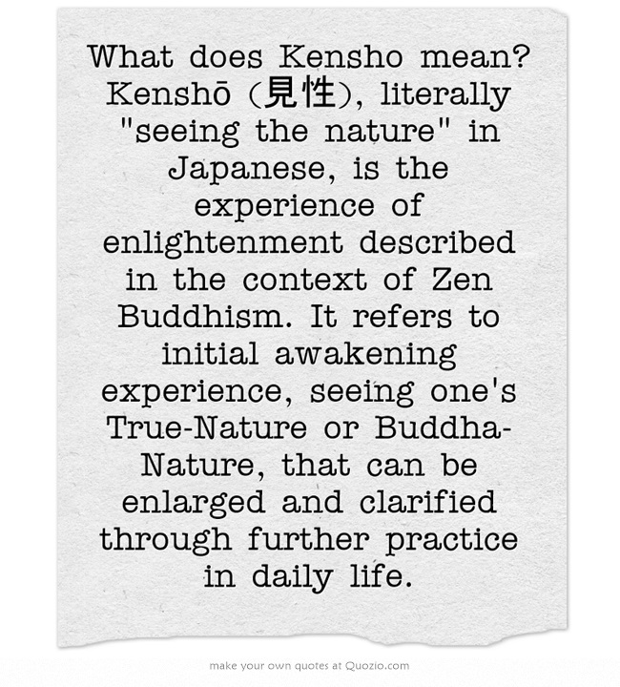
The Rinzai Zen School
In the Record of Linji, Master Linji says, “On your lump of red flesh is a true man without rank who is always going in and out of the face of every one of you. Those who have not yet proved him, look, look!”
The basic stance of the Rinzai school is the self-realization of this “true man without rank.”
This self-realisation, called kensho, is regarded as the essence of the Buddha’s teaching, and has been passed from generation to generation in Zen, like, as the Zen expression has it, “water poured from one container to the next.”

Slide 21
The Rinzai Zen School
Rinzai Gigen:
a bit aggressive?
Rinzai schools have sought, through the practices of zazen, koan training, and samu (physical work that is done with mindfulness as a simple, practical and spiritual practice), to awaken the practitioner to the Buddha-nature inherent in all beings.
When engaged in zazen, kōans are frequently the object of meditation, while shikantaza ("just sitting") is less emphasised, but still used.
This contrasts with Sōtō practice, which has de-emphasised kōans since Gentō Sokuchū (circa 1800), and instead emphasises shikantaza. In general, the Rinzai school is known for the severity of its training methods (following in the spirit of Rinzai Gigen).
If you will just bring to rest the thoughts of the ceaselessly seeking mind, you will not differ from the patriarch-buddha. Turn your own light inward upon yourselves!

Slide 22
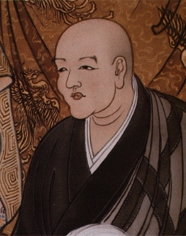
The Soto Zen School
Dogen Zenji, the founder of Soto Zen School, was born on January 26, 1200 CE.
With wealthy parents, it is presumed that young Dogen Zenji lived in comfort.
However, at the age of thirteen, he climbed Mt. Hiei, and the next year he shaved his head and became a monk.
It is said that he became a monk because he felt the impermanence of the world on his mother’s death when he was eight years old.
Tired of what he perceived as the Japanese departure from the Buddha’s original teachings, he travelled to China to find out about the wisdom of monks in history.
Just before he left, disappointed with a lack of success, he came across zazen meditation.
In order to encourage as many people as possible to practice zazen, Dogen Zenji wrote “A Universal Recommendation of Zazen”, in which he carefully explained the significance of zazen and how to practice it.
Dogen Zenji, the founder of Soto Zen School: focus on the internal self

Slide 23
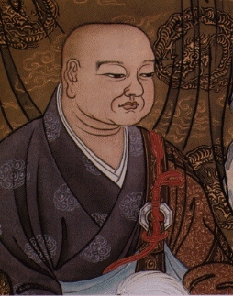
The Soto Zen School
Keizan Zenji was the 4th monk in the Japanese Soto Zen lineage
In contrast to Dogen Zenji, who deeply explored the internal self, Keizan Zenji stood out with his ability to look outwards and boldly spread the teaching.
For the Soto Zen School, the teachings of these two founders are closely connected with each other.
In spreading the Way of Buddha widely, one of them was internal in his approach while the other was external.
Spotting Keizan Zenji’s potential ability to lead the monks, Jakuen Zenji selected him to be ino, the monk in charge of the other monks’ practice.

Slide 24
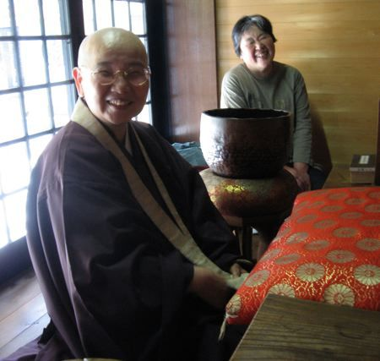
The Soto Zen School
Keizan Zenji also came forth emphasising the equality of men and women.
He actively promoted his women disciples to become resident priests.
At a time when women were unjustly marginalised, this was truly ground-breaking.
This is thought to be the origin of the organization of Soto Zen School nuns and it was for this reason many women took refuge in Buddha, Dharma, and Sangha.
Keizan Zenji

Slide 25
Key features of and differences between the Rinzai and Soto schools
While the heart of the Soto school is based on the practice of Zazen, the heart of the Rinzai school (臨済宗) still focuses on the use of koan.
The rather martial, sharp style of Rinzai is often contrasted with Sōtō, which has been called more gentle and even rustic in spirit. A Japanese saying reflects these perceptions: "Rinzai for the Shōgun [warrior], Sōtō for the peasants“.
Different schools of Zen also do zazen in different ways: Soto meditators face a wall, Rinzai meditators sit in a circle facing each other.

