Slide 1
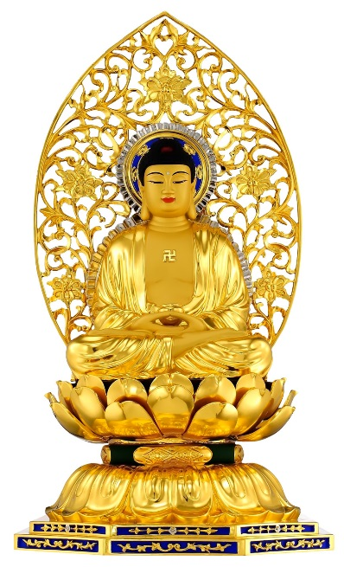
Budd 5: Society
Buddhism in the Far East
Zen Buddhism
Pure Land Buddhism
b) Buddhism in the West
The spread of Buddhism to the West
Buddhism in popular culture
Western ‘inculturation’

Slide 2
Prep deadline…….today!
Satori research
Trikaya notes for checking

Slide 3
Buddhism in the Far East: Content
The distinctive features of Zen Buddhism, including:
zazen meditation, its importance and the attainment of satori (awakening)
Zen attitudes to scripture and transmission of wisdom
key features of and differences between the Rinzai and Soto schools
The distinctive features of Pure Land Buddhism, including:
the person and importance of Amitabha
rebirth in a Pure Land
the practice of chanting, its importance and purpose
key features of and differences between Jōdo-shū and Jōdo Shinshū

Slide 4
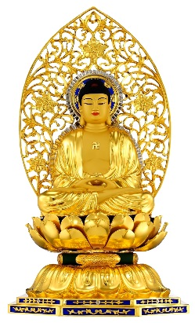
Pure Land Buddhism
The next two lessons on Pure Land involve 3 levels of engagement:
INTRODUCTORY
a) Read the introductory sheet What is Pure Land Buddhism? b) As you read, put brief, summarised notes into the right part of the grid (e.g. use the sutra to label sukhavati) c) complete Task 1 on the main worksheet.
INTERMEDIATE
Listen to the deeper level of information given through the PowerPoint. What other notes can be added to your grid? (e.g. Pure Land scriptures, concept of Nembetsu)
Complete Task 2 on the main worksheet
HIGHER
Complete Task 3 on the main worksheet b) Make notes on the two different schools (empty grid on back)
EXTENSION AT ALL STAGES: Try to interpret and analyse these scholarly teachings on Pure Land!

Slide 5
Pure Land Buddhism
The next two lessons on Pure Land involve 3 levels of engagement:
INTRODUCTORY
a) Read the introductory sheet What is Pure Land Buddhism? b) As you read, put brief, summarised notes into the right part of the grid (e.g. use the sutra to label sukhavati) c) complete Task 1 on the main worksheet.
INTERMEDIATE
Listen to the deeper level of information given through the PowerPoint. What other notes can be added to your grid? (e.g. Pure Land scriptures, concept of Nembetsu)
Complete Task 2 on the main worksheet
HIGHER
Complete Task 3 on the main worksheet b) Make notes on the two different schools (empty grid)
EXTENSION AT ALL STAGES: Try to interpret and analyse these scholarly teachings on Pure Land!

Slide 6
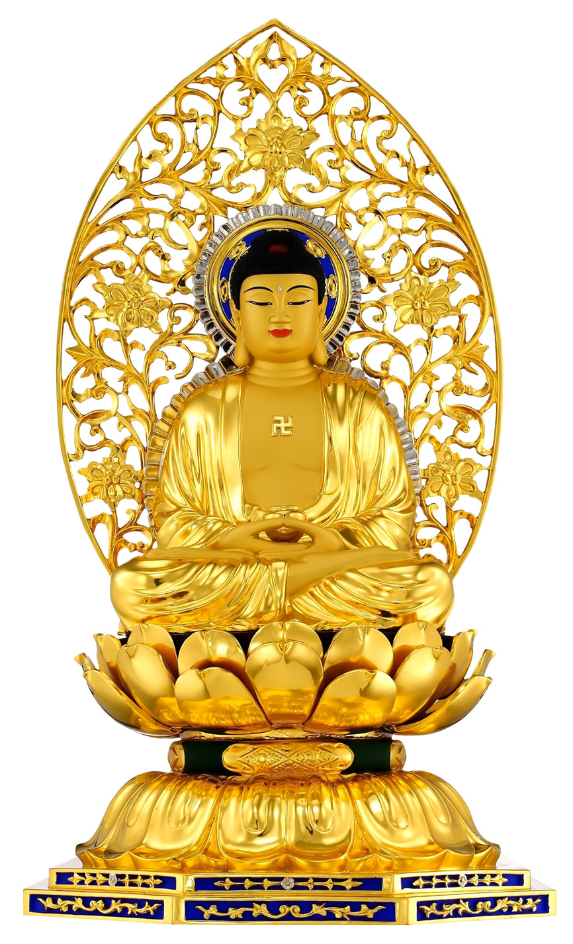
Introduction to Pure Land Buddhism
It is said that Pure Land Buddhism offers a way to enlightenment for people who can't handle the subtleties of meditation, endure long rituals, or just the living of especially good lives!
Pure Land Buddhism is particularly popular in China and Japan.
Reading: Pure Land Buddhism p.15-20 (not my resource but v.good)
The essential practice in Pure Land Buddhism is the chanting of the name of Amitabha Buddha, who is regarded by Pure Land Buddhists as a sort of saviour

Slide 7
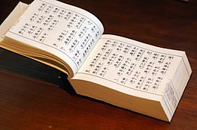
Pure Land Buddhism and Scripture
The Pure Land belief is based on three Sanskrit scriptures:
the Amitāyus-vipaśyana-sūtra (“Discourse Concerning Meditation on Amitāyus”)
the “larger” and “smaller” Pure Land sutras
These texts relate the story of the monk Dharmakara, the future Amitayus, or Amitabha, who made a series of vows that were meant to be fulfilled with the certainty of natural law when he became a buddha.
The most important of these, the 18th, promised rebirth in the Pure Land to all the faithful who called upon his name, who would then remain in that beautiful land, free from pain and want, until they were ready for final enlightenment.

Slide 8
The person and importance of Amitabha
The essential practice in Pure Land Buddhism is the chanting of the name of Amitabha Buddha (or Amida in Japanese) with total concentration, trusting that one will be reborn in the Pure Land (Sukhavati), a place where it is much easier for a being to work towards enlightenment.
Pure Land Buddhism adds mystical elements to the basic Buddhist teachings, which make those teachings easier (and more comforting) to work with.
These elements include faith and trust and a personal relationship with Amitabha Buddha, who is regarded by Pure Land Buddhists as a sort of saviour; and belief in the Pure Land, a place which provides a stepping stone towards enlightenment and liberation.

Slide 9
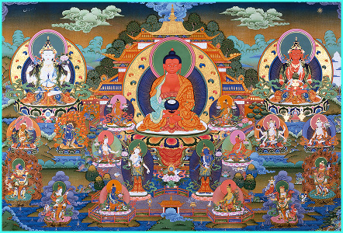
Rebirth in a Pure Land
Pure Land schools believe that rebirth in Amitabha’s Western Paradise, Sukhavati, known as the Pure Land, or Pure Realm, is ensured for all those who invoke Amitabha’s name with sincere devotion.
Calling the Buddha's name with full faith is known to the Chinese as ‘NIEN-FWO' meaning prayer-recitation. The Japanese term for this practice is known as Nembutsu.

Slide 10
Rebirth in Sukhavati
“Sukhavati (the Pure Land) is rich in a great variety of flowers and fruits, adorned with jewel trees, which are frequented by flocks of birds with sweet voices…..And all the beings who are born…in this Buddha-field, they are all fixed on the right method of salvation, until they have won nibbana. For this reason, that world system is called the ‘Happy Land’”
The Larger Sukhavativyuha Sutra, sections 16-24

Slide 11
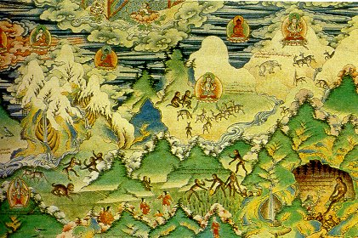

Slide 12
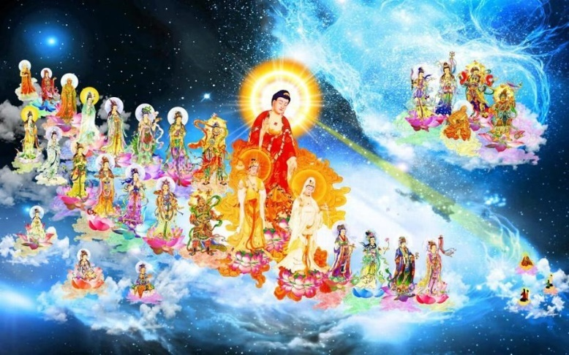

Slide 13
Rebirth in Pure Land stories
In this video, Master Chin Kung describes contemporary stories of Pure Land devotees who predicted their time of death in advance, and who passed away in a sitting or standing position while reciting Amithaba’s name.
He also outlines the advantages of a rebirth in the pure land, including the 6 supernatural powers - abhijñā - associated with the Buddha himself.
Master Chin Kung is a Buddhist monk from the Mahayana tradition. He is the founder of the Corporate Body of the Buddha Educational Foundation, an organization based on the teachings of Pure Land Buddhism.
Click me!

Slide 14
Rebirth in a Pure Land
Some near death experiences support the claim, not only that some other realm exists after death, but that rebirth in the pure land is what follows for pure land devotees...
However, many pure land Buddhists won’t focus on near-death experiences, because they seem to suggest the existence of a permanent self that survives the material body, which might contradict the doctrine of anatta.
Shinran, the founder of the Jodo Shinshu sect of Pure Land Buddhism, regarded deathbed visions of the Pure Land as unimportant, and he never claimed to have one himself. This is because Shinran taught that our future rebirth into the Pure Land is assured the moment we first say the Nembutsu with a sincere mind.
Use this to annotate the picture and add explanatory notes.

Slide 15
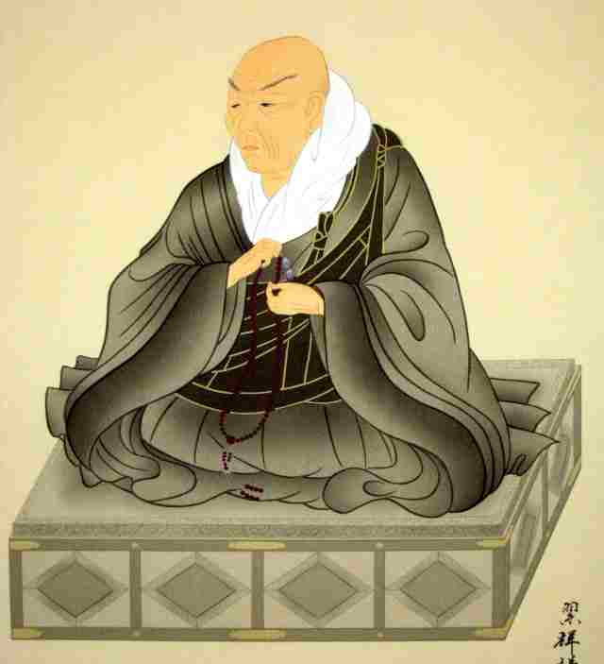
The practice of chanting, its importance and purpose
In Jōdo Shinshū chanting the name of Amitabha Buddha does not do anything at all to help the person get to the Pure Land.
Chanting is nothing more than an expression of gratitude to Amitabha Buddha and an expression of the chanter's faith.
But it's not possible to do away with the chanting…
"the True Faith is necessarily accompanied by the utterance of the Name“ (Shinran)

Slide 16
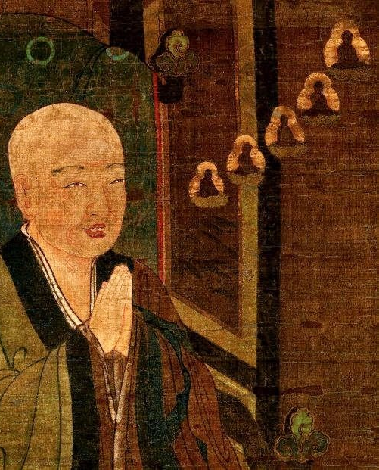
Nembetsu
This means concentration on Buddha and his virtues, or recitation of the Buddha's name.
No special way of reciting the name is laid down.
It can be done silently or aloud, alone or in a group and with or without musical accompaniment.
The important thing is to chant the name single-mindedly, while sincerely wishing to be reborn in the Pure Land.

Slide 17
Key features of and differences between Jōdo-shū and Jōdo Shinshū
Jōdo Shinshū is also known as the Shin Sect
A century after Honan, one of his disciples, Shinran (1173-1262) brought a new understanding of the Pure Land ideas. Shinran taught that what truly mattered was not the chanting of the name but faith. Chanting on its own had no value at all.
Those who follow the Shin school say that liberation is the consequence of a person achieving genuine faith in Amitabha Buddha and his vow to save all beings who trusted in him.
Shinran taught that arriving in the Pure Land was actually the final liberation - the Pure Land was nirvana.

Slide 18
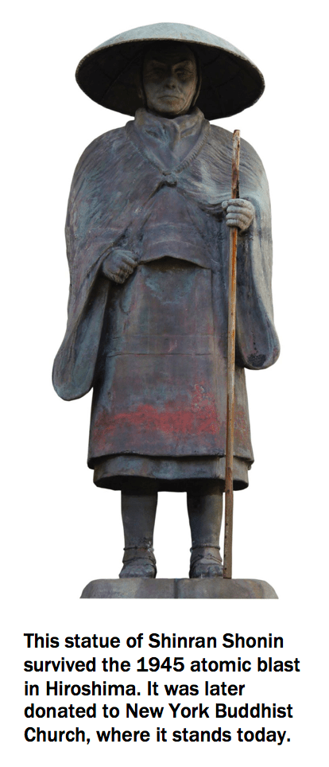
Shinran explained Amida as Dharma-body itself, rather than a literal Buddha from eons before the Big Bang, and the Pure Land as the formless realm of Nirvana.
Shinran went beyond the literal meaning of the Pure Land sutras to explain their ultimate meaning, just as the Buddha distinguished between relative truth and ultimate truth:

Slide 19
Click on me to hear a short recording of the Nembetsu chanting

Slide 20
Buddhism in the Far East
Learners should have the opportunity to discuss issues relating to Zen and Pure Land ideas, including:
whether Pure Land Buddhism is an ‘easy’ path
how and if Siddhartha’s original teachings can be seen in these two schools
the implications of Zen’s rejection of theory, ritual and the use of language to express truth

Slide 21
1. Is Pure Land an easy path? YES
Recall the video with Master Chin Kung on stories of people being reborn in the pure land.
He clearly states that the pure land is advantageous because one can be reborn there despite having leftover karma.
He also refers to people being reborn in the pure land despite knowing little about the dharma itself.

Slide 22
1. Is Pure Land an easy path? NO
It is telling that the BBC religions webpage on Pure Land opens with the words:
“Pure Land Buddhism offers a way to enlightenment for people who can’t handle the subtleties of meditation, ensure long rituals, or just live especially good lives.”
Peter Harvey writes,
“Both [Honen and Shinran] regarded the traditional Mahayana path of gradual spiritual development as too difficult, and so turned to Amitabha to save them.”
What else did you come up with?
How can we subject these beliefs to scrutiny (i.e. go back-and-forth with evaluation)?

Slide 23
How far (if at all) can Siddhartha’s original teachings can be seen in Pure Land?
Chin Kung categorizes Buddhism in practice into four different types.
First, traditional Buddhism, the teachings of Buddha Shakyamuni, which is very rare in our days.
Second, religious Buddhism, which does not represent the real Buddhism but it becomes recognised by the society, since temples nowadays no longer practice intense teachings and meditation as they once did.
Third, the academic Buddhism being taught in many universities today, where Buddhism is treated purely as a philosophy. This is not comprehensive either since Buddha's education covers everything essential to human beings rather than being one branch of the whole knowledge.
Finally, the total degeneration of Buddhism into a cult. This type of Buddhism came into being in the late Twentieth Century, and does great harm to society.
Chin Kung tries to correct these misunderstandings and lead the public back to the original form of Buddhism as taught by Buddha Shakyamuni.

Slide 24
2. How far (if at all) can Siddhartha’s original teachings can be seen in Pure Land?
From Wikipedia…
Ironically, the Pure Land tradition from which Chin Kung hails, as a branch of Mahayana tradition is arguably fairly distant from Shakyamuni's original teachings.
All three of Pure Land sutras were compiled after one century CE, with the Amitayurdhyana Sutra (the 1st Mahayana sutra written) even regarded by modern scholars to be apocryphal of Chinese origin.
Furthermore, Chin Kung is known for his advocacy of understanding and blending of Confucianism, Taoism, and Buddhism teachings, which further removes him from the "original form of Buddhism".
Numerous YouTube videos of him espousing Confu-
cian morals are a clear demonstration of this fact.

Slide 25
Suggested Reading
Suggested scholarly views, academic approaches and sources of wisdom and authority
The Flower Sermon (various traditions and versions exist)
Cush, D. (1994) Buddhism, Hodder Education, Chapter 4, pages 123–150
Suzuki, D. T. (Author) and Dobbins, J. C. (Editor) (2015) Selected Works of D.T. Suzuki, Volume II: Pure Land, University of California Press, Chapters 1, 2 and 4

Slide 26
The six types of higher knowledges (chalabhiññā) are:
"Higher powers" (iddhi-vidhā), such as walking on water and through walls;
"Divine ear" (dibba-sota), that is, clairaudience;
"Mind-penetrating knowledge" (ceto-pariya-ñāṇa), that is, telepathy;
"Remember one's former abodes" (pubbe-nivāsanussati), that is, recalling one's own past lives;
"Divine eye" (dibba-cakkhu), that is, knowing others' karmic destinations; and,
"Extinction of mental intoxicants" (āsavakkhaya), upon which arahantship follows.
The attainment of these six higher powers is mentioned in a number of discourses, most famously the "Fruits of Contemplative Life Discourse" (Samaññaphala Sutta, DN 2). The first five powers are obtained through meditative concentration (samadhi) while the sixth is obtained through insight (vipassana). The sixth type is the ultimate goal of Buddhism, which is the end of all suffering and destruction of all ignorance. According to the Buddha, indulgence in the abhinjas needs to be avoided, as they can distract from the ultimate goal of Enlightenment.
BACK!

