Slide 1
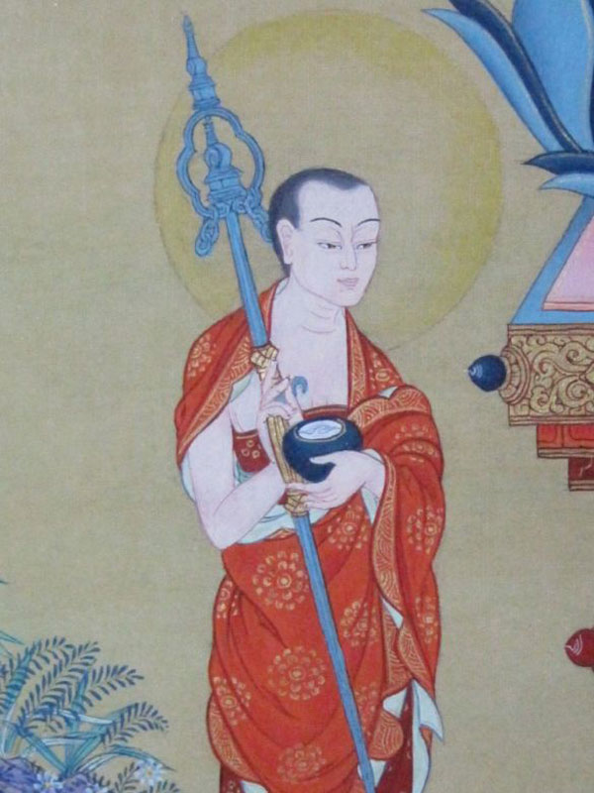
The Arhat Path
The goal of Theravada Buddhism and Hinayana Buddhism is to become an Arhat.
Arhat = worthy one
From a Theravada POV an Arhat is fully enlightened
Also known as a Shravaka Buddha (enlightened through listening to another Buddha’s teachings)
Shakyamuni is often called an Arhat in Theravada Buddhism

Slide 2
The four stages
Stream Enterer – the imagery here is that one has seen where Nibbana lies across the water and so ‘enters the stream’ to reach it, leaving the country of samsara behind
Once returner – one had one more life before enlightenment
Non-returner – enlightenment in this life
Arhat – the end of the path where one has achieved nibbana

Slide 3
The four stages of Awakening….
#1 - Stream-winner
The first direct insight into selflessness is often the most powerful because it’s unlike anything you’ve ever experienced before.
For a timeless moment (which may last just an instant), no one is there — that is, there’s no trace of a separate self anywhere.
A feeling of tremendous relief, often accompanied by joy and bliss, generally follows the experience: At last, you’ve had the insight you’ve been seeking for so long. At last, you’ve “entered the stream” of realisation.
When you become a stream-enterer, you can never again believe that you’re really a separate self that lives inside your head and looks through your eyes. Your experience forever eliminates this illusion. When you look within, you can’t find a self anywhere. In everyday life, however, you may still feel like a separate somebody and may still get caught up by greed, anger, ignorance, and various other negative feelings and patterns. Fortunately, the stage of stream-enterer also brings an unshakable confidence and dedication to the Buddhist spiritual path, so you’re motivated to keep deepening and refining your realisation.

Slide 4
The four stages of Awakening….
#2 - Once-returner
After you become a stream-enterer, your practice includes reminding yourself of your new realization of “no-self,” as well as paying attention to the ways that you’re still attached and your resistance to life as it unfolds.
After a period of time (generally years of devoted practice) in which your concentration gets even stronger and your mind becomes even more tranquil, you have another direct insight into no-self. (Remember, knowing this truth as a concept or memory is one thing, but experiencing it directly, beyond the conceptual mind, is something else entirely.)
This insight (essentially the same as the first but even stronger and clearer) brings a significant reduction in attachment and aversion and the suffering that accompanies these states of mind. For example, occasional irritation and preference replace hatred and greed, which no longer have any hold over the once-returner. Someone who reaches this stage has only one more rebirth before becoming completely enlightened — hence the name once-returner.

Slide 5
The four stages of Awakening….
#3 – non-returner
After the experience that signals entry to this stage, all of the worst hindrances, such as hatred, greed, jealousy, and ignorance, completely drop away, but a hint of a self-sense (a “me”) still remains — and with it, the slightest trace of restlessness and dissatisfaction sticks around as well.
The experience itself is rarely accompanied by any emotion or excitement, just a clearer recognition of what has already been seen twice before.
These people appear to be extremely content, peaceful, and without desire, but the subtlest preference for positive rather than negative experiences remains.

Slide 6
The four stages of Awakening….
#4 – arhat (worthy one)
At this stage, the path bears ultimate fruit in nirvana — any residual trace of a separate self falls away for good.
The experience, frequently accompanied by unimaginable bliss, has been compared to falling into the depths of a cloud and disappearing. At this point, the circumstances of life no longer have the slightest hold over you; positive or negative experiences no longer stir even the slightest craving or dissatisfaction.
As Buddha said, all that needed to be done has been done. There’s nothing further to realize. The path is complete, and no further rebirths are necessary.

Slide 7
The 10 Paramis (perfections)
The Arhat Path is similar to the Bodhisattva Path in that it involves cultivating 10 perfections/Paramis.
However, this is equivalent the Six Perfections of the Bodhisattva path in Mahayana
The function of the Noble Eightfold path is to develop these 10 perfections
Generosity (dana)
Moral conduct (sila)
Renunciation (nekkhamma)
Wisdom (paññā)
Energy (viriya)
Patience (khanti)
Truthfulness (sacca)
Determination (adhitthana)
Loving-kindness (metta)
Equanimity (upekkha)

Slide 8
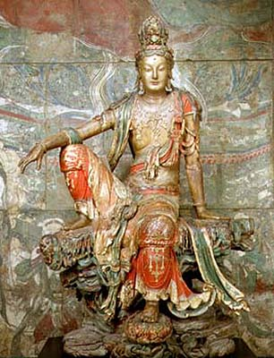
The Bodhisattva Path (Mahayana)
A bodhisattva is a person or being who is motivated by an altruistic desire called Bodhicitta (lit. ‘Mind of Enlightenment’)
Bodhicitta = Then Genuine desire to become a fully enlightened Buddha in order to liberate all other beings.
Mahayana believes that Bodhisattvas postpone their parinirvana until all other beings have been liberated as well.

Slide 9
The Six Perfections (Paramitas)
Generosity
Discipline
Patience
Diligence
Meditation
Wisdom
The Six Paramitas are equivalent to the 10 Paramis of Theravada.
Both lists could be seen as ways of describing aspects of enlightenment in more tangible ways.
E.g. an Arhat or Bodhisattva should be perfectly generous, patient, etc.

Slide 10
The 10 Bhumis (stages)
Stages 1-6 are achieved by cultivating the six paramitas.
When the first six Bhumis are completed, a Bodhisattva has achieved the same level as a Bodhisattva and achieves Nirvana.
They are free from Samsara and can choose the manner of their rebirth.
After that they usually manifest as ‘Heavenly Bodhisattvas.’
Stages 7-10 represent a deepening of the Bodhisattvas’ practices until they are fully enlightened and not only realise the truth of Anatta but also the truth of Shunyata
The Very Joyous
The Stainless
The Light-Maker
the Radiant Intellect
The Difficult to Master
The Manifest
The Gone Afar
The Immovable
The Good Intelligence
The Cloud of Dharma

Slide 11
Comparisons
Worthy One
Four Stages
Fully enlightened
Theravada Arhat
Bodhisatta Merely a future Buddha
Non-reciprocal relationship with Buddha. Ie. He can’t respond to prayers
10 Paramis/ Perfections
No rebirth after Parinibbana

Slide 12
Comparisons
Reciprocal (two way) relationship
Arhats not fully enlightened but have achieved Nirvana
Heavenly & Earthly Bodhisattvas
Mahayana Bodhisattva
Many Bodhisattvas
Postpone Parinirvana in order to help liberate all other sentient beings
6 Paramitas/ Perfections
10 Bhumis/stages
NB: first 6 relate to the perfections

