Slide 1
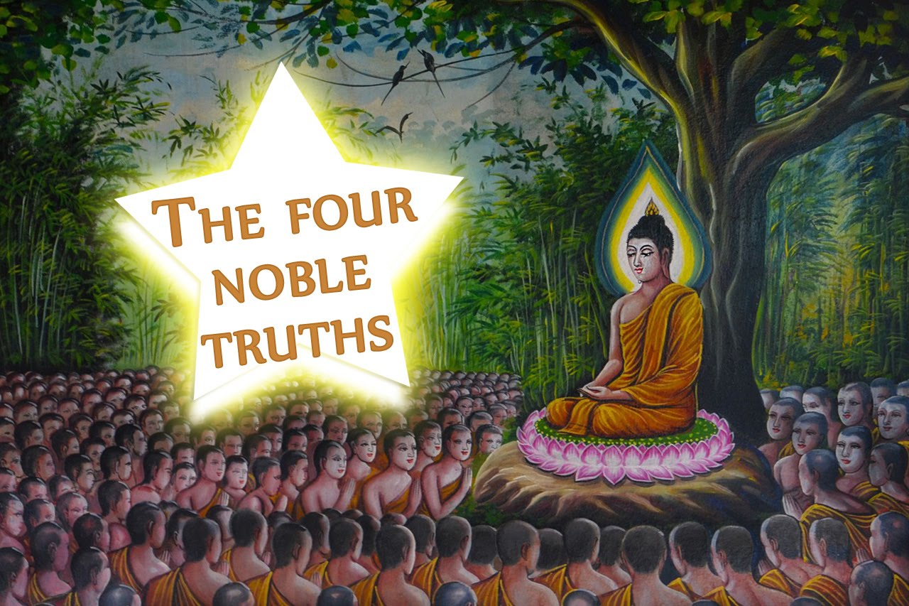

Slide 2
Anatta | Annica | Samudaya | Dukkah
Nirodha | Magga | Eternalism | Annihilationism
Doctor Analogy | Dharma | Mustard Seed | Mindfulness and Meditation
Dependant arising | Sila | 4 Noble Truths | Eightfold path

Slide 3
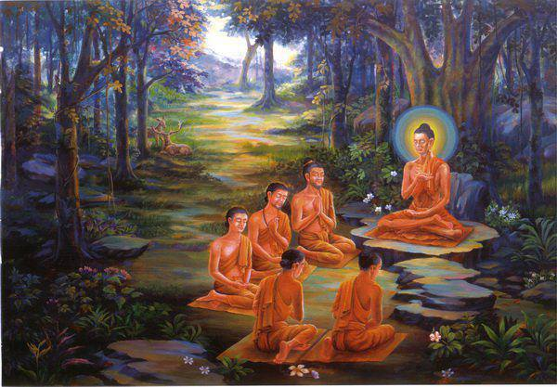
the Deer Park Sermon (as recorded in Samyutta Nikaya 56.11)
It is believed that the day after his enlightenment, the Buddha sat with 5 ascetics and taught them. A key focus was the 4 noble truths.
Those monks gained enlightenment as a result of his teachings.
They became arhats those who are spiritually enlightened.

Slide 4
The four noble truths
1st: dukkha
(Suffering)
2nd: Samudaya
(the arising of dukkha)
Tanah
Nirodha (the cessation of dukkha)
Magga (the middle path)

Slide 5
Recall: The four noble truths

Slide 6
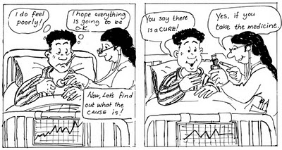
The doctor analogy
A: Is Buddhism pessimistic or not – give a reason?
B: What aspects of Buddhism might be difficult to accept and why?
A: Explain the Doctor Analogy – which teaching does this link to?
B: Why might the Doctor Analogy mean that Buddhism is optimistic
Challenge:
Is taking medicine always easy?
What is the difficult ‘cure’ in Buddhism?

Slide 7
ANALYSIS: ANATTA
Explain why Buddhism is neither:
eternalistic nor annihilationist
eternalism (sassatavaada)
The belief in our ongoing survival across lives; our immortality.
annihilationism (ucchedavaada)
The truth of our nothingness, that we do not survive and cease to exist at death.

Slide 8
Is Buddhism inherently pessimistic?

Slide 9
Make them think
Let’s make sure your arguments are well explained…
You must include in your arguments the following words and phrases.
Try to cross them off as you use them.
Anatta | Annica | Samudaya | Dukkah
Nirodha | Magga | Eternalism | Annihilationism
Cessation | Dharma | Mustard Seed | Mindfulness and Meditation
Dependant arising | 3 Types of suffering | 4 Noble Truths | Eightfold path
Stretch yourself task:
Use The Evaluation Stem support sheet to write a conclusion
Make sure you refer back to some of the above terms and teachings
Top Philosopher task:
Tricycle Article
‘Lighten Up’
Is there joy in Buddhist teachings?

Slide 10
AO2: ANALYSIS and Evaluation : The 4 noble truths
Discuss and evaluate whether the Buddhist teachings are pessimistic

