Slide 1
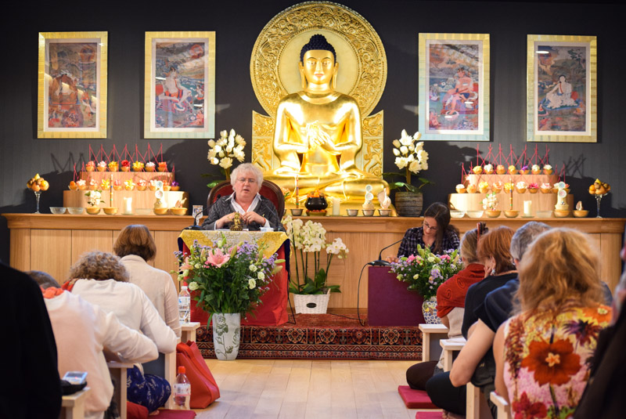
Buddhism in the West

Slide 2
Buddhism in the West
The spread of Buddhism to the West
The main reasons for the spread of Buddhism, such as migration and the popularity of Buddhist ideas in modern western societies
Buddhism in popular culture
Exploration of how Buddhism is portrayed in the West, including media stereotypes and depiction of Buddhist role models, including portrayals of figures such as the Dalai Lama
Western ‘inculturation’
the ways in which Buddhism has changed and adapted on encountering Western science, ideas and culture, including the ideas of Secular Buddhism, with reference to Stephen Batchelor
the interplay of Christianity and Buddhism, the idea of ‘dual-belonging’, with reference to Paul Knitter

Slide 3
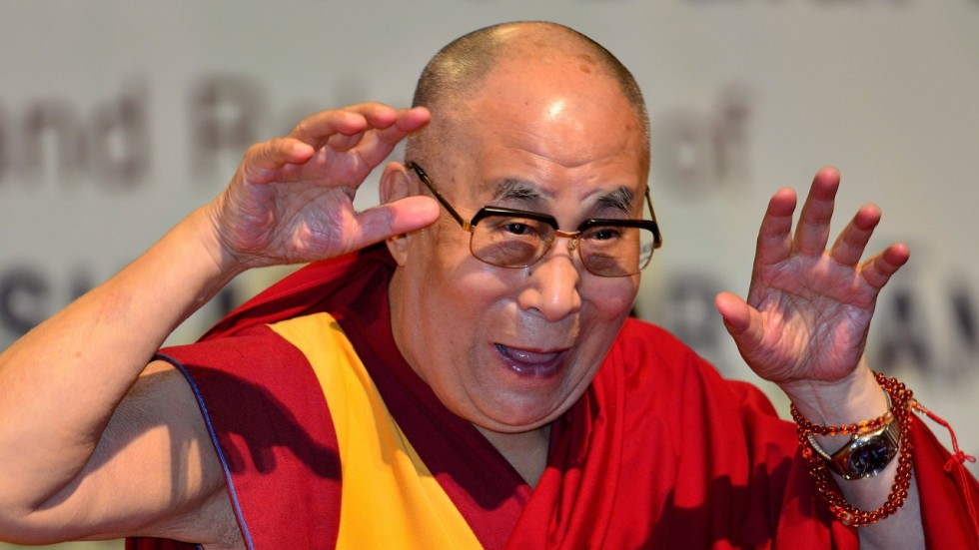
Buddhism in popular culture Exploration of how Buddhism is portrayed in the West, including media stereotypes and depiction of Buddhist role models, including portrayals of figures such as the Dalai Lama
What do you already know about the Dalai Lama?

Slide 4
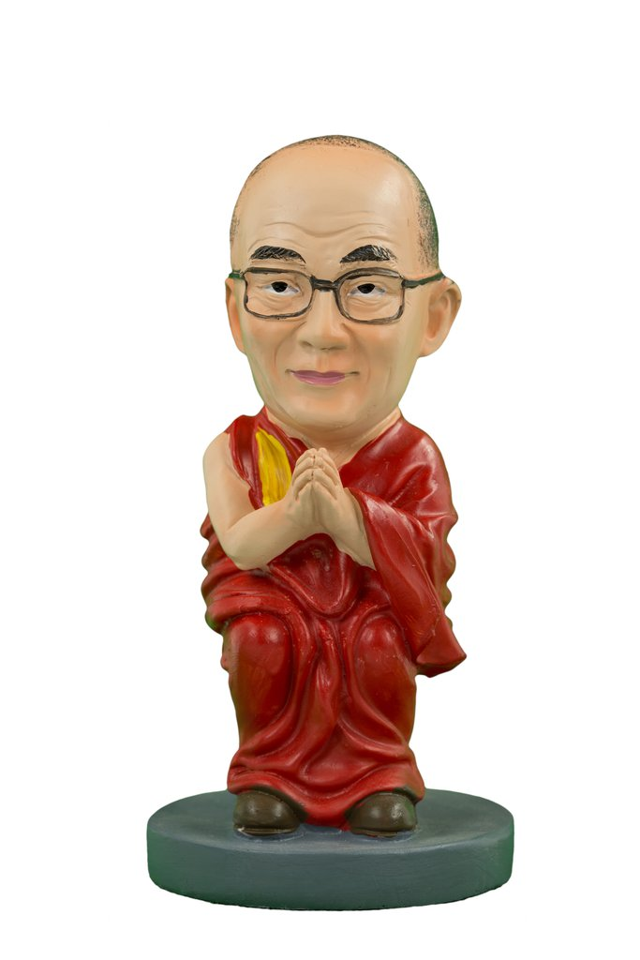
The 14th Dalai Lama
Nobel peace prize winner (1989), writer, speaker
De facto leader of Tibetan Buddhism (branch of Mahayana)
In exile from Chinese-occupied Tibet since 1959
Buddhist name Tenzin Gyatso
Born 6 July 1935
Incarnation of Avalokitesvara
The Dalai Lama was featured on the March 5, 2017, episode of the HBO late-night talk show Last Week Tonight, in which host John Oliver conducted a comedic interview with the Dalai Lama, focusing on the topics of Tibetan sovereignty, Tibetan self-immolations, and his succession plans.

Slide 5
The 14th Dalai Lama
The weirdness of the reincarnation
Cheerful bloke
Political cause: occupied Tibet
Says “interesting quotes!”

Slide 6
The 14th Dalai Lama
Task 1
Read through these quotes attributed to the Dalai Lama. a) Identify the 3 most ‘Buddhist’ and the 3 most ‘secular’.
Be prepared to explain your reasoning.
b) Based on these teachings, why do you think the DL has so much secular appeal?
Extra reading
In this article Georges Dreyfus analyses the Dalai Lama’s appeal and assesses the nature and impact of his modernism.
Highlight any three quote/excerpts worthy of discussion and explain why you chose these.

Slide 7
How might the depiction of Buddhism in the Western media, including the fame of figures such as the Dalai Lama, shape (and possibly distort) Western understandings of Buddhism?

