Slide 1
Business Ethics

Slide 2
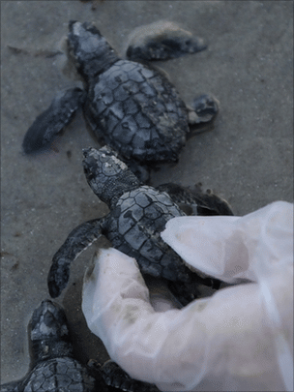
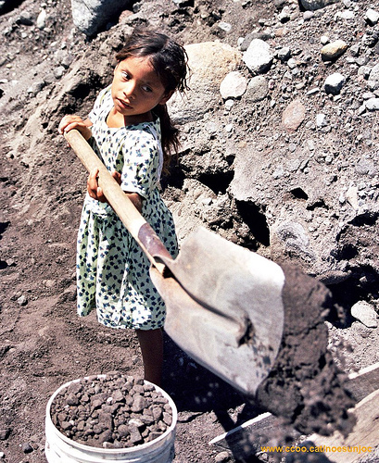
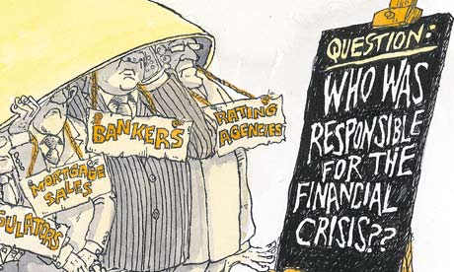
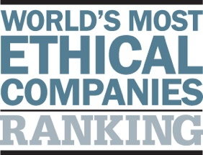
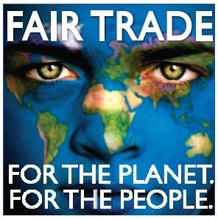
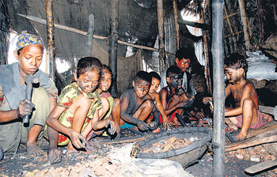
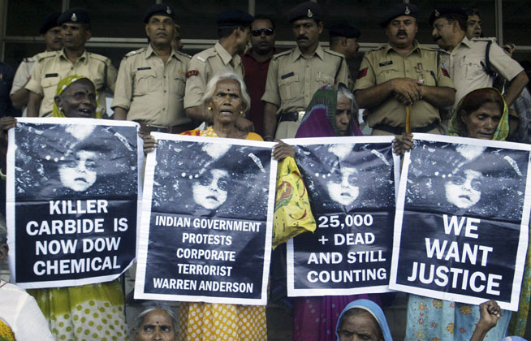
Business Ethics

Slide 3
Areas of Study
Stakeholders in a business (consumer, employee, environment).
Ethical business practises – case studies.
Immoral business practices – case studies.
Globalisation and its ethical issues.
Business and the environment.
Christian responses to business ethics.
Is business solely for profit – views (thinkers!) towards free trade, capitalism and corporate social responsibility.
Applying the ethical theories to business ethics and evaluating their responses.

Slide 4
Key Term Bank – revise and use!

Slide 5
What is a Stakeholder?
A stakeholder is a person, group or thing that has an interest in a business or is affected by a business.
Employees – are affected by the business as they may be treated well or badly (workers rights) For example the Fair Trade movement to improve workers rights (low pay, dangerous conditions, child labour)
Shareholders – these are people that own a share of the business. They can lose money if the business does badly and make money if it does well.
Environment – is affected by a business as it may be polluted by a businesses actions or the business may use natural resources (logging companies in the Amazon)
Consumer: is affected by a business if the products are of a poor quality or unsafe. Consumers may also wish for products to be ethically sourced (not through child labour, sweat shops, animal testing for example)
Task
Which of the three stakeholders would your say is least and most important and why?
Write a short paragraph for each to show your reasons with examples.
What would Kant think? What would Bentham think? Why?

Slide 6
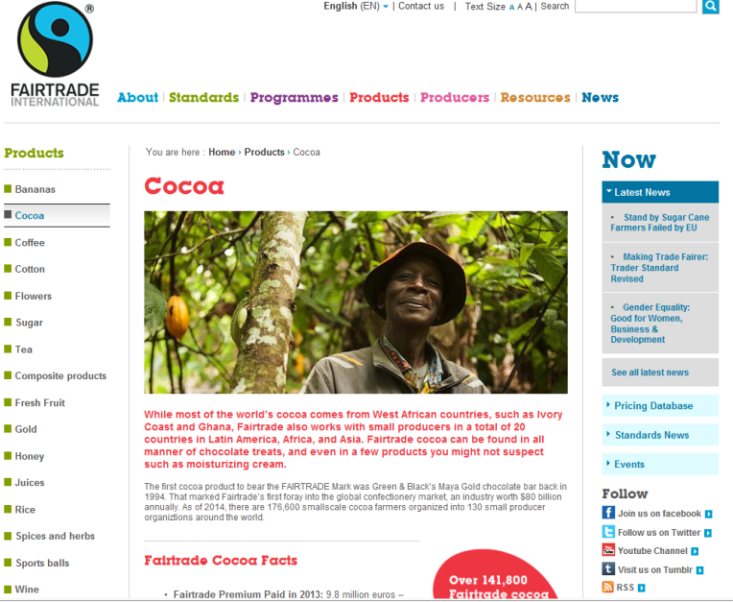
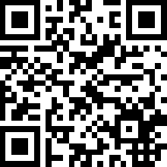
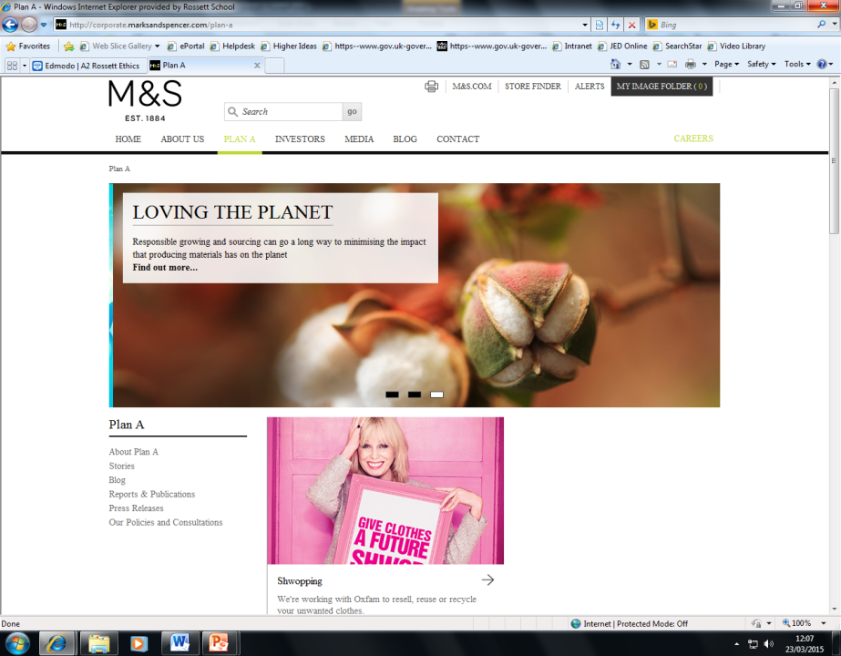
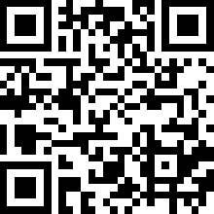
Positive Case Study – if you cannot refer to this when needed you will be too vague and will lose marks.
Areas to ensure you can mention:
Basic business profile (dates/stats)
Company stance on ethical issues (environment/employees/consumers/social responsibility et al)
Ethical mission statement
How the company promotes ethical business - examples
News coverage recent campaign.

Slide 7
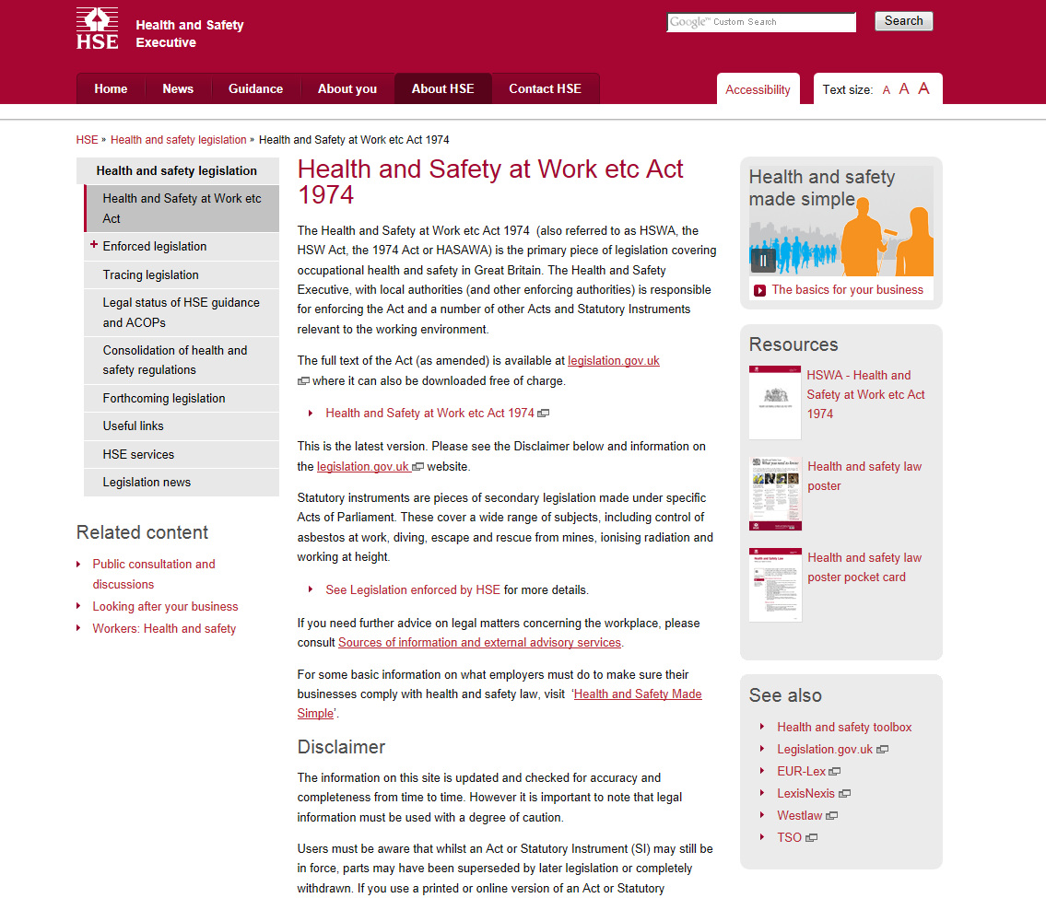
Laws – you need to use these in your essays
Consumer Rights.
Employment Rights.
Health and Safety.
Example of the above not being followed.
Task: 3 facts about each

Slide 8
Immoral Behaviours in Business
Some businesses behave in a way that does not consider protecting the environment, workers safety, consumer safety or to ensure money is not handled in an unfair or fraudulent way.
Businesses are regulated by laws. The laws differ country to country. Some have strict laws on these issues, other countries do not have laws.
You need to be able to explain and analyse different case studies of businesses that have behaved in a way that could be described as immoral.
It is important that you understand which stakeholder or groups are affected (consumer, workers, environment)
Task:
List 2 examples of businesses you think may be immoral.
Explain why you think their behaviour is not acceptable.

Slide 9
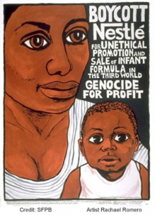
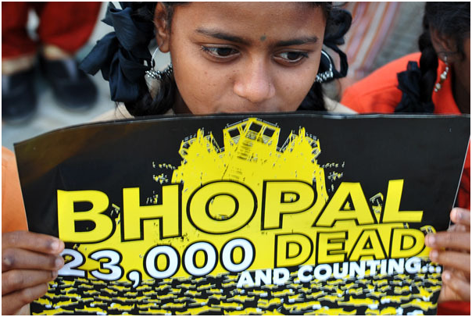
Negative Case Studies
Areas to ensure you can mention:
Basic business profile (dates/stats)
Event or example which shows immoral behaviour.
Who was affected and how.
Were there any punishment or repercussions?

Slide 10
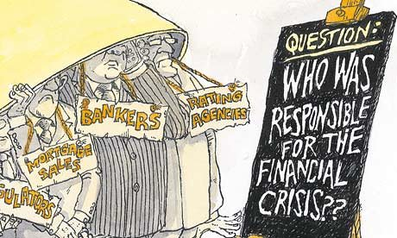
Goldman Sachs – Banking Crisis
Goldman Sachs 2010
Goldman Sachs' chief executive has denied his bank contributed to the US financial crisis (recession in many other countries too) by betting some of its own investment products would fail.
They knowingly sold shares and mortgages that would be likely to fail meaning business could go under and people went bankrupt.
Lloyd Blankfein and other executives at the Wall Street giant were accused by a US Senate panel of acting immorally while Americans lost jobs and homes. Because many UK and European banks had money in these bad debts or shares this was a factor in recessions and the financial crisis globally.
The firm claimed that it was not their role to be moral in business, rather to make a profit. They could act in an amoral manner and not consider the rights or wrongs of what they did.
They said it was not their job to ensure what they sold was ethical or of good quality.
http://news.bbc.co.uk/1/hi/business/8645945.stm
http://www.bbc.co.uk/blogs/thereporters/robertpeston/2010/04/goldman_consequences_of_the_se.html

Slide 11
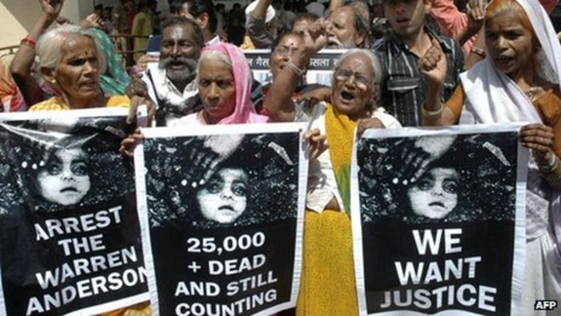
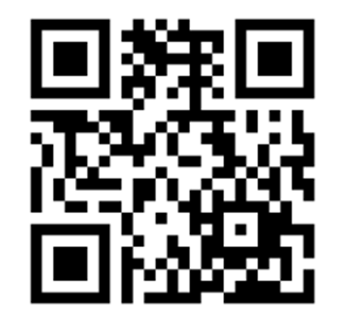
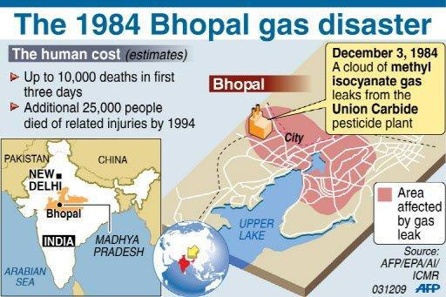
Case Study - Bhopal Disaster
On the night of December 2nd, 1984, a Union Carbide plant in Bhopal, India, began leaking 27 tons of the deadly gas methyl isocyanate.
None of the six safety systems designed to contain such a leak were operational, allowing the gas to spread throughout the city of Bhopal.
Half a million people were exposed to the gas and over 25,000 have died to date as a result of their exposure. Over 150,000 survivors struggle with chronic illness as a result.
The water and soil around the factory was poisoned along with the deaths of wildlife and domestic animals.
http://news.bbc.co.uk/onthisday/hi/dates/stories/december/3/newsid_2698000/2698709.stm

Slide 12
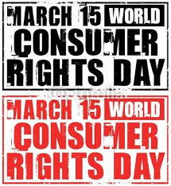
Consumer Rights
Task:
Explain the dangers of not having consumer rights.
Explain one case study that could be used to illustrate the ethics of consumer rights.
Detail one law that protects consumer rights.
How might human rights link to consumer rights?
What might utilitarianism think of human rights?
Are there any potential downfalls or dangers to using a theory like utilitarianism when dealing with consumer rights?

Slide 13
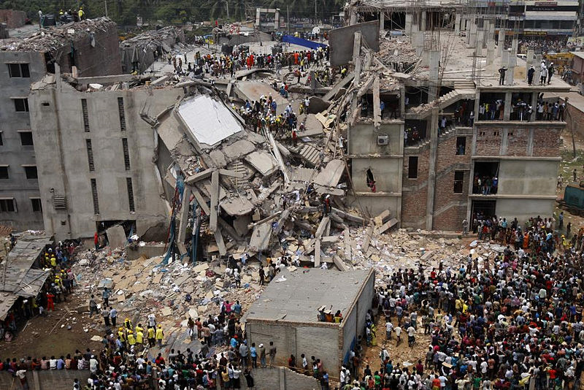
The relationship between employers and employees
In the UK we have laws that govern the relationship between employers and employees. There are laws to protect workers rights in a number of areas.
Think, Pair, Share
A: List 4 areas involving workers rights that may be protected by law
B: Explain what may happen in each case if we did not have these rights.
In many areas of the world businesses do not have to follow such strict rules and laws. This links into our work on Globalisation.
Task:
Give an example of a place or companies that do not or have not followed workers rights.
Rana Plaza sweatshop building collapse

Slide 14
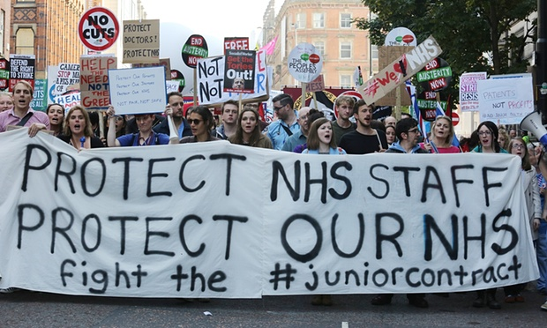
Workers Rights and Unions
Find 5 facts about a union that works to protect workers rights.
Doctors
Teachers
TUC

Slide 15
Whistle Blowing
Think, Pair, Share:
Why is whistle blowing important?
Task:
Define the concept of whistle blowing.
Why may an employee feel they have to take this course of action?
Why is whistle blowing important? explain 3 key reasons.
Explain two criticisms of whistle blowing.

Slide 16
Whistle Blowing: Case Study
Investigate 1 case study from the video/resource pack.
Be ready to feedback in 10 min.
What was the impact of the employee choice to WB?
Whistle Blowing in the NHS:
Watch the clip and read the story:
- What are the issues and impacts of WB?
- Why is WB important?

Slide 17
What is Globalisation?
With the advancement of information communication, technology and transport the world has become more and more interconnected.
The relationship is built up through international trading, communication and culture.
In other words, the world is becoming one large market, rather than just a series of separate national markets. It also means that same goods and services can be found not just in one country, but throughout the world.
It is easier and beneficial for companies to reach a larger, global audience. According to the Oxford Dictionary, the word ‘globalisation’ means:
“The process by which businesses or other organizations develop international influence or start operating on an international scale.”
Tasks:
2. Give 5 examples of global products and companies.
3. Explain 2 dangers of globalisation.
4. Explain 2 benefits of globalisation.

Slide 18
What has globalisation effected
Task: Pick 4 aspects and explain how globalisation has changed the world and that particular aspect. This can be in a positive or negative way.

Slide 19
Why is globalisation happening?
The reasons for the increase in the pace of globalisation are:
Technological change – especially in communications technology.
Transport is both faster and cheaper.
Deregulation – an increase in privatisation, and countries now able to own businesses in other countries, e.g. some UK utilities which were once government-owned are now owned by French businesses.
Removal of capital exchange controls – money can now be moved easily from one country to another.
Free trade – many barriers to trade have been removed, sometimes by grouping countries together such as the EU.
Consumer tastes have changed and consumers are now more willing to try foreign products.
Emerging markets in developing countries.
Think, Pair, Share
A: Explain one reason that globalisation is happening
B: Explain another reason for globalisation

Slide 20
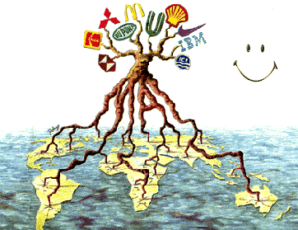
Is globalisation a good thing?
When migrant workers come to a new country they bring influences of their culture and language with them. This can enrich the overall culture of society e.g.?
MEDC OR First World countries often move businesses to LEDC or Third World countries bringing poorer areas of the world job opportunities and income. This can help to improve the standard of living in these countries.
If wages are lower and costs less in LEDC then the cost of items may be less for us consumers to buy. There is therefore competition to produce cheaper goods.
Task:
Fill in the zigzag sheet to debate the pros and cons of Globalisation
You have the pros (left)
Discuss a con for each bullet point and complete the sheet.
You may not have any key thinkers – YET!

Slide 21
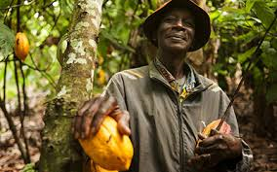
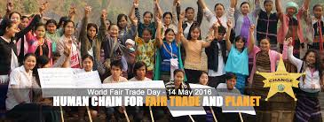
Positive Case Study
Task:
Use the link/QR Code and find out 10 facts about what Fair Trade do. Use the points below to guide your research:
When were they set up/background (2/3 points)
What is their aim?
Minimum price
Fair Trade Premium
Fair Trade Standards – employee rights, child labour, health and safety and discrimination.
50% Fair Trade System
Impact of work
Example of where and how Fair Trade has improved lives.
How is Fair Trade acting in a Global market?
Do you think their approach is successful and will influence change in businesses?

Slide 22
Ted Talk
Watch from Benjamin Conrad the talks and fill in the task sheet.
Create a poster on Fair Trade as a form of ethical business.

Slide 23
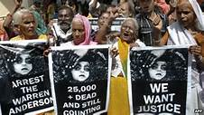
Negative Case Study
Task:
Explain how you might use the Bopal disaster to illustrate in your zigzag the negative impacts of globalisation.
Link to workers rights

Slide 24
The Bible and Business Ethical Conduct
Read Wright pages 281-283 (Christian Ethics section) and answer the questions in your notes.
Which two basic ethical concepts are promoted in matters of business throughout the scriptures?
2. How might applying these two ideas impact on a business persons conduct? Give examples using the ideas from your silent debate.
3. Why are theses ethical concepts important in business historically and now?
4. What does Leviticus say about honesty in business? Give and analyse a quote.

Slide 25
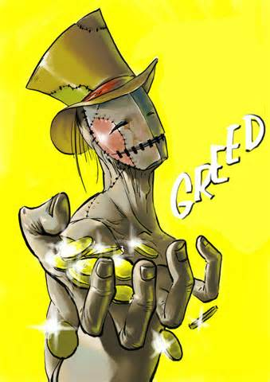
Bible Teachings – Treatment of Workers
There are many teachings in the Bible about greed, which was one of the seven deadly sins.
Jesus taught Christians that they should ‘love your neighbour’ this would involve not allowing greed within business to rule their interests over caring about others.
In 1 Timothy 6:10, Paul says, famously, "The love of money is a root of all kinds of evil, for which some have strayed from the faith in their greediness." Clearly it is wrong for Christians to enter business purely to make money.
Task: Explain how we might apply the teaching of agape to treatment of workers.
Task: Based on this how would a Christian respond to one case study involving exploitation for profit?

