Slide 1
Business Ethics 2

Slide 2
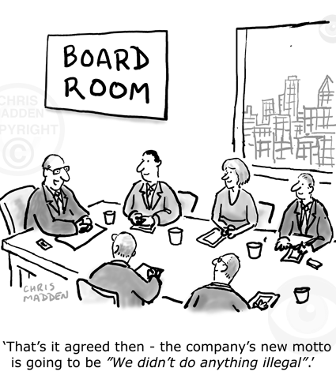
Does Business have to be Ethical?
In business ethics the key questions mainly centre around whether or not a business has to be moral or not and whether a business should be allowed to decide itself or does it need strict laws and rules to ensure moral behaviour?
Do we need to make safe cars (Pinto) or maximise profit?
Should we have strict laws to stop bankers selling shares that may fail or should a business just try to make the most money it can?
Do we need to worry about the conditions in sweat shops or just try to maximise our profit by allowing poor conditions and low pay?
Are Businesses that are ethical simply appealing to a market in a form of ethical window dressing

Slide 3
Approaches
1. Some think business sits outside of ethics and is simply to make profit. Profit and free trade is the key aim we do not need to care about the ethical consequences to others (unbridled capitalism)
2. Some thinkers say we are altruistic and moral in business and that it is possible to be ethical and run a successful business (corporate social responsibility)
3. Some think suggest we can maximise our own interest as this will still lead to benefits for society, we can have fewer rules (Capitalist- Trickle down)
4. Others think people will always put their interests first and without a set of agreed rules and contracts business would be immoral (social contract theory)
5. Some thinkers state that capitalism and trade should be heavily restricted and monitored as it promotes oppression.
Tasks: In pairs discuss
Read the statements.
Which do you most agree with and why?
Which do you least agree with and why?

Slide 4
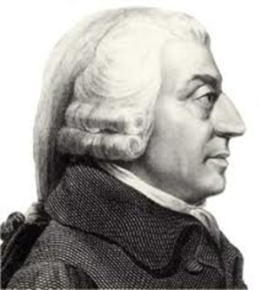
Adam Smith Invisible Hand and Capitalism
Task:
1.
How does the ‘invisible hand’ motivate the acts of businesses?
2.
Do you agree/disagree? Why?
3.
Should businesses let this happen?
Adam Smith, an 18th century economist and author of The Wealth of Nations, is often viewed as the father of modern capitalism. He was an Ethical Egoist that thought benefiting our own interests in business and fewer rules and laws could be good.
Smith’s three main underlying concepts were:
Invisible hand that individuals pursuing their own best self-interest would result in the greatest overall good to society, and that levels and kinds of goods and services in the market should be determined by the free market alone (i.e., not by government).
The first notion, that of the invisible hand, suggests that people essentially vote with their dollars. If we want a society with nothing but solar energy and organic food, we’d all go out and buy those things.
Consumers and the ‘invisible hand’ drive the actions of businesses.

Slide 5
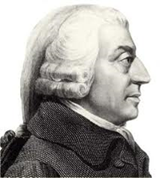
Adam Smith Trickle Down Economics
Task:
Is Smith right in saying that personal gain would have ‘trickle down’ positive affects for the rest of society?
Why yes?
Why no?
Why does Smith think the government should stay out of business and business should have fewer rules and restrictions?
Do you agree?
Why yes
Why could this be an ethical concern?
The second notion, that an individual seeking his/her own best self-interest is actually the best thing that the person can do for society.
Smith thought that, given sufficient motivation for personal gain, each person would work hard, and as a result, society as a whole would benefit with more jobs, more competition, and better quality goods and services.
So we don’t need strict rules in business as our egoism will drive social improvements.
The third notion effectively just means that government should stay out of the market, and limit their role to police. We do not need strict laws and rules in business.

Slide 6
For Free Trade: Laisse Faire Capitalism
Free Trade/Capitalism = fewer restrictions on a business.
It promotes the idea that businesses should not be too restricted by law or ethical concerns.
It holds that profit is the main focus of a business.
What are the practicalities of a need for profit?
What might happen to a LEDC if profit was restricted by enhanced laws and rules?
3. Explain the ideas of Adam Smith – Trickle Down and Invisible Hand
4. Case - Study Goldman Sachs.

Slide 7
Against Free Trade and Capitalism
This includes thinkers and opinions that would argue that putting profit first in not acceptable.
Many thinkers argue that unrestrained capitalism does not lead to a trickle down of benefits in society but that the rich simply get richer.
1. How could you use Thomas Hobbes?
2. How could you use Marx
3. Which other ethical theories would fit into this camp?
4. How could you us a case study to show this view?

Slide 8
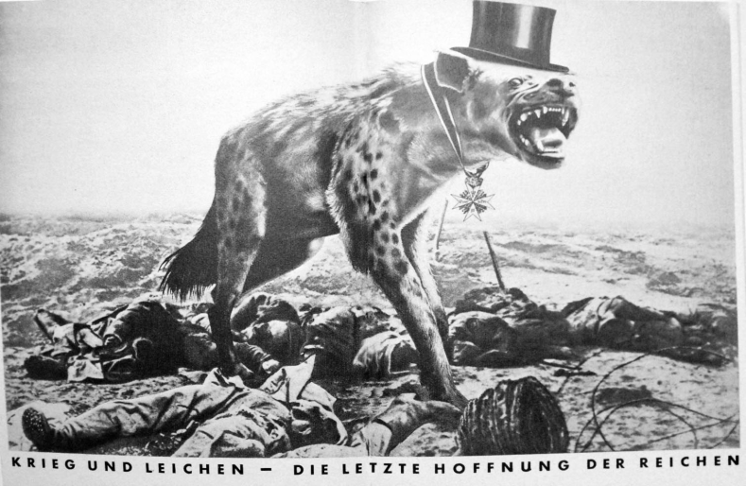
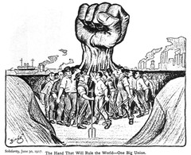
Karl Marx
Explain what Marx considers capitalism to be.
Who are the proletariat and the bourgeoisie?
Do you think allowing free trade (lack of restrictions on business men, company owners and traders) is dangerous and encourages abuse of the working class? Give reasons for views.

Slide 9
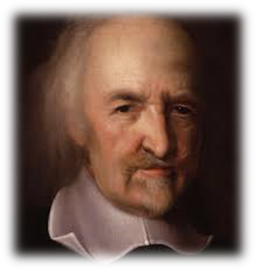
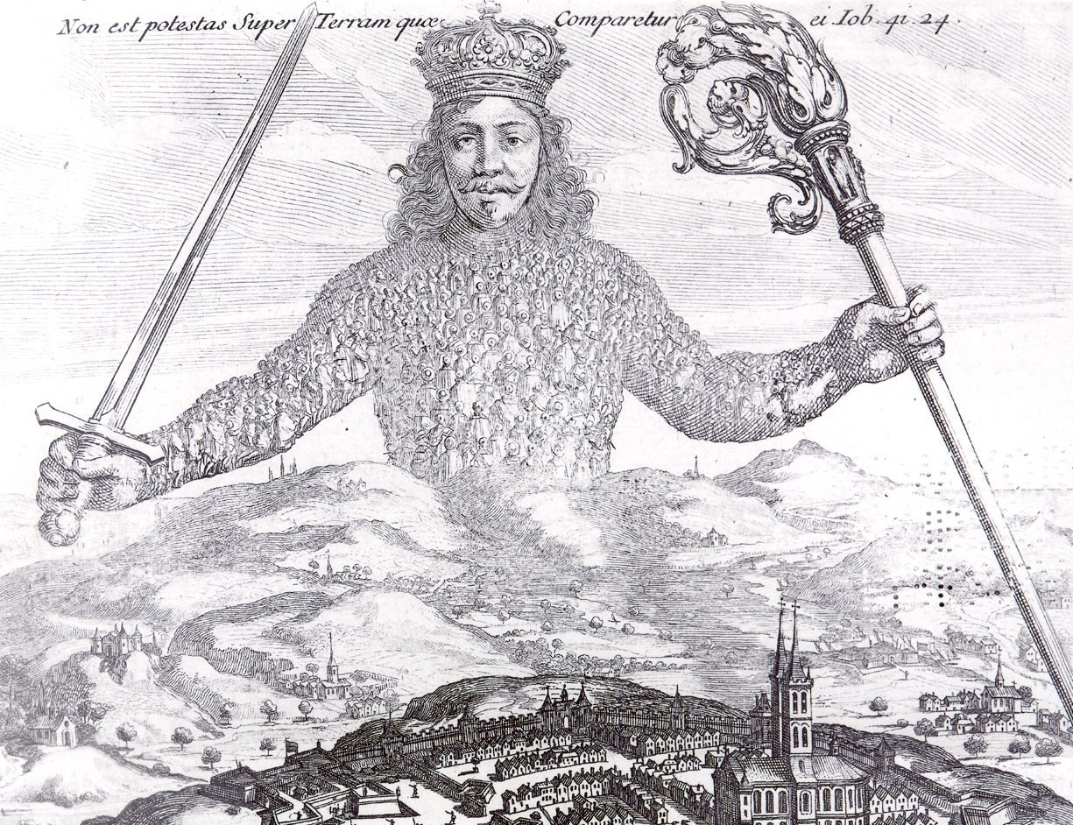
Thomas Hobbes
Investigate
6 facts about Hobbes.
Include his text Leviathan and his approach to capitalism and business without restraints.
What is the image depicting or symbolising?

Slide 10
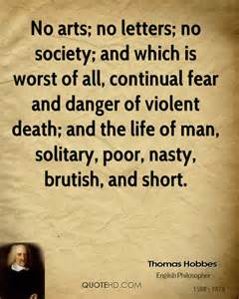
Leviathan
In Leviathan, the philosopher Thomas Hobbes offers what was then a radical idea civil government. Hobbes’ ideas of the commonwealth (government) are predicated or based upon his views of human nature and the state of mankind without government.
Hobbes states that the natural condition of human beings is inherently troublesome and focused on self preservation. He addresses the state of society and human nature without a government, which to Hobbes is terrifyingly chaotic and degenerate.
Once these presuppositions are established, then Hobbes discusses the formation and design of the commonwealth (or government).
The Leviathan’s creation through a covenant (social agreement) is voluntary, rational and necessary, Hobbes believes, because is it the only way to guarantee man’s peace and security and the only way to escape the dreaded state of human nature. The contract or covenant is voluntary but then enforced
Continuing along this line of thought, Hobbes decides that the most powerful government is best to keep society in check, and so he concludes that a monarch with unlimited rights should rule.
What does Hobbes think about humans and our nature?
What might this mean for his views on unrestrained capitalism

Slide 11
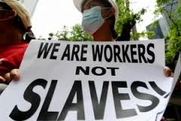
Hobbes and Business
Task:
How would Hobbes respond to the issues of:
Workers Rights
Capitalism without governmental restraint
Task:
Apply Hobbes ideas to Globalisation and one case study that might support Hobbes’ ideas about the need for strict controls and what would happen without them in business

Slide 12
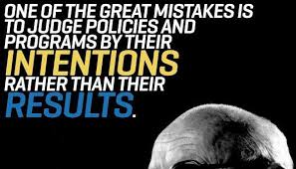
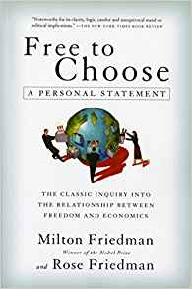
Milton Friedman
Q: What does Friedman think about businesses and how strictly they should be restricted by laws and the government?
Q: Why does he think this?
Q: What are the potential positives and negatives of following his outlook?
Q: Your evaluation?

Slide 13
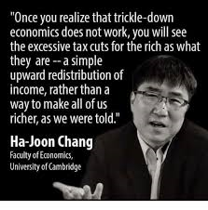
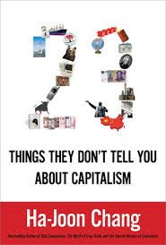
Extra Thinker : Challenge
Find out 3 facts about Ha-Joon Kang.
What is his view towards capitalism, free trade and ‘trickle down’ economics (video interview link via the image to the right).
Your Evaluation – Who do you prefer? Adam Smith or Kang? Why?

Slide 14
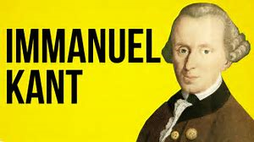
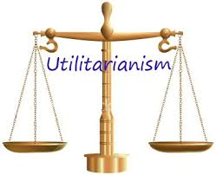
Apply the Ethical Theories
Kant
Natural Law
Utilitarianism
Situation Ethics

Slide 15
‘Businesses should not have absolute ethical constraints’
Create a plan to debate this point. Each point should clearly link to the question and follow a clear path. This means any argument you make should respond to the previous argument.
the names of the key thinkers to the relevant opinions in your plan.
Some may be a Key Thinker others may be a smaller ‘Little Thinker’ if their contribution is smaller in terms of this essay
Include at least 2 responses from an ethical theory from AS
Plan:
Key Thinker – Blue
Little Thinker – Orange

