Slide 1
Think, Pair, Share
‘Torture is Good’
How does that phrase make you feel?

Slide 2
Emotivism

Slide 3
Learning Outcomes
To be able to explain the general ethical theory of Emotivism.
To be able to analysis the different views of Ayer and Stevenson.
To be able to evaluate the strengths and weaknesses of Emotivism.

Slide 4
Emotivism
Emotivism is a non-cognitive theory. It was developed out of the logical positivism that developed in Vienna in the early 20th century.
This group known as , the Vienna Circle, rejected the absolutism of the past developed a new philosophy.
They believed that the only absolute truths were based on science. They claimed philosophy had become too romantic. They claimed statements were only true if you could verify them and they were based on factual information (analytic and synthetic developed by Kant). If not the statement was meaningless.
Their problem was they believed religious ideas such ‘God’ to be meaningless. However they struggled to apply there beliefs to morality. Human beings need morals but they are unverifiable. They believed Morality was necessary but is not verifiable. A.J Ayer attempted to solve this problem.

Slide 5
The influence of Hume
The logical positivists were influenced by Hume who also rejected Naturalism. He believed Sentiment was the source of right and wrong. If you decide to help someone in need it is because you have feelings, not because you have reason. Hume believed we have a common feeling of each other’s welfare.
We all have a capacity for compassion, but it has nothing to do with reason. You can’t go from a factual statement (an ‘is’) to a moral one (an ‘ought’).
Logical Positivism acknowledged that moral facts were not like scientific ones, but then went to concluded not facts at all.
Think, Pair, Share:
How does this relate to Hume’s Fork?

Slide 6
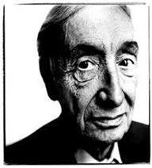
Emotivism – non cognitivist
A.J Ayer
Emotivism helps us understand moral statements.
‘ethical terms do not serve only to express feelings, They are calculated also to arouse feeling, and so to stimulate action’.
Two kinds of meaningful statements – analytic (all bachelors are unmarried men) and synthetic (the Battle of Hastings was in 1066).
Ethical statements are not verifiable – they can only be understood as an expression of feelings. This is known as the
Boo/Hurrah theory.
Read the article and write down 5 facts on the Hurrah-Boo theory in your notes:
1)
2)
3)
4)
5)
Stretch yourself task:
What does James Rachel’s argue against Ayer?
Top philosopher: Find out 5 facts about Ayer’s verification principle.

Slide 7
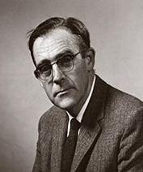
Emotivism – non-cognitivist
C.L Stevenson
Book – Ethics and Language (1944)
Discussed the emotive meaning of words. When making a moral judgement we are offering our opinion on it but also trying to influence others’ attitudes.
Ethical statements are therefore based on emotions but ALSO on our experience of the world and how we want it to be.
Ethical disagreements are disagreements about fundamental principles.
Read the article and explain in your own words how he developed on Ayer’s theory…
Stretch yourself task:
What do Peter Vardy say about Emotivism?

Slide 8
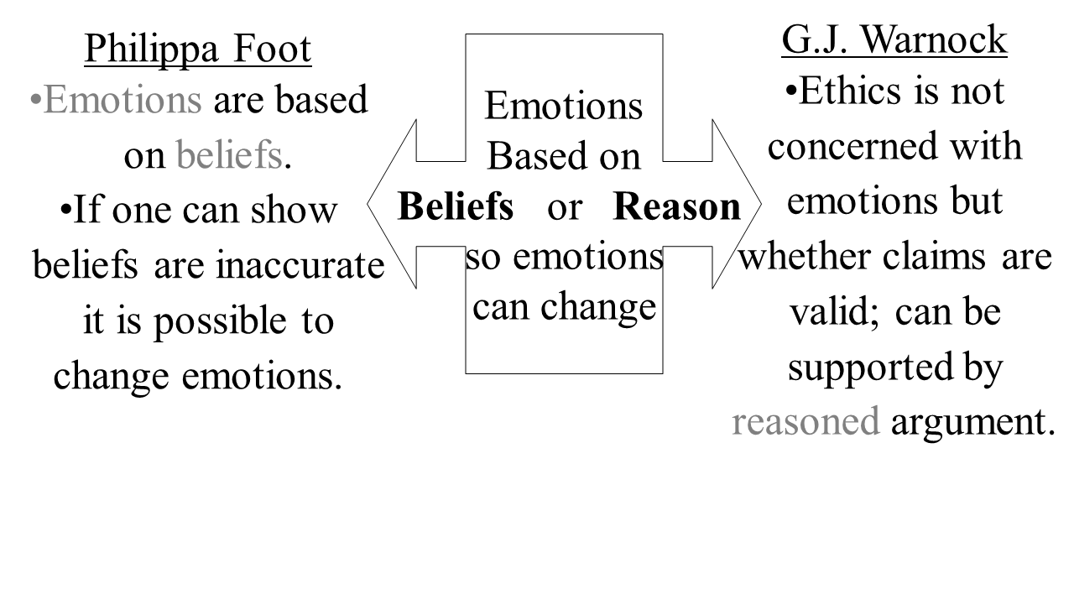
Challenges to Emotivism

Slide 9
Evaluation Zigzag!
Complete the zig-zag in your books.
Zig-zag from arguments that support and criticise Emotivism.
For
Against
Stretch yourself:
Add Naturalism and Intuitionism to your Zig-zag.
For
Against
Top philosopher:
Virtue ethicist Alasdair MacIntyre argues that emotivism wrongly places child carers and paedophiles as equals. Explain why in your notes.

Slide 10
Opinion Line: Mel Thompson famously said "You cannot reduce morality to a set of cheers and boos.“ Do you agree?
Read the Statement –
Think carefully and silently for 1 minute – what do you think and feel about this and why?
Post-it:
Take your post-it note and clearly write your view with a reason for it. Try not to be vague about WHY you feel how you do.
Stick your opinion to where you feel it best belongs on the opinion line at the front of our classroom.

