Slide 1
Social Activism and Engaged Buddhism

Slide 2
What do I need to know?
Why a Buddhist may feel social activism is an important
part of Buddhist practice
Evaluate different views about Engaged Buddhism
Examples of Buddhist activism in the following areas:
environmental awareness and action
opposition to oppression and injustice
war and peace

Slide 3
We need to discuss:
Learners should have the opportunity to discuss issues relating to Engaged Buddhism and social activism, including:
the role and focus of Buddhists in different societies and contexts
whether or not engaged practice should be central to the Buddhist path, and how this affects the stereotypical view of Buddhism as inward-looking
whether or not a Buddhist could ever accept the need for war

Slide 4
So what is social activism?
Social activism is the promotion and guidance used to cultivate changes in business practices, business policies or the government to influence social change. The duties of a social activist include communicating with policy makers, researching for the cause, and organizing responses for the media.
Activism consists of efforts to promote, impede, or direct social, political, economic, or environmental reform or status with the desire to make improvements in society.
Forms of activism range from writing letters to newspapers or to politicians, political campaigning, economic activism such as boycotts or preferentially patronizing businesses, rallies, street marches, strikes, sit-ins, and hunger strikes. ne can also express activism through different forms of art (artivism). Daily acts of protest such as not buying clothes from a certain clothing company because they exploit workers is another form of activism. Research has begun to explore how activist groups use social media to facilitate civic engagement and collective action.

Slide 5
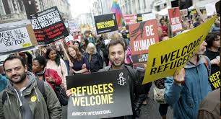
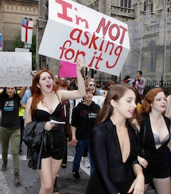
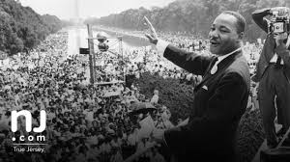
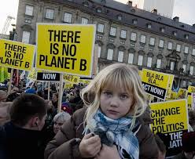
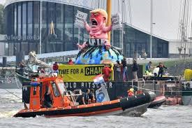
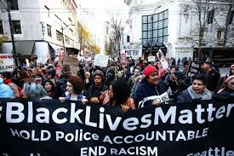
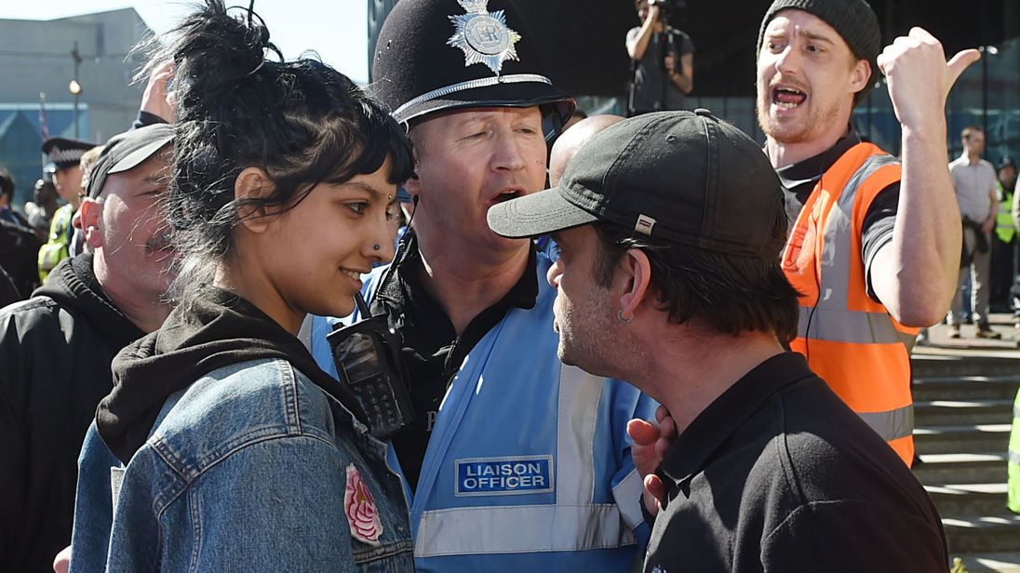
Can you think of any examples of social activism? Apply aspects of Buddhist ethics to 2 examples

Slide 6
Why would this monk inflict so much pain on himself?

Slide 7
Engaged Buddhism
Wiki definition:
Engaged Buddhism refers to Buddhists who are seeking ways to apply the insights from meditation practice and dharma teachings to situations of social, political, environmental, and economic suffering and injustice, including War and Peace
Discuss:
Should Buddhists engage in social activism?
What teachings or Buddhist schools of thought could you link in to this debate?

Slide 8
Is this part of ‘real’ Buddhism?
Why might Engaged Buddhism be controversial?
Enlightenment – is this consistent with the aim of Buddhism?
Are Buddhists seen as peaceful and passive – is this a stereotype?
Mystical and removed from day to day struggles – is this accurate or a stereotype?
How does fit with the need to help society/world with worldly concerns?
Can insight and wisdom be expressed as compassionate action?
How could you link in the different schools of thought within Buddhism?

Slide 9
Emerged in Vietnam
Developed from the 1930s onwards a part of the drive for independence from oppression
Developed by Zen Monk Thich Nhat Hanh who later helped to care for victims of Vietnam war and helped them leave the country and took part in various socially engaged organisations and activities
Defined in 3 parts:
Awareness in daily life
Social service
Social activism

Slide 10
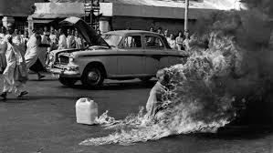
The History of Engaged Buddhism
The Roman Catholic Church was the largest landowner in the country and enjoyed special exemptions in property acquisition, and land owned by the Roman Catholic Church was exempt from land reform.
The white and gold Vatican flag was regularly flown at all major public events in South Vietnam.
Buddhist discontent erupted following a ban in early May on flying the Buddhist flag in Huế on Vesak, the birthday of Gautama Buddha. Just days before, Catholics had been encouraged to fly the Vatican flag at a celebration for Archbishop Ngô Đình Thục of Huế, Diệm's elder brother.
A large crowd of Buddhists protested the ban, defying the government by flying Buddhist flags on the Buddhist holy day of Vesak and marching on the government broadcasting station. Government forces fired into the crowd of protesters, killing nine people. Diệm's refusal to take responsibility — he blamed the Viet Cong for the deaths — led to further Buddhist protests and calls for religious equality.As Diem remained unwilling to comply with Buddhist demands, the frequency of protests increased.
Thích Quảng Đức had formed a suicide pact with a colleague in North Vietnam who subsequently carried out his pledge in protest of North Vietnamese mistreatment and oppression of Buddhists by the government.

Slide 11
The Origins of Engaged Buddhism
Discuss:
What do you think of the responses to the oppression in Vietnam?
Do you agree with Thich Nhat Hanh’s explanation of the motivations behind their actions?
Explain the context of oppression and social conflict in Vietnam.
Describe the response from some Buddhists including Thích Quảng Đức.
How does Thich Nhat Hanh explain to act of self immolation in his letter?
Which Mahayana practice does he draw a link to?
List 2 or 3 of the groups Thich Nhat Hanh has been involved in as part of engaged Buddhism.
Notes:
Thich Nhat Hanh interview with Oprah - link on the image

Slide 12
Thich Nhat Hanh
Mindfulness must be engaged – once there is seeing there must be acting or what is the point of seeing?
Be aware of the real problems of the earth and we will know what to do.
Are you massaging our Mother Earth every time your foot touches her? Are you planting seeds of joy and peace? Is peace in your every step?

Slide 13
Buddhist Ethics Case Study: Free Tibet
Watch the two video clips and make notes on the following:
1) Who is the Dalai Lama?
2) Why is there conflict in Tibet?
3) Evaluate: what is your response and why?
4) How is self immolation explained – link to sunyata and other Buddhist teachings.
Tibetan Buddhism
Situation in Tibet
Read the article and explain the Dalai Lamas position on this issue

Slide 14
Evaluate this example of Engaged Buddhism

Slide 15
The 14 mindfulness trainings/precepts
Use the article to create a mind map to explain the 14 Principles of Engaged Buddhism.
Include on your mind map:
What parallels can you find with the 8 fold path?
What other Buddhist principles/concepts can you identify – such as links to the 5 precepts?
Is there anything new in THN’s list?

Slide 16
Reminder! 5 precepts
All Buddhists try to follow the 5 precepts:
Don’t take life
Don’t take what is not freely given
No sexual misconduct
Abstain from wrong speech
Abstain from intoxicants
Essentially this is the ‘action’ bit of the 8FP

Slide 17
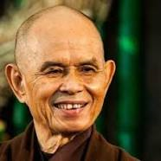
‘interbeing’ – another way of saying sunyata…
Thich Nhat Hanh used sunyata and annatta to explain that we should not see sunyata as something to fear, rather that we inter-be
So if we ‘inter be’ why does this lead us to action? (Engaged Buddhism)
Does this impact on how some people may view the actions of self immolation or not/?

Slide 18
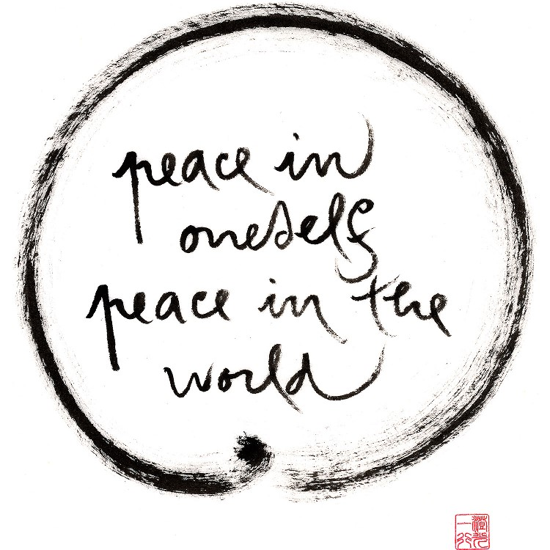
Investigate:
Community of Interbeing
Who are the Community of Interbeing?
What are the ‘teachings’
What types of ‘engagement’

Slide 19
Is Engaged Buddhism the same as old Buddhism or something new?
Thinkers are divided opinion on this issue:
Tich Nahat Hanh says Buddhists have always been socially engaged, the idea of Buddhism as passive and world rejecting is inaccurate and the bodhisattva ideal of selfless service is a an ideal to aspire to
The Buddha himself chose to found a sangha rather than rule a kingdom
Rather that Engaged Buddhism has refocussed this and came from Metta and Karuna due to the political circumstances.
Use the comparisons that you made between the original Buddhist teachings like the 5 Precepts and the 8 Fold Path to illustrate similarities.

Slide 20
Is Engaged Buddhism really new or part of Buddhism?
Batchelor:
Draws on material not explicitly Buddhist (nationalism, democracy)
BUT – long tradition of social engagement – the Buddha himself reacted against his cultural norms (caste system in the Brahmin traditions)
The Buddha’s decision to teach
The Bodhisattva’s Vow
Logical conclusion of paticcasamuppada/sunyata – no boundary between self and other
‘a sign of the dharma unfolding in Western Culture. Insight into the selfless and interconnected nature of life expresses itself as appropriate compassionate action’

Slide 21
Others argue that this level of engagement is relatively new due to certain factors:
Sufficiently new as these idea have only been actualised in recent years – should be recognised as a new movement ‘yana’ (vehicle) in the way Mahayana was
Some argue Christianity has played a role in the emergence of engaged Buddhism and see its concern with social issues as inspired by liberal Christian ideas of justice
parallels with liberation theology in South America
Deitrick talks of ‘cultural mingling’ – infusion of Euro-American thought through the veins of Buddhist Asia

Slide 22
Injustice
What could we link to 8 fold path? Sila
Sunyata?
Bodhisattva ideal?
5 Precepts?
6 Perfections
Karuna?
Metta?

Slide 23
‘right livelihood’
Livelihood could link to environmental concerns but also to human justice – should not be benefitting from harming others.
What jobs could harm others?
Wealth is fine as long as obtained in right way and used for benefit of others (good kamma)
‘hunger is the greatest illness, contentment is the greatest wealth’
(dhammapada)

Slide 24
‘right livelihood’
Could link to environmental concerns but also to human justice – should not be benefitting from harming others.
What jobs could harm others? Arms trade, betting industry, advertising…
Wealth is fine as long as obtained in right way and used for benefit of others (good kamma)
‘hunger is the greatest illness, contentment is the greatest wealth’
(dhammapada)

Slide 25
Kamma (from Harvey) – Extra Thinker Challenge!
Social concern may to an extent be limited by the belief in kamma – why might some think this?
Buddhasa (activist) felt Buddhist principles were socialistic and should be aimed at the good of all – opposed individualism. Can you link this to Arhat V Bodhisattva?
He saw the bodhisattva idea as a socialist one and argues we should be basing society on need rather than tanha type greed (consumerism feeds this)

Slide 26
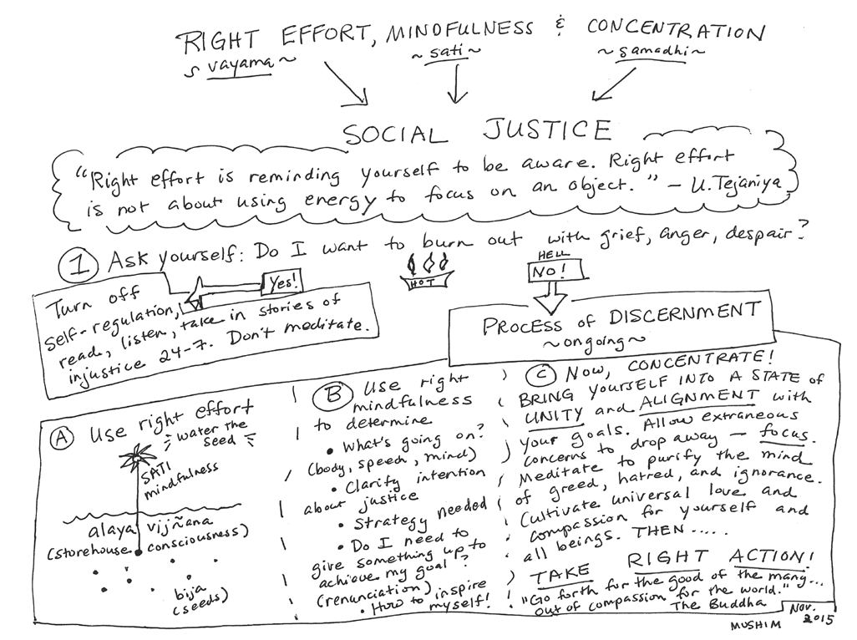
Handout – Buddhism and Social Justice
Read, highlight and annotate – what justification does the author give for saying Buddhism should be concerned with social justice
Look for examples given past and present

Slide 27
Handout –Buddhism and Social Justice
Always concerned with social justice
Karuna
Karma
Tanha leads to conflict
Countries should rule according to the dharma – cut crime/socialist principles
Bad dharma impacts whole society (examples of mythological stories)
Buddha seen to favour democracy – real example of Ashoka who converted and lead a society based on ahimsa, medical care
Mahayanist ideal of Bod very relevant in many countries who have suffered under colonial rule
Engaged Buddhism inspired by interbeing/sunyata

Slide 28
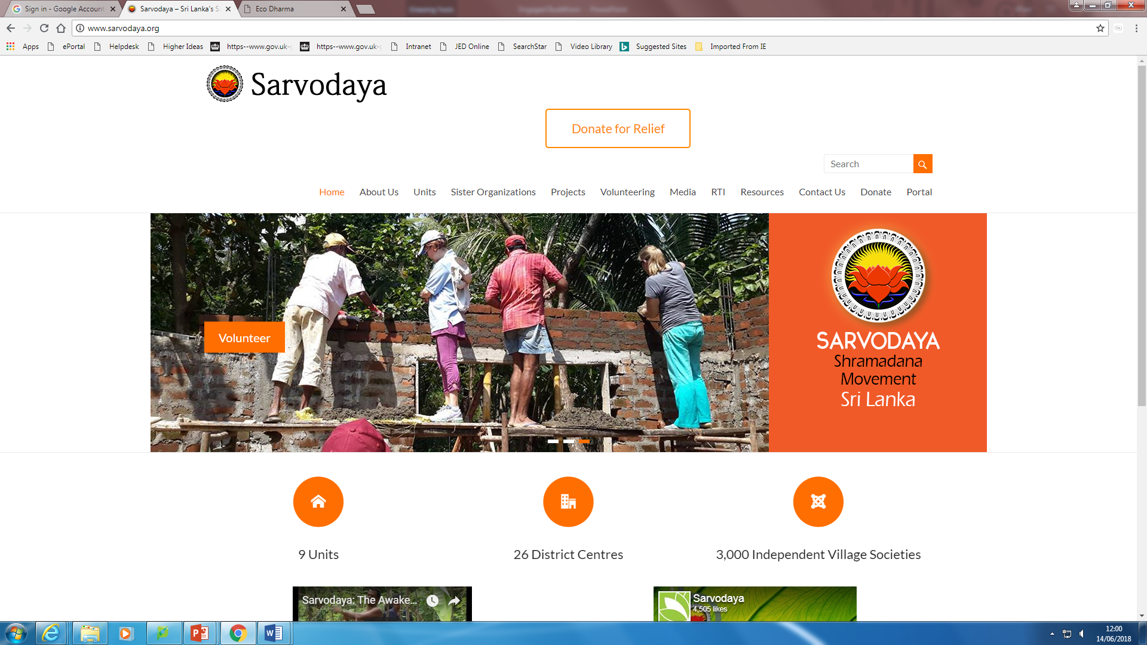
Social Justice: Sarvodaya
History
Aims
Actions
Link to Buddhist teachings
Example of a project

