Slide 1
Engaged Buddhism
The Environment

Slide 2
Soto Zen: The Five Principles of Green Life

Slide 3
Engaged Buddhist Groups -Environment

Slide 4
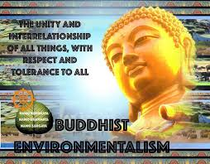
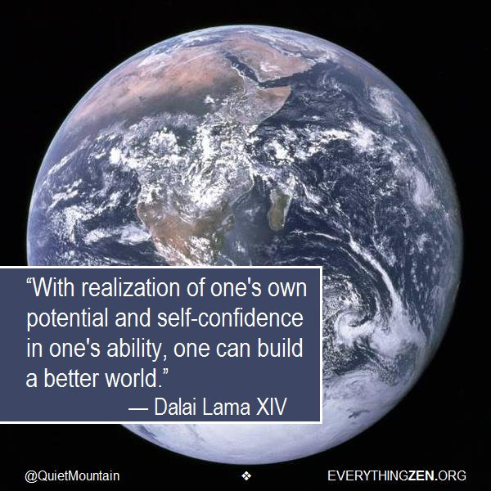
The Environment
‘Buddhism has a contribution to make to environmental ethics - discuss’
Use the article to fill in your worksheet
Using your worksheet, and your existing knowledge, plan an answer to the question above.

