Slide 1
Do these phrases describe: Meta or Normative ethics?
More philosophical
Concerned with what is right and wrong.
A guide to behaviour
more rigid
Concerned with what meant by right and wrong.
Theoretical

Slide 2
Similarities & differences
Similarities
Understanding words & concepts
Understanding why we use certain words
Reasons behind decisions
Differences
Meta is theoretical, normative is a guide to behaviour
Meta is more rigid than normative. There is less manoeuvrability in defining words, compared to applying ethical theories.
Meta is more philosophical

Slide 3
Ethical Naturalism

Slide 4
Learning Outcomes
To be able to describe the view point of Ethical Naturalism
To be able to explain the main thinkers views associated with ethical naturalism.
To be able analyse the strengths and weaknesses of ethical naturalism.

Slide 5
Ethical Naturalism
If a naturalist view of meta ethics is taken, it might support normative ethical theories such as natural law or utilitarianism. Both are different yet they start from the same assumptions.
The first premise is that moral laws exist. The next is that they can only be experience and understood through an analysis of a) the natural world or b) human nature.

Slide 6
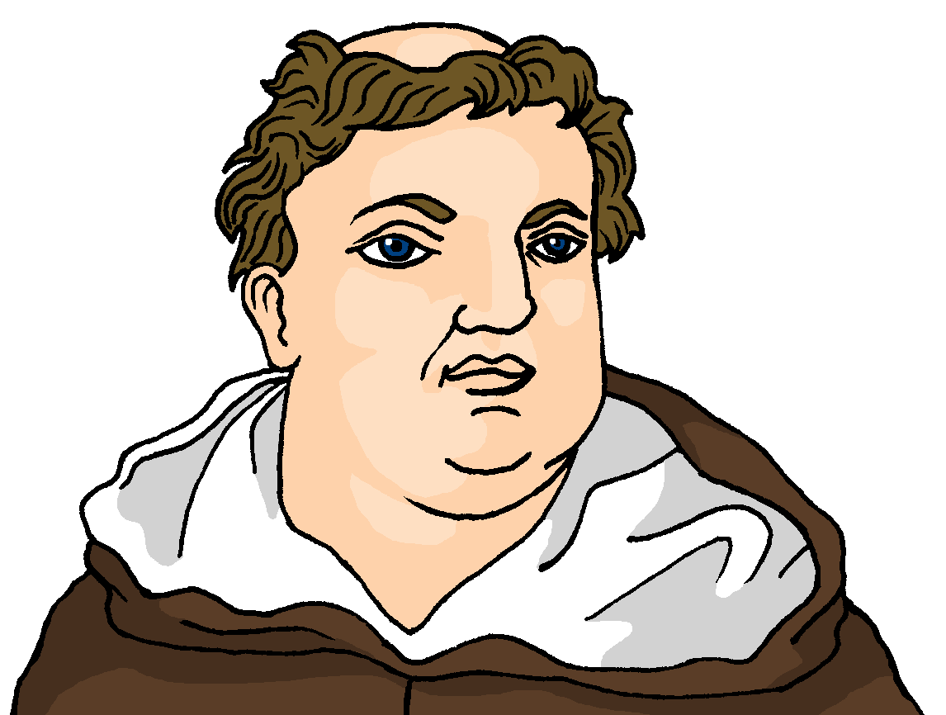
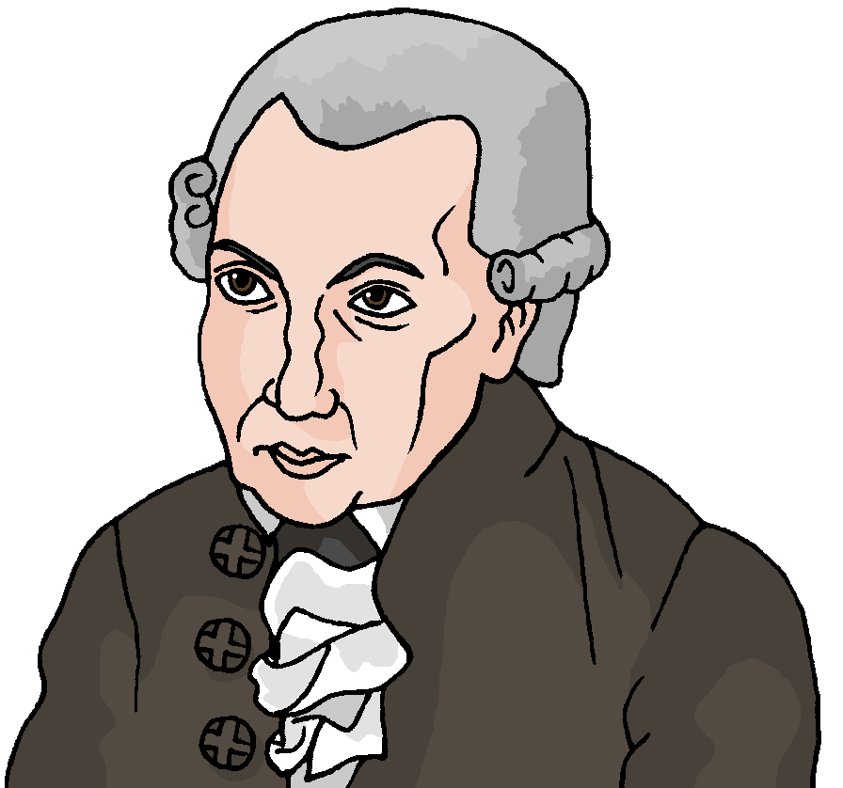
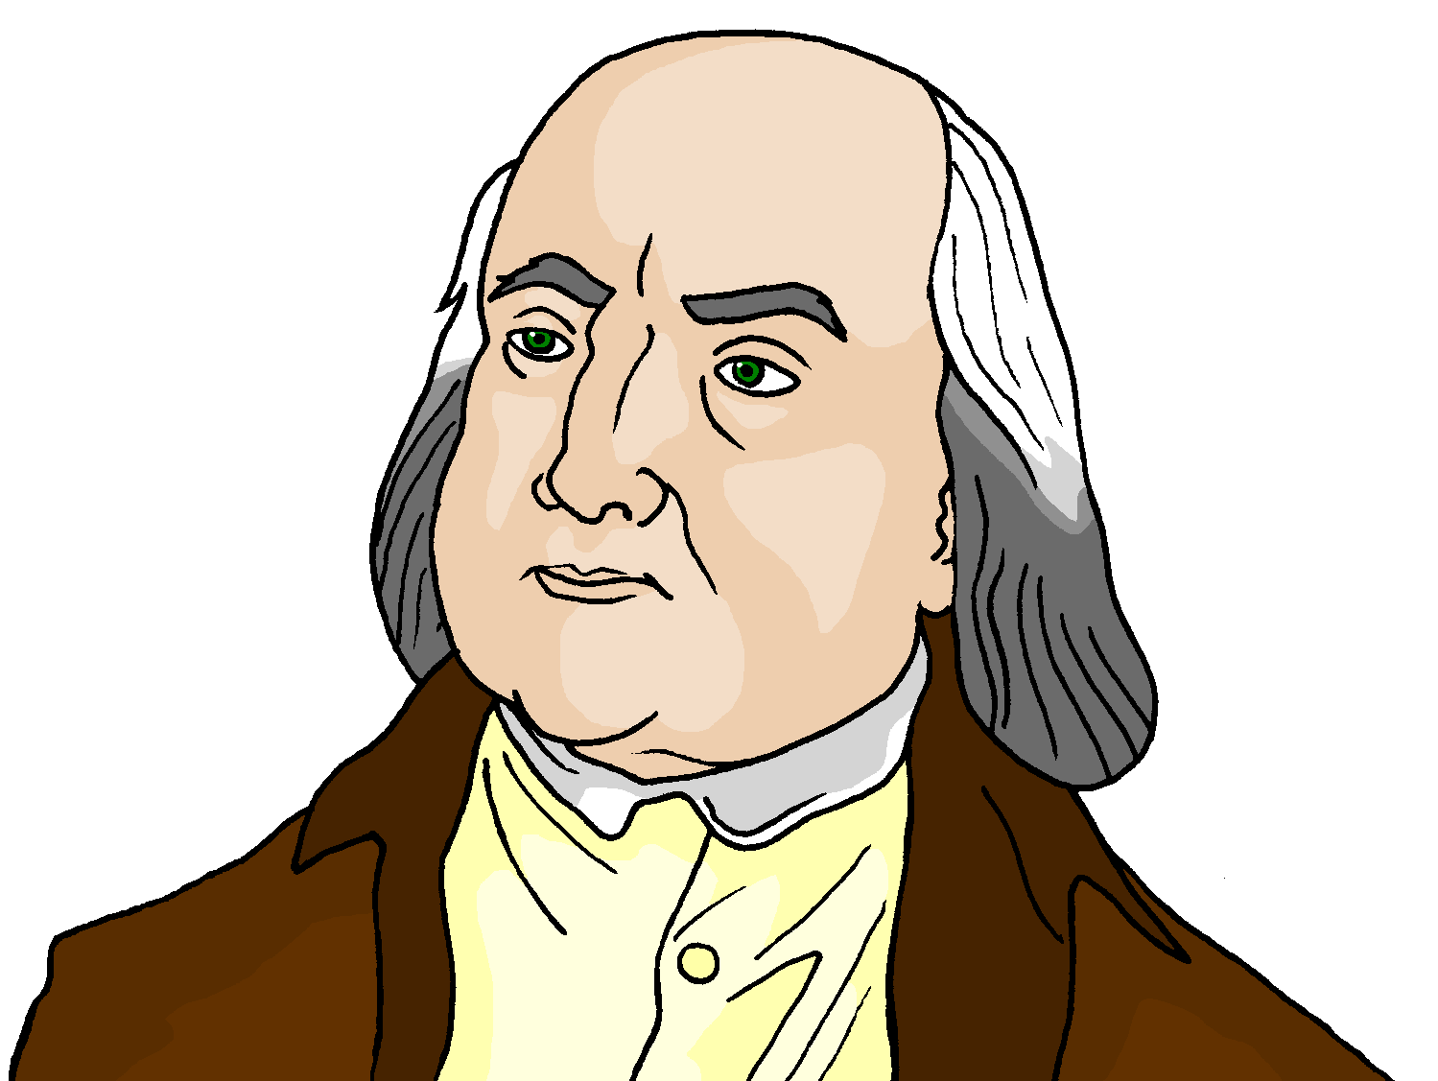
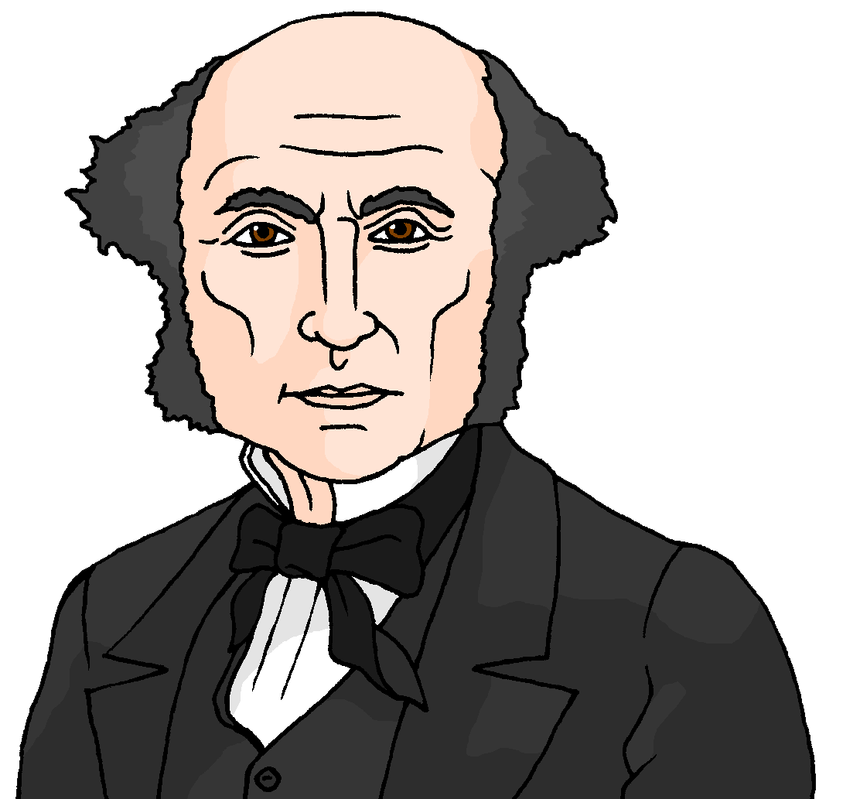
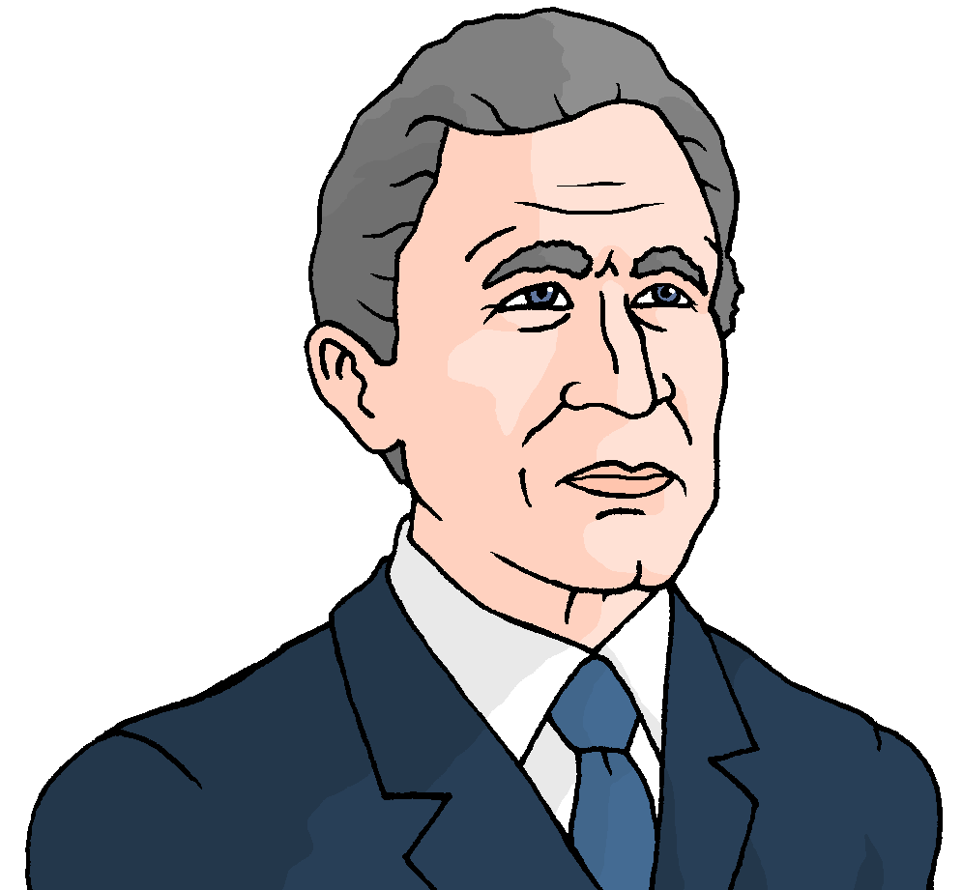
Ethical Naturalism
Aquinas Kant Bentham Mill
Ethics can be understood like other empirical statements
Empirical Assessment
George was
elected
President
of the USA.
War against
terrorism
is good.
Both statements can be proven to be either
true or false through observation or evidence

Slide 7
Ethical Naturalism –An example
A naturalist view of ethics argues that, once verified by nature, moral statements are objectively true.
For a utilitarian, the statement ‘murder is wrong’ is true because a person killed is harmed an this prevents his or her happiness. In all cases the moral proposition ‘murder is wrong’ is non-negotiable. It is a universal law. Nature reveals why it is a moral law.

Slide 8
Think, Pair, Share
Watch the clip:
A: Where do Ethical Naturalist think our moral laws come from?
B: Explain how Natural law is an example of this point of view?

Slide 9
The Critics of Ethical Naturalism
Non- cognitivists
Strong cognitivist
Non- cognitivists assert that it is not possible to draw moral law from human nature or the way the universe works since moral laws are concepts whereas the universe is physical.
Strong cognitivist have concerns about the reduction of naturalism. They believe that moral propositions do exist, but argue that it is not possible to reduce the concept of good to a simple law e.g. The Hedonic calculus. Strong cognitivists reject the claim that there is a single, empirical basis to morality.

Slide 10
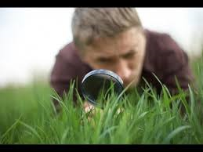
Ethical Naturalism- The Thinkers
Read through the article and summarise the views of each thinkers in your own words:
Perry
F. Bradley
Charles R. Pigden
G. E. Moore
Stretch yourself:
Explain in your own words which ethical theories fall under this category of ethical naturalism. Remember to give reasons

Slide 11
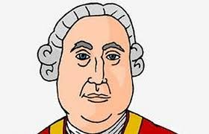
Naturalistic Fallacy
The idea that just because nature acts in a certain way it does not follow that this is how things ought to be.
Read through both articles and write 5 facts about each view in your notes.
G. E. Moore :
We should not confuse ‘good’ with a factual or natural physical or metaphysical property.
We should not presume that good is equal to or the same as a natural or metaphysical property.
David Hume:
We cannot deduce an OUGHT from an IS.
We cannot move from FACTS to VALUES.
Next steps: Research and explain Hume’s fork in your notes.
Top philosopher: What does John Searle say about the Naturalistic Fallacy.

Slide 12
Complete the table: Evaluating Ethical Naturalism
Strengths
Weaknesses
Next steps:
Check you have used the keywords:
Realist/Anti-realist
Cognitivist/Non-cognitivist
Top philosopher task:
How would moral relativists view ethical naturalism?

Slide 13
Evaluating Ethical Naturalism
Strengths
Weaknesses
Based on what’s natural and everyone can experience it.
Nature is universal so supports the fact that morals are universally known.
Presents a solid guideline to follow in each situation.
Regards of whether a situation has evidence to support it may still not match with the law of the country e.g. euthanasia.
Right and wrong are subjective and need humans to exist to determine how we should live.
Do ethical/moral situations really have evidence?

Slide 14
Learning Outcomes
To be able to describe the view point of Ethical Naturalism
To be able to explain the main thinkers views associated with ethical naturalism.
To be able analyse the strengths and weaknesses of ethical naturalism.

Slide 15
PING – PONG!
YES
NO
Does Ethical Naturalism work?

