Slide 1
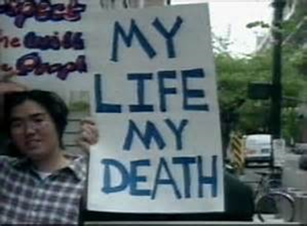
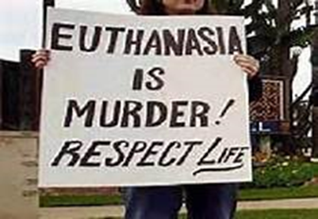
Youngest in the pair
Oldest in the pair
Do all people, regardless of health have a right to euthanasia?
How could laws allowing euthanasia be used in a corrupt manner?
Should euthanasia be legalised in the UK?
What is your view on assisted euthanasia and why?

Slide 2
Rapid Recall!
5 types of euthanasia | Name 2 case studies we could use as evidence in a 12 mark question | Church of England View
Give one Bible teaching against voluntary euthanasia | Explain the Quality of life argument | How does Sanctity of Life relate to euthanasia

Slide 3
Excellence Writer’s palette DIRT
Use a quote or piece of evidence in every paragraph in your answer | Explained the meaning of any quotes that you may have used | Written in two clear, well organised paragraphs
What would a consequentialist approach be to this issue and which denomination might it belong to? | Explained all key terms: Sanctity of life IVF ED SD Surrogate | What would a deontological approach be to this issue and which denomination might it belong to?
Explain two Christian views about fertility treatments (5)
Use the targets on your work and the grid to improve your work
Check through your work crossing off the things you have used from the grid

Slide 4
Voluntary Euthanasia
Euthanasia is performed without the dying person being told. e.g. a coma patient.
Doctors give the patient pain killing drugs knowing that the drug will also kill the patient.
Involuntary Euthanasia
Passive Euthanasia
Doctors give a painkilling drug but do nothing to save the patient.
Active Euthanasia
Euthanasia has to be performed because a person has a certain illness or has reached a certain age. (NOT LEGAL)
Euthanasia is performed because the patient has asked for it. e.g. a cancer patient who asks for a drug to quicken their death
Compulsory Euthanasia

Slide 5
Euthanasia is performed because the patient has asked for it. e.g. a cancer patient who asks for a drug to quicken their death
Voluntary Euthanasia
Involuntary Euthanasia
Euthanasia is performed without the dying person being told. e.g. a coma patient.
Passive Euthanasia
Doctors give a painkilling drug but do nothing to save the patient.
Doctors give the patient pain killing drugs knowing that the drug will also kill the patient.
Active Euthanasia
Euthanasia has to be performed because a person has a certain illness or has reached a certain age. (NOT LEGAL)
Compulsory Euthanasia

Slide 6
Recall: Ethical Issue - Euthanasia
Define the following:
Voluntary euthanasia -
Active euthanasia –
Involuntary euthanasia –
Living Will –
DNR –
Dignitas -
Care Not Killing –
Palliative –
Respite –
Sanctity of Life
Bible evidence and analysis
Suffering is a Test of Faith:
Bible example Job:
Christian explanations for suffering
Suffering due to Free Will and Sin:
Original Sin:
Augustine:
Quantity (ammount) of Life
All life has value:
Irenaeus:
Care Not Killing

Slide 7
Recall: Ethical Issue - Euthanasia
Roman Catholic View
Pope Jean Paul
Right to Die Argument
Pope Francis
Case Study Evidence
Dignitas:
Noel Conway:
Debbie Purdy or Diane Pretty:
Anglican View
Quantity of Life
All life has value:
Irenaeus:
Care Not Killing
Quality of Life

Slide 8
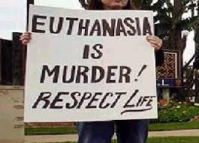
Sanctity of Life
Christians believe that God made human life.
Literalist Christians believe that the account in Genesis describes how when God made Adam and breathed life or a soul into him through Adam’s nostrils.
‘made in the image of God’ Genesis 1:26-27
Both of these teachings show the Christian belief that humans are special and different to other life forms. Humans are like God and it is believed, have a soul that will continue after death and go back to being with God.
Human life was given by God and can only be taken by God
Task: Consider and add – what may make humans so different to other life forms? Giving examples to illustrate your point gets you more marks.

Slide 9
Sanctity: Value and Quantity of Life
Teachings about sanctity mean that as God has made all life, young, old, healthy, ill or disabled. All life is special, planned and supposed to be here.
This idea of sanctity and value of life means many Christians will respect that their life and body was given to them by God to look after and will not waste it or discard it.
This also means if life is valued we will value our life when we may be ill or restricted in what we do and so would not opt for euthanasia but would still believe we have a purpose and value.
It means Christians may choose to support charities such as Age UK or Hospices instead of euthanasia.
Find a quote to back this up:
1 Corinthians
6:19
Synoptic Philosophy Link:
How can you link to Irenaeus and Soul Preparing/Strengthening?

Slide 10
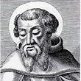
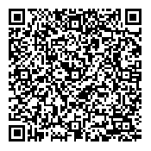
Suffering = soul strengthening
Irenaeus 130-202 CE
St Irenaeus in his book Against Heresies suggested that although humans are special and created with souls, those souls are immature.
Through life and our experiences and suffering our souls will become stronger, better and more worthy of God
Christians may use this to suggest that all our suffering is part of our individual journey and teaches us compassion and empathy. Euthanasia may be seen, then, as detrimental to our soul growth.
Stretch Yourself:
Explain the arguments of John Hick and John Keats to this concept.

Slide 11
Suffering has purpose?
Suffering is a result of sin:
Brief synopsis of Genesis 3 The Fall
Give quote evidence
How does original sin link to suffering and why we suffer?
Many Christians believe that all life has value, that the suffering we go through has a purpose.
This is linked to the sanctity of life as to a Christian there is always a value to life even in suffering; although we may not see this God, as our omniscient creator can.
No life is without a God given purpose and is therefore sacred. Christians believe if we can try to understand why we suffer we can bear suffering and see that life should not be prematurely ended.
Reasons for Suffering:
Result of our sin (original sin)
Test of faith in God
Soul strengthening/ enhancement
Synoptic Philo Link: Investigate and link in Augustine on original sin as an explanation for suffering.

Slide 12
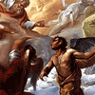
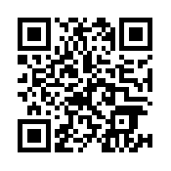
Suffering is a test of faith
Suffering is a test of faith:
In the Book of Job we can see how Christians view suffering as a test of faith.
That God alone can know (omniscient) the purpose of what we go through and we should have faith in his wisdom and understanding of our path.
‘But those who suffer he delivers in their suffering; he speaks to them in their affliction’
Job 36:15

Slide 13
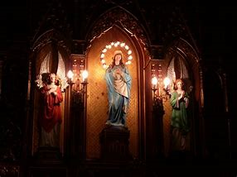
Catholic Teaching
Sanctity
Sin
Test of Faith
Quantity and value of life
The Catholic Church teaches that all forms of euthanasia are not acceptable. Active and voluntary euthanasia are seen as being of particular moral concern – using many of the arguments we have discussed
‘Thou Shalt not Kill’ Exodus
Only God can end a life, this means all forms of euthanasia seen as a sin. Sanctity of life is the teaching that all life is sacred and from God
‘made in the image of God’ Genesis
Doctrine of Double Effect
However, if large doses of painkillers are used to help a person’s suffering, and as a result, the person dies, this is acceptable as long as the primary intention was to alleviate pain, not to shorten life span.
This is called the ‘doctrine of double effect’.

Slide 14
Catholic Teachings – Switching off Life Support? Views on Involuntary Euthanasia
Catholics believe knowingly and intentionally hastening death is wrong. God decides when we live or die. To remove treatment (like a ventilator keeping someone alive) is done knowing it will end life – going further than DDE as the intention is that the life will end.
This means RC generally do not support removal of life support. However, as Pope John Paul II’s comments show that how far we go to prolong life and when we can withdraw treatment is debated.
Catholics may accept not striving at all costs to prolong life. This does not mean they would always accept switching off a life support or ventilator for example but do discuss avoiding ‘exceptionally burdensome’ treatments.
Exactly what is a burdensome treatment? It seems even with an absolute approach which is against euthanasia there are still unclear aspects.

Slide 15
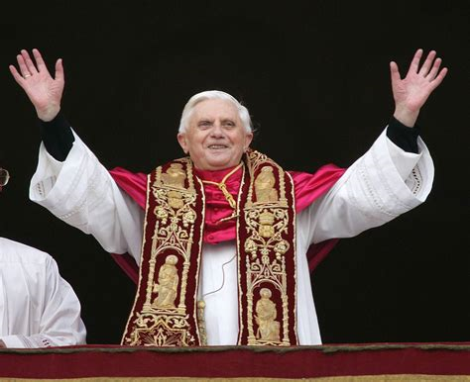
View from the Leaders of the Catholic Church
Pope Francis (current leader)
Denounces euthanasia as a ‘a false sense of compassion’
Sees euthanasia as a symptom of our ‘throw away culture that does not properly care for our needy. ‘
Pope John Paul 11
Pope John Paul II spoke out against using extreme measures to keep terminally ill people alive in 2002
The Pontiff, a frequent defender of the sanctity of human life, said using medical techniques to preserve a patient's life "at all costs" could be "useless and not fully respectful of the patient".
However he stated that euthanasia was ‘the deliberate and morally unacceptable killing of a human person’.

Slide 16
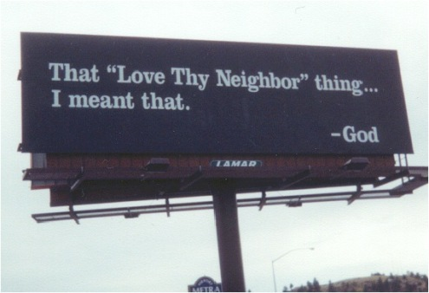
Anglican Teaching
The Church of England teaches that although the deliberate taking of human life is forbidden, there are strong arguments for people not to be kept alive at all costs when they are suffering intolerable pain.
They believe that Euthanasia is wrong, but do not regard switching off life support machines when someone is technically ‘brain-dead’ as wrong (as God has already decided to end this life). Passive euthanasia is potentially acceptable – depending on the situation.
They believe in these extreme circumstances the most loving thing to do is the best – as they are more consequential in their approach. They do not accept that active and voluntary euthanasia should be legalised.

Slide 17
Evaluate: ‘Euthanasia should be a human right’

