Slide 1
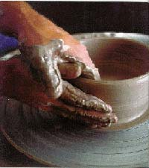
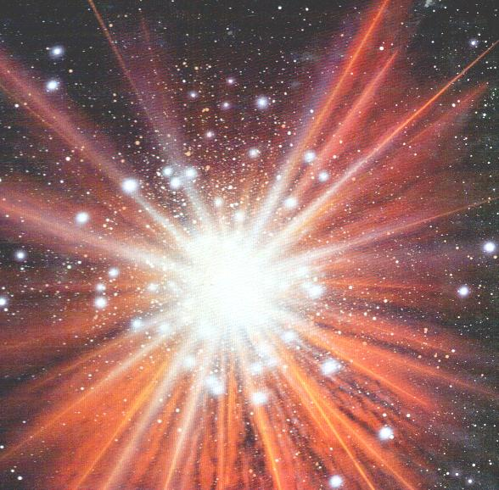
Which picture is related to what were doing last lesson?

Slide 2
Evaluation of Aristotle’s thought

Slide 3
Lesson Outcomes
To be able to describe the qualities of the Prime Mover.
To be able to evaluate Aristotle’s epistemology.

Slide 4
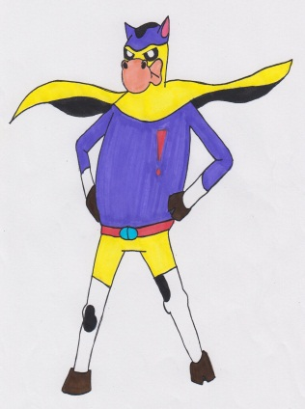
Cow time! Literacy Target
Check that you have spelt all the key words correctly.
Take the time to check over the rest of your work for any other spelling mistakes.
Ask for a dictionary or use the internet to check over any words that you are not sure are correct.

Slide 5
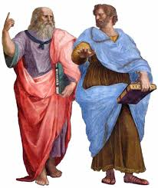
An evaluation of Aristotle’s thought
Although Aristotle was a genius, he did not inherit Plato’s academy.
Plato left it to a nephew instead. This may have been due to family loyalties but probably, it was because Plato know that Aristotle’s beliefs were just too different to his own.
Aristotle’s work is difficult to evaluate because it often lacks clarity. Although Plato wrote in clear elegant prose, with plenty of examples to make sure others understood him, in contrast Aristotle’s work is difficult to follow. Many scholars believe the surviving writings of Aristotle were only meant to be lecture notes.

Slide 6
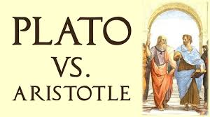
Plato’s Form of the Good compared to Aristotle’s Prime Mover
In some ways, these two different ideas have a lot in common. Both Plato’s ideas about the form of the Good, and Aristotle’s ideas about the Prime Mover, have been influential on the Christian idea of God.
Plato’s Form of the Good gives them the concept of God as the perfect form of Goodness. Aristotle’s Prime Mover gives them the concept of God who is the ultimate cause of all that exists.

Slide 7
Prime Mover Versus the Form of Good
Compare and Contrast the Prime Mover with the Form of the Good…
Similarities | Difference
Hints:
Cause of everything
Necessary existence
Not interactive
Perfect nature
Being/essence
Can we experience them?
Stretch yourself:
How have both these ideas influenced Christianity?

Slide 8
A02 Giant Evaluation zigzag
Sort out the arguments cards into statements that support and criticise Aristotle’s epistemology...
For
Against
For
Against
Stretch yourself:
Add your own arguments to the zig-zag…

Slide 9
Most people agree the universe is in a constant state of flux and concepts of Potentiality and Actuality.
Russell criticised the idea that universe has a purpose. Could it not be chance?
Aristotle does not personify the primer mover which leaves it open for interpretation.
Based on empirical knowledge unlike Plato. This is unusual in Aristotle’s time.
Aristotle’s writing is unclear and often lack clarity. Scholars argue they were meant to be just lecture notes.
Why do we need the prime mover? (criticised by theists) Why can’t the chain of cause and effect not go on forever?
Is it wrong to totally reject the idea of spiritual or intuitive knowledge?

Slide 10
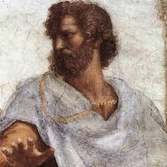
Aristotle’s epistemology
Complete the crib sheet to demonstrate your understanding of Aristotle.
It covers:
Four Causes
Substance Categories
Prime Mover
Stretch yourself: Include his influence on St Aquinas.

Slide 11
Think, pair, share
A: Describe the purpose of Prime Mover
B: Explain the qualities of Prime Mover
A: Why does Aristotle need a Prime Mover in his epistemology?
B: What would Christians say the efficient cause of the universe is?

