Slide 1
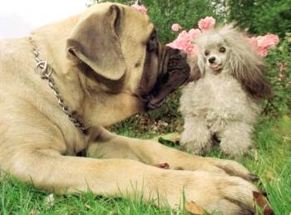
How would Plato say we recognised these?
Think, Pair, Share!

Slide 2
Plato’s Form of the Good

Slide 3
Learning Outcomes
To be able describe the concept of the Form of the Good.
To be able to explain how the Form of the Good fits into Plato’s epistemology.

Slide 4
Taboo
Try to explain the concepts given to you without using the word Good.
Good is taboo!

Slide 5
Form of the Good
People do not learn new things they actually learn the reality of how things are (anamnesis).
The Form of the Good is the highest of all forms and the source of other forms.
The Form of the Good makes other concepts ‘knowable’ e.g. Justice.
‘without the source (Form) of Goodness it’s like trying to see in the dark’ –it is the sun in the analogy.

Slide 6
The Good
Once you understand Good you can understand everything else....
Justice
Truth
Beauty
Universal Qualities
Concepts and ideals
Physical living objects
Physical inanimate object

Slide 7
The Form of the Good
When we understand something as “good” we are recollecting the Form of the Good in the world of Forms
Any good action in this world is a pale reflection of the perfect Form of the Good
The Form of the Good was later taken by Christian theologians to mean God.

Slide 8
Form of the Good?
Draw your own timeline that helps you understand the Form of the Good.
The end point should be:
‘Woman see the beautiful bouquet of flowers and cries’
Stretch yourself: Find out 5 pieces of information about Plato’s demiurge.

Slide 9
Note: The Demiurge (craftsman)
Plato believed that the world was created by a
god he called the demiurge.
The Demiurge made the world by fashioning it out
of material that was already there, but which was a
shapeless mess before the demiurge got to work.
However he is not omnipotent and that is why the world is not perfect. Goodness still comes from the Form of the Good.

Slide 10
Plato’s epistemology
Complete the crib sheet to demonstrate your understanding of Plato.
It covers:
Analogy of the cave
Concept of Form
Form of the Good
Demiurge
Stretch yourself: Include your group’s opinions on Plato’s epistemology.

Slide 11
Think, pair, share
A: Explain the difference between our world and the world of the Forms.
B:Explain why Plato says the world we live in is not the real world.
A: Explain what the Form of the Good is.
B: Explain what the Demiurge is.

