Slide 1
If I ruled the world…
What 5 rules or laws do you think are absolutely essential for a society to run ethically?

Slide 2
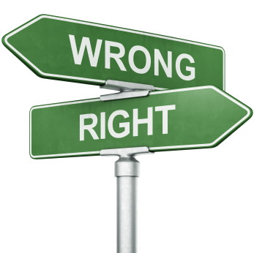
Buddhist Ethics
Learning Objectives:
Identify the 5 precepts of Buddhism
Explain how these differ from the 10 commandments
Analyse some of the ethical dilemmas faced by Buddhists
Key Terms
Dharma
Metta
Ahimsa

Slide 3
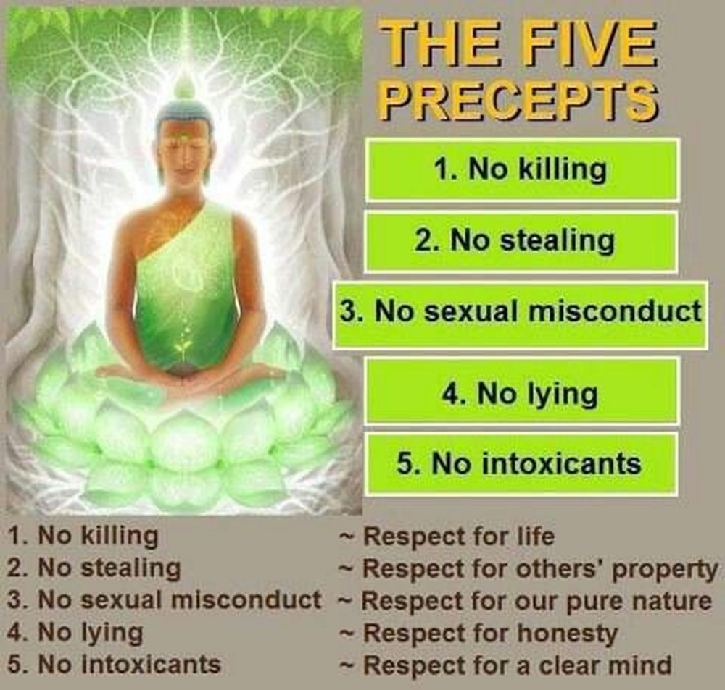

Slide 4
Ethical behaviour is central to Buddha Dharma (Buddha’s teachings):
Morality is one of the three divisions of the Eight Fold Path (Right action, right speech, right livelihood)
Making moral/ethical choices produce good karma and therefore a positive rebirth and closer to enlightenment. Making unethical/immoral choices produces negative karma and results in a negative rebirth and therefore further away from enlightenment.
But how do Buddhists know what things are right and what things are wrong? Well, the Buddha did give instruction on some fundamental ethical behaviours, the most famous of which being the 5 precepts, which are 5 rules that all Buddhists must follow: 5 Precepts

Slide 5
What are the similarities/differences between the 5 Precepts of Buddhism and the 10 commandments of Judeo/Christianity?
5 Precepts
10 Commandments
Not linked to a divine being who will punish you if you break them
Following them leads to a more ethical society
Rules set out by God who rewards/punishes accordingly (heaven/hell)
Following precepts leads to good karma, not following leads to bad karma
Consequences if not followed
Not just focussed on ethical conduct, also includes rules about showing respect for God etc.
Some rules are the same e.g. do not kill, do not steal
Not seen as absolute rules – Buddha disagreed with blind faith!
Usually seen as absolute because given by an omnipotent, omniscient God.

Slide 6
Metta and Ahimsa
The concepts of Metta (Loving Kindness) and Ahimsa (Non-violence) are central to Buddha Dharma.
Both these concepts link to the first precept ‘do not harm any living thing’. For Buddhists this includes animals too and hence most are vegetarian. A minority of Buddhist monks take this to extremes and wear special face masks to avoid breathing in tiny insects!
Many people therefore assume that all Buddhists are pacifists but it isn’t necessarily as simple as this. Some Buddhists argue that non-violence is not the same as pacifism and use this story to illustrate their point:

Slide 7
Points for Discussion:
1) Do you think this story goes against the following Buddhist teachings?
1st Precept – ‘Do not harm any living thing.
Ahimsa
Metta
2) How does the concept of karma link to this story?
3) What would you have done in this situation? Why?
4) Do you think all Buddhists would agree with this story?
The Buddha, in a past life as a ship's captain named Super Compassionate, discovered a criminal on board who intended to kill the 500 passengers. If he told the passengers, they would panic and become killers themselves. With no other way out, he compassionately stabbed the criminal to death. Captain Compassionate saved the passengers not only from murder, but from becoming murderers themselves. Unlike him, they would have killed in rage and suffered hell. He saved the criminal from becoming a mass murderer and even worse suffering. He himself generated vast karmic merit by acting with compassion.

Slide 8
Buddhist Ethics Case Study: Free Tibet
Watch the two video clips and make notes on the following:
1) Who is the Dalai Lama?
2) Why is there conflict in Tibet?
Tibetan Buddhism
Situation in Tibet

Slide 9
Homework
Read the article from the Guardian about the Dalai Lama’s attitude towards violence. Based on everything you had learnt today, write a persuasive speech arguing that Tibetan Buddhists either should or should not use violence in their struggle for independence.
Homework Tips
Your speech should be about 1-2 sides of A4 (hand written)
You should include religious teachings and examples in your speech
The best speeches will predict counter arguments and contradict them in their own speech
Further Reading:
Keown, D. (2013) Buddhism: A Very Short Introduction. Oxford University Press, Pp. 112-127

Slide 10
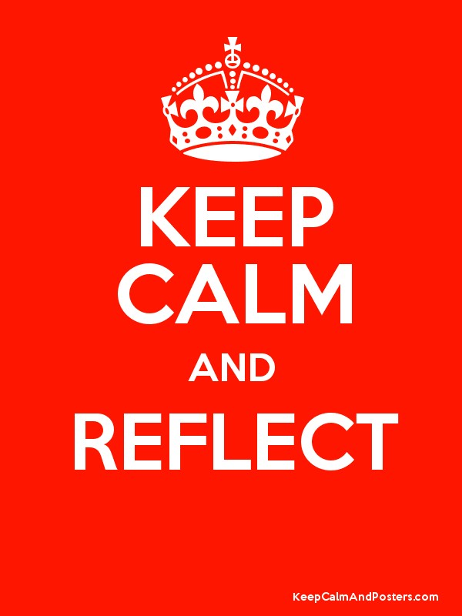
And finally…
Sum up what you have learnt today in your SOL booklet.
Add the definitions of any new key terms you have learnt to your glossary.
Make a note of anything you need to do some further research on, or that you need to email me to arrange a time for me to go over with you before next lesson.

