Slide 1
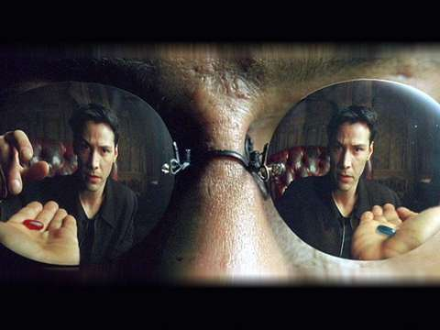
Metaphysics
Think, pair, share
How do you know something is real?

Slide 2
Plato’s analogy of the cave

Slide 3
Learning outcomes
To be able to explain what the Greek Philosopher Plato thought about reality.
To be able to explain the purpose of Plato's analogy of the cave.

Slide 4
What are these?
How do you know?

Slide 5
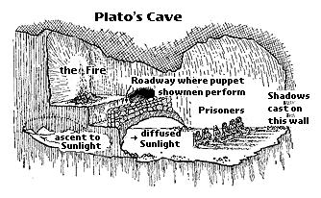
Plato’s epistemology
Plato used an analogy to explain this views of the world.
Watch the video and write a brief explanation of what you think it is trying to say.

Slide 6
Plato’s epistemology
He believed that the world we are in is merely an illusion:
a ‘copy’ if you like, of the real world of the forms.
The mind craves knowledge of that real world but,
because it is trapped inside the body, it is forced to
experience the poor imitation we experience through our
senses.
Plato believed that philosophers were the ones who were
able to see the truth and therefore philosophers should be
in charge of society.

Slide 7
The purpose of the analogy
According to Plato, the world outside the cave represents the real world of forms while the shadows on the wall represent objects in our physical world.
The escape of the prisoner represents philosophical enlightenment and the realisation that the realm of the forms are the true reality.
Most people are like the prisoners in the cave. They think the shadows are reality. The prisoners in the cave are people who just accept everything at face value and never ask questions or try to understand.
Philosophers, though, are like the man who escapes the cave and sees the real world. They have true knowledge.

Slide 8
Create your own cartoon strip to illustrate Plato’s analogy of the cave.
Use the worksheet to help you.
Stretch yourself:
Add an explanation of the analogy.

Slide 9
Plato’s Republic
Read Plato’s extract from the republic.
Find one key sentence that you think sums up Plato’s view of reality.
Be prepared to read it to the class…

Slide 10
Make a key explaining what each part of the analogy represents…
1)The Cave
2)The prisoners
3)The Shadows
4)The outside world
5) The prisoner who leaves the cave
6) The return to the cave
Stretch yourself:
What do you think the sun represents?
This is one of the most important parts of the analogy.

Slide 11
What link is there between Plato’s Analogy of the Cave and The Matrix? Discuss in pairs.

