Slide 1
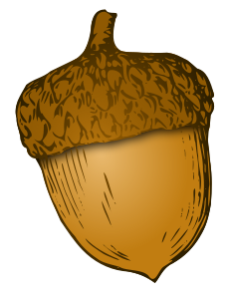
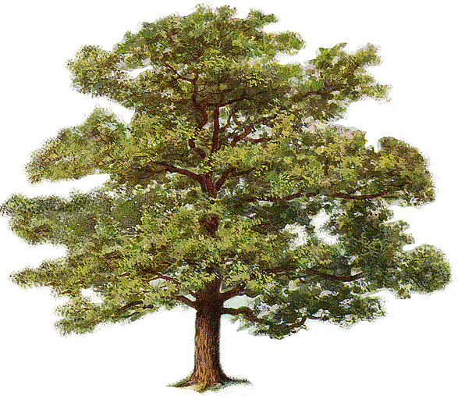
What makes an acorn into a tree?
Potentiality is when something contains the ingredients to become something else.
Actuality is when an object fulfils its potential and becomes something else.

Slide 2
Aristotle

Slide 3
Learning Outcomes
Learning outcome 1:
To be able to describe the relationship between
Plato and Aristotle.
Learning outcome 2:
To be able to explain Aristotle's material,
efficient, formal and final cause.

Slide 4
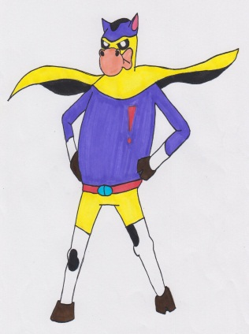
Cow time! Literacy Target
Check that you have spelt all the key words correctly.
Take the time to check over the rest of your work for any other spelling mistakes.
Ask for a dictionary or use the internet to check over any words that you are not sure are correct.

Slide 5
Aristotle (384 – 322 BC)
Unlike his teacher, Plato, Aristotle believed that the world could be explained by physical observation.
This approach of using the five senses, cataloguing and categorising, is the foundation of scientific enquiry and study.
The approach is known as empiricism.
Plato believed that we needed to look beyond the physical for a metaphysical explanation of the universe in the guise of the World of Forms. Aristotle refuted this.

Slide 6
Empiricism and Reason
For Aristotle, observation of the natural world was crucial. Aristotle was the founder of many of the sciences we recognise today: Physics, biology, psychology, meteorology and astronomy. He had an insatiable desire to understand the world as it makes itself available to our five senses, and to see if there were universal rules which governed processes and which we could understand.

Slide 7
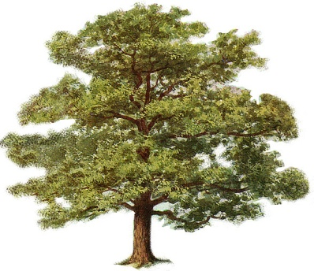
Four causes
Aristotle begins with the assumption that is present in all Greek philosophy, the notion of pre-existing matter.
He observed the world around him and noticed that it was in a state of constant flux, a movement from potentiality to actuality (like the acorn and the tree).
In his Metaphysics book XII, this movement from potentiality to actuality lead Aristotle to the conclusion that there are four stages in causation.

Slide 8
Key word Match up!
is when something contains the ingredients to become something else.
Empirical
Potentiality
is when an object fulfils its potential and becomes something else.
Actuality
is the word used to describe a view that is based on observable evidence that you can study. They believe that only truth claims based on evidence are meaningful.

Slide 9
The four causes
Read through the notes and select four sentences that summarise each of the four causes.
1)
2)
3)
4)
Stretch yourself:
Read Aristotle’s Metaphysics and pick out useful quotes.

Slide 10
What are the four cause?
Move around the room to find out what each of the four causes is…
Material Cause
Efficient cause
Formal cause
Final cause
Top Philosopher:
What do you think Aristotle says the final cause of human being is?
Write an explanation in your notes!
Stretch yourself:
Compare and contrast Plato and Aristotle.
Write down the similarities and differences on the back of your sheet.

Slide 11
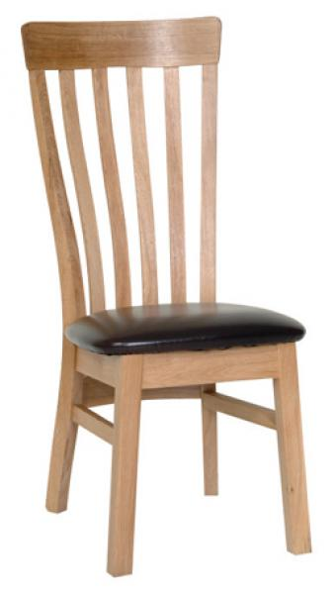
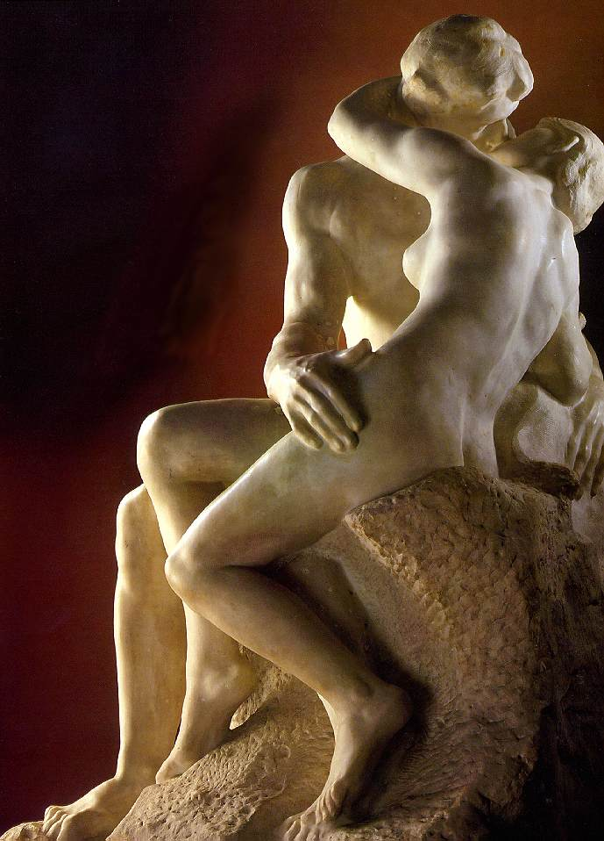
In pairs, explain the four causes of the objects!

Slide 12
Four causes diagram!
1) Material | 2) efficient
3)formal | 4) final
Stretch yourself: Find 5 facts about Aristotle’s Prime Mover.

Slide 13
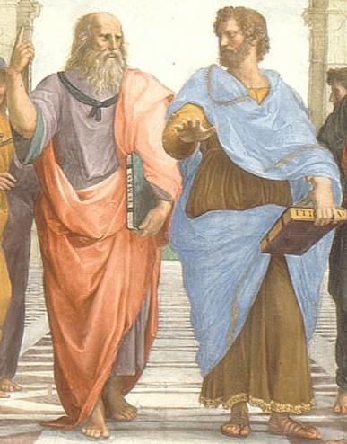
What was the difference between Plato and Aristotle?
Use the picture as a clue!

Slide 14
Learning Outcomes
Learning outcome 1:
To be able to describe the relationship between
Plato and Aristotle.
Learning outcome 2:
To be able to explain Aristotle's material,
efficient, formal and final cause.

Slide 15
The material cause:
‘the ultimate substratum of matter consists of the elements from which all particular things arise. Matter is the possibility of form. Matter has the potential to form.’
His first cause, the material, explained what the object or thing being described was made from. Aristotle used the example of a marble sculpture. Marble in this case would be the material cause. However, objects can have more than one material cause. Take for example my laptop. It is made of wires, plastic, alloys and other materials. These things become the material cause of my laptop

Slide 17
His second cause was the efficient cause. In Aristotle’s sculpture idea this was the way in which the marble was moved from its state of potentiality to becoming the actual marble statue. A chisel and sculptor primarily but also a cloth or water perhaps in order to change the material into the shape required. My laptop’s efficient cause may vary from machines and people to plastic moulds and screwdrivers.
The efficient cause:
‘the source of the movement of particular things accounts for the generation or the coming to be and the passing away of those particular things. The efficient factor is what is ordinarily meant by the contemporary use of the term "cause." Although change is the actualization of potential, actuality precedes potentiality in that something actual "causes" potentiality to reach another form.’

Slide 19
The formal cause: ‘the essence or the form or pattern of particular things. Form is the actuality of matter – the matter has gone from be in potential to its actual form’. WHAT IT IS – IT’S ACTUAL FORM.
The third cause takes the formal shape of the object. It is what we recognise as the thing we are looking at, the statue of David or the laptop itself for example. We can categorise things that we see this way. For Aristotle this is where the ‘form’ that Plato wishes to speak of resides. At this point in the change of causes we have reach an actualisation of the material cause through the efficient cause to arrive at the formal cause of the object.

Slide 21
The final cause: ‘The purpose of a thing accounts for the end or the good of a thing—what it's for. The development of natural processes move to completion—what a thing is designed to achieve or do. The internal design of things is part of the ordinary action of natural factors.’
Lastly in terms of his understanding of causation, the final cause of a thing or object was its purpose (telos). The purpose of the statue is aesthetic in that it is admired; the purpose of my laptop is to help me do my job well. This is perhaps the most important of all the causes. Yet his understanding does not end here. Once something has achieved a state of actuality it is also in a state of potentiality. Take ‘whiteness’ again. Once my shirt becomes clean and so ‘white’ it has the potential to become mucky and so ‘not white’ anymore. In this sense we can see that Aristotle saw that the universe was moving constantly between ‘potentiality’ to ‘actuality’ back to ‘potentiality’ once again. This idea required Aristotle to explain things further still because in order for this theory to work it must explain everything in the universe, including the universe itself.

