Slide 1
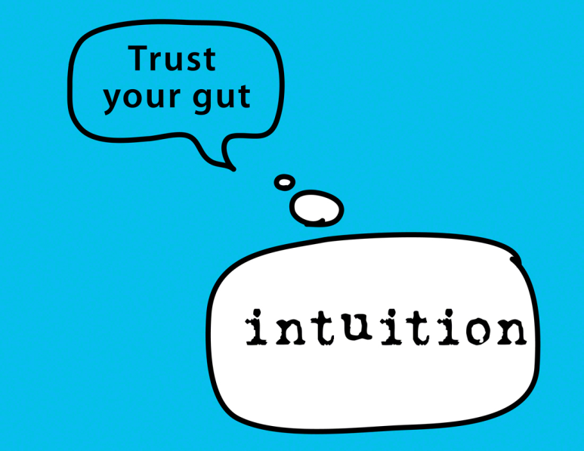
Think, Pair, Share
A: What is your intuition?
B: Is intuition something we should rely on?
A: Give an example to illustrate how we might use intuition in an ethical dilemma.
B: Give an example to illustrate how we might use intuition in an ethical dilemma.

Slide 2
Intuitionism

Slide 3
Learning Outcomes
To be able to explain the general ethical theory of Intuitionism.
To be able to analysis the different views of G.E Moore, W.D Ross and H.A Prichard.
To be able to evaluate the strengths and weaknesses of intuitionism.

Slide 4
Intuitionism (Cognitive)
Ethical Intuitionism is an absolutist and realist theory. This approach to ethics was first put forward in the early 20th century by the English philosophers W.D Ross (1877-1971) and G.E Moore (1873-1958). Intuitionists believe that moral norms have an objective existence that is independent of human experience. Morality is intuitive.

Slide 5
G.E Moore
Research Nietzsche’s criticisms of G.E Moore. What did he mean by the term ‘ethically colour blind’?
Right acts are those that produce the most good BUT goodness cannot be defined.
We cannot use our senses but we can use our moral intuition. We recognise goodness when we see it – ‘a simple notion’.
According to Intuitionists, when we say something is ‘good’ or ‘bad’ we are referring to properties that we cannot define. However we intuitively know what they mean.
Moore, writing in his Principia Ethica, sums it up in this way:
‘We know what yellow is and can recognise it whenever it is seen, but we cannot actually define yellow. In the same way we know what good is. But we cannot actually define it...’

Slide 6
Think, Pair, Share
In the same way you do not have to experience a killing to know that ‘Murder is wrong’. A moral norm such as ‘you shall not kill’ is determined without reference to any murders. The starting point is self evident.
What is the difference between the way intuitionism and Ethical Naturalism explain the phrase ‘Do not Murder’.
Discuss in pairs.
According to ethical naturalism, the statement can be verified by observing the act of murder and its consequences. For intuitionism, no such analysis is need; we know murder is bad through our intuition.

Slide 7
W. D. Ross: Prima Facie
Can you find and research W.D Ross’ 7 prima facie principles?
List them in your notes with an explanation of the meaning:
1)
2)
3)
4)
5)
6)
7)
Intuitionists believe that there are foundation moral principles from which moral laws develop.
Ross called these prima facie (at first appearance), meaning that on the face of it they are evidentially true.
They are:
Beneficence
Faithfulness in relationships
Gratitude for favours done to you.
Justice
Non-maleficence
Promise keeping
Self-improvement
These core values are self-evident.
If these conflict, follow the one we think is right in that situation. However, he doesn’t say how we decide this.

Slide 8
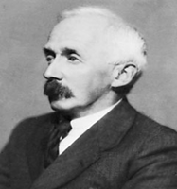
Intuitionism - Cognitive
H.A Prichard
No definition can be given to the word ‘ought’ however everyone can recognise when we ought to do a certain action.
Two types of thinking – 1) reason (looks at the facts in a situation) and 2) intuition (decides what to do).
However, due to the fact we have different morals to each other, it is not always appropriate to use intuition to prove intrinsic goodness of any action. Only the obligation in the situation.
People’s morals differed as some people have clear intuitions than others.

Slide 9
Intuitionism in more detail…
Read the extract and make a note of 5 key piece of information from it.
1)
2)
3)
4)
5)
Stretch yourself:
Research and find what Henry Sidgwick says about what our moral judgement is based on.

Slide 10
Evaluating Intuitionism
Read through the arguments and sort them into strengths and weaknesses of the theory.
Stretch yourself:
Explain in your own words the differences between intuitionism and naturalism.

Slide 11
Opinion Line: ‘Intuitionism is a better way to discover what is good than naturalism is’
Read the Statement –
Think carefully and silently for 1 minute – what do you think and feel about this and why?
Post-it:
Take your post-it note and clearly write your view with a reason for it. Try not to be vague about WHY you feel how you do.
Stick your opinion to where you feel it best belongs on the opinion line at the front of our classroom.

