Slide 1
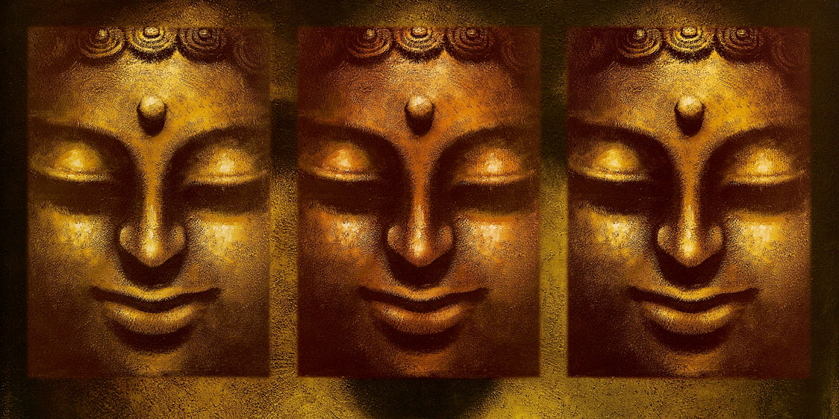
The development of Mahayana Buddhism

Slide 2
The bodhisattva ideal and its significance
Including:
Details of the Bodhisattva vow and way
The six paramitas (perfections) and their significance
Comparison with the Theravada arhat
Key bodhisattvas and what they represent, including:
-Avalokiteśvara
-Manjusri
-Maitreya

Slide 3
The Bodhisattva vow
The Bodhisattva Vow is as follows: “The number of living beings is endless: I vow to save them all. The amount of suffering in the world is infinite: I vow to end it all. The number of dharmas in the world is beyond measure: I vow to learn them all. The Buddha-Way is unsurpassable: I vow to accomplish it.”
A Bodhisattva is someone who sees their own enlightenment as being bound up with the enlightenment of all beings
Out of compassion, they remain in the cycle of samsara in order to help others achieve enlightenment as well
The ultimate goal for Mahayana Buddhists is to become Bodhisattvas
Bodhisattvas combine being compassionate with being wise – Mahayana Buddhists believe that the original message of the Buddha’s teachings to his followers was to ‘go forth for the welfare of the many’.

Slide 4
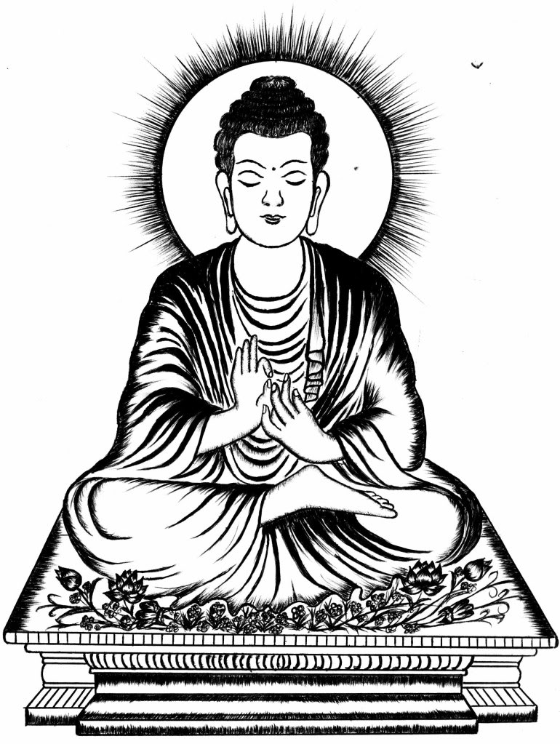
“The Buddha-Way is unsurpassable: I vow to accomplish it.”
But How? The Six Pāramitās
To become a Buddha, a bodhisattva has to practise six perfections
Six perfections are virtues that someone must have in order to be a complete moral being. Buddhists use meditation and good actions to develop them.

Slide 5
Becoming a Bodhisattva – introduction to the 6 perfections
A person becomes a Bodhisattva by perfecting certain attributes in their lives. There are six of these that Mahayana Buddhists focus on and are called the six perfections:
Generosity – to be charitable and generous in all that is done
Morality – to live with good morals and ethical behaviour
Patience – to practise being patient in all things
Energy – to cultivate the energy and perseverance needed to keep going even when things get difficult (resilience)
Meditation – to develop concentration and awareness
Wisdom – to obtain wisdom and understanding
Mahayana Buddhists believe there are earthly and transcendent Bodhisattvas – the ‘earthly’ ones continue to be reborn and live on Earth, while the ‘transcendent’ ones remain as spiritual or mythical beings. Mahayana Buddhists pray to these Bodhisattvas in times of need

Slide 6
The 6 perfections or paramitas
The Six Perfections, or paramitas, are guides for Mahayana Buddhist practice. They are virtues to be cultivated to strengthen practice and bring one to enlightenment.
The Six Perfections describe the true nature of an enlightened being, which is to say they are our own true nature. If they don't seem to be our true nature, it is because the perfections are obscured by our delusion, anger, greed, and fear. By cultivating these perfections we bring this true nature into expression.
Each of the Six Perfections supports the other five, but the order of the perfections is significant also. For example, the first three perfections -- generosity, morality, and patience -- are virtuous practices for anyone.
The remaining three -- energy or zeal, meditation, and wisdom -- are more specifically about spiritual practice.

Slide 7
For each of The Six Paramitas use the information sheets to add further detail.
Do you have a Buddha-nature?
Complete the agree/disagree tasks on the back if you have a bit of extra time.

Slide 8
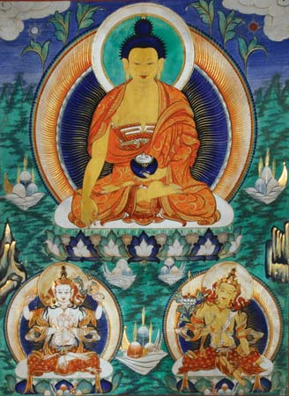
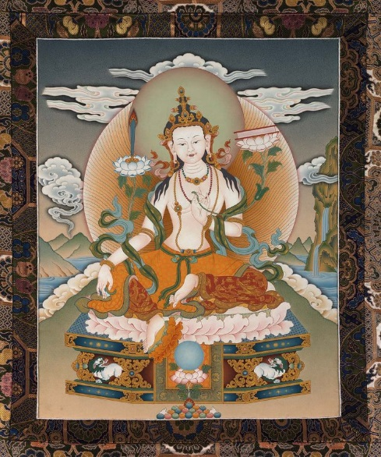
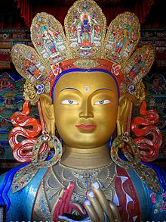
Key Bodhisattvas
Avalokiteśvara
Swot up on your assigned Bodhisattva
Bring your expertise of that Bodhisattva to a group
Use your shared expertise to get the answers to the questions
Extension
Read this article on the Western adoption of Maitreya.
Mañjuśrī
Maitreya

Slide 9
Compare and contrast the arhat with the bodhisattva
Make sure you have your blank venn diagram ready

Slide 10
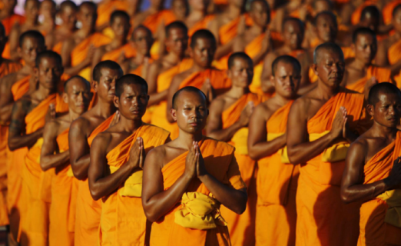
Arhat:
Where have you heard this term before?
What do you already know?
Arhats in Theravada Buddhism
It is not possible to become a Buddha/Bodhisattva: these terms refer to the journey of the Historical Buddha and his previous incarnations.
Theravada Buddhists aim to become saints: known as Arhats/Arahants.
This process has four stages, which involve being liberated from 10 fetters (bonds/limitations/shackles)

Slide 11
A Stream-enterer (Sotapanna) is free from:
1. Identity view
2. Attachment to rites and rituals
3. Doubt about the teachings They are at the beginning of their journey.
A Once-returner (Sakadagami) has greatly reduced:
4. Sensual desire
5. Ill will They will be reborn just one more time.
A Non-returner (Anāgāmi) is free from:
4. Sensual desire
5. Ill will
They will be reborn only in a heavenly realm.
An Arhat/Arahant is free from all of the five lower fetters and the five higher fetters, which are: 6. Craving for prosperity in the material world
7. Craving for existence in the ideal world (heaven) [very different to Pure Land Buddhism]
8. Conceit
9. Restlessness
10. Ignorance
They have achieved nirvana and so they will not be reborn.
Arhats in Theravada Buddhism
It is not possible to become a Buddha/Bodhisattva: these terms refer to the journey of the Historical Buddha and his previous incarnations.
Theravada Buddhists aim to become saints: known as Arhats/Arahants.
This process has four stages, which involve being liberated from 10 fetters (bonds/limitations/shackles)

Slide 12
Compare and contrast the arhat with the bodhisattva
Use the following to help you complete a venn diagram comparing the two:
Arhats vs Bodhisattvas table
Rupert Gethin p.229-231
Powerpoint print out
Your learning so far

Slide 13
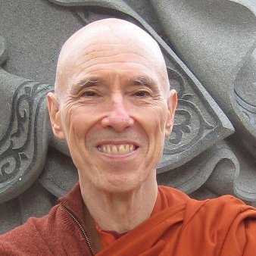
Optional extra reading to make you smarter (guaranteed)
Ven. Bikkhu Bodhi, in his book Arahants, Bodhisattvas and Buddhas states:
“The arahant ideal and the bodhisattva ideal are often considered the respective guiding ideals of Theravāda Buddhism and Mahāyāna Buddhism. This assumption is not entirely correct, for the Theravāda tradition has absorbed the bodhisattva ideal into its framework and thus recognizes the validity of both arahantship and Buddhahood as objects of aspiration.”
Bhikku Bodhi is an ordained Theravada monk.

Slide 14
Optional extra reading to make you smarter (guaranteed)
Ven. Bikkhu Bodhi, in his book Arahants, Bodhisattvas and Buddhas states:
“[The Buddha’s] uncanny ability to reach deep into the hearts of those who came to him for guidance and teach them in the unique way suitable for their characters and situations…This ability betokens a depth of compassion, a spirit of selfless service, that harmonizes better with the later concept of the bodhisattva than with the canonical concept of the arahant”
The arahant ideal and the bodhisattva ideal are often considered the respective guiding ideals of Theravāda Buddhism and Mahāyāna Buddhism. This assumption is not entirely correct, for the Theravāda tradition has absorbed the bodhisattva ideal into its framework and thus recognizes the validity of both arahantship and Buddhahood as objects of aspiration.
Bhikku Bodhi is an ordained Theravada monk.

Slide 15
What to do with this reading
These are only suggestions, but they may help you to keep your focus rather than get bogged down with the reading and endless, undirected note-taking.
Don’t make notes at all; just read and absorb.
Use the chapter headings to guide you, and just make 3-5 bullet pointed notes under each.
As you go, create questions that could have relatively short answers. On a separate sheet, record the answers. Then you can use these to revise from, or check your understanding with, later.
Pull out from the whole reading just 10-12 quotes that you are fairly short but that you know you could use to make a point. To do this most easily, collect 1-2 quotes from each chapter.
Use the reading to answer the question, To what extent do the life and teachings of the Buddha support the Bodhisattva path? (this would be difficult, but worthwhile)

Slide 16
1. An Arhat / Arahant 2. A Bodhisattva 3. Buddhahood 4. A celestial Buddha 5. The Pure Land
6. Destiny
A. A fully awakened one holds this rank. One who has attained perfect Nibanna and wishes to save all living beings.
B. The events that will necessarily happen to a particular person or thing in the future. Note: Buddhists do not believe in fate.
C. An awakened one who has transcended this world and inhabits a realm outside of samsara (outside of ‘The wheel of Life’)
D. A saint of one of the highest ranks. for people far advanced along the path of Enlightenment, but who may not have reached full Buddhahood
E. The realm of the celestial Buddha of infinite love known as ‘Amitabha Buddha’.
A quick quiz! Which number links with which letter?
F. One who, out of compassion, has taken The Bodhisattva Vow: to attain enlightenment for the sake of all living beings.

Slide 17
1. An Arhat / Arahant 2. A Bodhisattva 3. Buddhahood 4. A celestial Buddha 5. The Pure Land
6. Destiny
D. A saint of one of the highest ranks. for people far advanced along the path of Enlightenment, but who may not have reached full Buddhahood
F. One who, out of compassion, has taken The Bodhisattva Vow: to attain enlightenment for the sake of all living beings.
A. A fully awakened one holds this rank. One who has attained perfect Nibanna and wishes to save all living beings.
C. An awakened one who has transcended this world and inhabits a realm outside of samsara (outside of ‘The wheel of Life’)
E. The realm of the celestial Buddha of infinite love known as ‘Amitabha Buddha’.
B. The events that will necessarily happen to a particular person or thing in the future. Note: Buddhists do not believe in fate.

Slide 18
The trikaya (three bodies of the Buddha)
Understanding of the nature and significance of:
The truth body
The heavenly body
The earthly body

Slide 19
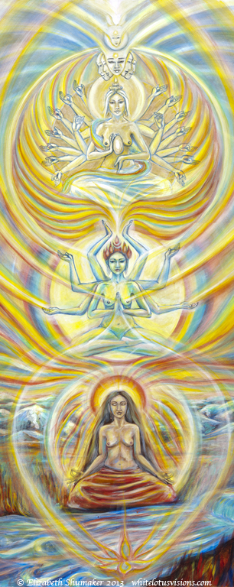
The Trikaya
Mahayana sees the Buddha is existing in three separate states
This allows M. Buddhists to see the Buddha as a historical, earthly figure, but also as an elevated spiritual (bordering on divine?) figure
The doctrine provides a very supernatural account of the figure of the Buddha, which Th rejects.

Slide 20
Trikaya Task
Use the information sheet taken from thoughtco to label this diagram- just brief explanations will do.
The images match the order of the explanations.
You will find further information in this reading from Dominique Side.
Remember to highlight key terms and use your Mahayana key terms to help you.

Slide 21
The development of Mahayana Buddhism
A general introduction, including:
Possible reasons for its emergence
The context of its emergence
The idea of upaya (skilful means) and how this is applied to the original teachings of Siddhartha

Slide 22
Mahayana Buddhism – an introduction
Mahayana means ‘The Great Vehicle’
From a Mahayana viewpoint, ‘Hinayana’ or Theravada Buddhism has its limitations.
Theravada Buddhists would respond by stating they have the original, pure teaching of the Buddha, with which Mahayana Buddhists have tampered.
Mahayana Buddhism is not a single group but a collection of Buddhist traditions: Zen Buddhism, Pure Land Buddhism, and Tibetan Buddhism are all forms of Mahayana Buddhism.
Most Buddhists from China, Japan, Tibet, Korea, Mongolia, Vietnam, Nepal, Sikkim and Bhutan refer to themselves as Mahayana Buddhists.

Slide 23
The development of Mahayana Buddhism
Context of the emergence of the Mahayana:
no clear founder or point of origin
emergence between 150BCE and 100CE of various groups calling themselves ‘Mahayana’
2nd Buddhism Council held because of debates about orthodoxy
4th Buddhist Council not recognised by the Mahayana
However, there were traditionally many schools, and we have evidence of monks from the two living side by side etc.

Slide 24
The development of Mahayana Buddhism
Some suggested reasons for the emergence:
revolt of the laity against the elitism of the monastics; a path all can tread
disagreements over practice: can the Sangha adapt to new times and places?
Conze suggests it might be due to influence by non-Indian elements
‘back to basics’ movement: emphasis on compassion as the Buddha’s motivation and a reimagining of no-self as sunyata
doctrinal differences: new literature, trikaya and new cosmology, bodhisattva path, sunyata

Slide 25
‘Upaya’ or skilful means
Upaya (skilful means) and its implications, in terms of responses to other religious truth claims and diversity within Buddhism:
use of methods or techniques that fit the situation; these may not be ultimately ‘true’ in the highest sense, but may be an expedient practice to perform or view to hold; may facilitate higher understanding further on
Parable of the Burning House:
using the expedient means of white lies to rescue children from a burning building
this parable describes three carts (yana) drawn by goats, deer, and oxen, representing the Buddhist paths: the arhat path (sravakayana), solitary path (pratyekabuddhayana), and the Bodhisattva path (Mahayana)

Slide 26
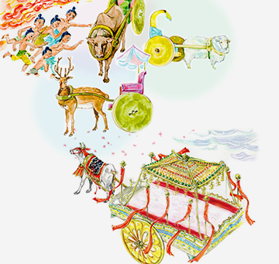
Parable of the Burning House
Read the parable and consider the following questions…

Slide 27
The Parable of the Burning House
What is your interpretation of this sutra? Who is represented by the Father? Who are the children? What does the burning house represent?
In this parable the father, of course, is the Buddha and sentient beings are the children trapped in the burning house. The Burning House represents the world burning with the fires of old age, sickness and death. The teachings of the Buddha are like the father getting the boys to leave their pleasures for a greater pleasure, Nirvana. A further interpretation is to see the goat, deer, and ox carts as representing the early teachings of Buddhism, as the teachings of Hinayana Buddhism (the Mahayana term for the Buddhism that preceded it), and the cart pulled by white bullocks to 'The Lotus Sutra' which, when followed, leads to Buddhahood.

Slide 28
‘Upaya’ applied to the original teachings of the Buddha
How upaya might be applied to the original teachings of
Siddhartha:
idea that different versions or approaches to the teachings might be examples of upaya and context dependent
separation of the 5000 (those who left during the Lotus Sutra)
- upaya used as a polemic device [a strong attack or argument against something] against previous
traditions; the Buddha did not reveal to them the ultimate truth, as they were not ready

Slide 29
Using the Lotus Sutra for study
The above to be studied with reference to the following parables from the Lotus Sutra:
The burning house (chapter 3)
The magic city (Chapter 7)
The hidden gem (chapter 8)

Slide 30
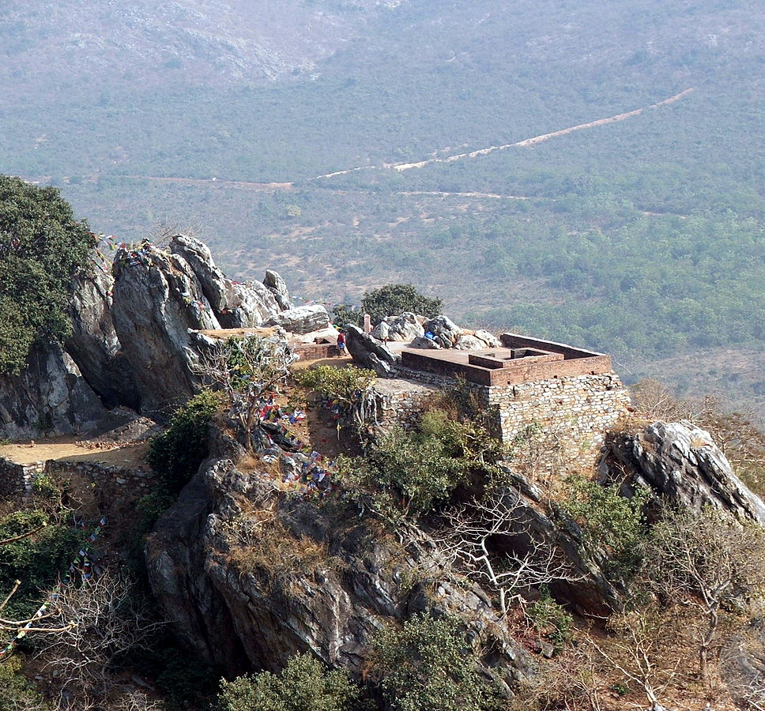
The Lotus Sutra
The Lotus Sutra consists of a series of lectures by Shakyamuni Buddha given toward the end of his forty years of teaching.
The sutra is given by Gautama Buddha or Shakyamuni (as seen through the eyes of faith rather than seen as a human being) to a vast congregation of disciples and bodhisattvas at the Vulture Peak.
The Vulture Peak is said to be the Buddha’s favourite retreat and the scene for many of his discourses.

Slide 31
To the amazement of his audience, he puts forward the idea that beings are called not to be arhats but to be Buddhas.
“There are now here before me the sons and daughters of the Buddha, who are pure in all ways, wise, virtuous… I can announce to them that they shall become Buddhas, for the benefit and out of compassion for the world. The way in which you walk is the Bodhisattva way. By gradually practicing and learning all of you will become Buddhas.”

Slide 32
At the heart of the sutra are three major concepts of Mahayana Buddhism:
1. All beings can attain Perfect Enlightenment.
2. The Buddha energy/consciousness is eternal, having existed from the infinite past and appearing in many forms throughout the ages to guide and support people for the fulfilment of their lives.
3. The noblest form of Buddhist practice is the way of the Bodhisattvas, those who devote themselves to attaining enlightenment not only for themselves but for all beings.

Slide 33
The lotus flower is special because it is rooted in muddy water yet grows and opens to be a pure and beautiful flower.
This is true of humankind as well.
We have the capability to acknowledge our existence in this chaotic world and, by study and practice of the path, we can grow and blossom into compassionate human beings with perfect freedom of mind.

Slide 34
This announcement that “all of you shall become Buddhas” is so astounding, and so different from what is normally taken as the teaching of Gautama Buddha, that the Lotus Sutra has to explain why the Buddha did not give this teaching from the start.
The answer is in the concept of Upaya Kausalya (skilful means), whereby the Buddha gives people the teaching they are ready for, whatever they need at this particular stage of development.

Slide 35
The Lotus Sutra is also revealing upaya on the part of the Buddha.
For the sake of beings, he tells them the story about his birth, enlightenment and death, but in truth “it is many hundreds of thousands of myriads of aeons ago that I have awoken to full enlightenment” and “even today my lifespan has not ended”.
The birth, enlightenment and death was just a teaching device.
The Buddha pretended to pass away into nirvana, but in fact is still around, working to liberate all beings.
This links to the concept of Trikaya or the three body doctrine.
Why did the Buddha go through the motions of birth, enlightenment and passing into parinirvana?
Because otherwise beings would not have realised the urgency of getting on with the spiritual path, and would have been lazy about following the dharma, thinking that there was plenty of time.

Slide 36
The concept of Upaya in the Lotus Sutra puts all teaching under suspicion of only being provisional- how far should we take it literally?
Some have pointed out that the answer is in the Lotus Sutra itself, which presents itself as the final teaching of the Buddha.

Slide 37
Recap
What does the word Mahayana mean?
How long after the Buddha did the movement begin to emerge?
In what way can Mahayana be seen as a back to basics movement?
What is meant by upaya?
Retell the parable of the burning house and explain how it shows upaya
Where and where was the Lotus Sutra taught?
Name the other two parables from the Sutra that you have learnt about
Why is the lotus flower a useful tool for understanding Buddhism?
The Lotus Sutra teaches that the life story of the Buddha is an example of upaya. Why did the Buddha go through the motions of birth, enlightenment and passing into paranirvana?
What is the noblest form of Buddhist practice?

Slide 38
Issues for discussion:
The differences and similarities between the bodhisattva and the arhat/arahant and their paths
How the nature of the bodhisattva can be explained
The implications, in terms of responses to other religious truth claims and diversity within Buddhism, of the idea of upaya (skilful means)
The development in the understanding of ‘Buddha’ illustrated by the trikaya doctrine

Slide 39
Resources
Mahayana Buddhism: key terms
Gethin, R. (1998) The Foundations of Buddhism, OUP, Chapter 9 (photocopy)
Selected extracts from Ven. Bhikku Bodhi (2013), Arahants, Bodhisattvas and Buddhas, (Access to Insight) online edition [full reading also available]
Lotus Sutra, Chapter 2 and the three parables
Key bodhisattvas questions
The six paramitas worksheet
Arhats vs Bodhisattvas table (information from www.britannica.com) and blank venn diagram
Your trikaya notes/labelled picture

Slide 40
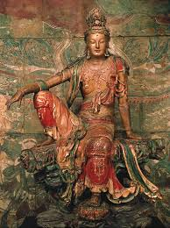
Mahayana Buddhism
Mahayana = Greater vehicle
Hinayana = Lesser Vehicle
The goal of Maha. is to become a Bodhisattva rather than an Arhat

Slide 41
Mahayana Buddhism
It started on India as an intellectual movement that wished to focus on the ideals of
The Bodhisattva
Shunyata

Slide 42
Mahayana Buddhism
As early as the Second Buddhist Coucil (100 years after the Buddha) there as a schism in the Sangha. Some of the issues were to do with the status of Arhats and so some of the Sangha may have felt that the Bodhisattva path was more worthwhile

Slide 43
Mahayana Buddhism
But it wasn’t until around 100 BCE that a distinct movement called Mahayana arose.
This is when the joint emphases became
The compassionate activity of the Bodhisattva
The Teachings on Emptiness
So, ‘Wisdom’ and ‘Compassion’ become the two ‘wings’ of Mahayana.

Slide 44
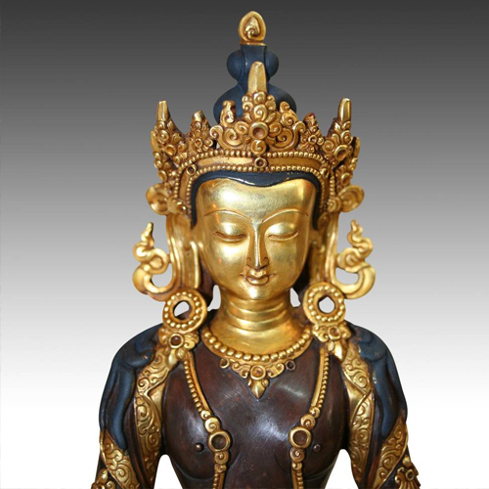
Bodhisattva
A bodhisattva = a being who has a genuine wish to become enlightened for the benefit of all sentient beings
Bodhisattvas are usually depicted wearing crowns whereas Arhats usually appear as monks and nuns

Slide 45
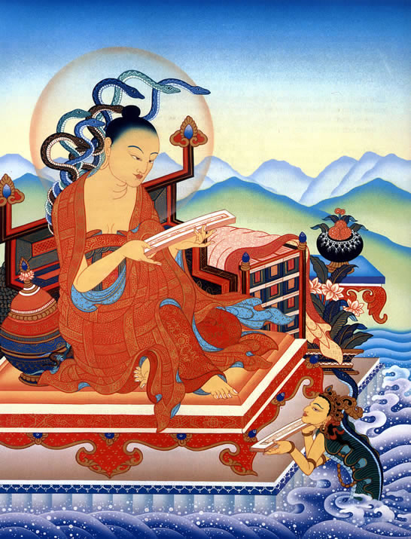
Nagarjuna
c. 2nd & 3rd Century CE
Nagarjuna is often regarded as the founder of the Mahayana tradition but is more likely to have been it's first prominent expounded rather than founder. Mahayana had become a distinct movement several centuries earlier

Slide 46
Semi - mythical figure
Nagarjuna gets his name from two sources.
Nag = The ‘Naga’ people who were a race of snake spirits who lived underground or in water. Nagarjuna received the ‘Prajnaparamita Sutras’ from them.
Arjuna = a legendary archer. Ie. Nagarjuna’s teachings are as straight as an arrow

Slide 47
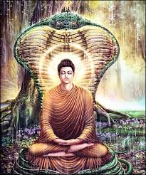
Semi - mythical figure
The Nagas
According to legend Nagarjuna started the Mahayana tradition when he visited the Naga people people in their subterranean world. There they conferred upon him the Prajnaparamita Sutras that the Buddha had entrusted to them. By teaching these Sutras Nagarjuna ‘turned the Wheel of Dharma’ a second time. He is sometimes regarded as a second Buddha by Mahayanists.
The Buddha being protected by a Naga. Such detail is common in Buddhist images

Slide 48
Madhyamaka Philosophy
Madhyamaka = ‘the Middle Way’
His claim is that he was simply reasserting the Buddha’s original teaching about Anātman (Anatta) and Dependent Origination.
The reason for this is that several Buddhist schools in Ancient India had begun to assert that some things do have inherent existence (svabhava). Nagarjuna wanted to refute this.

Slide 49
Śunyata
This is one of the central ideas behind Mahayana.
Shunyata = ‘Emptiness’ and refers to the idea that all things are ‘empty’ of inherent existence.
In other words, all things are ‘Dependently Originated’ and nothing has independent existence from anything else.
‘Shunyata’ is a ‘via negativa’ way of asserting how we exist. Perhaps if the Buddha were around today he would say we are ‘full’ of dependent existence rather than ‘empty’ of independent existence.

Slide 50
Nagarjuna refutes the Hinayana
Hinayana = ‘lesser vehicle’ (hina literally means crappy) and was a rather polemical term to certain Indian Buddhist schools that rejected, amongst other things, the Shunyata teachings.
Eg. The Sarvastivada school (which no longer exists today) taught that certain ‘dharmas’ (moment of reality) exist inherently. Ie. Partless particles (atoms) and the skandhas exist inherently.

Slide 51
Nagarjuna refutes the Hinayana
So the enthusiasm with which Nagarjuna presents his philosophy is within the context of trying to disprove ‘lesser’ views.
The problem with the Hinayana view is that it cannot lead one to ‘full enlightenment’ (sammasambodhi ).
By realising the truth of the 5 skandhas you can achieve a high level of enlightenment and attain Nirvana as an ‘Arhat’, in spite of believing they exist inherently.
However, the goal of a Mahayanist is to become a ‘bodhisattva’ and then to become a fully enlightened Buddha (sammasambuddha)
Therefore, one needs to realise that not only are all things empty of ‘own being’ but also the skandhas they are made from are also empty of ‘own being’.

Slide 52
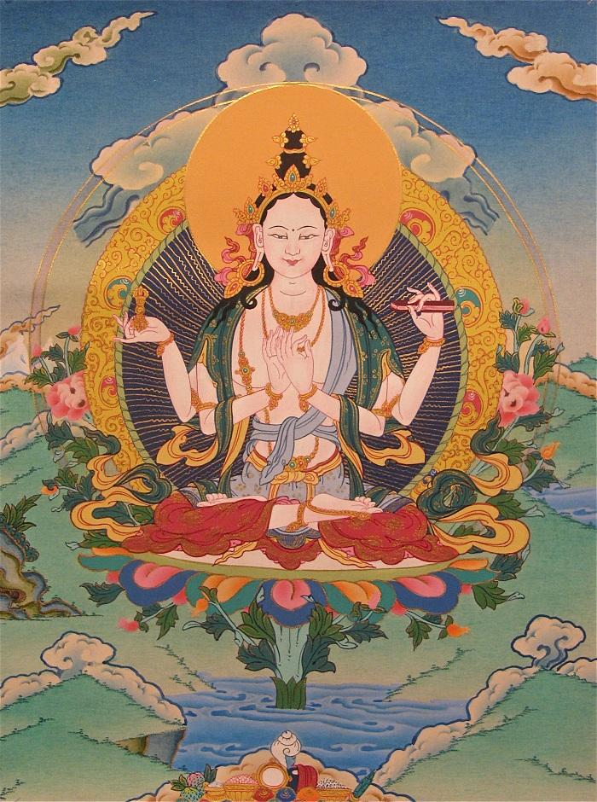
The Prajnaparamita literature
One of the main characteristics of Mahayana is the huge amount of Prajnaparamita Sutras (pronounced pragyaparamita).
They were written over many centuries in India and some of them are over 100,000 lines!
The main topic of these Sutras is the philosophy of Shunyata
The Heart Sutra is the most popular of all these sutras, partly because, perhaps, it’s really short, only 28 lines!
Prajnaparamita = ‘Perfection of Wisdom’
Prajnaparamita is also personified as a goddess of wisdom
Prajnaparamita, the goddess of wisdom, seen here holding the Heart Sutra

Slide 53
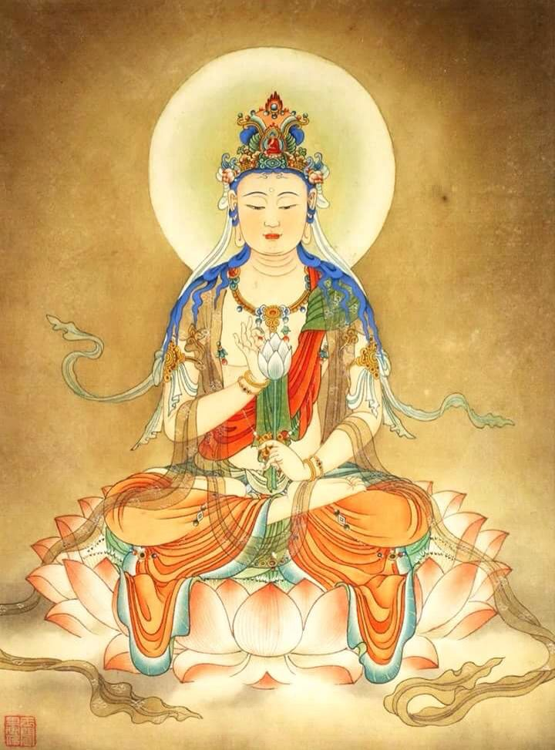
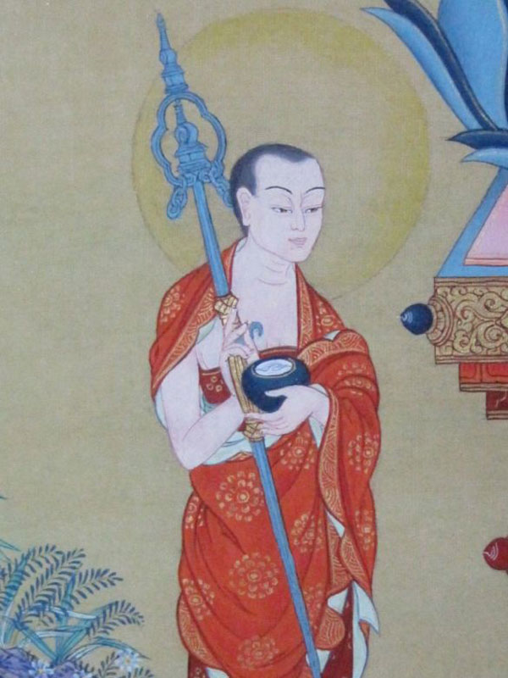
The Heart Sutra
The HS is a popular text because, apart from being really short, it gets right to the ‘heart’ of Mahayana philosophy.
In it we see the bodhisattva Avalokiteshvara explaining to the Arhat Shariputra the meaning of ‘Emptiness’.
“He beheld but five heaps (skandhas), and he saw that in their own-being they were empty.”
In other words, not only are we, and everything else, made up of the 5 skandhas but also the skandhas are made up of skandhas. This is the truth that lead Avalokiteshvara to full awakening.
“O Shariputra, form is emptiness and the very emptiness is form”
In other words, all things that exist are marked by emptiness of inherent existence. Therefore all things exist dependently, not independently.
Avalokiteshvara, above, teaches the Arhat Shariputra, left, what is truly needed to achieve full enlightenment.

Slide 54
The Two Truths
Conventional Reality
Ultimate Reality
Madhyamaka Philosophy is trying to assert that all things (dharmas) exist on two levels.
Conventionally we see things in an ordinary way and that allows us to function in an ordinary samsaric way. Ie. In a ‘conditioned’ way.
However, things (dharmas) actually exist in an ultimate, ‘empty’ way. Ie. all things are empty of inherent existence
So ordinary beings see things as having independent existence whereas a Buddha sees that all things are empty (Shunya)
Both of these views in themselves are not wrong. It is not wrong that you are looking at a screen right now but it is also not wrong that the screen is a mere concept that you are projecting in your mind

Slide 55
Why Madhyamaka?
The reason why Nagarjuna’s philosophy is called ‘The Middle Way’, apart from being an obvious reference to the Buddha’s original teachings, is because he wished to avoid the extremes of Nihilism and Eternalism which were being hotly debated in Ancient India at the time
Pudgalavada believed that persons had inherent existence
Saravastivada believed partless particles (atoms) had inherent existence
NB: these two schools no longer exist

Slide 56
The Emptiness of Emptiness
Nagarjuna wished to avoid giving a nihilistic impression
Since ‘Emptiness’ involves not finding the thing (dharma) when you examine it, it follows then that when you look for the emptiness of an object you fail to find something that is ‘empty’.
This is Nagarjuna’s pedagogical way of avoiding fixating on the notion that things do not existence.
Ultimately, it takes an enlightened mind to see things the way they are

Slide 57
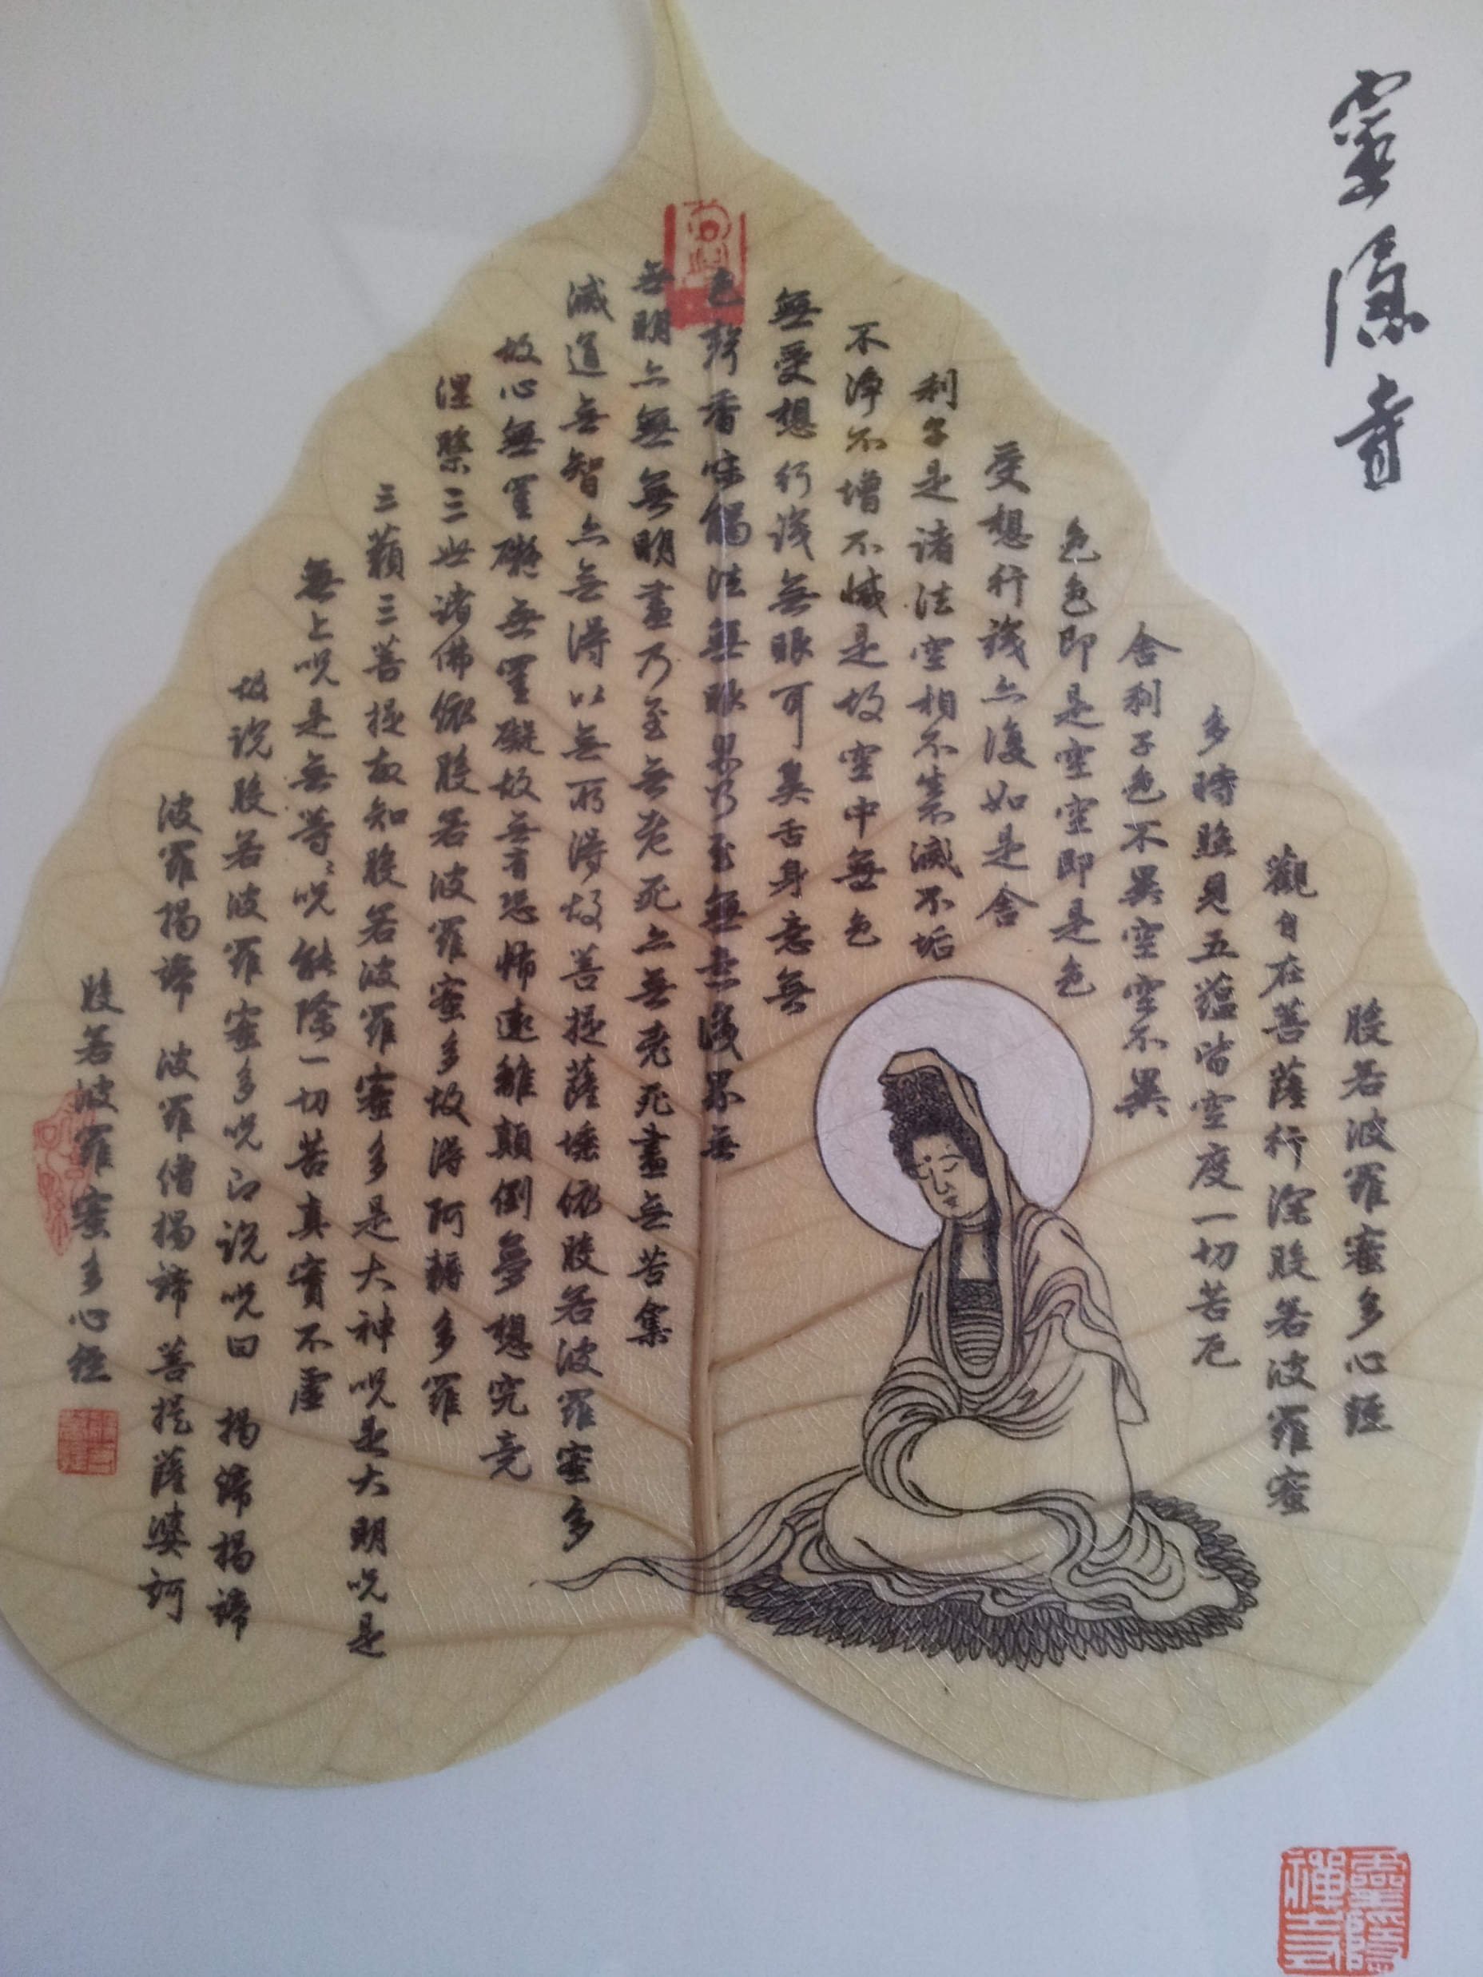
The Heart Sutra
“Form is Emptiness and Emptiness is Form”

Slide 58
The Enlightened Mind
What a Buddha sees is no different from what we see
They see the ultimate way of seeing an object but at the same time they see the conventional way of looking at it.
Because they have a liberated mind they are therefore ‘free’ to see all the possible ways that an object can be see. Ie they fully understand the impermanence and interdependence of all things
We, however, are still conditioned into see things in a Samsaric way. Ie. Our minds can’t help putting insubstantial labels onto things. Eg. The idea of a table does not come from the table itself but is merely the way our mind is karmically conditioned to see it. A Buddha is free from this narrow way of seeing things and is therefore free to see it in every possible way.

Slide 59
Samsara and Nirvana
A logical conclusion of giving up definitive ontological statements about existence is that Samsara and Nirvana are the same
When we look at this screen we see it exactly the same way that a Buddha does in their Nirvanic way. However, we go further and impose concepts onto it and come up with the notion of ‘screen’. A Buddha understands the conceptual way of looking at it but it is not his/her primary way of seeing it.
So, Samsara and Nirvana are just two different ways of looking at the same thing

