Slide 1
Rapid Recall!
Fill in the table with what you remember from memory!
Prizes for the first correctly filled in one!
1) What is constant flux? | 2) What is the name of Aristotle’s book? | 3) What are Aquinas’ first three ways?
4) What is the Principle of Sufficient reason? | 5) What is meant by the term ‘fallacy of composition’? | 6) What does the term ‘induction’ mean?

Slide 2
Learning Outcomes
To be able to explain, in detail, Philosopher’s views towards Free Will and Omniscience (Grade B).
To be able to evaluate the concept of God and moral responsibility (Grade A).
Aiming for an A*? Try to complete the ‘Top Philosopher’ tasks!

Slide 3
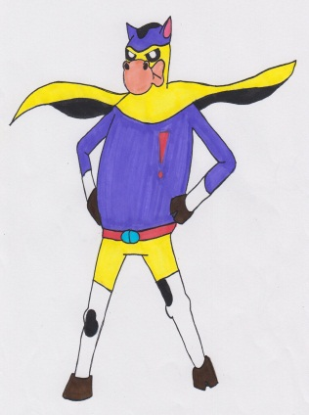
Cow time! Literacy Target
Check that you have spelt all the key words correctly.
Hosea
Boethius
Agape
Take the time to check over the rest of your work for any other spelling mistakes.
Ask for a dictionary or use the internet to check over any words that you are not sure are correct.

Slide 4
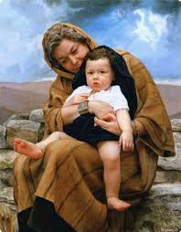
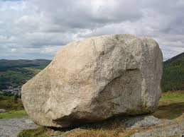
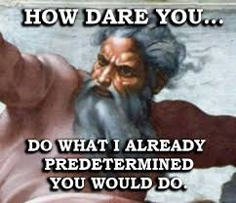
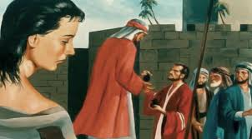
Think, Pair, Share
How does this link with what we are learning about?
a)
b)
c)
d)
e)
f)

Slide 5
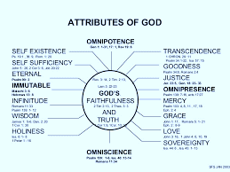
Attributes of God: Which Philosophers?
Work as a class to remember the names of the philosophers in this topic and their key ideas…
Anselm : The four-dimensionalist approach
Attributes of God: Which Philosophers?
Challenge task:
What synoptic links might we use?

Slide 6
Writing an introduction in ... S!
Work in pairs to write an Introduction paragraph to the essay:
‘God’s foreknowledge is incompatible with human free will’
You will each spend half of the time writing, when you are not writing you must be checking what the other person is writing against the checklist.
I will tell you when to swap the writer!
Checklist:
Explain the question in your own words.
Start one sentence with ‘However.’
Include at least two philosophers.
Use a range of technical terms such as presentist.
Stretch yourself:
Include an synoptic link as a little thinker.

Slide 7
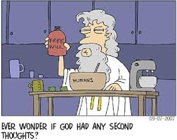
‘God’s foreknowledge is incompatible with human free will.’ Discuss.
Use the philosophers to complete the evaluation zig-zag…
For
Against
Stretch yourself:
To reach a better A02 grade you must always link your arguments. E.g. However Boethius would disagree with Swinburne because…..
For
Against
Top philosopher:
Include two synoptic links on your zig-zag!

Slide 8
We can do Conclusions!
‘God’s foreknowledge is incompatible with human free will’ Discuss.
(40 marks)
Let’s make sure your conclusion is well argued…
You must include in your arguments the following words and phrases.
However | Consequently | On the other hand | Therefore
Presentist | Eternal | Prayer | Choice
Moral Responsibility | Immutable | knowledge | Stretch yourself: Platonic

Slide 9
Mini White Boards
Describe one issue with God’s omniscience.
Explain one philosopher views on God’s Omniscience.
Explain one philosopher views on God’s Omniscience.
Explain your own opinion whether God experiences time like we do.

