Slide 1
The Cosmological argument
In pairs, order these statements:
Therefore, God exists.
Originally, Something must have caused the universe.
The 'first cause' is called God.
Nothing happens by itself, everything needs a cause

Slide 2
Introduction to the Cosmological Argument

Slide 3
Learning Outcomes
To be able to explain the Cosmological argument for the existence of God.
To begin to consider the strengths and weaknesses of the Cosmological argument.

Slide 4
Cosmological Argument = Causation (the same!)
St Thomas Aquinas
1.Nothing happens by itself, everything needs a cause
2. Something must have caused the universe.
3. The 'first cause' is called God.
Therefore, God exists.

Slide 5
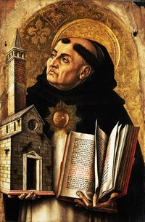
Who created it?
The Cosmological Argument stems back to Thomas Aquinas in the thirteenth century.
Aquinas was a famous Philosopher, Roman Catholic Priest, and later on a Saint.
He was inspired by Aristotle!

Slide 6
Premise of the Argument
A posteriori
Assumption:
The universe has not always been in existence and for it to come into being an eternal Prime Mover is necessary.
The universe needs an explanation and it can’t be explained without reference to causes outside of itself, the existence of a first cause is necessary! Cause and effect →
God, necessary being!

Slide 7
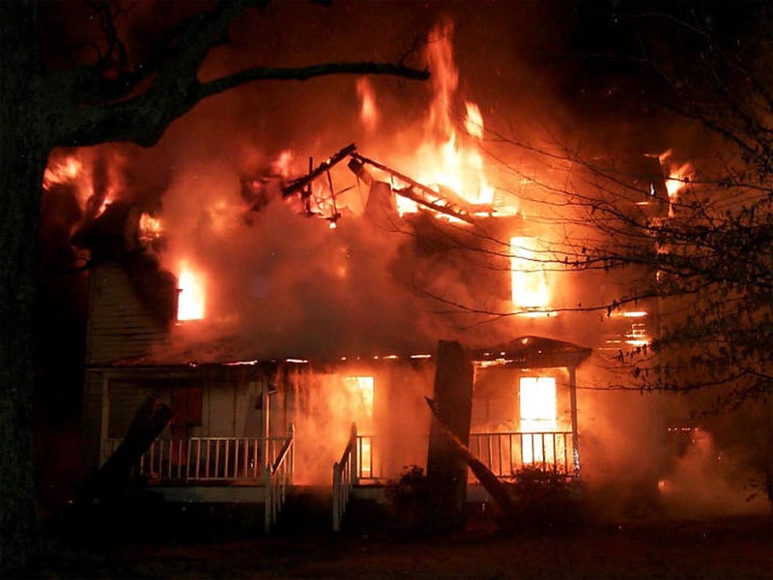
Example of Causation
Try to test the theory of causation!
Write a example in your book.
Stretch yourself:
Write an explanation of how this links to the cosmological argument.

Slide 8
Market place
Stage 1 – Preparation. Each group reads resource material and converts it into a poster however your poster can only have 10 key words on it.
Stage 2 – Market. Stall holder stays with poster, to explain poster to visiting researchers. Researchers go to find other information and make notes.
Stage 3 – Teaching. The researchers teach the stallholder and the others what they have found out.
Stretch yourself:
Create a list of criticisms of the cosmological argument. You may need to do some research!

Slide 9
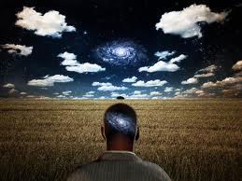
What is the Cosmological Argument trying to do?
Theists are people who believe in a God who has created and will
sustain the universe.
The Cosmological Argument attempts to show that God exists by
looking at how the universe (the cosmos) works.
This argument uses a posteriori and empirical evidence.
This means evidence from observation and use of senses. The
argument uses observation of cause and effect around us to try to
find the cause of the world and universe.

Slide 10
History of the Argument
Aquinas based his ideas on earlier work by Aristotle (Greek
Philosopher).
Aristotle sad that if we look at the world it is evident that all
things have a cause. He said their must be a Prime Mover
(first cause to have started this chain of events).
Aristotle’s Prime mover was not like the Christian idea of
God (caring/father figure) The Prime Mover was removed
from the world, it was distant and without human
characteristics. The Prime Mover attracted or caused
actions or events almost like a magnet.
Aquinas was Christian – he took Aristotle’s ideas and made
them more Christian.

Slide 11
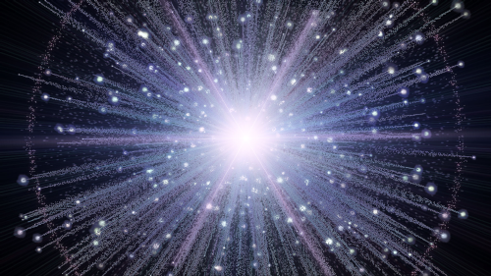
Thomas Aquinas said....
Aquinas said that you could use evidence in the world around
you To prove that God existed. The laws of nature works
according to the idea of cause and effect. All things change and
each change has a cause.
If we trace the causes of the universe back we must eventually
come to a First Cause. He said that if there is a point when
nothing existed – something separate must have been
responsible for the origins/creation of the universe.
Aquinas stated that the cause of the universe must be something
That was not caused by anything else (as nothing existed) and is
completely eternal (has no cause) that something he said was
God.
He said that God was a necessary
being.

Slide 12
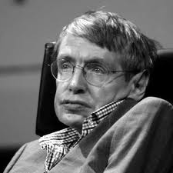
Support for the Cosmological Argument
Stephen Hawking said the question ‘What caused God?’ is silly. “It's like asking what is north of north.”
For something to have a cause it means that cause came before it in time.
It supports the view that God may have caused the Big Bang.
According to Hawking time did not exist before the universe.
This means anything that caused the universe to come about not only existed before it but was also outside of time, therefore, the concept of that needing a cause is immaterial.

Slide 13
What is the Cosmological Argument trying to do?
History of the Argument
Thomas Aquinas said....
Support for the Cosmological Argument
Criticisms of the cosmological argument

Slide 14
Criticisms of the cosmological argument
If the universe follows a cause and effect
pattern; what caused God?
Just because we can see a pattern on cause and
effect on Earth, it doesn't mean that this law has to
be true elsewhere. The universe could might have
no cause.
Even if the universe does have a cause it does
not have to be God.

Slide 15
How do these key terms apply to the Cosmological Argument?
Key Term | Why does this apply to the Cosmological argument?
Empirical-
A Posteriori -
Inductive-

Slide 16
Quiz time!

Slide 17
1) Who came up with the cosmological argument?

Slide 18
2) What is another name for the cosmological argument?

Slide 19
3) Explain the cosmological argument in four steps.

Slide 20
4) How was the prime mover different to Aquinas’ God?

Slide 21
5) What is one criticisms of the cosmological argument?

Slide 22
6) What is one of the strengths of the argument?

