Slide 1
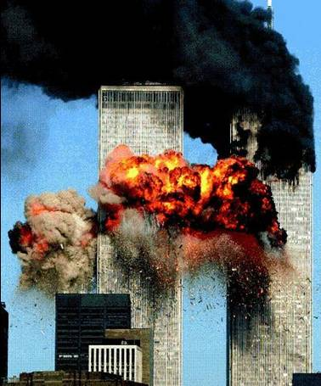
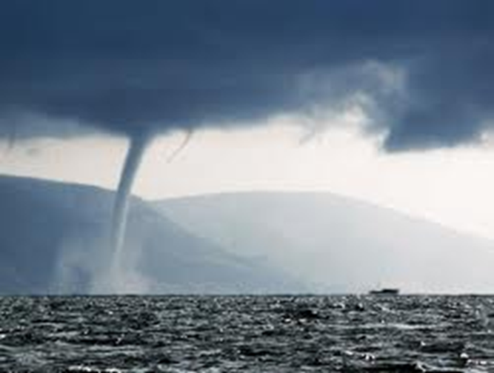
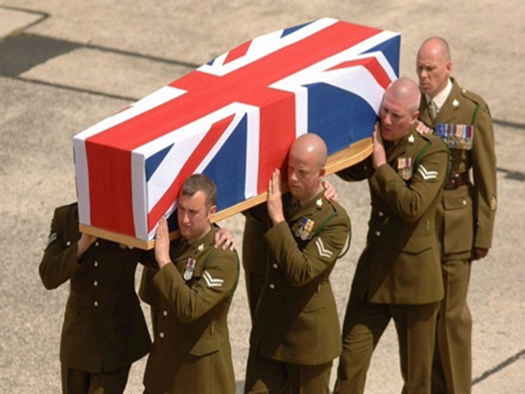
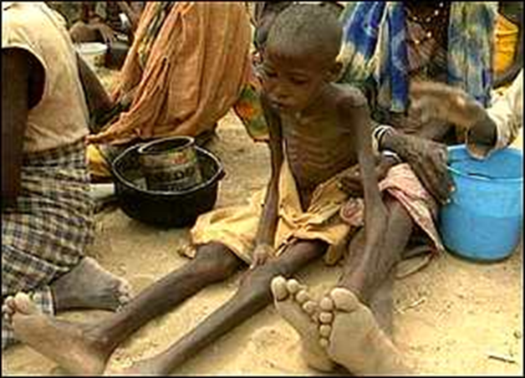
Moral or Natural evil?

Slide 2
The Problem of Evil

Slide 3
Learning Outcomes
To be able to describe the problem of evil.
To be able to explain Augustine’s theodicy.
To be able to evaluate Augustine’s theodicy.

Slide 4
Think, Pair, Share
What is he talking about?

Slide 5
The problem of evil
Omnipotent - If he is all powerful, why can’t he stop our suffering?
Augustine (354 AD) says: “either God cannot abolish evil, or He will not; if he cannot then He is not all-powerful; if He will not then He is not all-good”.
Omnibenevolent – If he is all loving, why does he not care about our suffering?
Omniscient – If he is all knowing, why does he know we suffer and does not do anything about it?
INCONSISTENT TRIAD The problem of evil can be viewed as an inconsistent triad: The three are logically inconsistent. If God is omnipotent, he is aware of the existing evil and suffering and knows how to put a stop to it. If God is omni-benevolent he will want to put a stop to it. Yet evil and suffering does exist.

Slide 6
Who is this a problem for?
The atheist David Hume argued that only three possibilities exist:
I. God is not omnipotent II. God is not omni-benevolent III. Evil does not exist
Since we have sufficient direct experience to support the existence of evil, if God exists he is either an impotent God or a malicious God; not the God of classical theism. Hume concluded that God therefore does not exist.
Antony Flew wrote that the biggest challenge to the believer is accepting that the existence of evil and suffering is a major problem that demands an adequate response.
The problem faced by monotheists demands a solution, not of qualification; in which the nature of God is arbitrarily changed to suit different circumstances – this concept of God ‘dies the death of a thousand qualifications,’ but by the rational justification of God’s right to allow evil and suffering to continue despite his ability to stop it.

Slide 7
Think, Pair, Share
A: Who was Epicurus?
B: What is the inconsistent Triad?
A: What does Hume say about evil?
B: What does Flew say religious believers do?

Slide 8
Theodicy
Etymology:
Greek… theos meaning ‘God’
dikaios meaning ‘justification’
An explanation of how a belief in a good, omnipotent
God can be maintained in the face of all the evil and
suffering in the world.

Slide 9
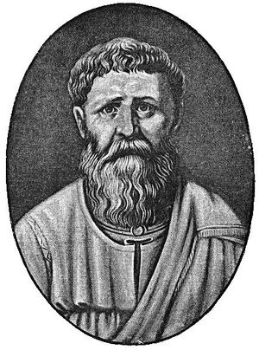
Augustine argued that the Bible shows that God is wholly good and that, according to Genesis 1, created a world perfectly good and free from defect, evil, and suffering: “God saw all that he had made, and it was very good” (Genesis 1:31).
1)God created all things good.
2)Evil is not good.
3)Therefore, God did not create evil.
1)God created all things good.
2)Evil is not good.
3)Therefore, evil is not a thing.

Slide 10
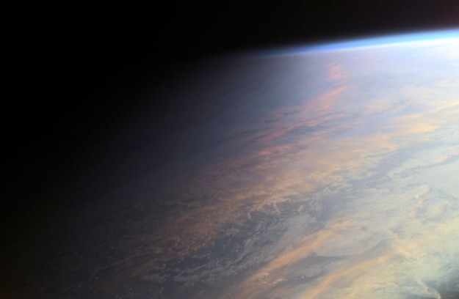
Evil is the PRIVATION of good, just as darkness is the absence of light.
Augustine said that evil came not from God, whom is all-good, but from those entites which had free will –angels and humans who turned their backs on God, the supreme good, and settled for lesser goods.
As a consequence, the state of perfection
was ruined by human SIN
and the delicate balance
of the world was
destroyed.

Slide 11
The types of evil
Moral Evil:
Natural Evil:
Derived from human free will and disobedience
Augustine reasoned that all humans are worthy of the punishment of evil [original sin] and suffering because we are “seminally present in the loins of Adam” (this means we all are from Adam as he is the father of man).
God has the right not to intervene and put a stop to evil and suffering, since he is a just God and we are worthy of punishment.
It is by his grace and infinite love however, that some of us, to whom he chooses to give grace, are able to accept his offer of salvation and eternal life in heaven.
Occurred because of the loss of order in nature due to the first sin which broke natural order, defined by Augustine as the ‘penal consequences of sin’

Slide 12
Think, Pair, Share
Why is Augustine’s Theodicy often referred to as the Soul-deciding theodicy?
Discuss in pairs.

Slide 13
Augustine’s Theodicy
Draw a flow diagram showing how Augustine’s Theodicy works or describes it.
Include key terms:
Privation, Fall of Man, Seminally, free will
Stretch yourself: How does
Romans 5:12-13 support Augustine?

Slide 14
‘Original sin explains the existence of suffering’ Discuss
Use the article to create a Zig-Zag with for and against reasons.
For
Against
Stretch yourself:
Add your own personal opinion and give reasons.
For
Against
Stretch yourself:
Use a key Colour code the logical, Scientific and Moral errors.

Slide 15
Do you think the concept of evil as privation works?
In pairs, using Augustine’s theodicy of evil as a privation rather than existing in its own right define the following:
Blindness
Earthquakes
Torture
Famine
Think, pair, share

Slide 16
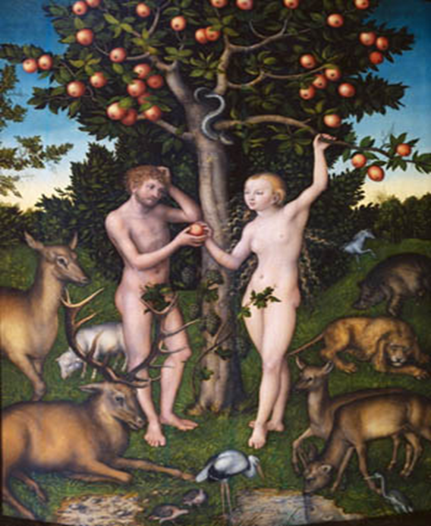
How does the bible Support his view?
Research the Fall of Man in Genesis 3.
Summarise the story in 5 sentences:
1)
2)
3)
4)
5)
Next steps:
Explain how this is a strength of Augustine’s theodicy?

