Slide 1
Think, Pair, Share
Watch the clip:
A: How does this make you feel?
B: What adjective would you use to describe how this makes you feel.
A: Where does this feeling come from?
B: How does the feeling of guilt effect people?

Slide 2
Conscience

Slide 3
Learning Outcomes
To be able describe the definition of conscience.
To be able to explain Aquinas’ concept of conscience.
To be able to evaluate Aquinas’ concept of conscience.

Slide 4
What is Conscience?
Find a definition of conscience and write it on the post it note...

Slide 5
What is Conscience?
The Oxford Dictionary of English defines conscience as:
A person’s moral sense of right and wrong, viewed as acting as a guide to one's behaviour.
As such it ought to be expected that conscience should play a decisive role in any moral decision. Yet, if you turn to recent books on moral philosophy, it becomes clear that conscience plays very little part in contemporary ethics. Its bad press is, in part, due to two factors. These are (a) that scholars have differed radically over what they mean by conscience and (b) the source of the conscience continues to be highly contested.

Slide 6
Conscience
A study of conscience crosses over between psychology and philosophy, because it raises questions about the origins and purpose of guilt feelings and feelings of shame in guiding human behaviour.
Would you ever act against the strong views of your peer group?
Would you ever disobey the voice of your conscience?
Can your conscience be mistaken?
All this presupposes that we are clear what conscience is. Is it a "voice" in our heads? Or a feeling in our gut? Is it a process of reasoning as Aquinas suggested, or something purely God-given, as Butler argued? Does our conscience come from an authority figure, as Fromm suggests, or from our upbringing, as Freud argued?

Slide 7
Conscience and God?
Although there is no Hebrew word for conscience, there is a Greek word ‘synderessi’ which appears in the Book of wisdom 17:11. In the New Testament, St Paul mentions conscience many times. He describes it as an awareness of what is good and bad, and observes that it can be weak and mistaken (1 Corinthians 8:10-12).
Christian writers in the first few centuries developed explanations of conscience and its role in moral decision –making. St Jerome (AD 147-240) saw conscience as the power to distinguish good from evil, writing ‘the spark of conscience...with that we discern that we sin’.

Slide 8
Conscience?
Research and draw an diagram to demonstrate Aquinas’ idea of conscience…
Complete the worksheet and find the meaning of the key words…
Write an A01 paragraph explaining Aquinas in your own words. Imagine the essay question is ‘It is always write to follow your conscience’ Discuss.
Read through the article and pick out 5 key pieces of information…
Create an evaluation zig-zag with arguments that support and criticise Aquinas' ideas. Use research and synoptic links to help you …
Try to link your points together so there is a thread through your zig-zag.

Slide 9
Key Philosophical ideas...
Key Word | What does it mean? | Where does it come from?
Synderesis
Conscientia
Prudence

Slide 10
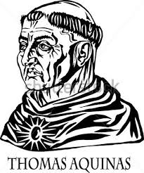
Aquinas’s ideas on Conscience...
Stretch yourself: What did Freud say Conscience was? Add it to your A01 paragraph as a little thinker criticism.
Top philosopher: Conscience may have helped abolish Slavery, find out how. Hint: Wilberforce.

Slide 11
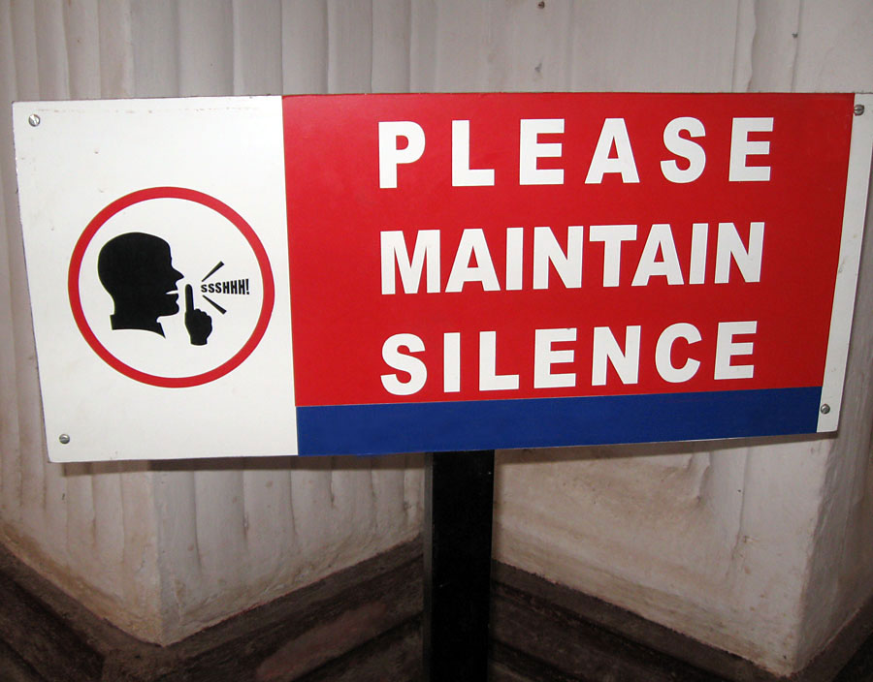
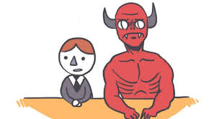
Silent debate!
Stretch yourself: Be a devil’s advocate and argue from a different point of view!

Slide 12
Aquinas: An example
Major Premise: All evil must be avoided
Minor Premise: Murder is evil
Conclusion: Murder must be avoided at all cost
…Therefore conscience can make decisions.
Synderesis Reason Conscientia
Where would these key words fit into this example?

Slide 13
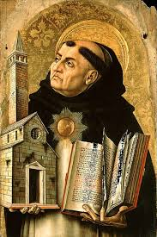
Homework:
Read through the article and explain what Aquinas meant by the:
Golden Mean
Recto Ratio

