Slide 1
Think, Pair, share
Person A attempted to solve a jigsaw blindfolded, Person B by sight. What do you think happened?
Is a complex thing like the universe more likely to be the product of design or chance?
Is the jigsaw task a fair analogy?

Slide 2
Paley’s Teleological Argument

Slide 3
Learning Outcomes
To be able to explain Paley’s teleological argument.
To be able to explain the two parts of Paley’s argument.

Slide 4
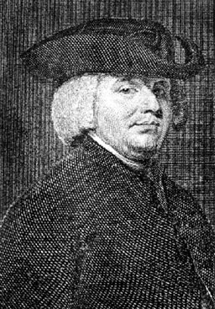
William Paley
English philosopher and clergyman, 1743-1805.
Reforming tendencies, ‘progressive’ in the Church and abolitionist (opposed to the slave trade).
Author of Natural Theology (1802), his work arguing for philosophical knowledge of God.

Slide 5
Natural Theology
The full title of Paley’s book is Natural Theology, or Evidences of the Existence and Attributes of the Deity collected from the Appearances of Nature
Look carefully at all the words of the full title.
What does this tell us about Paley’s intentions in writing the book?

Slide 6
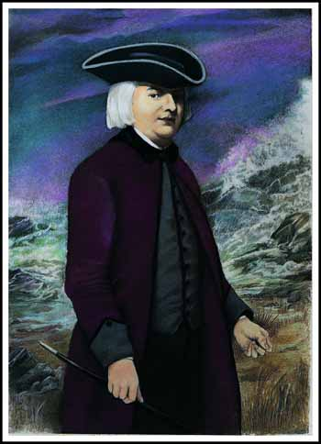
Chapter 2 of Natural Theology
In crossing a heath...
Complete the worksheet on Paley’s analogy.
What did mean?

Slide 7
William Paley (1743 -1805) - Design Argument
Paley says that the watch is complex.
It is made for a specific purpose or telos.
A watch cannot manufacture itself, so there must be a watchmaker.
Nature displays purpose (e.g. birds have wings to fly) and regularity (e.g. planets orbit in regular motion).
As with a watch, the attributes of purpose and regularity are suggestive of a designer.

Slide 8
Two parts to Paley’s argument
Paley has two parts to his argument:
Design qua Purpose (the universe was designed to fulfil a purpose).
Design qua Regularity (the universe behaves according to some order).

Slide 9
Two parts to Paley’s argument
Design qua Purpose
Design qua Regularity
Paley uses the example of the eye to illustrate that there is specific design in the universe. He says that it is obvious that the eye was designed with the specific purpose to see.
Thus, Paley argues for a Designing Creator – God.
The second part of Paley’s argument goes on to suggest that there is further evidence for a creator God in the regularity of the universe.
Paley considered the motion of the planets in our solar system. The relationships between the planets, and the effect of gravity could not have come about without a designing principle at work – that is God.
i.e. if gravity was slightly stronger or weaker, the universe may not exist today.

Slide 10
Think, Pair, Share
A: Explain what design qua Purpose means.
B: Explain what design qua Regularity means.
A: Give an example of Design qua Purpose.
B: Give an example of design qua Regularity.

Slide 11
Read through the notes on answer the following questions...
What does the word telos mean?
What does a posteriori mean?
Summarise the teleological argument in your own words.
Explain what design qua purpose means. Use an example.
What does Arthur Brown use as an example?
Stretch yourself:
Explain the similarities between Aquinas and Aristotle.

Slide 12
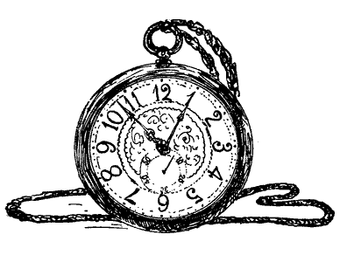
Complete this question in your books
Explain Paley’s teleological argument.
Stretch yourself: Include Aquinas’ views on the argument.

Slide 13
How do these key terms apply to the Teleological Argument?
Key Term | Why does this apply to the Teleological argument?
Empirical
A Posteriori
Inductive

Slide 14
What are the questions to these answers?
Telos
eye
William Paley
Intelligent
Watchmaker

