Slide 1
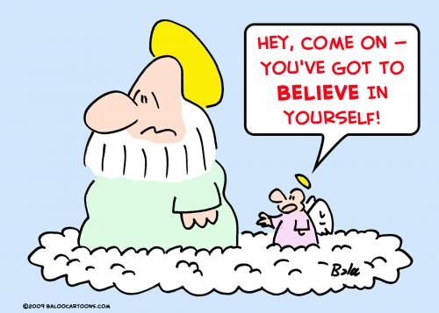
In pairs, write a list of all the reasons people believe in God.

Slide 2
The Ontological Argument

Slide 3
Learning Outcome
To be able to explain Anselm’s Ontological Argument.
To be able to begin to analyse Anselm’s Ontological Argument.

Slide 4
Key Terms
A priori - An argument that relies on knowledge gained from reasoning.
A posteriori - An argument that relies on knowledge gained from experience and the sense.
Deductive – where the arguments states that the conclusion is guaranteed to be correct if the premises are true.
Inductive – where the arguments states that the conclusion is only probable, not certain.
Analytic- A statement that is true by definition. No evidence is needed.
Synthetic- A statement that needs to be confirmed through the use of the senses (i.e. by empirical data)

Slide 5
Two types of statement:
Blue is a colour 4+6=10
The car is broken A bachelor is an
unmarried man
A daughter must The cake is chocolate have a father flavoured
List the statements under two headings in your notes: Analytic and synthetic.

Slide 6
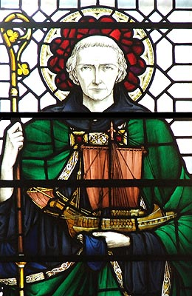
St Anselm of Canterbury (1033-1109)
Ontology is the theory of being. This branch of philosophy attempts to answer such questions as: What is real? Thus Anselm's ontological proof attempts to answer the question of whether or not God is real.
A few things are interesting about the argument. One is that he makes no appeal to sense/empirical data, his proof relies on pure reason. It is a priori.

Slide 7
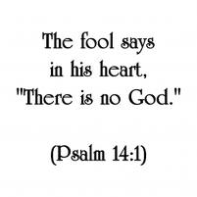
Anselm set out to prove the foolish atheist was wrong....

Slide 8
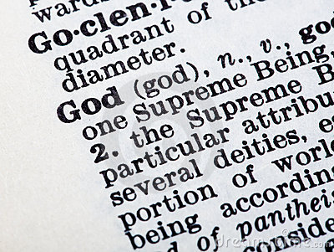
How do we define God?
Write down your definition of God.

Slide 9
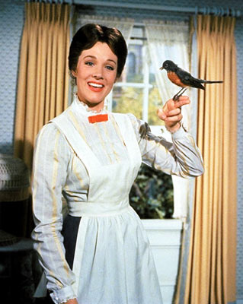
Anselm’s definition
God is “that than which nothing greater can be conceived”
He said you can’t imagine anything greater than God. God is perfect in every way.
These observations demonstrate how heavily Anselm was influenced by Plato.

Slide 10
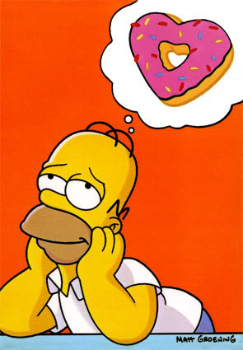
Is something that is real better than something imaginary?
Think, Pair, Share

Slide 11
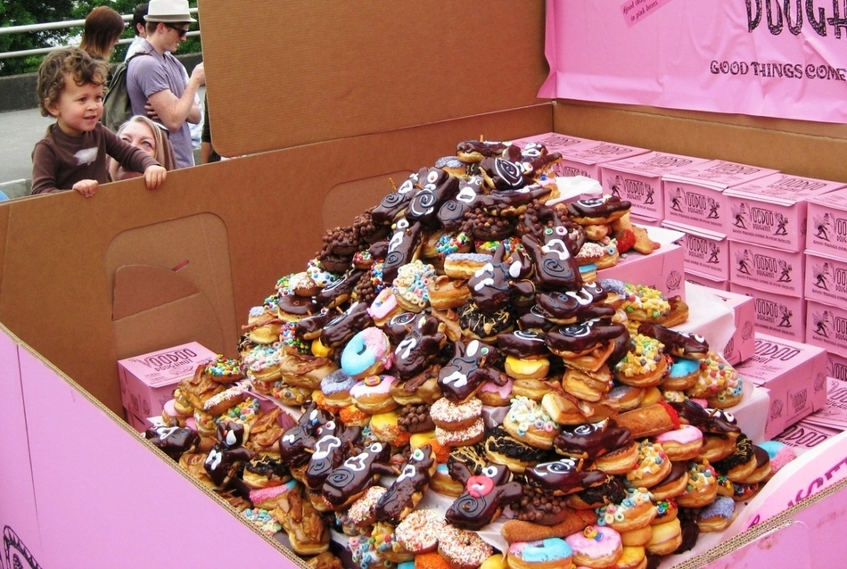
Simply the best.....
Doughnuts that exist are better than the imaginary doughnuts.
Something that exists is better than something that doesn't exist.
Notes:
11

Slide 12
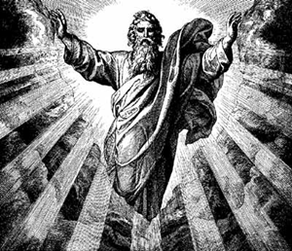
Therefore Anselm says:
If God is perfect in every way he must exist in reality.
If he existed only in the mind we could imagine a more perfect God – one that existed in the mind and in reality.

Slide 13
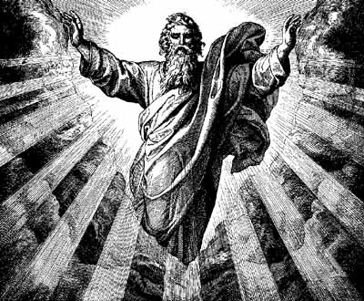
The Ontological Argument
P1. The definition of God is 'the greatest thing which can be thought of'.
P2. It is not possible to think of anything greater than God.
P3. Something that exists is better than something that doesn't exist.
C. Therefore, God exists..
Notes:
13

Slide 14
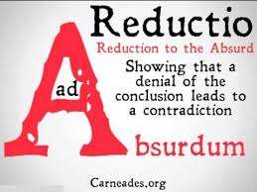
Proslogion
Read the extract from Anselm’s Proslogion.
Highlight 5 key sentences!
Stretch yourself: What does reductio ad absurdum mean? How does Anselm use it?

Slide 15
Have a look at the criticisms of the argument...
Complete the worksheet and fill in the blanks.
We will look at these in more detail over the next few lessons.
Stretch yourself task:
‘Anselm’s argument just plays tricks with words’
Do you agree? Answer in your notes.

Slide 16
How do these key terms apply to the Ontological Argument?
Key Term | Why does this apply to the ontological argument?
Analytic
a priori
Deductive

