Slide 1
Draw the most perfect holiday Island you can imagine...
Does it exist?!

Slide 2
The challenge from Gaunilo

Slide 3
Learning Outcomes
To be able to explain Gaunilo’s challenge to the
ontological argument.

Slide 4
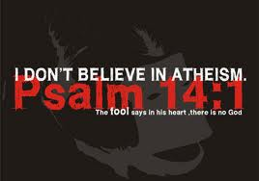
Gaunilo’s analogy of the island in ‘On Behalf of the Fool’
Gaunilo responded with his own written argument which he called ‘On Behalf of the Fool’ following on from the idea of the atheist being the fool.

Slide 5
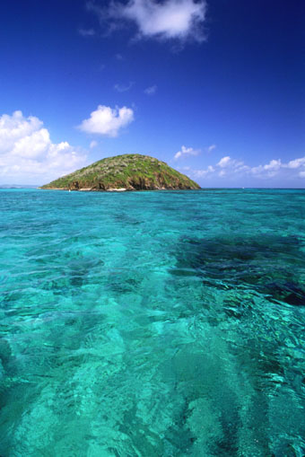
Gaunilo’s Objection: What about the greatest conceivable island?
The monk and philosopher Gaunilo rejected Anselm’s argument by making a parody of it. Let us say that we have a concept of the greatest conceivable island – beautiful and great in all respects. Now, let us ask, does this island exist in the mind only or in reality as well?
According to Gaunilo, Anselm’s logic is absurd because it demands that this island too exists: “for if it did not exist, any other land existing in reality would be more excellent than it”. The greatest conceivable island must exist…

Slide 6
Gaunilo of Marmoutiers’ objection to Anselm’s Argument…
One problem with Anselm’s ontological argument for the existence of God is that it invites parody.
Parody arguments purporting to prove the existence of any perfect thing at all can be constructed.
This objection was first raised by one of Anselm’s contemporaries, the monk Gaunilo of Marmoutiers, who constructed an ontological argument for the existence of the perfect island ‘On Behalf of the Fool’.

Slide 7
Gaunilo of Marmoutiers’ objection to Anselm’s Argument…
Gaunilo invited his readers to think of the greatest, or most perfect, conceivable island.
As a matter of fact, it is likely that no such island actually exists.
However, his argument would then say that we aren't thinking of the greatest conceivable island, because the greatest conceivable island would exist, as well as having all those other desirable properties.
Since we can conceive of this greatest or most perfect conceivable island, then it must exist.
Gaunilo argued that this line of argument was no less absurd than Anselm’s original argument.

Slide 8
Dragons are real?
Gaunilo argued that this line of argument was no less absurd than Anselm’s original argument. Similar arguments for the existence of the perfect baseball pitcher, or the perfect husband or dragons or even unicorns —for the existence of any perfect thing at all—can be constructed. If any of these arguments is sound, it seems, then they must all be sound.
Clearly, though, these arguments are not all sound; the perfect baseball pitcher does not exist, and neither does the perfect husband. There is something wrong with the logic of these arguments. Each of these ontological arguments, though, uses the same logic. They must therefore all be unsound.
The fact that there is no perfect island, and no perfect baseball pitcher, then, shows that the logic of the ontological argument for God’s existence is flawed.
Such objections are known as "Overload Objections"; they don't claim to show where or how the ontological argument goes wrong, they simply argue that if it is sound, then so are many other arguments of the same logical form which we don't want to accept, arguments which would overload the world with an indefinitely large number of things like perfect islands, perfect pizzas, perfect pencils, etc.
Such objections always depend upon the accuracy of the analogy. That is, we must be able to show that the objector's argument is sufficiently like the ontological argument for us to be able to conclude that if one works so must the other.

Slide 9
Gaunilo’s perfect island
Summarise his argument in 5 key points:
1)
2)
3)
4)
5)
Stretch yourself: Do you agree with his points?

Slide 10
Perfect?
Gaunilo also points out that we are human and all our experiences gained through the senses has shown us that things are not perfect. They always have the potential to improve. It is impossible for humans to think of a fully perfect being.
‘Of God, or a being greater than all others, I could not conceive at all, except merely according the word. An object can hardly or never be conceived according to the word alone...’

Slide 11
Write a letter..
Write a letter to Anselm from Gaunilo setting out his criticisms of Anselm’s argument for the existence of God.

Slide 12
Stretch yourself: Anselm’s response..
Anselm's Reply: There is no contradiction in denying the existence of a perfect island, but there is in denying God's existence.
What do you think he means?

Slide 13
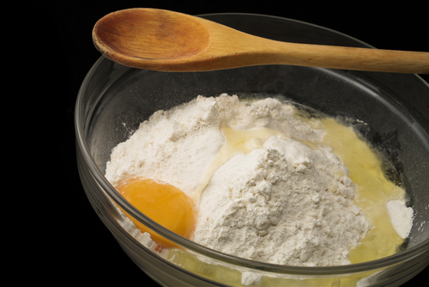
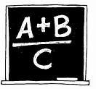
Equation
Write an equation showing your learning…
For example :
Eggs + flour + milk + sugar X oven = cake

