Slide 1
Think, pair, share
A: Privation
B: The Fall of Man
A:Seminally
B: Free will

Slide 2
Irenaeus’ theodicy

Slide 3
Learning Outcomes
To be able to explain Irenaeus’ Theodicy.
To be able to evaluate Irenaeus’ Theodicy.

Slide 4
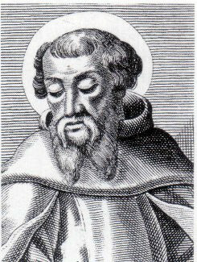
Irenaeus also suggested that evil could be traced back to human Free Will. However, he differed from Augustine by saying that God did not make a perfect world and that evil has a valuable part to play in God’s plan for humanity.
He thought that God created humans imperfectly in the likeness of God in order that they could develop into perfection over time….

Slide 5
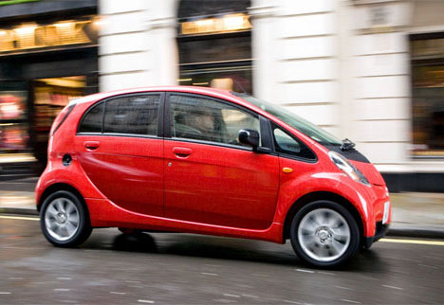
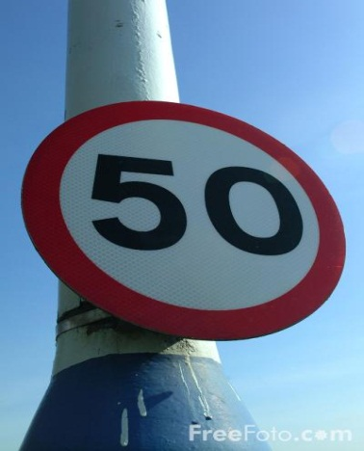
Policeman analogy
No choice/freedom
Versus
Morality and free choice

Slide 6
Think, Pair, Share
Why is Irenaeus’ Theodicy often referred to as the Soul-Making theodicy?
Discuss in pairs.

Slide 7
The world is a place of SOUL MAKING
Humans have to strive to meet challenges in order to gain PERFECTION

Slide 8
Evil is necessary
The modern philosopher, John Hick developed Irenaeus’ arguments further, explaining that evil and suffering were necessary for human development because qualities such as Kindness and compassion can grow out of suffering.
He believes that soul-making may continue in the next world and natural evil such as earthquakes and famine are God-given opportunities for people to develop.
Irenaeus was convinced everyone would develop enough to go to heaven.

Slide 9
Irenaeus’ Theodicy
Draw a flow diagram showing how the Irenaeus’ Theodicy works or describes it.
Include key terms:
Imperfect, likeness of God, soul making.
Stretch yourself task:
Research Process Theology.

Slide 10
Think, Pair, Share
Where does Irenaeus say Moral and Natural evil come from?
Discuss in pairs.

Slide 11
John Hick
Research 5 facts on what John Hick meant by ‘epistemic distance’.
1)
2)
3)
4)
5)
Top Philosopher: What does John Keats say about ‘soul-making’?
Stretch yourself: Research Peter Vardy’s story of the king and the peasant.
How does it support Hick?

Slide 12
Epistemic Distance and the Irenaean theodicy
John Hick argued that there needed to be room for improvement for development to be possible. This room was called the epistemic distance by Hick.
'Epistemology' is to do with knowledge. When Hick talks about an 'epistemic distance', he means that God is not 'in our face' (so to speak). If one thinks about how people might act if their favourite actor or singer was standing next to them (and how they would act differently if they were not), we can begin to get some idea of why Hick believes God needs to 'draw away from us', in order that we might act (spiritually and morally) 'naturally'
Remember Peter Vardy’s story of the king and the peasant.

Slide 13
‘Soul making is not an acceptable explanation for suffering.’ Discuss
Use the article to create a Zig-Zag with for and against reasons.
For
Against
Stretch yourself:
Add your own personal opinion and give reasons.
For
Against

Slide 14
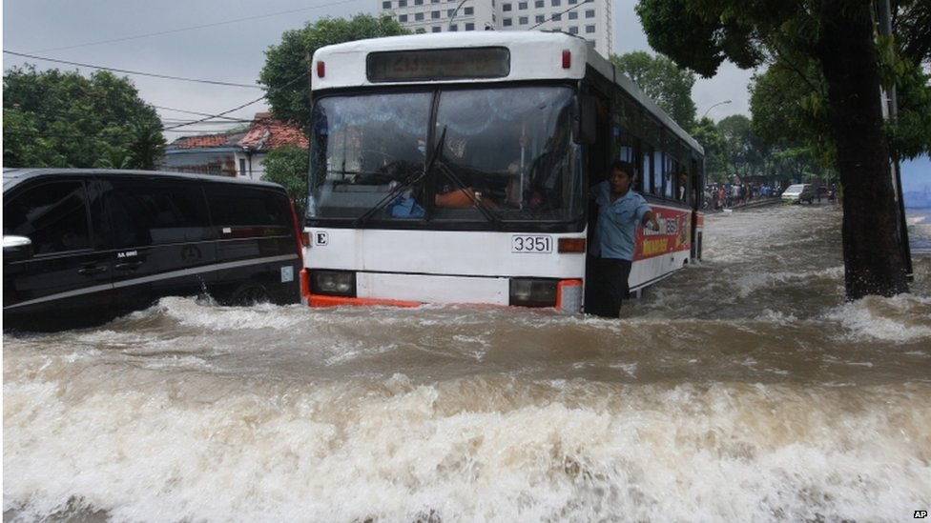
What would Irenaeus have said the purpose of the terrible floods in 2007?
In your own words:
Write a paragraph explaining Irenaeus’ response.
You may want to write in in a interview style.

