Slide 1
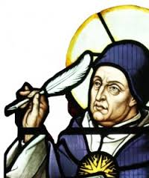
Key word Match up
synderesis -
Conscientia-
Prudence-
The virtue of right-reasoning in moral matters, balancing ours and others' needs.
Deriving secondary precepts, and applying them.
An innate knowledge of human nature and primary precepts through practical reason.

Slide 2
St Paul and Augustine concept’s of Conscience

Slide 3
Learning Outcomes
To be able to explain St Paul and Augustine’s views on conscience.
To be able evaluate whether conscience is a reliable guide in decision making.

Slide 4
The Bible and Conscience
The Old Testament has no word for ‘conscience’, but it does speak of the true heart that interiorises the divine law. Some Old Testament figures experience God calling them to live his will or Law; at other times they experience him probing or judging their hearts. Jesus taught his followers to have a pure heart:
God blesses those whose hearts are pure, for they will see God. Matthew 5:8
What goes into a man's mouth does not make him 'unclean', but what comes out of his mouth, that is what makes him 'unclean' ... the things that come out of the mouth come from the heart, and these make a man 'unclean'. Matthew 15:11,18
This then is how we know that we belong to the truth, and how we set our hearts at rest in his presence whenever our hearts condemn us. For God is greater than our hearts, and he knows everything. Dear friends, if our hearts do not condemn us, we have confidence before God. 1 John 3:19-21

Slide 5
St Paul and Conscience
Paul uses the term συνειδησις - often translated as 'conscience' and 'heart' - to describe the human ability to know and choose the good. He taught that all people, whether or not they are Christians, know what is right and wrong. He said it is written on our hearts:
When outsiders who have never heard of God's law follow it more or less by instinct, they confirm its truth by their obedience. They show that God's law is not something alien, imposed on us from without, but woven into the very fabric of our creation. There is something deep within them that echoes God's yes and no, right and wrong. (Romans 2:14,15, The Message).
For Paul, conscience is the universal knowledge of God's law, an inner guiding of our external behaviour. Our conscience can be corrupted, but through Christ's redeeming love, and the action of the Holy Spirit, we can 'put on the mind of Christ'.

Slide 6
Conscience and The Catholic Church
Research the Catholic Church’s view on conscience…
Quote | What does the quote mean?
1)
2)
3)
Stretch yourself task: Explain in your own words which philosophers may have influenced this view and why.

Slide 7
Aquinas: An example
Major Premise: All evil must be avoided
Minor Premise: Murder is evil
Conclusion: Murder must be avoided at all cost
…Therefore conscience can make decisions.
Synderesis Reason Conscientia
Where would these key words fit into this example?

Slide 8
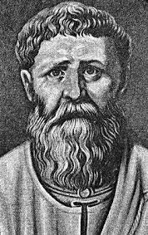
Augustine of Hippo’s Conscience
Read through the article and answer the following questions:
How was he influenced by Plato?
What is Conscience according to Augustine?
What does God’s love highlight for humans?
Explain two examples of where Augustine’s teachings on conscience have impacted on other people’s beliefs.
What are the issues with Augustine’s views on conscience?
Top philosopher task:
What does Vincent MacNamara say about conscience?
Stretch yourself: Find another case study to support the idea that conscience is not a reliable guide to decision making.

Slide 9
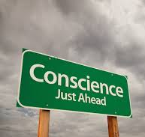
"Individual conscience must have the final word“ –Peter Vardy
Complete the speech bubbles to show a potential debate for and against.
You can include synoptic links.
Top philosopher challenge: Find about Richard Gula’s views on conscience and add them to your debate.

Slide 10
Opinion Line:"Individual conscience must have the final word“ –Peter Vardy Do you agree?
Read the Statement –
Think carefully and silently for 1 minute – what do you think and feel about this and why?
Post-it:
Take your post-it note and clearly write your view with a reason for it. Try not to be vague about WHY you feel how you do.
Stick your opinion to where you feel it best belongs on the opinion line at the front of our classroom.

