Slide 1
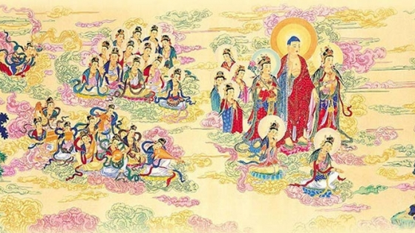
Pure Land Buddhism

Slide 2
To begin, true or false….on Zen Buddhism
False – The Flower Sermon
1) Zen Buddhism originates from ‘The Tree Sermon’ by the Buddha
2) Mahakashyapa was the name of the monk that understood this ‘wordless insight’ from this sermon
True
3) Enlightenment in Zen can only happen over thousands of lifetimes
False – it can happen all at once – what was this called in Chinese and Japanese?
4) Zen Buddhism plays down the over-reliance of scriptures
True
5) A Zen master is called a sotori
False – They are called Roshi and pupils are expected to submit totally to their master
6) The paradoxical riddle-like sayings in Rinzai Zen are called Zazen
False – They are called Koans
7) In Soto Zen, the monk is expected to keep the monasteries spotless
True

Slide 3
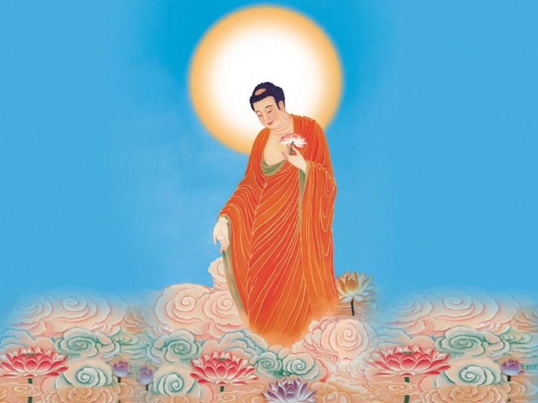
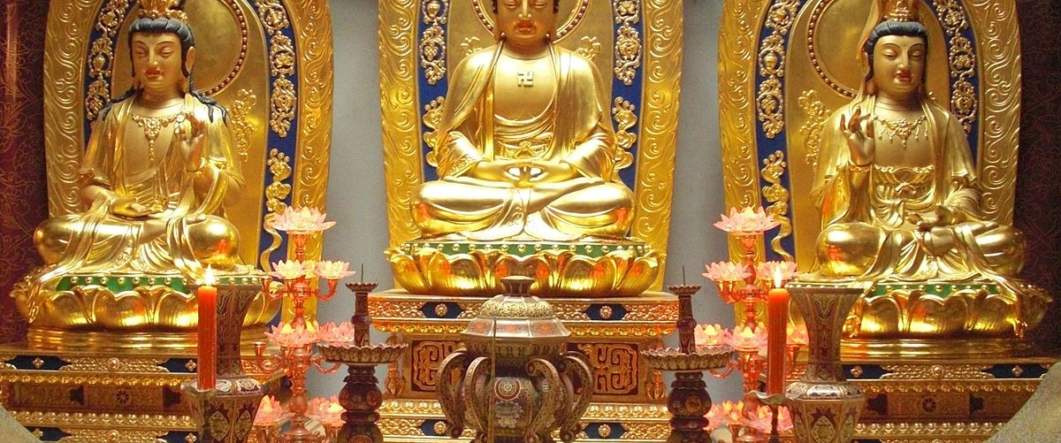
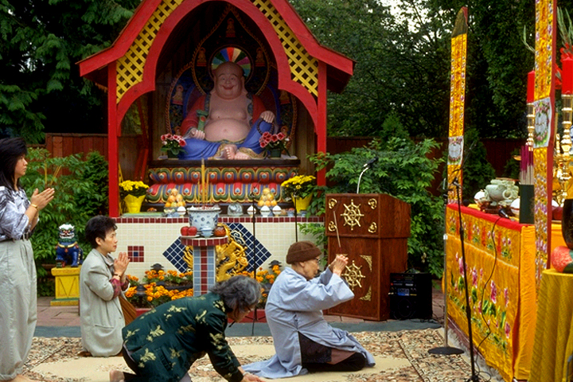
Images from Pure Land Buddhism:

Slide 4
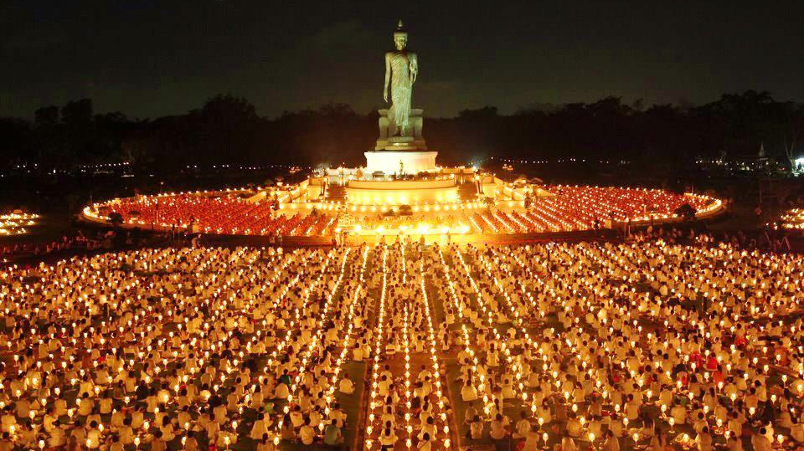
Images from Pure Land Buddhism:

Slide 5
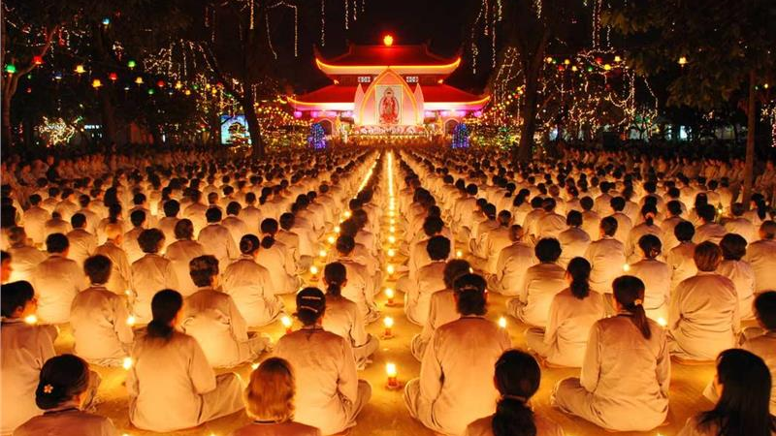
Images from Pure Land Buddhism:

Slide 6
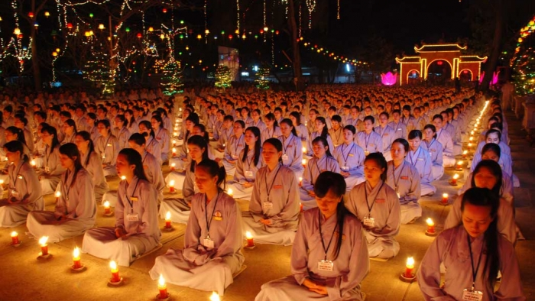
Images from Pure Land Buddhism:

Slide 7
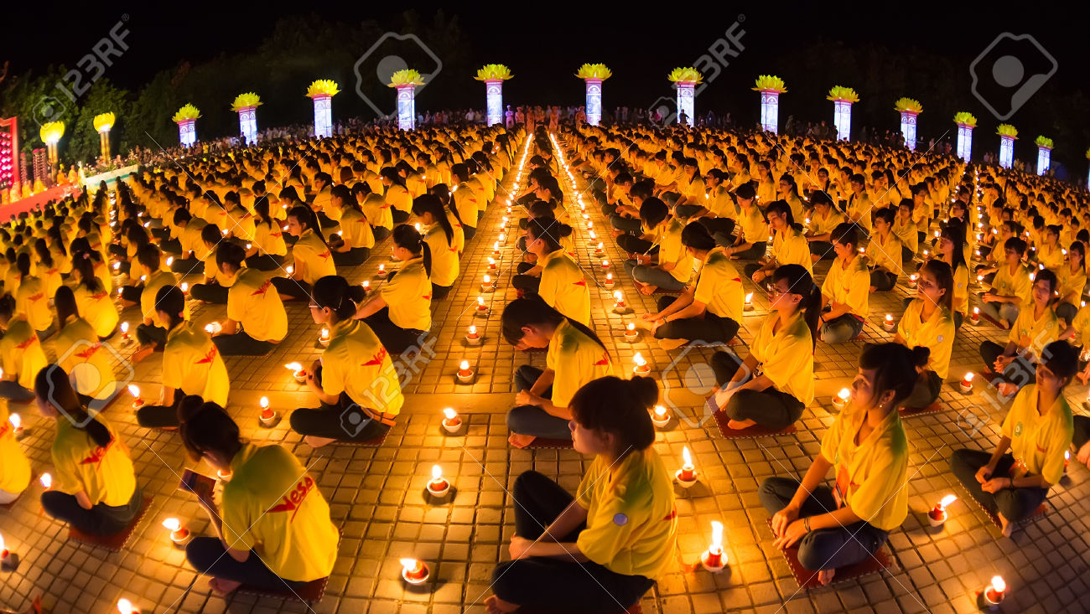
Images from Pure Land Buddhism:

Slide 8
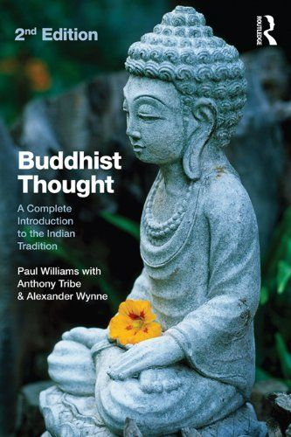
What are ‘Pure Lands’?
‘In the Pratyutpanna Sutra……we find details of a visualisation practiced in which the meditator visualises Buddha Amitayus in his ‘Pure Land’ (Buddha domain, or Buddha Field) somewhere ‘in the West’, for 24 hours a day, or a whole week’. After that, the sutra says, the meditator may have a vision of Amitayus, and receive new teachings not before heard. Moreover, these new teachings the meditator is exhorted to transmit and expound to mankind’
(Buddhist Thought by Williams P. et al 2012)

Slide 9
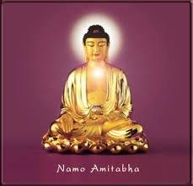
Key points on Pure Land
It is based on WORSHIP of the Buddha Amitabha (Amida)
Buddha Amitabha dwells in a paradise (Pure Buddhaland) known as ‘Sukhavati’ or ‘The Happy Land’

Slide 10
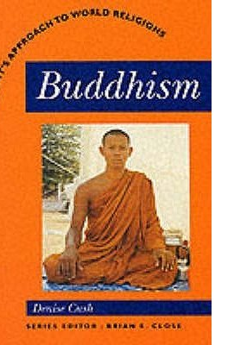
Pure Land Buddhism and Japan
What can we learn from this extract from Buddhism by Denise Cush?

Slide 11
Pure Land Buddhism
“In the Indian Mahayana sutra – Sukhavati vyuha – in which Shakyamuni Buddha tells Ananda the story of a bodhisattva monk named Dharmakara (In Japanese, Hozo), who in a past aeon vowed in the presence of a living Buddha that he would create a perfect paradise out of compassion for suffering beings. Dharmakara made 48 vows which refer to the beauty of this land, its pleasant lifestyle, the presence of bodhisattvas and, most important of all, that beings only have to think of him in trusting devotion and he will take them to this land upon their death. He made his vows on pain of forfeiting enlightenment for ever, and, as Shakyamuni taught Dharmakara did become a Buddha called Amitabha (Infinite Light) and dwells in a paradise land in the West, people can have confidence in the efficacy of his vows. There are two versions of the Sukhavati scripture, the longer one includes the merit of a moral life, as well as faithful devotion, as the methods for gaining rebirth in the Pure Land”
(Buddhism by Denise Cush, 1991)

Slide 12
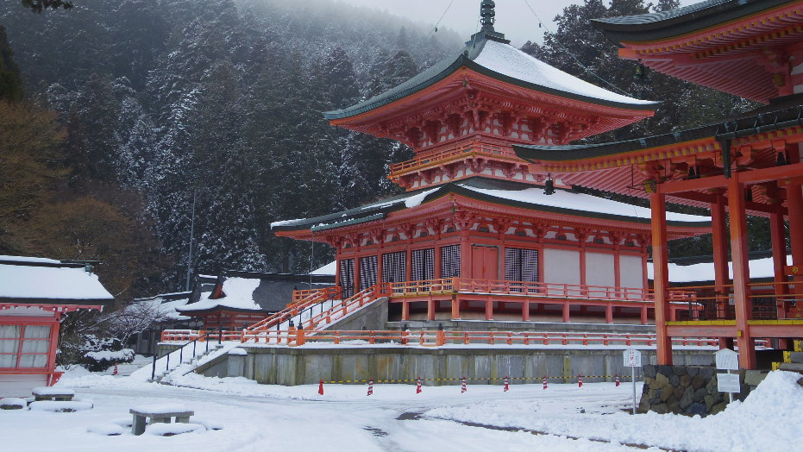
Key points on Pure Land
In the 1930s, between 60-70% of Chinese Buddhists were of the Pure Land variety
In Japan it took off at the Mount Hiei sect.
The 12th century was a time of social upheaval for Japan – this led to many reformed Buddhist groups developing
Two characters were vital in the development of Pure Land in Japan from this movement……….

Slide 13
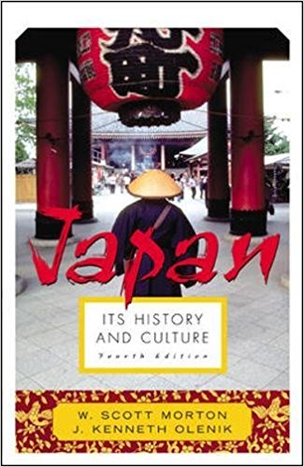
Pure Land Buddhism and Japan
Let’s use this source as a guide to understanding the popularity of Pure Land in Japan – what can we learn from this source?

Slide 14
Pure Land Buddhism and Japan
“The school was brought into prominence in Japan in the tenth century by a learned monk, Eshin. It stressed neither elaborate ritual nor arduous study of abstruse doctrine; repetition of the sacred formula,’Namu Amida Butsu’ calling upon the Buddha of infinite compassion, was sufficient for salvation and would ensure being reborn in the Western Paradise or Pure Land. It was thus a religion of faith alone and not works, and it made a strong appeal to the common people and the unfortunate. It found a response also among the aristocrats and warriors, for even the educated Japanese were inclined to a faith involving feeling rather than one of abstract speculation. To this day the branches of this sect command the largest following of any in Japan”
(Japan: It’s culture and history by Morton W.S. & Olenik J.K. 2005)

Slide 15
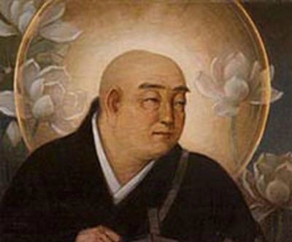
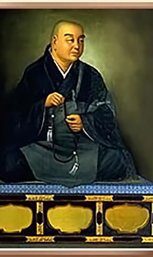
Pure Land Buddhism and Japan: Honen

Slide 16
Pure Land Buddhism and Japan
Key figures in the development of Pure Land: Honen
Honen (1133 – 1212) was the only son of a small clan chieftain in Japan
His father was assassinated, and on his deathbed is reported to have told his son: “Don’t hate your enemy but become a monk and pray for me and for your deliverance”
After being ordained at the famous Mount Hiei temple, he studied there for nearly 30 years
At the age of 40 he decided to break with tradition and leave the monastery and followed in the footsteps of the shamans of his day, and went to live alone in a mountain hermitage
It was at this time that he wrote his most important treatise which later became the foundational text of the Pure Land School
He emphasised the moral deterioration of the age, called mappo in Japanese, and taught the nembutsu as the only method one needed to be free of suffering. His teachings attracted a large following

Slide 17
Pure Land Buddhism and Japan
Key figures in the development of Pure Land: Honen
Honen broke with tradition in the sense that he taught the dharma to people from all walks of life. Until then, laypeople had been rather like spectators, while the heart of Buddhist life was lived in the temples
Honen taught both men and women, and those from all social classes
People said he attracted ‘butchers, prostitutes and fortune-tellers’ who would otherwise not have a place in the Buddhist sangha
His genuine holiness, coupled with his personal appeal and the simplicity of his teaching, made him more and more popular

Slide 18
Pure Land Buddhism and Japan
Key figures in the development of Pure Land: Honen
This did not please either the political leaders or the Tendai authorities.
Honen was expelled from the sangha and forced to disrobe, and was banished to the countryside – passion was so strong that some of his followers were executed
He continued to give his teachings in small villages until 1211, when the ban was lifted and he was allowed to go back as a layperson
Buddhist historians usually honour Honen as the founder of the Pure Land school in Japan, but, in fact he never began a school. the school developed later with his followers

Slide 19
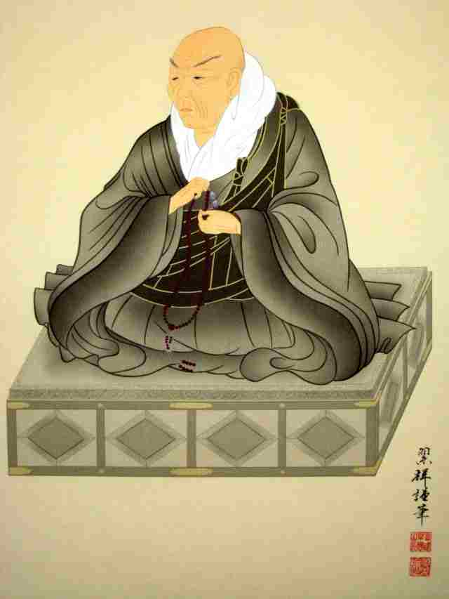
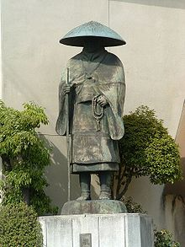
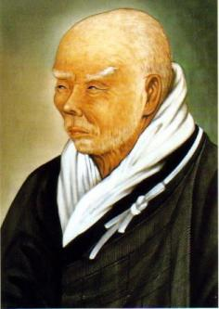
Pure Land Buddhism and Japan: Shinran

Slide 20
Pure Land Buddhism and Japan
Key figures in the development of Pure Land: Shinran
Shinran (1173-1263) was born into aristocratic elite near Kyoto. He lost his father when he was four and his mother when we was nine
His uncle sent him to Mount Hiei in order to advance his career through scholarship rather than through marriage
He studied for some 20 years, but was disillusioned by the complex and difficult practices taught there
He claimed to have a vision of Kuan Yin, the bodhisattva of compassion, who directed him to find a Buddhist monk called Honen. So in 1201 he left Mount Hiei and joined Honen in Kyoto
He remained with him until they were forced into exile
He had been forced to disrobe, and at that juncture he called himself ‘the foolish, bald-headed one’, reflecting his unease at being neither a monk nor a layperson
He claimed that he had another vision, this time advising him to marry so he married and had 6 children

Slide 21
Pure Land Buddhism and Japan
Key figures in the development of Pure Land: Shinran
Shinran wrote many treatises and commentaries, and of particular interest is the fact that he wrote then in simple Japanese, not classical Japanese so ordinary people could read them
His major work was published in 1224 and is entitled ‘Kyogoshinsho’ or ‘The True Teaching, Practice an Realisation of the Pure Land Way’. It is a selection of sutra passages which are relevant to the Pure Land school
He always said that his teaching was a clarification of Honen’s teachings
However, he developed some of Honen’s principals much further
He regarded his teachings as an expression of the true meaning of Honen’s teachings, and therefore called his school True Pure Land or Judo-shinshu
Shinran himself lived a humble life

Slide 22
Honen and Shinran
Honen had expressed the mercy of Amida in the following saying:
“Even a bad man will be received in Buddha’s land, how much more a good man”
Shinran preferred to say:
“Even a good man will be received in Buddha’s land, how much more a bad man”
TASK –
What are they both trying to say here about Amitabha Buddha and Pure Land Buddhism?

Slide 23
Pure Land Buddhism
The idea of merit simply leads to false self-importance whereas one should rely totally on the power of Amida in the humble opinion that one can do nothing for oneself
To guard against any form of self-assertion creeping in, Shinran stressed that even a single act of faith in Amida was sufficient; repeating his name on subsequent occasions earned no extra merit but was merely a way of expressing thanks to Amida
Even faith would be a temptation to pride for some people, something we achieve for ourselves
It seems that for Shinran, the Pure Land was the final goal, equivalent to nirvana or Buddhahood, rather than a step on the way there

Slide 24
Pure Land Buddhism
‘Shin’ Buddhists are taught to lead a humble life, fitting in with people around them, and not marking themselves out as different and superior by any special customs
Ordinary family life is the pattern rather than monastic celibacy, and the organisers of the sect form a kind of married clergy for simple ceremonies, the office being hereditary rather than based on any personal qualification
The worship of other Buddhas and bodhisattvas is discouraged, and Shakyamuni is seen as merely an earthly representative of Amida
However, Shin Buddhists are taught not to criticise other religions or sects – this attitude, of humbly following the ‘Shin’ oath without advertising it or criticising others, was particularly stressed by the 15th century teacher Rennyo

Slide 25
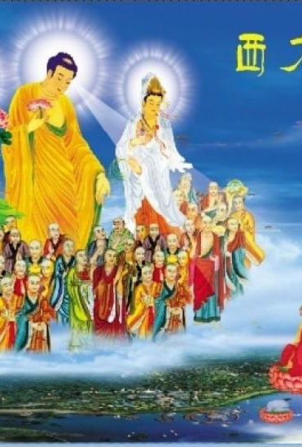
Pure Land Buddhism
Shin Buddhism was particularly appealing to ordinary, busy people
It attracted the outcaste members of society, women and others who were excluded by traditional monastic Buddhism
It can seem a long way from the original teachings of the Buddha, but it can be explained as a form of upaya – one of the many skilful means employed by the Buddhas to save beings

Slide 26
Pure Land Buddhism
There have been several attempts to harmonise the teachings of the Pure Land with other forms of Buddhism –
Praying to Amida can be seen as drawing on the Buddha nature within oneself rather than to a separate divinity, and the Pure Land as a state of consciousness rather than a place
Shinran’s insistence on eliminating any trace of self-pride in total reliance on Amida, can be seen as an alternative way of expressing the basic Buddhist teachings of anatta, ‘no-self’
The Zen scholar Suzuki suggests that the importance of reciting the nembutsu (namu Amida Butsu) is its effect on the consciousness
Mantras are often used in meditation as a technique for stopping discursive thought and achieving mystical experiences
Thus Suzuki feels that it can achieve the same goal as Zen practices, such as meditation on the koan
However, this is not the traditional way in which the nembutsu is understood

