Slide 1
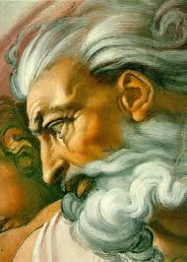
What makes these things different?

Slide 2
Anselm’s second ontological argument

Slide 3
Learning Outcome
To be able to understand Anselm’s second argument or his response to Gaunilo.

Slide 4
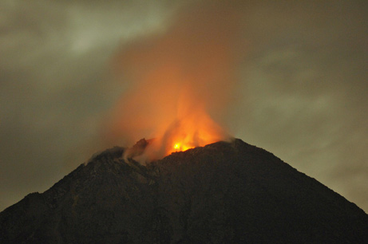
Anselm’s reply to Gaunilo:
God has necessary existence – he cannot not exist. God is not contingent.
The Island can come into and go out of existence – God can’t or he would not be perfect!

Slide 5
Anselm’s response continued...
He refused to allow that the argument could ever be applied to other things.
An island, perfect or otherwise, like any material state is contingent, i.e. it may or may not exist, and that at some time it does not exist.
Something which, at some time does not exist, cannot necessarily exist, for what necessarily exists must always exist and so cannot be contingent.
The only thing that is non contingent is God and therefore the ontological argument only applies to God.

Slide 6
So in conclusion...
Anselm said that the ontological argument did
not apply to temporal contingent things (such as
islands which are in time and space), but of ‘the
Greatest thing that can be thought’
Islands have no ‘intrinsic maximum’ - a idea of the
perfect island can always be better.
God is not in the same category. God is not
temporal or contingent, he is necessary.

Slide 7
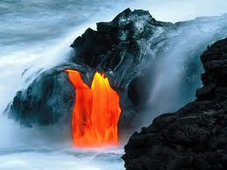
How do these pictures help explain Anselm’s response?

Slide 8
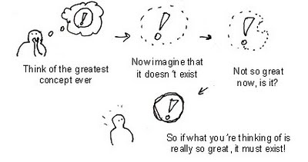
Complete the worksheet by explaining what the parts of the argument mean.
Stretch yourself: Do you think that you can logically prove God’s existence or do we need evidence? Answer in your notes.

Slide 9
Aquinas’ criticisms of Anselm
Thomas Aquinas (1225-74) was firmly convinced of the existence of God himself. However one of his points was that God’s existence cannot be regarded as self-evident.
Aquinas argued that there had to be more than just a definition in order to show the existence of God. It was necessary to provide firm evidence, rather than just argument.

Slide 10
Questions for Evaluation
Is the idea of a ‘necessary being’ credible or coherent?
Can we rely on a purely logical, a priori proof?
Does this argument fit in with other religious ideas and beliefs?
If it’s a ‘proof’, what exactly does it prove?
How does the ontological argument compare with other arguments you know of? (Hint: remember the design argument)
Stretch yourself: Is ‘existence’ a real predicate?

Slide 11
Think, pair, share
A: Contingent
B: Temporal
A: Intrinsic Maximum
B: Necessary

