Slide 1
Think, pair, share
A: What is the principle of sufficient reason?
B: What does empiricism mean?
A: What did Hume say about the cosmological argument?
B: What is the difference between a contingent being and a necessary being?

Slide 2
Copleston and Russell Radio debate

Slide 3
Learning Outcomes
To be able to explain the arguments put forward by Copleston in the 1948 radio debate with Russell and Russell’s counter arguments

Slide 4
Copleston
Copleston argued that the Universe relies on things outside of itself for it’s existence.
Nothing in the universe can be the creator of the universe. Therefore the cause must be something external to it.
The cause for the universe must be something self-causing = this is a necessary being. It must exist independently outside of the universe.
God is different from contingent beings as he is ‘his own sufficient cause’.

Slide 5
Russell
Russell replied that the concept of cause is one we make up ourselves when we observe things happening.
The explanation for the universe is beyond human understanding.
Because of this it is unnecessary for humans to have a sufficient explanation of the universe that goes beyond the contingent universe.
He then says that the universe doesn’t need a cause. “I should say that the universe is just there, and that’s all.”

Slide 6
Russell – Copleston debate
Use the iPads to research the debate and explain the key arguments on the worksheet.
Remember:
They agreed on a definition of God =
a supreme personal being distinct from the world and creator of the world’.
Copleston = Catholic priest
Russell = Atheist.
Stretch yourself :
“If one refused to sit at the chess board and make a move, one cannot, of course, be checkmated.”
What did Copleston mean? Answer in your notes.
Next steps: What is Russell’s fallacy of composition?

Slide 7
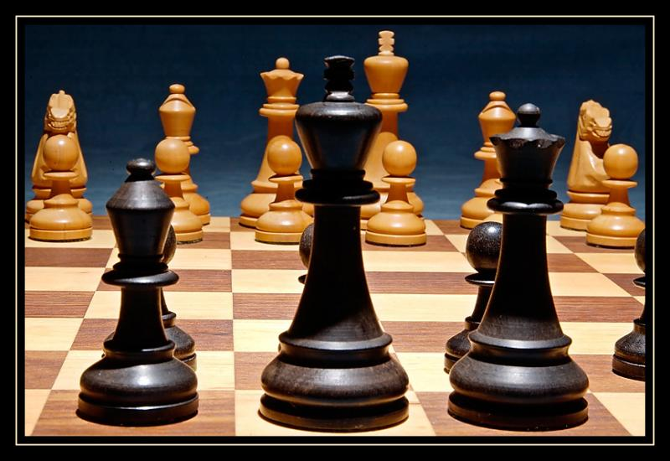
Which side of the debate do these pictures represent?

Slide 8
In your words- The debate
Write a script that sums up the Copleston- Russell debate.
Russell:
Copleston:
Russell:
Copleston:
Stretch yourself:
Add in your own opinion: What would you argue?

Slide 9
The famous radio debate on the cosmological argument
In a radio debate with Copleston, Russell argued....
In a radio debate with Russell, Copleston argued....
You now should be able to complete these sentences.

Slide 10
Think, pair, share
Who do you think won the debate and why?
Discuss in pairs

