Slide 1
Rapid recall!
What do you remember?!!!

Slide 2
What are the necessary properties of a triangle?

Slide 3
Descartes’ Ontological argument

Slide 4
Learning Outcome
To be able to understand Descartes’ version of the ontological argument.

Slide 5
Key word Match up!
Contingent
Necessary
refers to something which
logically must be true.
means when something
depends on something
else.

Slide 6
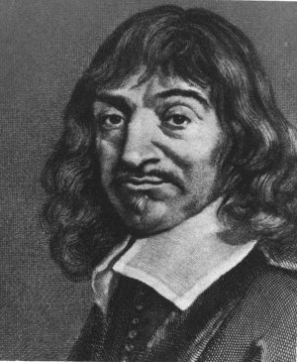
A different ontological argument: René Descartes
The French philosopher René Descartes was a very lazy gentleman who spent most of his day in bed and the rest of his time studying philosophy.
In his Discourse on Method he made the well-known argument “I think, therefore I am”. For Descartes, the existence of the self could be considered a known logical fact. Once this is accepted, we can then seek knowledge of the wider universe.
According to Descartes, the second important piece of knowledge following from our own existence is knowledge of God. Perhaps we can prove that he exists too, merely by logic.

Slide 7
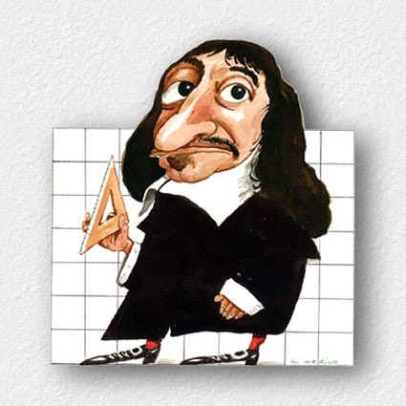
Let’s start off with a definition of God. By ‘God’ we mean a ‘supremely perfect being’. By definition, therefore, God must exist. Why? Because existence is a perfection. A thing which did not exist would by definition not be perfect, because the existing version would be more complete. So, anything perfect by definition must exist.
“Existence can no more be separated from the essence of God than the fact that it’s three angles equal two right angles can be separated from the essence of a triangle.”
Triangle:
Angles equal to two right angles

Slide 8
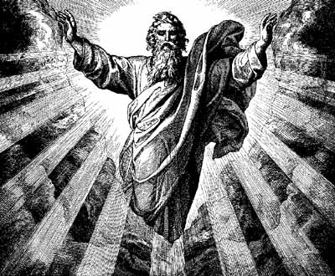
Descartes says:
A triangle has necessary properties e.g. three sides.
God has necessary properties – one of which is existence.

Slide 9
Descartes example!
"when I imagine a triangle, even if perhaps no such figure exists outside my thought anywhere in the world and never has, the triangle still has a certain determinate nature, essence, or form which is unchangeable and eternal, which I did not fabricate, and which does not depend on my mind." (88 mediations)
Write your own example!
Then explain how you can use this to support Descartes’ argument.

Slide 10
J.L Mackie (1917-1981)
Descartes argued that to deny the existence of God is as absurd as saying ‘the existing such and such does not exist’.
Mackie agrees and says all arguments that try to establish the necessary existence of other things, including Martians or unicorns, are trying to establish the necessary existence of contingent objects.
But only an absolutely perfect being can have necessary existence.

Slide 11
Descartes argument in five points...
Scan the QR code and read the article. Use it to help you summarise Descartes’ argument in 5 points...
1)
2)
3)
4)
5)

Slide 12
Descartes says:
1) God has every perfection
2) Existence is a perfection
3) God must exist

Slide 13
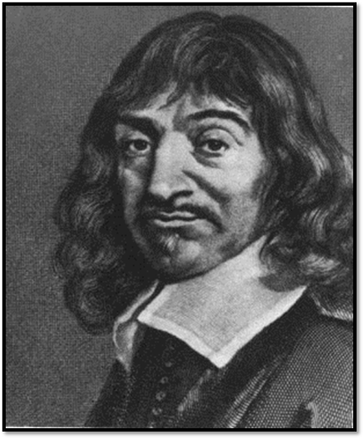
Descartes’ ontological argument
Complete the worksheet by explaining what each part of the argument means!
Stretch yourself: Create a plan for question ‘It is pointless to deny the logical necessity of the existence of God’ Discuss’.

Slide 14
Summary!
Summarise in one sentence how Descartes argument is different to Anselm’s…

Slide 15
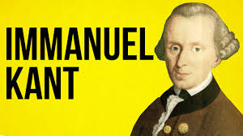
Homework
Research Kant’s criticisms of the ontological argument.

