Slide 1
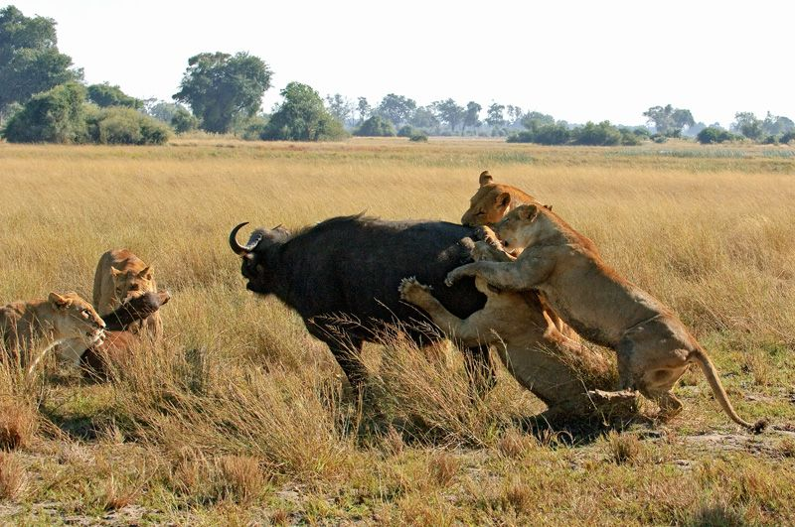
Think, pair, share
How does a scene like this challenge the idea of a designer God?

Slide 2
Evaluating the teleological argument

Slide 3
Learning Outcomes
To be able to explain Mill’s and Darwin's criticisms of the teleological argument.
To be able to evaluate whether you think the teleological argument is successful.

Slide 4
Charles Darwin (1809-1882)
Charles Darwin although not the first to propose the theory of evolution, first put forward a comprehensive theoretical explanation for it in his The Origin of Species (1858).
Based on his study of species in their own habitat, Darwin proposed that similarities between species could be explained through a common heredity - that is, that they both shared a common ancestor.
The way this works, according to Darwin, is through what he called Adaptation, whereby a certain species would change according to the environmental conditions. Once this happens, the environment also causes the species which is fittest - or best suited to the conditions - to survive. This theory is best known as Natural Selection or sometimes as survival of the fittest.

Slide 5
Consequences for the Teleological Argument…
1) The Separate Creation of Species: Because Darwinism argued that all species descended from a common ancestor this contradicted the biblical view that each species was created independently by God.
2) The Instant Creation of the World: The biblical account portrays God as creating the world in 7 days, after which nothing changes. However, the evolutionary perspective views things changing and evolving over millions of years.
The Goodness of God: The bible views the world as created by God as an expression of His goodness. However, Natural Selection seems to suggest the struggle of opposing forces for dominancy.
The Nature of Man: If man was made in God's likeness it could not also be possible that he evolved from apes. This view makes man no different from the other animals.

Slide 6
Think, Pair, Share
A) Evolution
B) Adaptation
Natural Selection
Survival of the fittest

Slide 7
Complete the worksheet
Stretch yourself: What was Dawkins’ referring to when naming his book the ‘Blind Watchmaker’?

Slide 8
‘Evolution means we do not require a designer God’ Discuss.
Sort the cards out into a Zig-Zag with for and against reasons.
For
Against
Stretch yourself: Research more on Mill’s view. Would he agree or disagree?
Stretch yourself:
Add your own personal opinion and give reasons.
For
Against

Slide 9
Epicurean Hypothesis:
At the time of creation the universe was just a mass of particles in chaos.
But gradually these particles evolved into order.
The universe is eternal so, in this unlimited time, it was expected that something orderly would come about.
Thus, the order isn’t a result of a designer, but of chance.
Steven Jones calls them ‘a series of successful mistakes’

Slide 10
Mill
He argued because there is evil and suffering in the world then the designer cannot have been all powerful, all knowing and all loving.
If the designer was all these qualities then the suffering wouldn’t have been included in the design. Hence, he rejects Paley’s and Aquinas’ arguments.

Slide 11
The Anthropic Principle
‘Anthropic’ means to be linked to the study of mankind
This is the more recent development of the teleological argument and suggests that the universe is designed for intelligent life to exist. If there had been even the slight variation in the forces in the universe, in the charge of an electron, for instance, intelligent life (or any life would have been highly unlikely to have developed.
Polkinghorne- Could God have chosen to designed universe governed by laws and chance?

Slide 12
Richard Swinburne
Swinburne accepted the Anthropic Argument and said it came down to probabilities. Which is more probable reason for order in the universe? Random chance or design? If design is accepted, then God is the simplest explanation.

Slide 13
FR Tennant
The best explanation for the amazing chain of ‘coincidences’ that led to us being here, is God. FR Tennant is the main philosopher behind this approach. He argues there are 3 types of natural evidence for design in the world:
1)The fact that the world can be analysed n a rational manner. It is not chaotic and rules apply.
2) The inorganic world has given the necessities required to sustain life.
3) The process of evolution has been towards the emergence of intelligent human life.

Slide 14
The Aesthetic Argument
Tennant also developed the idea that humans are capable of appreciating beauty in the world (in art, music, literature and nature) yet this is not necessary to human survival in evolutionary terms, therefore this is evidence of a divine creator.

Slide 15
Essay Plan
‘Evolution means we do not require a designer God’ Discuss.
Use the key thinkers you have learnt this lesson!
Stretch yourself: Plan your conclusion, can you make it an ‘insightful’ argument?

Slide 16
Think, pair, share
‘The theory of Natural Selection doesn’t weaken the teleological argument. It strengthens it because it shows a designer God in action’
A: Who would support this statement?
B: Who would disagree with this statement?
A: Who would support this statement?
B: Who would disagree with this statement?

Slide 17
Homework
Complete a revision resource on the teleological argument and then an essay plan on:
A: Explain Paley’s Teleological Argument.
B: ‘Evolution means we do not require a designer God’ Discuss. (If not complete)

