Slide 1
Think, pair, share
Darwin gave rise to a vision of a world without God. It upset Darwin too but he could see the evidence for himself.
He said: ‘I am almost convinced (quite contrary to the opinion I started with) that species are not (it is like confessing to a murder) immutable.’
Think: Why did he say it was like confessing to a murder?
In the 20th and 21st centuries certain religious communities have fought to stop the spread of ‘Darwin’s Dangerous Idea’

Slide 2
The issues
Whether the belief in God can make-sense with scientific discoveries.
Big questions such as how did we get here have been on debate by philosophers and theologians for years.
This has led to the debate of the Creationists and Evolutionists over the origins of the universe.
Some people think that science is better than religion, however a survey in America shows that many thought that evolution was unproven and chose Genesis instead.
Religion and science each have their own approach, some say religion asks why and science asks how. Different approaches = different answers.

Slide 3
The origins of the problem with evolution:
Started in late 19th and 20th centuries as evolution become more popular, people questioned status of the bible. Was the bible inspired or revealed?
Because people questioned, some started to question God.
Some more liberal Christians didn’t think evolution was a problem, but some literal Protestants did and this formed Christian fundamentalism.
They rejected evolution because challenged God as creator and said humans evolved from animals. Evolution denied the Genesis stories.
Some fundamentalist used the empirical method of science to prove science wrong, using it as a tool to prove the bible right.
E.g. they explained biblical miracles in an empirical way – Jesus appeared to walk on water, but actually he was walking on shallow water with sand banks below it, so appeared to walk on water.

Slide 4
Clashes between religion and science
Produce a timeline showing key clashes between religion and science.
Galileo
Wilberforce and Huxley
The Scopes monkey trial
The Flying Spaghetti Monster
Dover School
Stretch yourself task: Research news articles on Richard Dawkins where he criticises Emmanuel School, Gateshead as the head of science is a creationist.

Slide 5
Idea | What is it about?
Charles Lyell and the Fossil Record
Richard Dawkin’s Self Gene
The clash between Nicolas Copernicus and the Church
Deism
Intelligent Design
Micheal Behe’s Irreducible Complexity
Young Earth Theory
Old Earth Theory
God of the Gaps

Slide 6
‘Evolution leaves no room for belief God’ Discuss.
Sort the cards out into a Zig-Zag with for and against reasons.
For
Against
Stretch yourself:
Add your own personal opinion and give reasons.
For
Against

Slide 7
Essay Plan
‘Evolution means we do not require a designer God’ Discuss.
Use the key thinkers you have learnt this lesson!
Stretch yourself: Plan your conclusion, can you make it an ‘insightful’ argument?

Slide 8
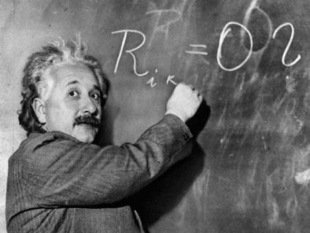
Think, Pair, Share
‘Science without religion is lame, religion without science is blind’ -Einstein
What did he mean?

