Slide 1
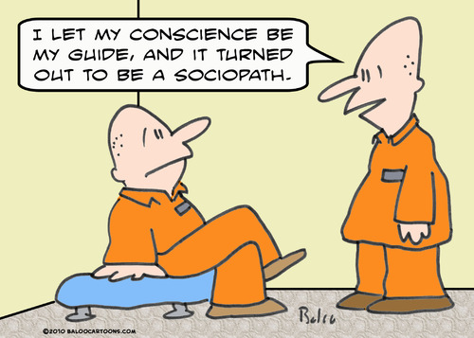
Think, pair, Share
‘Conscience is a reliable guide to moral decision making.’
Discuss in pairs.

Slide 2
Conscience: Evaluation

Slide 3
Learning Outcomes
To be able to explain some modern thinker’s views on conscience.
To be able evaluate whether conscience is a reliable guide to decision making.

Slide 4
Thinker | View on conscience | Strengths | Weaknesses
Freud
Piaget
Fromm
Kohlberg

Slide 5
Modern thinkers
Vernon Ruland
Richard Gula
Ruland tries to find a 'via media' (middle road) between rationalism and Divine Command. He views a moral decision as a reflection of
"ethics of loyal scrutiny“
which is enriched by many sources of moral and religious wisdom. It is not exclusive to Christianity, however; conscience is the interpretation of the voice of a God.
Gula says it is misleading to view conscience as a series of laws. He said that communities which influence how we see the world determine how our conscience works.

Slide 6
Vincent MacNamara
MacNamara is probably the best of the modern day ethicists to talk about in an exam. He says the conscience is not a voice, as Newman argues, but an attitude. He criticises Aquinas for referring to it as a 'faculty' we possess. Life is a moral path, MacNamara says, and it is up to us how we follow it. The attitude of our conscience shouldn't revolve around pleasure and profit. His belief is arguably quite similar to a virtue ethics approach, and he says that "It is not so much that I have a conscience as that I am a conscience"

Slide 7
Timothy O'Connell
O'Connell says that the conscience works on three levels:
our sense of responsibility for who we are and what we become
our obligation to do what is good
the concrete judgement we make to ensure good is achieved
O'Connell says that step 3 is infallible and must be followed, but he accepts that people will disagree with step 3 regarding what is good, and so states that at step 2 wrong judgements may be made. O'Connell states that morals are found through experience, not any internal or external law(s).
Daniel Maguire:
Maguire agrees with O'Connell, and adds that conscience is also shaped by experiences and culture. He also accepts that some of our values can be shaped by loss, tragedy and imagination.

Slide 8
Philosopher | Would they agree? | Strengths and who would support them? | Weaknesses and who would disagree with them?
Aquinas
St Paul
Augustine
Butler

Slide 9
Philosopher | Would they agree? | Strengths and who would support them? | Weaknesses and who would disagree with them?
Newman
Freud,
Fromm
Piaget
Kohlberg

Slide 10
‘Conscience is a reliable guide to moral decision making.’ Discuss
Create an essay plan for this question.
Who would you include?
Top philosopher:
How could you use situation ethics?
Stretch yourself: Include synoptic links – highlight these to make them clearer.

Slide 11
Can we do A * insight?
Read through the article: Can you use it to inspire your conclusion?
Can you show you’ve really thought about the question?

Slide 12
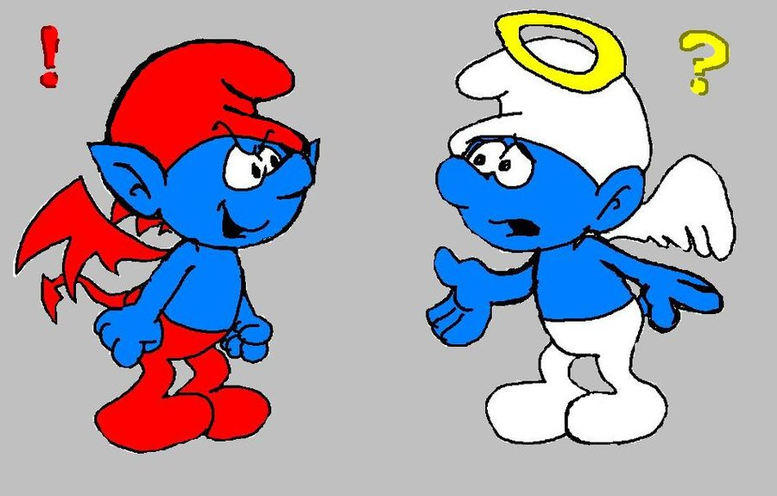
The debate
‘Conscience is a reliable guide to moral decision making.’ Discuss
A:Freud
B:Fromm
A: St Paul
B: Aquinas

Slide 13
Homework
Complete the crib sheet as part of your revision on Conscience.

