Slide 1
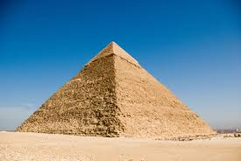
Describe this object:
Does it help describe it further by saying it exists?

Slide 2
Kant’s criticisms of the Ontological argument

Slide 3
Learning Outcomes
To understand and be able to explain Kant’s criticisms of Descartes’ Ontological argument.

Slide 4
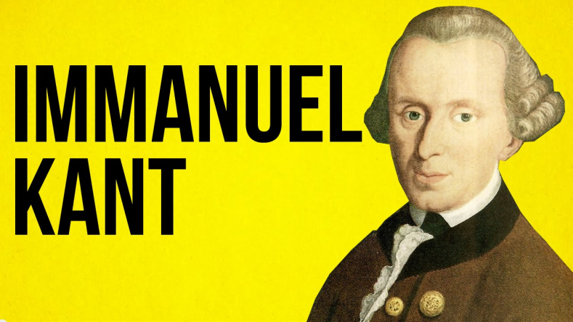
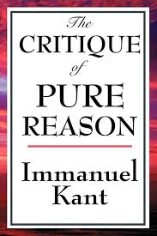
Who was Kant?
The philosopher Immanuel Kant lived in the late 18th century. He invented the phrase ‘ontological argument’ to describe the efforts of Anselm and Descartes. Kant was not at all convinced by such ‘proofs’.
Proofs = arguments not evidence

Slide 5
Kant’s first objection
His first main point is that ‘God does not exist’ is not self-contradictory. It is a statement which may be true or false.
Any statement about an object can be self-contradictory, but if the object is held not to exist in the first place then it has no essence to be contradicted.
Kant said:
you have a triangle, then it must have three sides because its a triangle, without these it is not a triangle.
But if you do not have the triangle, then you do not have three sides either.
If you accept God, it is logical to accept his existence.
But you do not have to accept God.

Slide 6
The response to Kant’s first objection
Kant’s first objection arguably deals with Descartes well – there’s nothing self-contradictory about saying that God does not exist.
But what about Anselm? Brian Davies argues that Anselm is not trying to say that we can move directly from an idea of God to knowledge of his existence.
Instead, Anselm’s focus is upon the claim that the greatest conceivable being cannot only exist in the mind. This is different from saying that God’s non-existence is self-contradictory.

Slide 7
Kant’s second objection
Kant’s second point is the (slightly) famous phrase “existence is not a predicate”.
That means, in the statement “so and so exists” the fact that he “exists” adds no real information about him.
By talking about “so and so” in the first place, we assume that he exists. Ontological arguments say that existence is one of God’s qualities, but it’s not really a quality at all – it’s just something taken for granted.

Slide 8
The response to Kant’s second objection
We can think of statements in which existence seems to add something meaningful about the subject.
If an object can be conceived of as existing or not existing, then to say that it exists means something. If an idea exists in the mind, then it is meaningful to consider whether it exists in reality as well.
For example, saying that Father Christmas exists in my mind and in reality as well tells us something about the object, because we allow for his possible existence in the mind alone.

Slide 9
Think, Pair, Share
Can you answer these questions in your pairs:
What was Kant’s first criticism?
What was the response?
b) What was Kant’s second criticism?
What was the response?

Slide 10
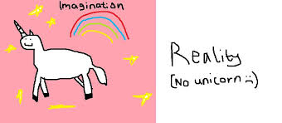
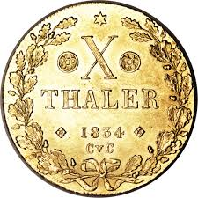
Read through the article on Kant’s criticisms…
Summarise 5 key sentences!
1)
2)
3)
4)
5)
Top Philosopher:
Explain what Plantinga thought about the argument in your own words.
Stretch yourself:
What is Kant’s Thalers analogy?

Slide 11
Complete the worksheet
Stretch yourself: What are Russell’s criticisms of the argument?
Stretch yourself: In your own opinion is existence a quality of something? Answer in your notes.

Slide 12
Kant on the Ontological argument:
First objection:
Stating that ‘God does not exist’ is not a contradiction. Unless we assume that an object exists in the first place, we cannot make contradictory statements about it.
Second objection:
“Existence is not a predicate”. Saying that X exists does not add real information about X, because by talking about X in the first place we assume that X does indeed exist.
Reply to first objection:
Anselm is not so much saying that a denial of God is a contradiction. Rather, he is suggesting that the greatest conceivable being cannot exist merely in the mind. There is a difference.
Reply to second objection
Existence is a meaningful predicate when applied to an object which can be conceived of as existing or not existing. Anselm’s argument is about the real existence of the God which exists in the intellect.

Slide 13
What is Kant’s (slightly) famous phrase?
What does he mean?
Write your own example.

Slide 14
Kant on the Ontological argument:
First objection:
Second objection:
Reply to first objection:
Reply to second objection

