Slide 1
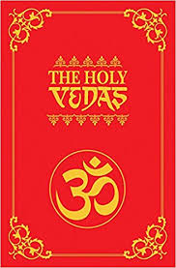
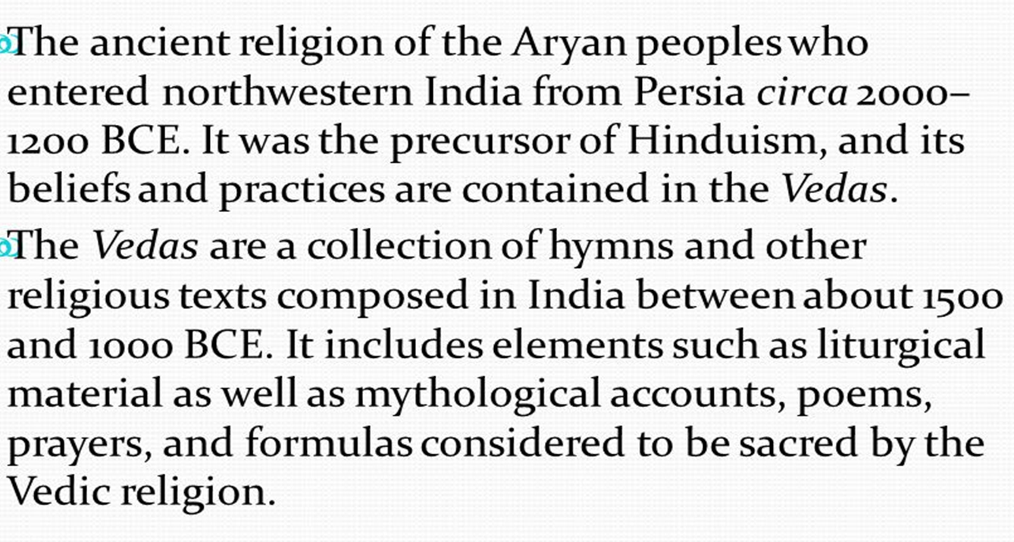
Vedic Tradition – the roots of Hinduism
Find out 4 or 5 facts about the Vedas
What is the Ramayana?

Slide 2
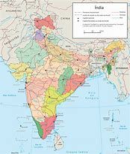
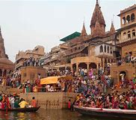
Religion in India
India had many different traditions and belief systems.
The Vedic Tradition was the oldest.
The Vedic tradition developed into Hinduism.
Later some decided that Hinduism needed reform and were known as Non-Vedic.
The Saramanic (Sharamana) movement was Non-Vedic and led to Jainism and Buddhism.
The traditions are different but share some aspects – like Karma.

Slide 3
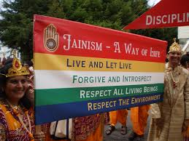
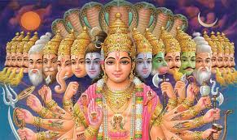
Influences on Buddhism: Hinduism and Jainism
Shramana movement – Non-Vedic movement away from Hinduism
Vedas – ancient Indian scriptures

Slide 4
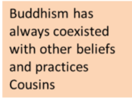
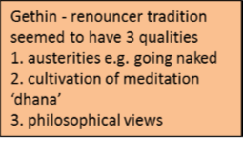
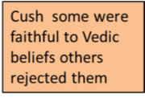
Influences on Early Buddhism: Ascetics and Shramana
One of the many eastern traditions was known as the Shramana movement. They were usually ascetics and perusing a spiritual path.
The Shramana movement was a Non-Vedic movement parallel (similar) to Hinduism in ancient India.
The Shramana tradition gave rise to Jainism, Buddhism, and Brahmanism, and was responsible for the related concepts of samsara (the cycle of birth and death) and moksha (liberation from that cycle).
These different religious groups have all influenced Buddhism.

Slide 5
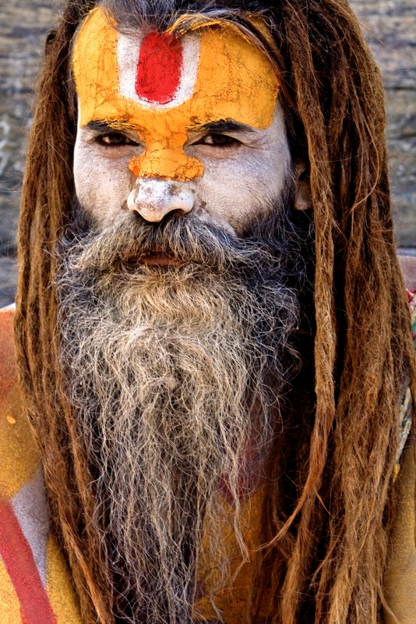
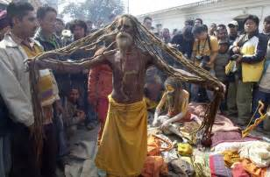
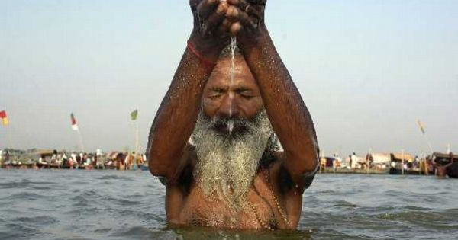
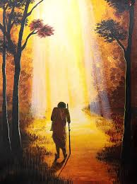
The Influence of Vedic traditions and Asceticism on Buddhism
Ascetic: A life based on denial of excesses and indulgence – often in the Brahmin/Indian traditions a wandering holy man that leaves their ‘normal’ role in society to live a spiritual live. Also known as: renouncer or samnyasin.
This is an important theme in the life of the Buddha as he is influenced by pre Buddhist ascetics and does himself renounce and live as an ascetic
Task: read ‘Gethin’ pages 9-11 (Renouncers and Ascetics)
What is this tradition?
Who practiced it?
How was it viewed in society?
Critical analysis – is there a good motivation to ‘renounce’? Are there any ethical dilemmas in this practice?
Why is this idea of rejection of materialism and society important?

Slide 6
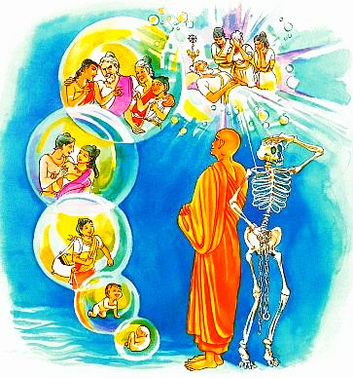
Before the Buddha
The Buddhist (and generally an eastern and Indian view is that all beings will experience rebirth many times.
All beings will experience a variety of different circumstances and lives (although the principle of ‘no self’ applies).
A being who becomes a Buddha has also had many previous lives. In various human forms, as various animal forms and according to ancient tradition as a ‘god’ (deva) residing in ‘the heaven of the contented’ (Tusita) one of the Six realms of Samsara and rebirth.
Investigate: The Realm of Deva-gati, the Realm of Devas (Gods) and Heavenly Beings

Slide 7
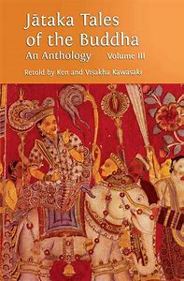
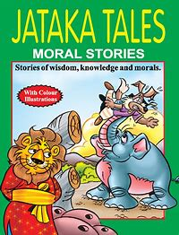
How the Buddha was influenced - Indian traditions and ascetics
In ancient tradition before the Buddha's life as Siddhartha Gautama, he lived as an ascetic named Sumedha. There a many stories and tales of the Buddha’s past lives or jatakas.
These former lives would have been pre-Buddhism so were influenced by the earlier Indian traditions (Vedic and Brahmin traditions for example)
During this life as Sumedha on his wanderings he meets Buddha Dipamkara (holy man) who impressed Sumedha with his infinite wisdom and kindness.
Sumedha is inspired to follow the 10 perfections and so is able to enter Tutsi Heaven (God Like Realm)
It’s easy to see how different pre-Buddhist traditions are woven into Buddhist ideology

Slide 8
Tusita: Realm of the God-like beings
Key Term:
In Buddhism, bodhisattva is the Sanskrit term for anyone who, motivated by great compassion, has generated bodhicitta, which is a spontaneous wish and a compassionate mind to attain buddhahood for the benefit of all sentient beings.
Pail: bodhissatta
After practicing ‘the perfections’ a being may reside in the Tusita Heaven as a God-like being.
The 10 ‘perfections’ (paramita) are:
generosity, morality, desirelessness, vigour, wisdom, patience, truthfulness, resolve, loving kindness and equanimity
After undertaking and cultivation of these 10 perfections a being can dwell in the Tusita Heaven.

Slide 9
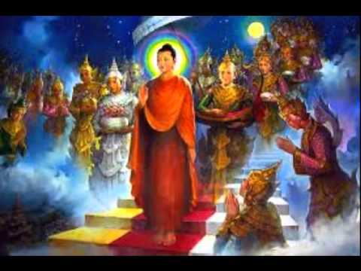
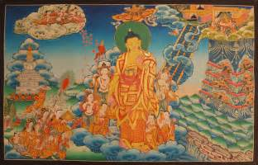
Tusita Heaven
The Tusita Heaven is one of the Six realms. Above this realm exists other realms in which reside the brahma deities. At the top of the cosmos is the arupa-loka “realm of formlessness”
In the Tusita heaven were Bodhisattva and god-like beings.
The Buddha (Siddhartha Gautama) was a Bodhisattva that cam from the Tusita Heaven to guide and support humanity.
The 12 Acts:
Completion of the 10 perfections and entering Tusita as a Bodhisattva is known as the First of the Twelve Acts in the Life of the Buddha.
AO1:You need to know detail of each of the Acts.
AO2: Compare and evaluate the significance and impact of these acts

Slide 10
Planning the Coming of the Buddha
Once the being that was Sumedha achived the 10 perfections he entered Tusita
It is rare, but not unique that a spirit or being from Tusita will come back to the Human realm.
This usually occurs when the teaching of a former Buddha ore lost and guidance is needed.
One surveying the world Bodhisattva saw that it was time for him to take a human birth and become the Buddha.
Stories tell of a council in Tusita to ascertain where he would be reborn. Eventually Jambudvip (India) was chosen as it was seen that his message would be best received there and have the most impact.
Task:
Why do you think this decision in the life of the Buddha is significant?
What comparisons could you make to the Brahmin tradition and other religions?
Why might this show the Buddha as an important role model to Buddhists?

Slide 11
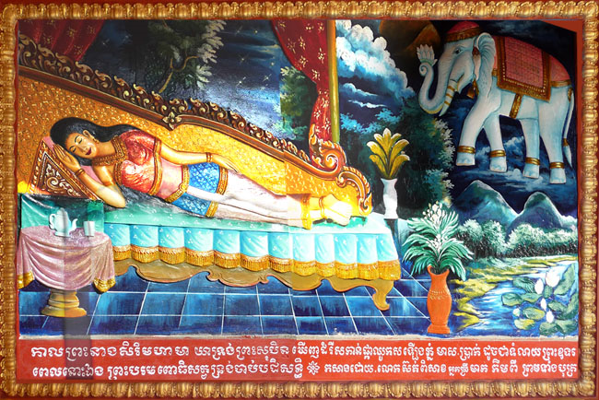
The Conception of the Buddha
As with many Buddhist tests and stories there are many versions – some seen as more literal others symbolic. The interpretation varies.
At the time of his conception the Buddha’s mother, Maya, dreamed that a white elephant entered her womb. In some versions this was through her side using a tusk.
In the Pali Cannon it is suggested that his conception occurred directly from Tusita Heaven, with no mention of intercourse or his father’s involvement at all. It is sometimes stressed that the Queen was in fact under a vow of chastity at the time.
This vision was interpreted to mean that the child would be a great leader or king – or an influential holy man.
This story is sometimes seen as symbolic and points to how the Buddha’s conception shows he is of a special and different nature, even at this early stage.
AO2 – Evaluate
What do these events show about the historical Buddha?
Why is this event seen as important in the life of the Buddha?
How do some aspects of the story signify the Buddha’s special nature
Why might some say this part of the story is more symbolic than literal?
How does Cush interpret the events? (page 13)

Slide 12
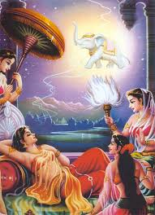
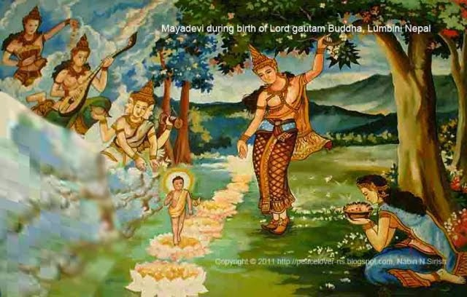
The Birth of the Buddha and his life
These events are known as the 2, 3 and 4th Acts.
Task: Describe each of the Acts in detail ‘Gethin’ page 19
Task : Investigate (using ‘Gethin’ 19-21) Acts 5-8

Slide 13
The Birth and early Childhood
The Buddha was born on the full moon of May in a Garden called Lumbini. There are various versions of the birth but common themes run throughout:
Questions:
According to the Plai Cannon (scripture) what happened after the Buddha’s birth?
What is the symbolic importance of the events?
Why do you think these events are seen as important?

