Slide 1
What the Buddha taught: The Dharma The Three Marks of Existence The Four Noble Truths The Noble Eightfold Path

Slide 2
Questions, questions, questions….
Approximately, when did the Buddha live?
Who wrote the first full length biography of the Buddha?
What happens to a story that gets passed down orally?
What is the earliest source for the Buddha’s life? What is the problem with this source?
What does the term legend mean? What motive would people have to exaggerate or to embroider these stories?
6. What is meant by the term ‘myth’? Give an example
7. What does the term hagiography mean in relation to the life story of the Buddha?
8. Identify a poem from the Dhammapada to help explain what the Buddha felt when he achieved enlightenment

Slide 3
We will discuss in groups what happiness looks like
You will consider follow up questions such as What would you need to be happy in life and is there such a thing as being permanently happy?
We will be introduced to the starting point of the Buddha’s teachings
You will consider a quote from the Buddha on the Middle Way and its links to happiness
You will analyse a passage from Old Path, White Clouds by Thich Nath Hanh on the importance that the Buddha put on the dharma
We will be introduced to the Three Marks of Existence
You will analyse and discuss anatta, anicca and dukkha
You will use 150 words or less, explain each of the Three Marks of Existence in Buddhism
You will take your learning further – and look to explain how each of the Three Marks of Existence are linked
We will be introduced to the Four Noble Truths
You will explain how the analogy of a doctor diagnosing a patient is a good way of understanding the Four Noble Truths
You will comment on the view that the Four Noble Truths are at the heart of Buddhist teachings
You will explain how the parable of the poisoned arrow demonstrates how the Buddha taught that life is so short so it must not be spent in endless metaphysical speculation
We will be introduced to the Eightfold Path
You will discuss the statement: ‘The Eightfold Path is a classic path for morality’ and write an explanation of your viewpoint to show your understanding of the Eightfold Path as the Middle Way and a path to enlightenment
You will analyse why the Buddha described the Eightfold Path as a means to enlightenment, like a raft for crossing a river. Once one has reached the opposite shore, one no longer needs the raft and can leave it behind and look to explain what you think he means by this [you can incorporate this into your first answer]

Slide 4
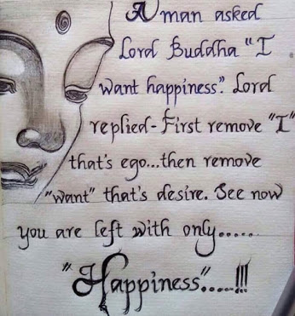
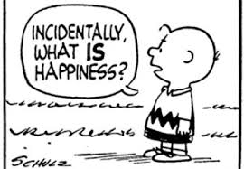
A question to start….
On reflection, what is happiness?
What would you need to be happy in life?
Are there many things or just a few things?
Would these things make you permanently happy?
Is there such a thing as permanently happy?

Slide 5
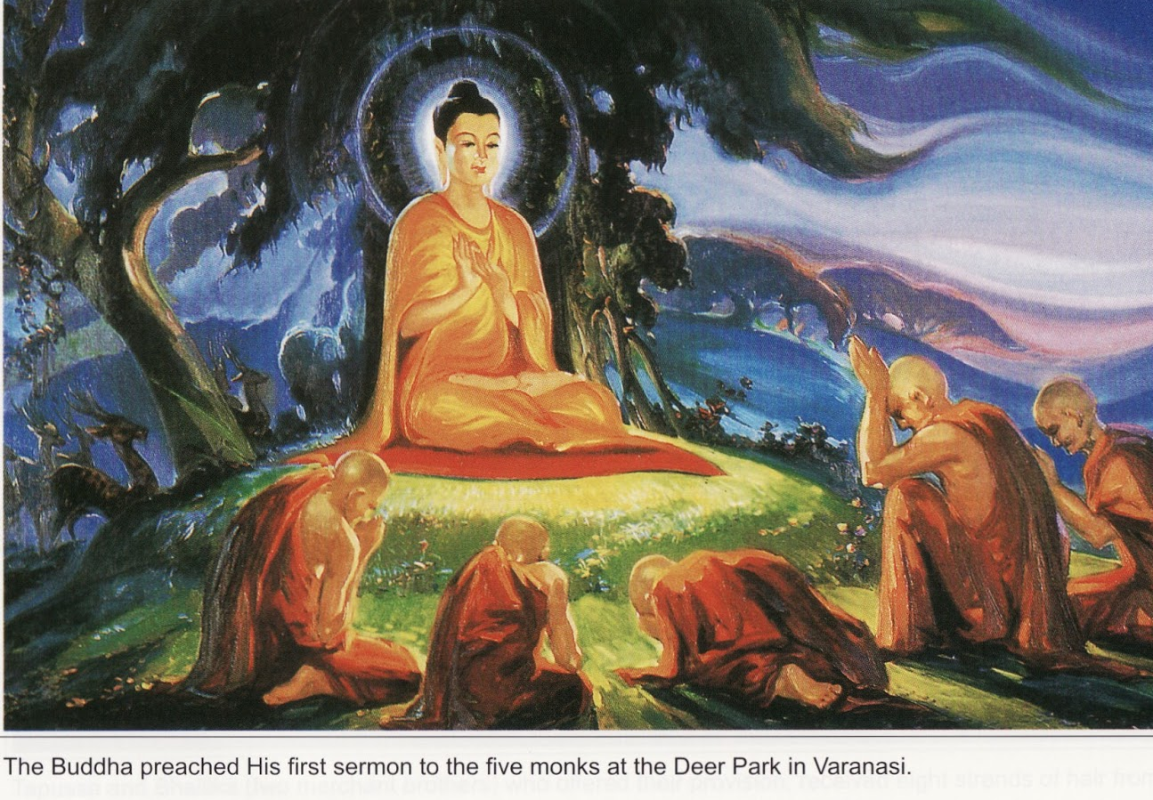
The life of the Buddha
So far we have studied the life of the Buddha up until his enlightenment
We will now look at the next part of his life and what he taught

Slide 6
Deer Park Sermon
The Buddha was once living in the Deer Park at the Resort of Seers and there he gave sermon for the first time to the group of five monks. He warns them over extreme devotion to the indulgence of sense-pleasures as well as self-mortification:
“Avoiding both these extremes, I have realized the Middle Path: It gives vision, it gives knowledge, and it leads to calm, to insight, to enlightenment, to Nirvana”
TASK:
What two extremes is the Buddha referring to and how are these extremes demonstrated in the hagiography of the Buddha?

Slide 7
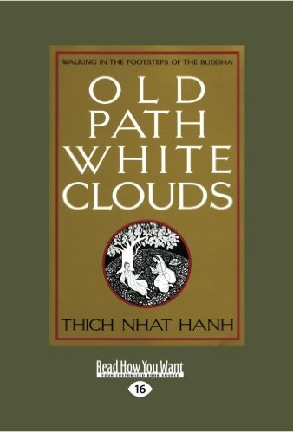
Old Path, White Clouds
Old Path White Clouds presents the life and teachings of Gautama Buddha.
Drawn directly from 24 Pali, Sanskrit, and Chinese sources, and retold by Thich Nhat Hanh.
This book traces the Buddha's life over the course of 80 years, partly through the eyes of Svasti, the buffalo boy, and partly through the eyes of the Buddha himself.

Slide 8
Deer Park Sermon
Within this sermon, the Buddha started to teach what he had discovered from his enlightenment. Look at the following from Old Path, White Clouds by Thich Nath Hanh
One who sees the Dhamma sees me. One who sees me sees the Dhamma.
O monks and wise men, just as a goldsmith would test his gold by burning, cutting and rubbing it, so must you examine my words and accept them, not merely out of reverence for me.
My teaching is not a philosophy. It is the result of direct experience... My teaching is a means of practice, not something to hold onto or worship. My teaching is like a raft used to cross the river. Only a fool would carry the raft around after he had already reached the other shore of liberation.
If you were to follow the Dharma purely out of love for me or because you respect me, I would not accept you as disciple. But if you follow the Dharma because you have yourself experienced its truth, because you understand and act accordingly - only under these conditions have you the right to call yourself a disciple of the Exalted One. From Old Path, White Clouds by Thich Nath Hanh

Slide 9
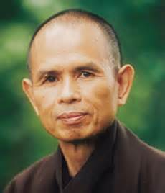
Deer Park Sermon
Within this sermon, the Buddha started to teach what he had discovered from his enlightenment. Look at the following from Old Path, White Clouds by Thich Nath Hanh
TASK:
Using the passage as a reference, explain the importance of the dharma in Buddhism and the importance the Buddha placed on people to experience it for themselves
Use the worksheet provided
Thich Nath Hanh is important in our study of Buddhism and we will return to him and his contribution to understanding modern Buddhism

Slide 10
The Three Lakshanas (the Three Marks of Existence)
The Buddha said: “I teach one thing and one thing only:
“suffering and the end of suffering”
(this is the goal of Buddhism)

Slide 11
The Three Lakshanas (the Three Marks of Existence)
The Buddha set out the ‘human existence’
There are only three things that we can be completely sure of
(We cannot know whether the world was created by God
We cannot know whether there is life after death)
So all we can be sure of is that existence has three qualities:
Dukkha – suffering/not being satisfied
Anicca – impermanence
Anatta – no permanent self

Slide 12
The Three Lakshanas (the Three Marks of Existence)
1: Dukkha
Dukkha can be difficult to translate, most often translated as ‘suffering’
Some scholars see this translation as misleading – Walpola Rahula says that this translation is: “highly unsatisfactory and misleading. It is because of this limited, free and easy translation, and its superficial interpretation, that many people have misled into regarding Buddhism as pessimistic”
Another scholar, John Snelling says: “At one extreme it takes in the most dire forms of mental and physical pain: the agonies of cancer, for instance, and the anguish of someone who falls prey to total despair. It covers our everyday aches and pains, our petty dislikes and frustrations too; and it extends to very subtle feelings of malaise”
The Buddha explained that happiness can happen in this lifetime (such as when he was in his father’s palace) but the importance of his teachings was that is no happiness is ever permanent, all happiness is ‘tainted’

Slide 13
The Three Lakshanas (the Three Marks of Existence)
1: Dukkha
This ‘taint’ is dukkha. It does not mean suffering, it just means the absence if total, perfect happiness. Dukkha is not only about good things coming to an end, it is about everything being fundamentally imperfect, even if only slightly.
The Buddha taught that dukkha touches everything that exists – it is a ‘mark’ or ‘quality’ or ‘characteristic’ of existence – this means it is a fundamental philosophical concept requiring a great deal of explanation
Discussion point:
Is the Buddha right? Is life full of suffering and satisfactoriness? Think about our starting discussion in this lesson

Slide 14
The Three Lakshanas (the Three Marks of Existence)
Anicca
Even the things that seem most solid, like land or mountains, are in fact in flux (or constant change)
Discussion point:
Is the Buddha right? Is everything in constant change? Can you think of any exceptions? The Buddha taught that anicca is linked to dukkha – why do you think this is so?

Slide 15
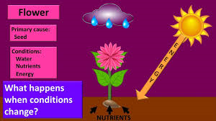
The Three Lakshanas (the Three Marks of Existence)
2: Anicca
A good example of this is the flowers often placed by Buddhists on their shrines. Real flowers don’t exist forever. They are obviously dependent on water for their existence, and if this dries up (which it does, as water evaporates – it is not stable, it is constantly changing) then the conditions for the flower’s existence change and it decays
The Buddha taught that impermanence is true in all things. Therefore Buddhists see all things (people, objects, states of mind, relationships, qualities, everything!) as being dependent on causes and conditions, and we are therefore constantly changing – nothing remains forever….
A flower is a good example if the transience of all things, because a flower perceptibly changes and decays. Buddhism says that this transience is a feature of all things. A plastic flower may have the ability to last forever, but actually it is decaying too, just much more slowly than the real flower

Slide 16
The Three Lakshanas (the Three Marks of Existence)
Challenge:
Use the article to help you explain the idea of dependant arising and the idea of contingence linked to anicca. Make links to scholars or thinkers or examples mentioned in the article
Tasks:
Briefly summarise the teaching of the Mustard Seed
Explain the links to the idea and realisation of Annica and its links to Dukkha
How did this realisation help Kisa Gautami?
Do you think this realisation can help people?

Slide 17
The Three Lakshanas (the Three Marks of Existence)
Anatta
However the Buddha taught that this was a mistake to think in this way. The self, he taught, was dependent on the coming together of five ‘skandhas’ or bundles, all of which are changing
Most religions argue that there is a soul, or an inner spark or essence of the person, which is eternal – the religion that the Buddha grew up in would have taught him that the atman would have been eternal and unchanging ‘self’
A good example of trying to explain this is a bicycle! What we call a bicycle is really a collection of other things, put together in a temporary (impermanent) arrangement. It has no fixed identity. Buddhism says this idea applies to everything, including human beings. Just like the bicycle, a human being is a collection of parts (skandhas) which themselves are subject to change.
These skandhas are Form (body), Sensations, Perceptions, Mental formations (impulses and habits) and Consciousness. None of these could be described as the soul or the essence of the person, not even consciousness, because there is no consciousness. Because the self is dependent on these five changing skandhas, it is, itself in flux, dependent and impermanent.

Slide 18
The Three Lakshanas (the Three Marks of Existence)
3: Anatta
The five skandhas are like five heaps of sand – put them together and you have one. They come together in a unique combination when a person is born, and they fall apart when that person dies
Discussion point:
Is the Buddha right? Is this way of describing the human condition completely different to anything you have heard before?

Slide 19
The Three Lakshanas (the Three Marks of Existence)
Dukkha
Anicca
Anatta
TASK:
Using 150 words or less, explain each of the Three Marks of Existence in Buddhism
Take your learning further – explain how each of the Three Marks of Existence are linked
Use the further reading hand-out to help support your learning and understanding of the Three Marks of Existence

Slide 20
The Four Noble Truths
The Buddha clarified his teachings with the Four Noble Truths

Slide 21
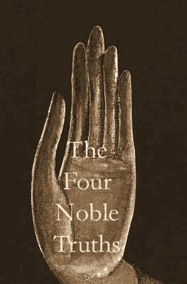
The Four Noble Truths
The Four Noble Truths
The Buddha taught the Four Noble Truths in his first sermon at the Deer Park:
Dukkha
Samudaya (the arising of dukkha)
Nirodha (the cessation of dukkha)
Magga (the way)

Slide 22
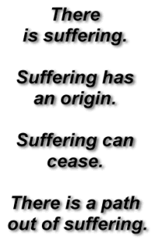
The Four Noble Truths
These truths are usually explained as follows:
All life is dukkha
Dukkha is caused by tanha (‘thirst’, desire, attachment, craving)
Tanha can be overcome, therefore dukkha can be overcome
Tanha can be overcome by following the Eightfold Path

Slide 23
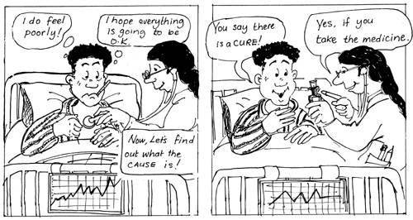
The Four Noble Truths
Often the analogy of a doctor diagnosing the illness and prescribing the cure is used to help explain the Four Noble Truths…..

Slide 24
The Four Noble Truths
1. All life is Dukkha
The Buddha explained that happiness can happen in this lifetime (such as when he was in his father’s palace) but the importance of his teachings was that is no happiness is ever permanent, all happiness is ‘tainted’
We have discussed this within the Three Marks of Existence…

Slide 25
The Four Noble Truths
2. The cause of suffering is craving
At the start of this lesson we talked about what would make us happy. The things we discussed sums up the second of the Four Noble Truths – as we think that the things we crave in life will make us happy. The Buddha fundamentally disagreed…
The reason why we find life to be unsatisfactory is because we rely on things to make us happy, when these things are unreliable
Why are these things unreliable?
Anicca - they change (remember Kisa Gautami)
We want things to say the same, but they don’t: they decay and die
Tanha - refers to this relationship of reliance of attachment

Slide 26
The Four Noble Truths
2. The cause of suffering is craving
It will cause us dukkha because our actions are dominated by three poisons:
Greed
Hatred
Ignorant
These are the poisons that cause us to grasp at things – to crave things - Tanha
Is it fair to describe humans like this? Let’s look at this further –
Are humans greedy?
Do humans love to hate?
Are we ignorant? What does ignorance mean in this context?

Slide 27
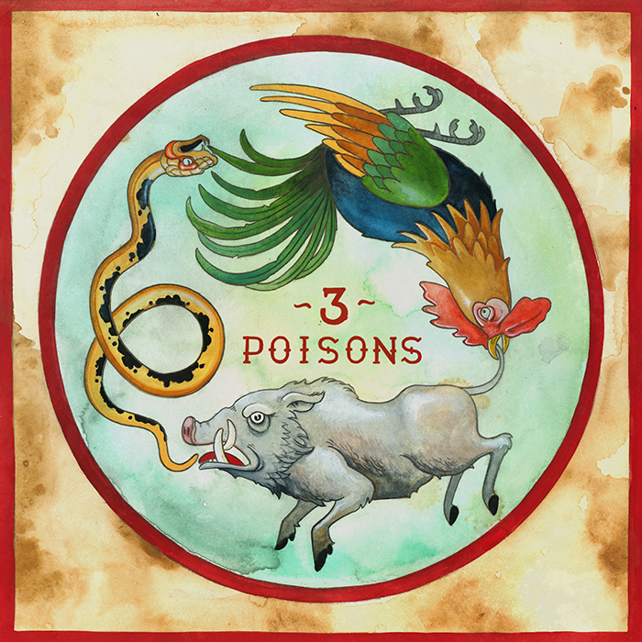
The Four Noble Truths
2. The cause of suffering is craving
What is the symbolism of each of the animals?
Greed refers to our desire to possess things and people in the belief that they will improve our lives
Hatred is a powerful emotion that ties us unhappily to others
Ignorance refers to our ignorance or illusion about the way things really are
When our actions are motivated by the Three Poisons, we end up suffering

Slide 28
The Four Noble Truths
3. The way to overcome dukkha is to overcome tanha
We must overcome our desires – then we can overcome our frustrations
The problem is that people who feel emotionally empty will want to grasp
Therefore we must discover inner satisfaction and an appreciation of life as it really is, to find happiness inside ourselves instead of relying on other things

Slide 29
The Four Noble Truths
4. The way to overcome tanha is follow the Middle Way
So a life of the Middle way is not only about avoiding extremes of luxury and asceticism, it is about avoiding extremes views about the nature of existence, such as nihilism or eternalism, or whether there is a creator, or whether there is life after death
It seems that the Buddha classed these views as metaphysical speculation
They are speculation because we cannot prove them one way or another, and even if we could, it would not help in the struggle to overcome dukkha
To follow the Middle Way, one will need to follow the Eightfold Path…..

Slide 30
The parable of the poisoned arrow
The parable – told by the Buddha - is considered a teaching on being practical and dealing with the situation at hand.

Slide 31
The Parable of the Poisoned Arrow
If we are concerned about 'what created the world?' and 'why are we here?' then consider the parable of the poison arrow.
A man went to the Buddha insisting on answers to these questions, but the Buddha instead put a question to him: "If you were shot by a poison arrow, and a doctor was summoned to extract it, what would you do? Would you ask such questions as who shot the arrow, from which tribe did he come, who made the arrow, who made the poison, etc., or would you have the doctor immediately pull out the arrow?"
"Of course," replied the man, "I would have the arrow pulled out as quickly as possible." The Buddha concluded, "That is wise, for the task before us is the solving of life's problems; until the problems are solved, these questions are of secondary importance."
Life does not depend on the knowing how we got here or what will happen after we are gone. Whether we hold these views about these things or not, there is still suffering, sorrow, old age, sickness, and death.

Slide 32
The Four Noble Truths
TASKS:
Explain how the analogy of a doctor diagnosing a patient is a good way of understanding the Four Noble Truths
Comment on the view that the Four Noble Truths are at the heart of Buddhist teachings
How does the parable of the poisoned arrow demonstrate how the Buddha taught that life is so short so it must not be spent in endless metaphysical speculation?
Use the further reading hand-out to help support your learning and understanding of the Four Noble Truths

Slide 33
The Eightfold Path
Discussion Point:
Could we in this classroom – in five minutes – come up with 8 rules that people should try to live by?

Slide 34
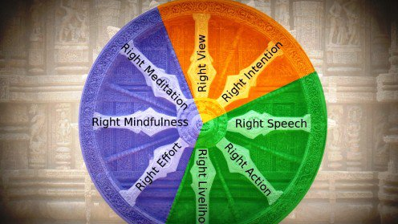
The Eightfold Path
The Buddha taught people to follow the Eightfold path to live in the Middle Way

Slide 35
The Eightfold Path
The path’s aspects can be grouped into three sections:
Wisdom (panna) –
Right understanding
Right thought
Morality (sila)
Right speech
Right action
Right livelihood
Meditation (samadhi)
Right effort
Right mindfulness
Right concentration

Slide 36
The Eightfold Path
Right Understanding
Understanding what the Buddha taught about impermanence and no-self
This might take lifetimes to perfect
To understand the truth: about how things really are and how they are different from our ‘ordinary; understanding

Slide 37
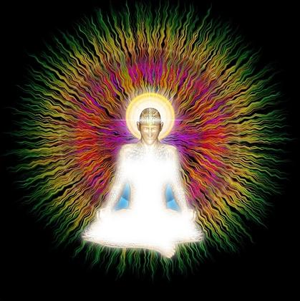
The Eightfold Path
Right Thought
Not only actions create karmic results
If, in our mind, we are hating or desiring that will inevitably affect our actions in a negative way
If we purify our minds of hatred and desire, then no negative actions or suffering can follow

Slide 38
The Eightfold Path
Right Speech
Buddhists are very aware of the consequences of things that they say
Have you said anything that you have regretted?
Have one of your friends said something that has hurt you?
Buddhists try not to gossip, or to lie, o to be argumentative, or to indulge in the sort of speech that is really designed to inflate the self and out others down
Buddhists try to speak the dharma whenever it is appropriate

Slide 39
The Eightfold Path
Right Action
This involves taking ‘the precepts’ and attempting to live by them – this is connected with the sangha (community) –
I undertake to abstain from harming
I undertake to abstain from taking anything that is not given
I undertake to abstain from misuse of the senses
I undertake to abstain from the misuse of speech
I undertake to abstain from taking any substance that clouds the mind

Slide 40
The Eightfold Path
Right Livelihood
Buddhist should not have an occupation that brings harm to others
Can you think of some occupations that this might cover?

Slide 41
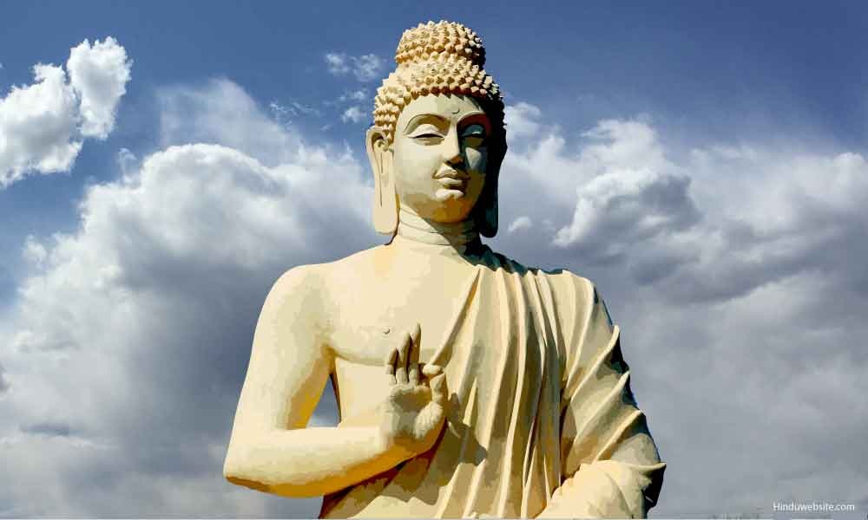
The Eightfold Path
Right Effort
The effort to avoid desire – which critics say is hard, after-all are Buddhists attached to the ‘desire’ of reaching nirvana?
They answer that desire is only bad if it is desire for oneself. The enlightened know that self is an illusion and that only the enlightened can teach others the way out of suffering
So the desire for enlightenment is good because it will benefit others

Slide 42
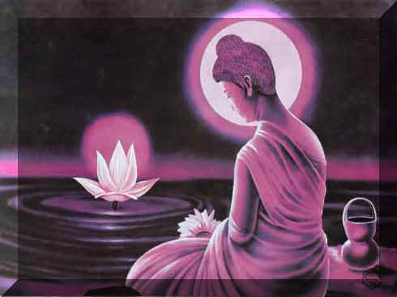
The Eightfold Path
Right Mindfulness
Buddhists try to live in a state of mindfulness at all times
Having the awareness of the consequences of thought, speech and actions, and to think, act and speak skilfully

Slide 43
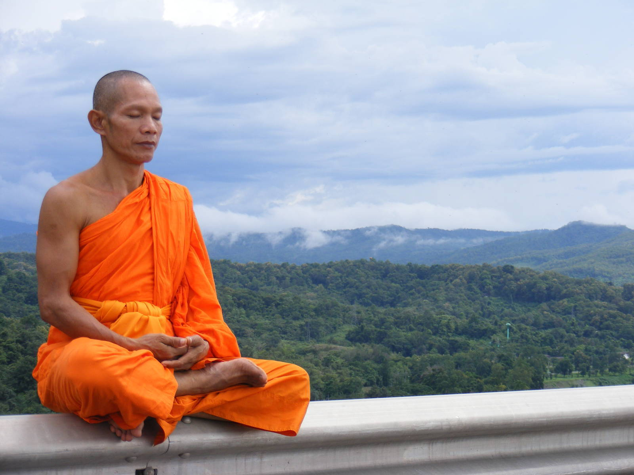
The Eightfold Path
Right Concentration
The proper use of meditation to gain insight into the true nature of things such as the self as a collection of the skandhas constantly in flux
Remind us what are the skandhas?
The arising and ceasing of desires and delusion and the connectedness of all beings and all aspects of the universe

Slide 44
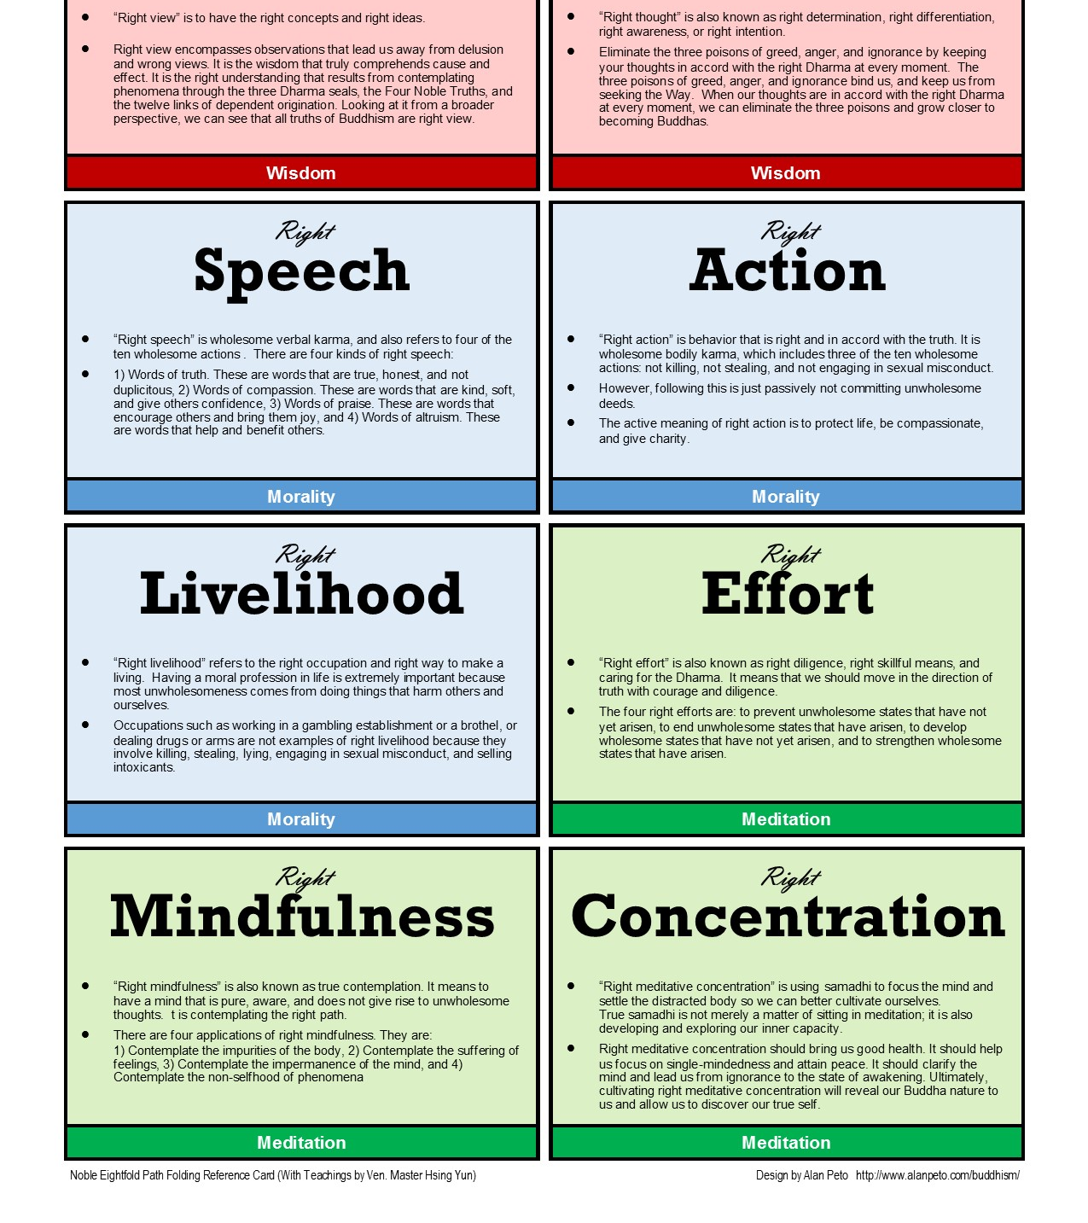
The Eightfold Path
TASKS –
‘The Eightfold Path is a classic path for morality’ – discuss this statement – write an explanation of your viewpoint to show your understanding of the Eightfold Path as the Middle Way and a path to enlightenment
The Buddha described the Eightfold Path as a means to enlightenment, like a raft for crossing a river. Once one has reached the opposite shore, one no longer needs the raft and can leave it behind – explain what you think he means by this [you can incorporate this into your first answer]

Slide 45
Questions, questions, questions….
Approximately, when did the Buddha live?
Who wrote the first full length biography of the Buddha?
What happens to a story that gets passed down orally?
What is the earliest source for the Buddha’s life? What is the problem with this source?
What does the term legend mean? What motive would people have to exaggerate or to embroider these stories?
6. What is meant by the term ‘myth’? Give an example
7. What does the term hagiography mean in relation to the life story of the Buddha?
8. Identify a poem from the Dhammapada to help explain what the Buddha felt when he achieved enlightenment
9. Explain what you understand about the Three Marks of Existence
10. Identify the Four Noble Truths
11. What are the two strand of the Eightfold Path that come under ‘Wisdom’?
12. What are the three strand of the Eightfold Path that come under ‘meditation’?
13. What are the three strand of the Eightfold Path that come under ‘morality’?
14. What is meant by impermanence in Buddhism?

Slide 46
What will progress look like today?
We will discuss in groups what happiness looks like
You will consider follow up questions such as What would you need to be happy in life and is there such a thing as being permanently happy?
We will be introduced to the starting point of the Buddha’s teachings
You will consider a quote from the Buddha on the Middle Way
You will analyse a passage from Old Path, White Clouds by Thich Nath Hanh on the importance that the Buddha put on the dharma
We will be introduced to the Three Marks of Existence
You will analyse and discuss anatta, anicca and dukkha
You will use 150 words or less, explain each of the Three Marks of Existence in Buddhism
You will take your learning further – and look to explain how each of the Three Marks of Existence are linked
We will be introduced to the Four Noble Truths
You will explain how the analogy of a doctor diagnosing a patient is a good way of understanding the Four Noble Truths
You will comment on the view that the Four Noble Truths are at the heart of Buddhist teachings
You will explain how the parable of the poisoned arrow demonstrates how the Buddha taught that life is so short so it must not be spent in endless metaphysical speculation
We will be introduced to the Eightfold Path
You will discuss the statement: ‘The Eightfold Path is a classic path for morality’ and write an explanation of your viewpoint to show your understanding of the Eightfold Path as the Middle Way and a path to enlightenment
You will analyse why the Buddha described the Eightfold Path as a means to enlightenment, like a raft for crossing a river. Once one has reached the opposite shore, one no longer needs the raft and can leave it behind and look to explain what you think he means by this [you can incorporate this into your first answer]

