Slide 1
Reviewing the Mahayana
Presentation 1.
The Madhyamaka

Slide 2
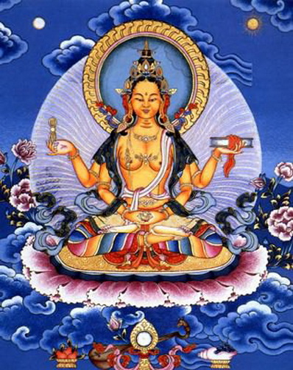
Madhyamaka – Origins P114 in Harvey PDF
Began with The Perfection of Wisdom sutra – Buddha
Where? When?
Nagarjuna presented a commentary called
What was it called? What does it seek to do?

Slide 3
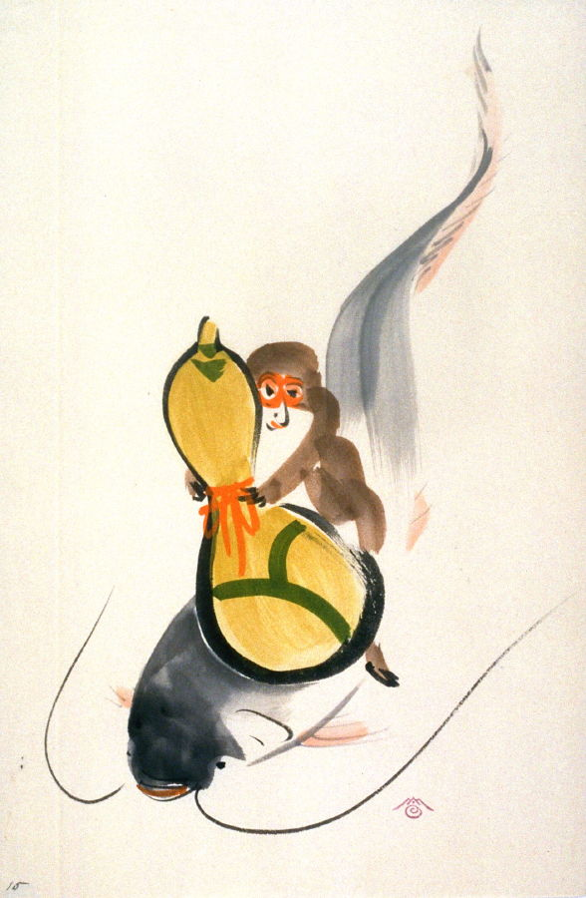
P115 Sunyatavadin orientation Sunyata = emptiness
What, according to this tradition is wrong with Buddhist texts that claim to have ‘grasped’ the true nature of reality?
Refer to the catfish and the gourd analogy!
Dharmas = partless atoms
‘The Theravadins are subtly self-seeking’ Justify this claim.

Slide 4
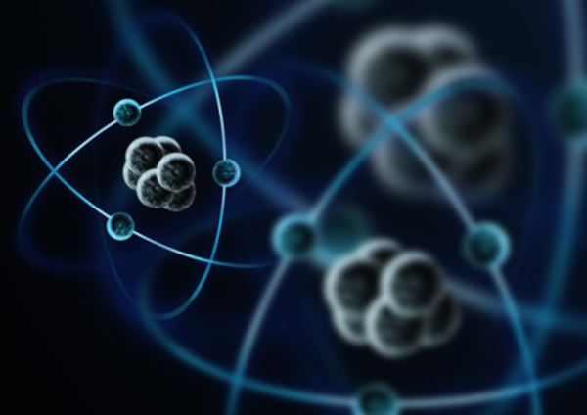
Empty dharmas and conditioned arising (dependent origination)
Perfection of Wisdom argues that Theravada Abhidharma philosophy does not go far enough in its understanding of anatta.
Why? What had it not properly understood?

Slide 5
Svabhava – own nature page 117
Paul Williams says Svabhava refers to Intrinsic / inherent existence. Explain…

Slide 6
Madhyamaka and Conditioned Arising Page 117
Anything that arises according to conditions can have no inherent nature.
Since what it depends upon conditions it.
If there is nothing with ‘own nature’ it logically follows there can be no ‘other’ nature. (para bhava)
What does this mean?
So if things don’t have ‘own nature’ as they are dependent and nor do they have ‘other nature’ then nothing can have any true substantial nature at all.
If there is nothing truly existent, it logically follows that there can be no ‘non-existent’.
Conclusion? – Things neither exist nor do they not exist – they are like dreams and illusions (maya)

Slide 7
Dharmas aren’t unreal
Ungraspable nature – different from what they seem.

Slide 8
Madhyamaka and Appearances (bottom of p117)
We do experience appearances.
Therefore It would be wrong to deny that there are appearances.
However they don’t have substantial existence.
What we experience is NOT ultimately true.
What we experience IS relatively true.
A thing does not exist ‘on its own’. It is a passing interdependent phenomenon
A thing is what it is only in relation to other things and they are what they are in relation to other things and so on and so on.
Example….

Slide 9
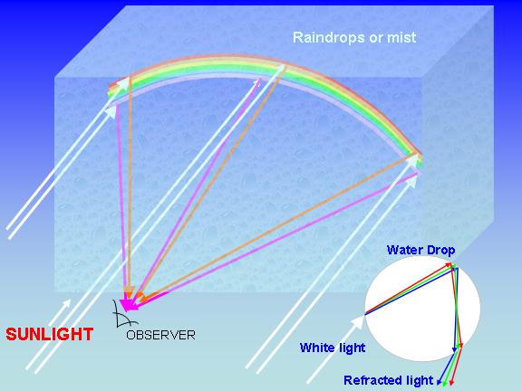
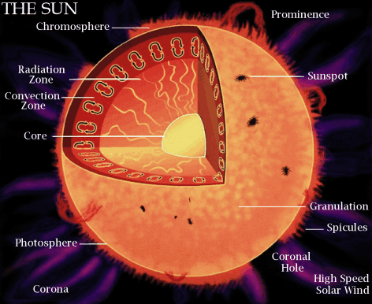
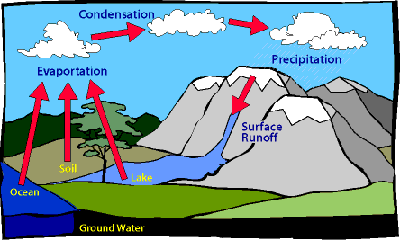
Rainbow
An obvious illusion.
The rainbow is nothing on its own.
It is what it is in relation to the sun, the mist/rain and an observer.
But each one of these things is only what it is in relation to other things
Banned!

Slide 10
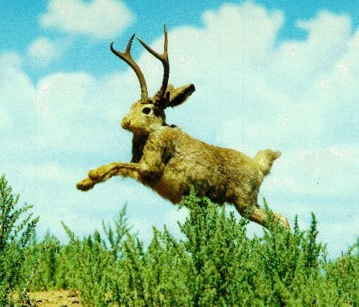
The Middle Way p117
The nature of dharmas lie between absolute ‘non-existence’ and substantial ‘existence’
Annhiliationsim
Eternalism

Slide 11
Madhyamaka – The two truths p119
The Buddha taught 2 levels of truth
Conventional (or relative) – our ‘day to day’ understanding;
Ultimate – The more precise understanding following analysis.
This originated in the Abhidharma texts
Conventional = ‘person’ ; Ultimate = dharmas (atoms)
Madhyamaka takes this a step further
Even dharmas are conventional.
Conventional is ‘true’ because we agree that certain sounds refer to certain appearances.
Language actually determines how we see the world.
However language is also just a convention though. It is also dependent.

Slide 12
Emptiness p120
All things lack inherent nature.
One dharma is not distinguishable from another
Heart Sutra “Whatever is material shape, that is emptiness, whatever is emptiness, that is material shape”
‘Emptiness’ is not an ultimate ‘base’ or ‘substance’ of the world. (Like ‘Brahman’ in the Vedas)
The world is a web of fluxing, interdependent, baseless phenomena
Emptiness is an adjectival quality of dharmas, not a substance which composes them.
It is neither a thing nor is it nothing ness
It refers to the fact that reality cannot be pinned down with concepts – it is essenceless and so… nothing to cling to!

Slide 13
Verses on the Middle way
“Whatever is conditioned arising,
That is explained to be emptiness.
That, being a dependent designation
Is itself the middle way”
Nagarjuna

Slide 14
Form is emptiness – emptiness is form
Sutra

Slide 15
Madhyamaka and AO2? p121 Harvey
What parallels might there be between physics and
and emptiness?
How might Theravadins criticise emptiness as subverting the Buddha’s teaching?
How did Nagarjuna reply to this criticism?
If suffering had ‘own nature’ it would be causeless and eternal and thus never-ending.
What has zero got to do with it?! 0?

Slide 16
Skilful Means p121
All Buddhist teachings are ‘provisional devices’
Their purpose is to induce people into a skilful frame of mind, in which there can be insight into the inexpressible ultimate truth.
Nagarjuna reduces every view to absurdity. All logical views about anything are untenable (they don’t work!)

Slide 17
Refuting causes p122
Things don’t arise from things that are identical to themselves
This leads to pointless duplication – experience contradicts this
Things don’t come about from things that are ‘other;’ than it.
This would mean anything could cause anything
Things are caused by both ‘self-production’ and ‘other’
This incurs the problems of the above two
Things are caused spontaneously, without cause.
This would make for an unpredictable chaos.
Conclusion: although things appear to be caused, ultimately there are no real ‘things’ which ‘originate’

Slide 18
Philosophy as an antidote p123
Emptiness is the ‘antidote’ to all theories
“Emptiness is proclaimed by the Buddhas as the refutation of all views; but those who hold ‘emptiness’ as a view are called incurable” (Nagarjuna)
‘Logical judo’ with his opponents ie use their logic to defeat logic itself!

Slide 19
Thusness p124
Ultimately even ‘emptiness’ is to be given up.
Why?
“The emptiness of all dharmas is empty of that emptiness”
Ultimate truth is ‘inconceivable’ and ‘inexpressible’
“Thusness” is it’s very ‘as-it-is-ness’ – without adding anything conceptually or taking anything away: it is simply ‘thus’.
“Fools cannot harm it and the wise cannot improve it”
Milarepa (11th century)

Slide 20
Nirvana and Samsara p125
“There is not the slightest difference between the two” (Nagarjuna)
Since Nirvana only exists in relation to samsara it is thus empty.
Theravadins also conceived of nirvana as empty of defilements.
“All dharmas are nirvanic from the very beginning”
They are not two separate realities, but the field of emptiness (dharmadhatu) seen as samsara by the ignorant and as nirvana by the wise.

Slide 21
Madhyamaka and Bodhisattvas
The Bodhisattva need not seek to escape samsara to attain nirvana.
S/he can tirelessly work for all beings sustained by the idea that nirvana is already present within samsara.
Advanced bodhisattvas directly experiences the non-duality (not separateness) of samsara and nirvana.

Slide 22
Madhyamaka and Buddha nature
The nature of Buddhahood is itself emptiness as is the nature of everything.
Therefore all beings are said to have a nature that is not different to buddhahood.
Without this ‘buddha nature’ beings could never create buddhahood.
The goal then, is not to ‘attain’ something they don’t possess, but to uncover and know their buddha nature.
The task of the bodhisattva is to skilfully help them with this.

