Slide 1
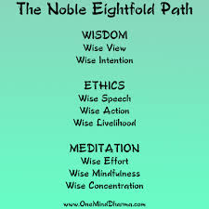
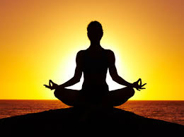
Task:
Create a mind map as a basic introduction to each key aspect

Slide 2
What is Meditation?
The usual term for meditation is bhāvāna, which means ‘cultivation’ or literally ‘making become’. The literal meaning is quite appropriate, for meditation is the principle Buddhist strategy for making oneself what one wishes to be.

Slide 3
Temples:
key features and uses
Stupas and Pagodas
Links to Sanga
Shrines and offerings – personal relationship with Buddha
Monasteries

Slide 4
Purpose of Worship
How Buddhists Worship:
Chanting
Mantra recitation

Slide 5
Practice of Meditation
Purpose of Meditation
Links to the historic life of the Buddha – enlightenment and jhanas
Links to Dharma – the 3 Jewels (8 Fold Path)
Research: a Buddhist centre and their resources and ideas about meditation and its importance

Slide 6
Samatha Meditation
Meaning
Mindfulness of breathing
Postures in Samantha meditation
The Purpose and aim of Samatha meditation

Slide 7
Vipassana Meditation
Meaning and purpose - Insight meditation, use of objects
Visualisation
Use of Thangkas or Mandalas

