Slide 1
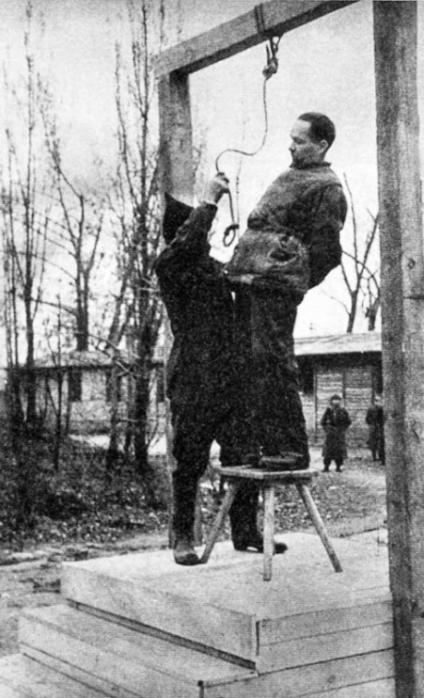
Is murder wrong?
A: What is murder?
B: What is the law on murder in the UK?
A: Do you think murder is wrong?
B: Do you think murder is wrong?
‘Garment Workers' Lives Are Worth More Than Fashion Industry Profits’

Slide 2
What does ‘good’ mean?
Is it something I approve of? (E.g. the Iraq War)
Is it something that fulfils its purpose? (E.g. a knife that cuts)
Is it someone or something that has moral worth? (E.g. Jesus or pacifism)
Is it my own opinion? (The music of U2 or Muse)
Is it what God/a holy book says that we should do? (E.g. do not steal)
Write down whether you agree or disagree with each of these definitions of what ‘good’ means and give reasons to support your answer.

Slide 3
Learning Outcomes
To be able to describe the differences between Meta-ethics and Normative Ethics (Grade C).
To be able to explain the terms, cognitive, non-cognitive, realist and anti-realist (Grade B).
To be to analyse the different types of Meta-ethic theories (Grade A).

Slide 4
Cow time! Literacy Target
Check that you have spelt all the key words correctly.
God
Cognitivism
Intuitionism
Take the time to check over the rest of your work for any other spelling mistakes.
Ask for a dictionary or use the internet to check over any words that you are not sure are correct.

Slide 5
Ethical theory – meta-ethics
The word ‘meta’ in Greek means ‘above’ or ‘beyond’; thus meta-ethics goes further than ethical theories to look at what is meant by the terms used in ethics – what does the language mean?
This is the discussion about the nature of ethical statements (expressions of a point of view or a statement of fact?) and whether these are useful or valid.
Meta-ethics analyses ethical language and seeks to understand the meaning of moral judgements.
Can an ethical statement have any meaning?
Abortion is murder for Catholics as they believe in the sanctity of life.
Abortion is murder

Slide 6
Normative Ethics v Meta Ethics
Normative Ethics | Meta Ethics
Deals with what things are right or wrong. They help people to understand what is right and moral and what is wrong and immoral. They tell people what to do and what not to do. How do we work out if Murder is wrong? | Deals with what it means to claim that something is right or wrong. It is like a foreign language you have to understand what the word means to understand what is being said. What does it mean to say murder is wrong?

Slide 7
Normative Ethics v Meta Ethics
Normative Ethics | Meta Ethics
‘First order moral discourse’ refers to when we apply normative ethical theories. E.g. A utilitarian might argue that country X ought to invade country Y because it will bring about the greatest amount of happiness. | Meta-ethics is known as ‘second order moral discourse’ because it takes us behind what is going on in Normative Ethics. It looks at the words that we use, the way we use them and the structure of the arguments. e.g. What do we mean by ‘good’ and ‘bad’?

Slide 8
Think, Pair, Share
A: What does the term ‘Meta’ mean?
B: What type of question would Meta ethics be interested in?
A: What is normative ethics? Give an example.
B:What is second order moral discourse?
To be able to describe the differences between Meta-ethics and Normative Ethics (Grade C).

Slide 9
Normative Ethics v Meta Ethics
Complete the table below with similarities and Differences between the two types of Ethics.
Similarities... | Differences...
Top Philosopher task: Who were the logical positivists? What did they have to say about religious/moral statements?
Next steps: In your notes, write your own example to show the difference between Normative Ethics and Meta Ethics?
To be able to describe the differences between Meta-ethics and Normative Ethics (Grade C).

Slide 10
Learning Outcomes
To be able to describe the differences between Meta-ethics and Normative Ethics (Grade C).
To be able to explain the terms, cognitive, non-cognitive, realist and anti-realist (Grade B).
To be to analyse the different types of Meta-ethic theories (Grade A).

Slide 11
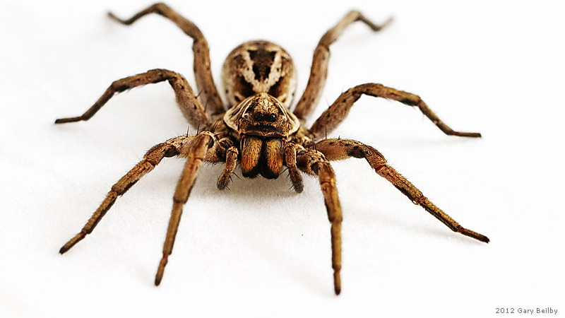
Think, pair, share
‘When I see something horrible I know it is evil and when I see something lovely I know it is good’
Do you think when we discuss ethical theory we are simply finding explanations for your gut reactions?

Slide 12
Do ethical statements have meaning?
Read the article and then match up the Key Words to the definition!
Realism
Anti- realism
Non-cognitivism
Cognitivism
Next steps: Sometimes the terms ‘analytic’ and ‘synthetic’ statements are used to describe statements. What do these terms mean?
Top philosopher task: Explain why David Hume agreed with the non-cognitive view (Grade A)
To be able to explain the terms, cognitive, non-cognitive, realist and anti-realist (Grade B).

Slide 13
Moral statements describe the world . They can be worked out using the senses and verified empirically.
E.g. ‘Murder is wrong’ is stated by observing the effects of the action.
Objective (not influenced by personal feelings)
The rejection of the idea that things have intrinsic value independent of the human mind.
They take the view that morality is just personal feelings or emotions. The words ‘good and ‘bad’ have no intrinsic value. It’s up to individual groups of people to give meaning to such words.
A moral statement is an expression of a feeling. They are not descriptive and cannot be described as true or false.
Moral truths are a matter of person choice and do not exist independent of human experiences.
Subjective (based on or influenced by personal feelings)
The belief that concepts have a value in and of themselves, which is independent of the human mind.
What is ‘good’ just its. Realist believe ethical facts exist.
Realism
Non-cognitivism
Anti- realism
Cognitivism

Slide 14
Learning Outcomes
To be able to describe the differences between Meta-ethics and Normative Ethics (Grade C).
To be able to explain the terms, cognitive, non-cognitive, realist and anti-realist (Grade B).
To be to analyse the different types of Meta-ethic theories (Grade A).

Slide 15
Applying the key terms: what type of theory is it?
In Meta-ethics there are four theories that we study. Analyse each theory and explain what type it is.
Next steps: Which theory do you agree with the most? Give reasons.
Top philosopher: What do you think Aquinas might argue is wrong with the non-cognitive approaches?
To be to analyse the different types of Meta-ethic theories (Grade A).

Slide 16
Learning Outcomes
To be able to describe the differences between Meta-ethics and Normative Ethics (Grade C).
To be able to explain the terms, cognitive, non-cognitive, realist and anti-realist (Grade B).
To be to analyse the different types of Meta-ethic theories (Grade A).

Slide 17
Mini-White boards
Summarise what Meta Ethics is in one sentence (Grade C)
What does the term non-cognitive mean? (Grade B)
What does the term realist mean? (Grade B)
What type of Meta-ethics theory is Naturalism? (Grade A)

