Slide 1
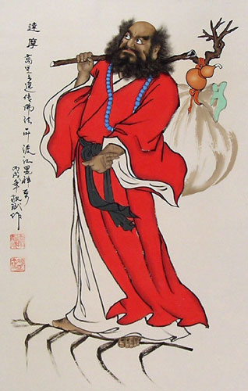
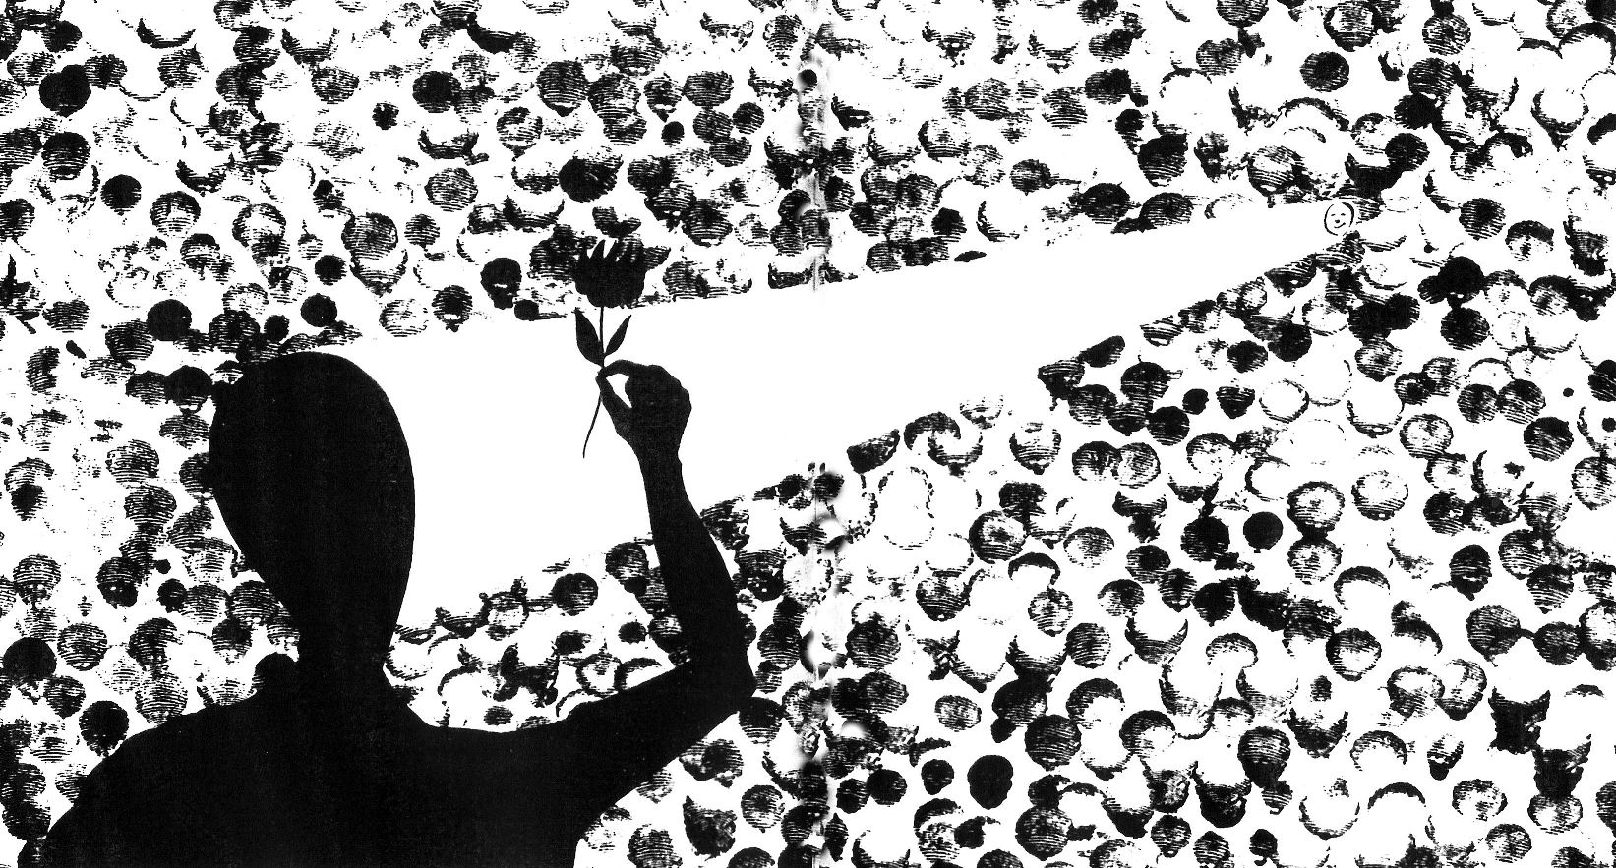
Zen Buddhism

Slide 2
Jhana(Pali) or Dhyana (Sanskrit) in the orginal Indian
Ch’an – taken from Dhyana (China)
Zen – taken from the Dhyana (Japan)
Son – taken from Dhyana (Korea)
Thien – taken from Dhyana (Vietnam)

Slide 3
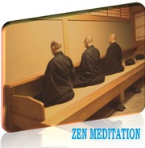
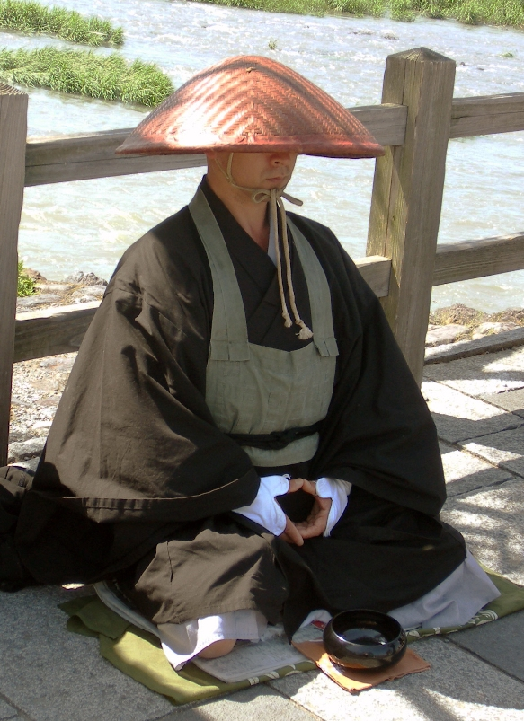
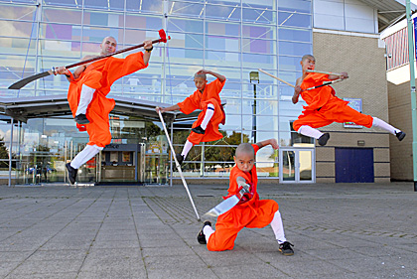
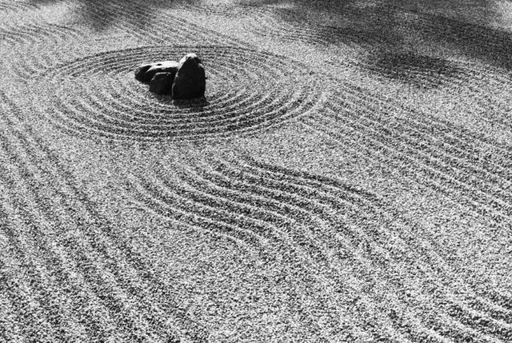

Slide 4
The Flower Sermon
The Buddha silently holds up a flower
The only person to understand the gesture is Kashyapa
The truth (Dharma) cannot really be conveyed using ordinary (samsaric) words and concepts but must be experienced directly.
Direct transmission of knowledge between master and disciple – the role of the guru is pivotal in helping students gain experience of enlightenment

Slide 5
28 Indian patriarchs from the Buddha to Bodhidharma
Śākyamuni Buddha
1.Mahākāśyapa
2.Ānanda
3.Śāṇavāsa
4.Upagupta
5.Dhṛṭaka
6.Miccaka
7.Vasumitra
8.Buddhānandi
9.Buddhamitra
10.Pārśva
11.Puṇyayaśas
12Ānabodhi
13.Kapimala
14.Nāgārjuna
15.Kāṇadeva
16.Rāhulata
17.Saṅghānandi
18.Saṅghayaśas
19.Kumārata
20.Śayata
21.Vasubandhu
22.Manorhita
23.Haklenayaśas
24.Siṃhabodhi
25.Vasi-Asita
26.Puṇyamitra
27.Prajñātāra
28.Bodhidharma

Slide 6
Bodhidharma – 5th -6th Century
A semi-mythical figure.
Travelled from India to China and started the Ch’an/Zen lineage there
Regarded as the first Ch’an ‘Patriarch’ in China
Empahsised the importance of meditation.
De-emphasised the importance of Karma
Emphasised the realisation of one’s Buddha-nature (Tathagatagarbha)

Slide 7
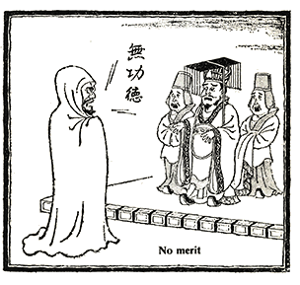
De-emphasis of Karma
Emperor Wu inquired of Bodhidharma, “I have up until now built temples, had sutras copied, and supported monks and nuns. What merit is there in these things?”
Bodhidharma curtly replied, “No merit!”

Slide 8
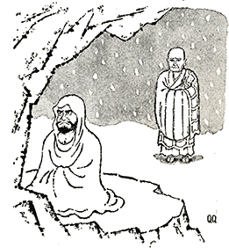
Nine years of Wall Gazing – one legends say that his legs actually fell off and that he cut off his eye-lids. Yikes!

Slide 9
Teachings:
Tathagatagarbha (Buddha-nature) – we are already enlightened. We just have to realise it.
Words and concepts cannot describe enlightenment
Karmic merit is of no use in the path to enlightenment. Emphasis on meditation.
Morality therefore a result of enlightenment, not part of the path towards it.

Slide 10
First Six Patriarchs (China)

Slide 11
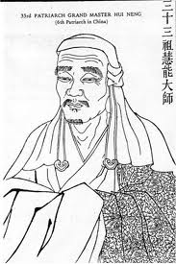
Huineng – 6th Chan Patriarch (638-713)
Was said to be poor and illiterate but had a moment of enlightenment when he overheard the Diamond Sutra being chanted
Codified much of early Chan beliefs in the form of ‘The Platform Sutra’
Gives Chan/Zen much of its Chinese flavour by incorporating Chinese ‘aesthetics’ into its concentration practices

Slide 12
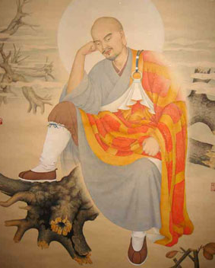
Linchi/ Rinzai
Named after Linji Yixuam – a rather eccentric master who used some extreme methods to provoked enlightened thoughts in his pupils.
Incorporates martial arts, as well as other chinese aesthetics, which led it to being viewed as a warrior class only branch of Zen. Because of this association peasant classes did not take a lot of interest in it.

Slide 13
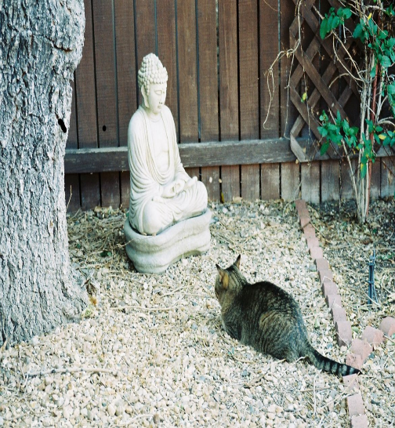
Rinzai views on Enlightenment
Buddha-nature
Kensho – insight into true nature
Satori – sudden enlightenment

Slide 14
Rinzai Methods and Practices
Zazen – Sitting Meditation
Samu – physical movement or work
Koans – riddling non-sensical questions/statements
Mondos – riddling stories

Slide 15
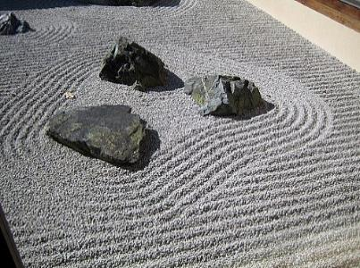
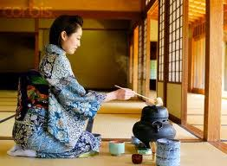
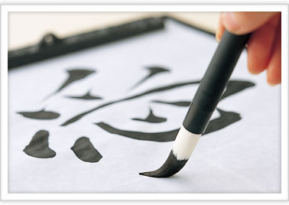
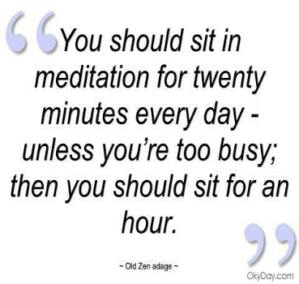
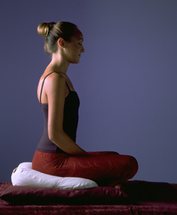

Slide 16
Satori/Kensho
Sudden insight into your Buddha-nature
Moments of enlightenment
One aims to repeat these temporary experiences until they are permanent

Slide 17
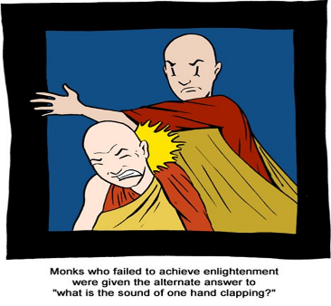
Traditional Koans
Designed to initiate moments of Satori – when the mind perceives things in a non-conceptual way
“what is the sound of one hand clapping”
“Does a falling tree make a sound of no one is around to hear it?”
“What is the original face?”
Modern, non-traditional koans
“Does a bear poop in the woods?”
“If you can get past, can you get future?”

Slide 18
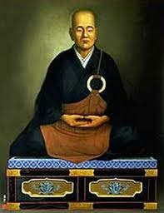
Eisai: 1141 – 1215
Was a Tendai monk but went to China and eventually adopted Rinzai Zen.
On return to Japan he established the very first Zen Temple but faced much opposition from other sects, especially those with imperial patronage near the capital of Kyoto
Eventually he re-located to Kamakura where he was welcomed by the uprising Samurai
Rinzai from very beginning became associated with the Samurai warrior class

Slide 19
Soto Zen
Also known as ‘Farmers’ Zen’
‘No need to seek enlightenment, just be enlightened’
‘Zazen and Enlightenment are one’
‘Shikantaza’ – nothing but sitting

Slide 20
Without Thinking
Dogen believed that it is meaningless to seek enlightenment if we are already enlightened. However, we do not allow are enlightened nature to manifest itself. Therefore, meditation is the purest expression of our enlightened nature.
How is this so?
We already perceive everything exactly as a buddha does. The difference is that we go further and impose concepts onto everything that those things do not necessarily have. A buddha simply does not do this.
So how can we do it too?
By neither ‘thinking’ nor ‘not-thinking’
This is achieved by the practice of ‘Without-Thinking’

Slide 21
Without Thinking
What might be the problem with
‘Thinking’
‘Not-Thinking’
And what, then is meant by ‘Without-Thinking’?

Slide 22
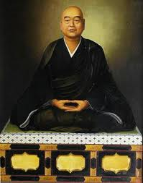
Dogen – 1200 - 1253
Dogen was orphaned at an early age and entered the Tendai monastery at age 7
As a teenager he was troubled by the idea of Buddha-nature – that if the Buddhas always had ‘original Enlightenment’ then why did they seek to become enlightened and why should we?
At 17 he was advised to seek the answer at the newly established Rinzai Zen temple.
From there he was encouraged to travel to China like Eisai did and study with the Ch’an masters there.
While in China he became disillusioned with the Rinzai emphasis on Sudden Enlightenment and relocated to the Caodong (Soto) monastery that he had heard about.
Here his spiritual instincts are realised

Slide 23
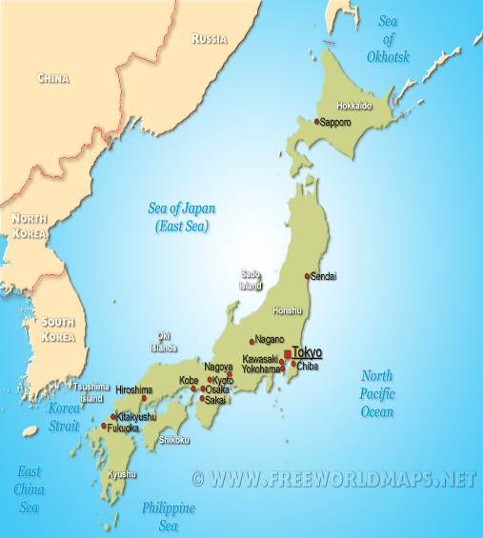
On his return, Dogen tried to set up a Soto Zen temple near the capital Kyoto but eventually had to abandon that plan due to political backlashes against Zen and Pure Land from the imperial court. He headed a little further north and established many Soto Zen temples there.
Although the Samurai based at Kamakura supported Rinzai Zen they saw no objection with Soto and its de-emphasis on the martial arts yet appreciation of mindful discipline in everyday life.

Slide 24
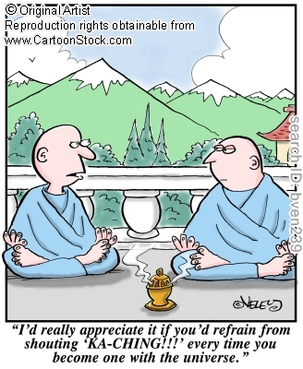
You already are enlightened!
So why bovver meditate at all?
For Dogen, meditation is Enlightenment. While one is sitting on the cushion one is a buddha. There is no need to realise enlightenment so the emphasis on Soto practice is to simply be enlightened.
Meditation therefore simply connects you with your inner buddha. The more you meditate the more in tune with your buddha-nature you are.

Slide 25
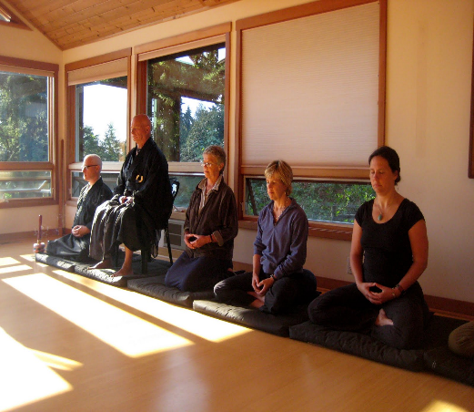
Shikantaza and other Soto Practices
The main Soto practice is Zazen. Soto monks might spend up to 6 hours (altogether) a day meditating. Other concentration practices (Samu) are practiced as well such as
Tea ceremony, poetry, and gardening.
However, martial arts is specifically de-emphasised in order to make Zen approachable for the peasant classes.

Slide 26
Zen Today
Much innovation in the 20th Century
DT Suzuki and other popular transmitters of Zen are uninterested in the ritual and hierarchical aspects of Zen that they see has beset Japanese Buddhism. They teach a version of Zen for Westerners who are more interested in meditation more than anything.
After the Meiji revolution of the 1850s and abandonment of feudalism Rinzai became less homogenous to the warrior class. This has allowed the mixing of Zen styles and techniques and the a flurry of new martial arts styles from non-warrior classes such as Karate.

Slide 27
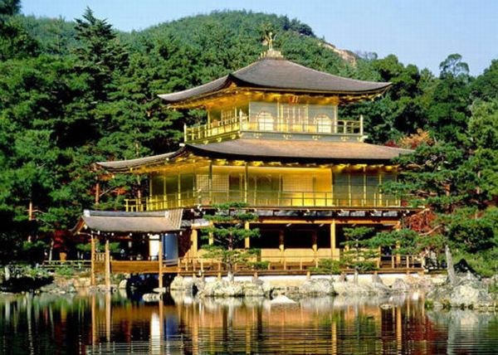

Slide 28
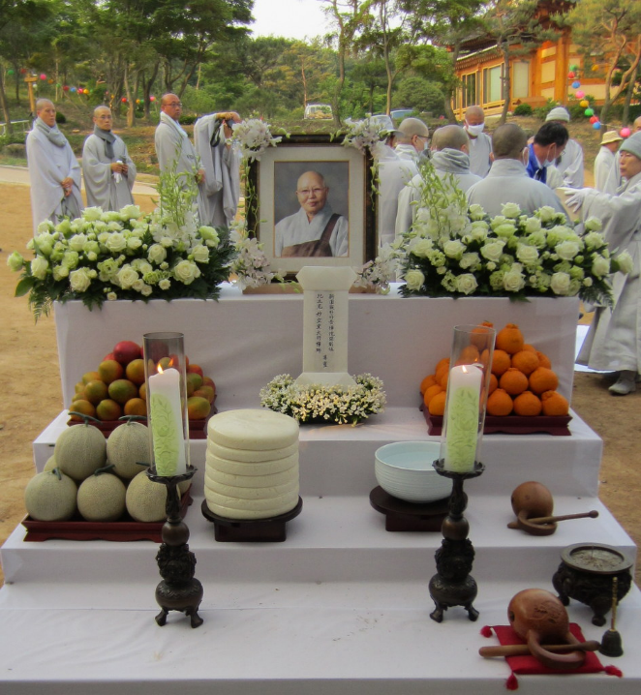
Funerals are a huge part of Zen temple life. 80% of Japanese buddhists visit temples to honour and pray for loved ones.

Slide 29
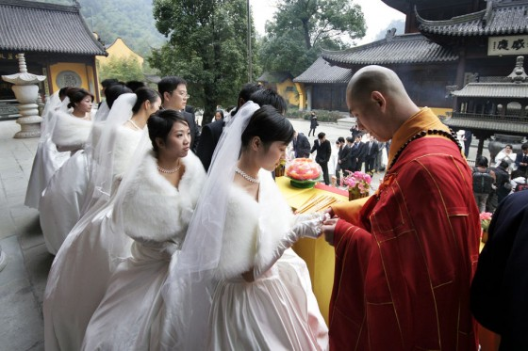
Buddhism plays less role in other sacred rites such as naming ceremonies for babies and weddings.
In fact, the increasing trend in Japan is to have a Western ‘White Wedding’ – in a church if possible.

Slide 30
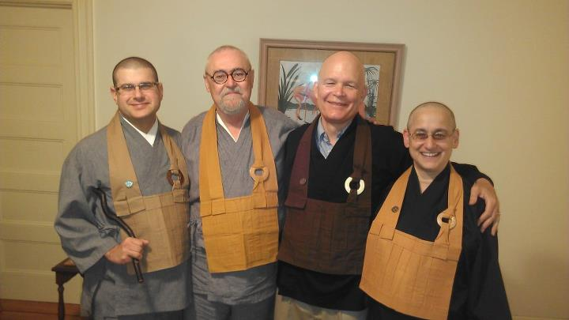
America
Originally Zen was practiced only by Asians but since 50s and 60s there are many trained American Zen Roshis.
Below is a picture of some teachers from ‘Boundless Way’ Zen which amalgamates Rinzai and Soto practices

Slide 31
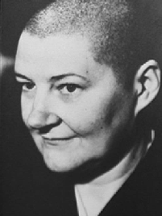
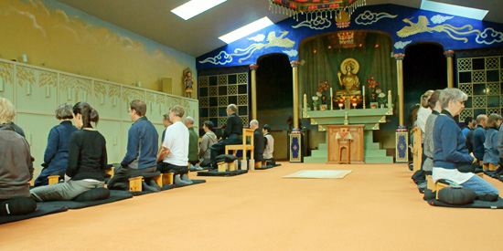
Houn Jiyu-Kennett – Peggy Kennett 1924-1996
Roshi Jiyu-Kennett founded the Order of Buddhist Contemplatives here in England and is headquartered at Throsel Hole Priory in Northumberland.
She was the first Western woman to be given the title of ‘Roshi’ after having spent much time studying in Japan. Her appointment as a Roshi was also done in public which was very rare at that time in Japan.
She initially attended lectures on Rinzai Zen from DT Suzuki in London but in Japan was attracted to Soto Zen.

