Slide 1
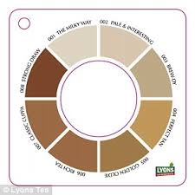
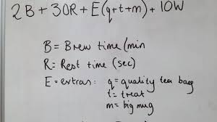
Think, Pair, Share
What is the ideal cup of tea like?

Slide 2
Evaluation of Plato’s concept of forms

Slide 3
Learning outcomes
To be able to explain how Plato influenced Christianity.
To be able to critically analyse Plato’s concept of forms.
To be able to evaluate your own opinion on Plato’s analogy of the Cave.

Slide 4
How Plato shaped Christianity?
People who came after him took his dualism to extremes.
A person’s appearance is not important – inferior.
Bodily pleasures are not the main source of our existence.
The acquisition of physical objects is tempting but misleading.
This world is not the only world.
The demiurge is god but not omnipotent– the highest is the Form of the Good from which all perfect forms come.
The soul will return to the World of Form after the body is dead.

Slide 5
How has Plato influenced Christianity?
Similarities
Differences
Top Philosopher: How did Alexander the Great have a impact on the spread of Greek culture?
Stretch yourself: Research what John Hick says about Plato’s influence of Christianity.

Slide 6
Discussion point!
That people who commit crimes or who are violent only do these things because they are ignorant of what is right?
Or do they know their deeds are wrong, but do not care?
What does Plato think?
What do you think?

Slide 7
(A02)
You should demonstrate skill in evaluation.
You need to show why some people might agree with the statement, and why others might disagree.
You also need to evaluate each points validity.
For high marks support your points with reasons

Slide 8
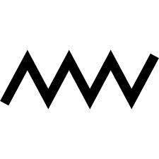
A02 Giant Evaluation zigzag
Sort out the arguments cards into statements that support and criticise Plato’s epistemology...
For
Against
For
Against
Stretch yourself:
Read through the extension material and add it to your zig –zag.

Slide 9
Plato’s analogy does not show the difference between the physical world and the world of Forms – they seem the same type. This a priori it is based on knowledge, not empirical evidence.
There is no evidence that the World of Forms exists. Plato considers the Forms to be more real than the visible world . Today, Scientists assist us in understanding the true reality. They claim our world is worth studying in it’s own right.
Richard Dawkins: ‘it is nonsense to speak of a transcendental world’.
Mimesis (imitation) – Plato’s analogy is poetry and yet Plato thought art and poetry to be poor forms of knowledge.
The concept of Forms explains why we all recognise the same
essential elements in something.
Also we can all identity certain concepts.
Plato assumes that no-one who has found true knowledge would ever want to return to the world of shadows. But even if we find truth we may choose not to live by it.
This argument helps us to understand why there
are imperfections in the world around us.
Subjectivism – good is a subjective term rather than absolute. Do we always agree about what is good? Aristotle: ‘There cannot be a single Form of Goodness’.
Quantifier shift fallacy – just because everyone loves something does not mean we all love the same thing.

Slide 10
Aristotle stated there maybe ideal concepts in maths but…
There is no logical reason why there has to be a perfect form of everything – why does there have to be a perfect form of jealous?
If everything in the visible world is a pale reflection of the world of Forms, then are there perfect forms of disease?
Elitist attitude: only those of intelligence are capable of knowing goodness – therefore someone with learning difficulties cannot know goodness?
Are philosophers more moral than others?
Plato thought we only do wrong when we are ignorant of what is right
(Even if there is another world – one of Forms- it is not relevant as we live in a visible world where our behaviour is linked to our actions – we live in the material world)
It encourages us to question in order to learn
and not to accept things at face value.
Plato asks us all to be philosopher, surely this will only improve society?
Plato himself does not say there is an ideal Form of everything in the world – Plato himself was ambiguous on this.
Can there be an ideal form of every plant? If so, the Forms stop being universal
The infinite regress argument – surely their needs to be a perfect form of each Form?
Do we all share the same concept of goodness? AJ Ayer’s view is that we do not. He says when we talk of good and bad we are merely expressing an emotion.

Slide 11
‘Plato’s analogy of the cave is not valid’
Complete an essay plan on this question!
Use the notes and zig-zag to help you…

Slide 12
Swap books with someone who has not marked your work before…
Then give their work two stars and a wish. Two
things good about it and a target to help them
improve.

