Slide 1
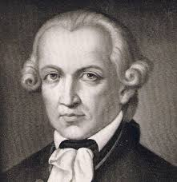
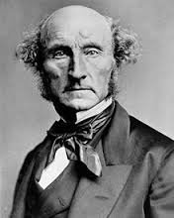
Think, Pair, Share
A: What is the Summum Bonum?
B: What is the Categorical imperative?
A: Who was J.S Mill?
B: What is the Hedonic Calculus?

Slide 2
Prescriptivism

Slide 3
Learning Outcomes
To be able to explain the general ethical theory of Prescriptivism.
To be able to analysis the different views of R.M Hare .
To be able to evaluate the strengths and weaknesses of Prescriptivism.

Slide 5
R.M Hare (1919-2002) Prescriptivism
Ethical language is prescriptive. An ethical statement says what ought to be done and these are moral because they are universal.
Ethical statements do not state facts and are not true or false, but are expressions of our will or wishes.
IF we use the word ‘good’ in a moral sense we are using a set of standards that apply to a person or action and we commend that person or action.
If we say someone ought to do something, we are saying that we ought to do it as well.
Note: Ethical statements are expressions of opinion as well as giving directions as to how we ought to act. Hare states that ethical statements are universalisable but this does not mean they are objective. There is no way of judging one person’s preferences over another.

Slide 7
Universalizability
The universalizability principle states that when an individual prefers one thing to another this implies that this preference would be good for anybody. If x prefers to care for a sick person rather than go to the pub, this implies that were x to be sick, then x wishes somebody to care for them in the same circumstances.
Prescriptivism asserts four basic ideas. Can you find out what they are?
1)
2)
3)
4)
Prescriptivism asserts four basic ideas:
Moral sentiment is not sufficient. The individuals morality must involve doing what is morally required.
The ethical action has to be consistent. It is important in all situations to practice consistent morality.
Moral belief must be in harmony with others.
The moral agent cannot be hypocritical.
Stretch yourself: Explain in your own words why Prescriptivism is a ‘non-cognitive’ theory.

Slide 8
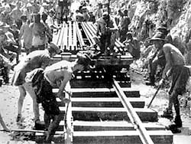
Hare, Singapore and Prescriptivism
Research and create a mind map or popplet on what led Hare developed a secular version of the Golden Rule in Christianity.
Stretch yourself: List the problems with always following the ‘Golden Rule’.

Slide 9
R.M Hare
Read through the article and select 5 key sentences.
Write these in your notes.
1)
2)
3)
4)
5)
Stretch yourself: How does prescriptivism answer the problem of ‘cultural relativism’?

Slide 10
The Debate
Complete the speech bubbles to show a potential debate evaluating prescriptivism.
Use the QR code to help.
Stretch yourself task:
Include the other Meta Ethical theories in your debate.

Slide 11
Think, Pair, Share – Hare’s Example
We may illustrate this process of modifying principles from the example already used, that of learning to drive. I am told, for instance, always to draw into the side of the road when I stop the car; but later I am told that this does not apply when I stop before turning into a side-road to the offside -- for then I must stop near the middle of the road until it is possible for me to turn. Still later I learn that in this manoeuvre it is not necessary to stop at all if it is an uncontrolled junction and I can see that there is no traffic which I should obstruct by turning. When I have picked up all these modifications to the rule, and the similar modifications to all the other rules, and practice them habitually as so modified, then I am said to be a good driver, because my car is always in the right place on the road, travelling at the right speed, and so on.
The good driver is, among other things, one whose actions are so exactly governed by principles which have become a habit with him, that he normally does not have to think just what to do. But road conditions are exceedingly various, and therefore it is unwise to let all one's driving become a matter of habit. One can never be certain that one's principles of driving are perfect -- indeed, one can be very sure that they are not; and therefore the good driver not only drives well from habit, but constantly attends to his driving habits, to see whether they might not be improved; he never stops learning.¹
Can you come up with your own example?

Slide 12
If these are the answers...
What are the questions?
1) Prescriptivism 2) Golden rule
3) Universalizability 4) hypocritical

