Slide 2
Secular Buddhism
At least 20% of non-Asian converts identified themselves as Buddhists but are not affiliated with any particular group.
This means that non-affiliated Buddhists are the largest single group.
However, their level of involvement in B.ism varies greatly from mere philosophic interest to fully practising.

Slide 3
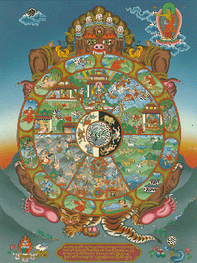
Secular Characteristics
For many British Buddhists metaphysical beliefs in things like Karma and reincarnation can be too difficult to believe in.
Meditation makes sense for therapeutic reasons
Six Realms of Samsara often interpreted in a psychological way, ie. Each ‘realm’ really refers to types of human existence with relative happiness or unhappiness

Slide 4
Stephen Batchelor and Paul Knitter
In this last section of ‘Buddhism in the West’ we will be looking at two key scholars – Stephen Batchelor who attempted to secularise Buddhism – for him, we will be looking at his book entitled ‘Buddhism without Beliefs’.
We will also look at and compare him to Paul Knitter who wrote ‘Without Buddha I could not be a Christian’ – he somewhat westernises Buddhism by linking Buddhism to Christianity in a very distinctive way.

Slide 5
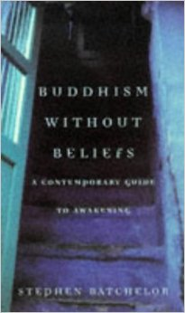
Stephen Batchelor
Batchelor lived as a Tibetan monk for 10 years and then as a Korean Zen monk
He came to his own conclusion that the historical Buddha did not intend to teach a system of metaphysics but was only interested in a system of meditative therapy
Believe scriptures were changed later on to add a more metaphysical dimension in order to compete with other religions
Batchelor can be considered the spearhead of ‘Secular Buddhism’ and an important figure for 20% of British Buddhists who just cannot subscribe to (get on board with) traditional Buddhism

Slide 6
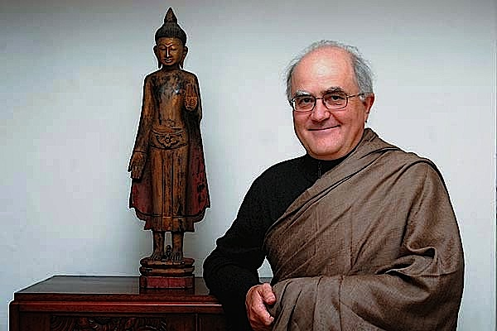
Stephen Batchelor
Task 1: Read the article and explain Batchelor’s point of view in your own words…
Task 2: Summarise the extract of his book in 5 key sentences…

Slide 7
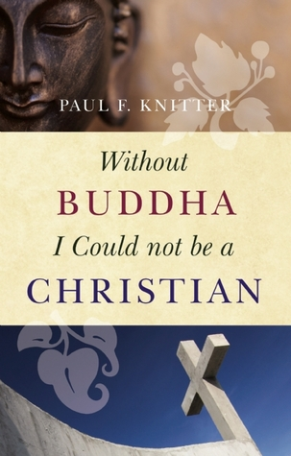
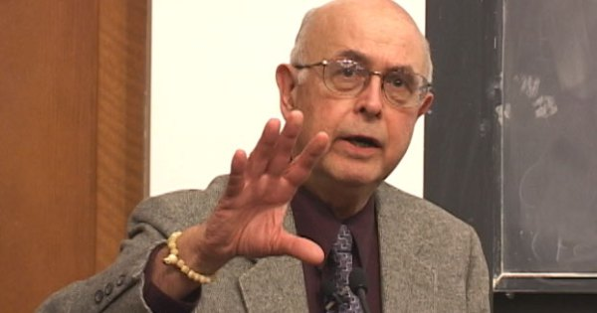
Paul Knitter
Task 1: Read the article and explain Batchelor’s point of view in your own words…
Task 2:Research his book and summarise what it’s about…

Slide 8
Buddhism in the West
Learners should have the opportunity to discuss issues relating to Buddhism in the West, including:
a comparison of the approaches and ideas of Stephen Batchelor and Paul Knitter, and the ways in which they have adopted and ‘Westernised’ Buddhist ideas
how the depiction of Buddhism in the Western media, including the fame of figures such as the Dalai Lama, shape (and possibly distort) Western understandings of Buddhism
comparison of how figures such as the Dalai Lama are viewed by Buddhists and non-Buddhists, and their significance to each group

Slide 9
Suggested Reading
Contextual references For reference, the ideas of Batchelor and Knitter listed above can be found in:
Batchelor, S. Buddhism Without Beliefs
Knitter, P. Without Buddha I could not be a Christian
Suggested scholarly views, academic approaches and sources of wisdom and authority
Thich Nhat Hanh, (1996) Living Buddha, Living Christ, Rider
Garfield, J. L. (2010) Buddhism in the West, Tibetan Buddhism in the West, online [http://info-buddhism.com/Buddhism_in_the_West_Jay_Garfield.html]
Dreyfus, G. B., From Protective Deities to International Stardom: An Analysis of the Fourteenth Dalai Lama’s Stance towards Modernity and Buddhism, Tibetan Buddhism in the West, online [http://info-buddhism.com/Dalai_Lama_between_ Modernity_and_Buddhism_by_Georges_Dreyfus.html]

