Slide 1
Stereotypes surrounding Buddhism…
This article has been recommended by the exam board, please read through the information given and then complete the task below…
Copy and complete the spider diagram below, adding as much information to each section as possible…For EACH of the stereotypes you must include: why this would be a stereotype of Buddhism (use specific teachings etc.) and why it is indeed a stereotype (i.e. on what grounds does Nicholas Liusuwan say it is not true for all Buddhists?)
Vegetarianism
Why people in the West might believe this…
Why it is not true for all Buddhists…
Western stereotypes surrounding Buddhism
2. How many of these stereotypes did/do you hold?

Slide 2
Western stereotypes: Nicholas Liusuwan
Vegetarianism
Uniform Language
Beliefs about heaven
Buddhism is non-materialistic
?Reincarnation?

Slide 3
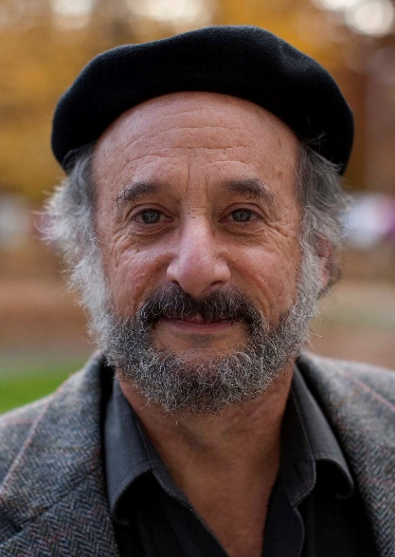
Jay Garfield
Lots of really interesting ideas here on the Westernisation of Buddhism that explore how the influence has worked both ways.
Read the excerpts and answer the questions….

Slide 4
Jay Garfield
“Perhaps even more interesting and maybe more puzzling is that we also start seeing strange things appearing on book shelves of Asian scholars. So when I go into student hostels in Sarnath I very often see translations by Jeffrey Hopkins, by Jay Garfield, by Bob Thurman, by Don Lopez sitting on students desks…
And so you begin now to also see this strange phenomenon that Western readings inflected by Western philosophical ideas are now moving back into Asia and so students who are studying these, are studying them in part through Western eyes.”

Slide 5
Jay Garfield
“And so again we find this kind of dialectic that reflects Buddhism as being relevant to physics and to neuroscience keeping its modernism going but also the openness of Buddhism to developments in physics and psychology reflects this kind of ideology of Buddhism as essentially a modern phenomenon, a phenomenon that is open to empirical science and to reason. And when we see this interaction, we don’t only see Buddhism contributing to Western science but we see Western science contributing to Buddhism. So when His Holiness teaches about emptiness very often he’ll mention quantum mechanics. When His Holiness is talking about the nature of mind he’ll very often mention phenomena in consciousness studies or in neuroscience. And these aren’t coming out of the sūtras, right? These are coming out of the laboratory. So these are ways in which Buddhism and its language are being inflected by interaction with the West.”

Slide 6
Jay Garfield
“with respect to the continuum of Buddhist teachings, Buddhist transmissions and Buddhist practices, we have a continuum that is constantly changing and never cut. We do not have to be bothered by the fact that there is nothing permanent that persists through that change, so long as the continuum continues to develop and to provide a path to the alleviation of suffering...”

Slide 7
Jay Garfield
What do you think about Buddhisms that don’t refer back to Buddha, like for example stress reduction programs: they work, they fulfil all criteria, but there is not referred back to tradition.
A: "There is certainly nothing wrong with extracting technical ideas from Buddhism and using them outside of a Buddhist context. I mean His Holiness the Dalai Lama for instance has often been asked about this, and he says: “It’s wonderful. If you can find something in Buddhism that relieves suffering, then relieve suffering using it!” So if you go to a stress reduction clinic and somebody is using Vipassana technics to reduce stress or to reduce pain, that doesn’t need to be “Buddhist” any more than if you discovered a medicine in a Christian hospital, the use of that medication would necessarily be Christian. And I think that’s really the right analogy, that Buddhism has given us a number of things: it’s given us insights, it’s given us teachings, it’s given us an understanding of reality, and if somebody wants to take something that comes to us as a fruit from the Buddha’s tree, and serve it in a non-Buddhist context, then you just don’t pretend that it’s Buddhism, but you can acknowledge that it’s something that came out of a Buddhist tradition: no problem.”

