Slide 1
What you need to do:
Be able to explain how The Three Jewels link to aspects of the life of the Buddha, especially his experiences when he left the palace and the Four Signs.
Explain why suffering and impermanence and The Three Poisons can be a problem in our journey to enlightenment (links to what you have learned with Miss Veitch)
Why do we need support on this journey to enlightenment?
How can taking refuge give Buddhists support.
Describe each of the Three Jewels and explain how it can help a Buddhist take refuge and overcome the issues that Dukkha and The Three Poisons create.
Evaluate how useful each Jewel may be. Is one more useful than the others – why? Are there any practical problems of challenges in how useful any of the Three Jewels?

Slide 2
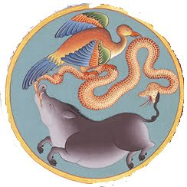
Taking Refuge
Buddhism teaches that The Three Poisons are the root of all suffering.
Explain how each could cause suffering
Desire
Hatred
Ignorance
Taking Refuge is how to overcome The Three Poisons
At difficult times in their lives, people sometimes look for refuge- any place, person, action, or thing that offers protection, help, or relief
Dukka is the Buddhist (and ancient Indian) idea that life is full of suffering, mainly induces by the lack of permeance.
Explain the suffering that the Buddha observed
How did he react?

Slide 3
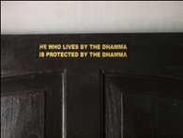
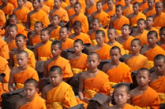
The Three Jewels
the Buddha
(the doctor)
the Dhamma
(the medicine)
the Sangha
(the community)

Slide 4
The Buddha, the Dhamma and the Sangha are inseparable: each depends on the other two.
The Dhamma could not have been taught without the Buddha and could not have been followed without the Sangha.

Slide 5
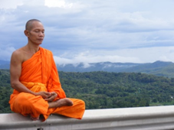
Every day a Buddhist makes a declaration to take refuge in the Three Jewels:
I take refuge in the Buddha,
I take refuge in the Dhamma,
I take refuge in the Sangha.
By making this declaration Buddhists show that they are dedicated to the Buddha and his teachings.

Slide 6
The Three Jewels – the importance for Buddhists
help them practically to cope with the inevitable suffering which life involves
point Buddhists in the right direction along the road to enlightenment
help Buddhists make sense of life
are very special and valuable to a Buddhist

Slide 7
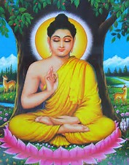
The First Jewel - Why is the Buddha a refuge?
He is a role model: his life and behavior while alive set Buddhists an example of how they should live
His teaching lives on after his death showing people how they should live
The Buddha's Enlightenment shows people that they can be Enlightened too, and so escape the endless cycle of births and rebirths

Slide 8
The importance of Buddha as teacher
After the Buddha's Enlightenment, he taught for many years until his death and gathered followers around him
He encouraged them to spread this message around, bringing Enlightenment to as many beings as possible
About 500 years after his death they grouped together and started writing down the things he said before they all forgot them
A Buddha is thus not merely an Enlightened One, but is above all an Enlightener, a World Teacher
His function is to rediscover, in an age of spiritual darkness, the lost path to Nirvana, to perfect spiritual freedom, and teach this path to the world at large.

Slide 9
Evaluate the significance of the Buddha as a form of Refuge:
Can you explain and evaluate why some of the key aspects of the Buddha’s life may be seen as important?
What does each show about the Buddha?
Before conception and birth (Tusita Heaven and the 10 Perfections) Conception and Birth
Conception and Birth
Renunciation
Enlightenment
Teaching and setting up the Buddhist community
Think!
What might this mean for the Buddha being the most important form of Refuge?
Should we instead rely on Dharma and our own journey?

Slide 10
The Second Jewel – What is the Dharma?
From the Buddhist Centre:
The Dharma primarily means the teachings of the Buddha, or the truth he understood.
The word ‘Dharma’ has many meanings but most importantly it means the unmediated Truth (as experienced by the Enlightened mind).
In this second sense, Dharma is the teaching that was born when the Buddha first put his realisation into words and communicated it to others at Sarnath in Northern India. The occasion is traditionally referred to as ‘the first turning of the wheel of the Dharma’, and the eight-spoked Dharma wheel is a common emblem of Buddhism.
The teachings given by the Buddha (such as the Eightfold Path) is the way for Buddhists to deal with suffering.

Slide 11
Teaching to investigate:
Evaluate:
How might Buddhists use these teachings in day to day life?
Why might some Buddhists see Dharma as the most important aspect of The Three Jewels?
What do you think about the importance of Dharma?
The Eightfold Path
Four Noble Truths
The 4 Noble Truths

Slide 12
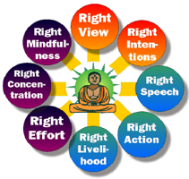
The Eightfold Path
For Buddhists the Dharma is a vital part of being a Buddhist
The Buddha is a role model and the origin of their way of life but the teachings and Dharma provide the practical guidance that Buddhists need when faced with Dukkha or ethical dilemmas in life
The Four Noble Truths sum up this problem and the truth for Buddhists about how to respond to the problem of impermanence and Dukkha
The Eightfold Path is often seen as the cornerstone of Buddhist teachings. Following these aspects is referred to as ‘turning the wheel of Dharma’ in order to progress on the journey of Samsara and towards enlightenment
Theses are the 8 aspects Buddha said we need to follow to be happy and reach enlightenment. Consideration and meditation on these aspects in a Buddhists daily life will be key in their own personal development.
But how can we follow them in our lives?
Give examples to illustrate how at least 3 of these aspects could apply and be important in a Buddhists life

Slide 13
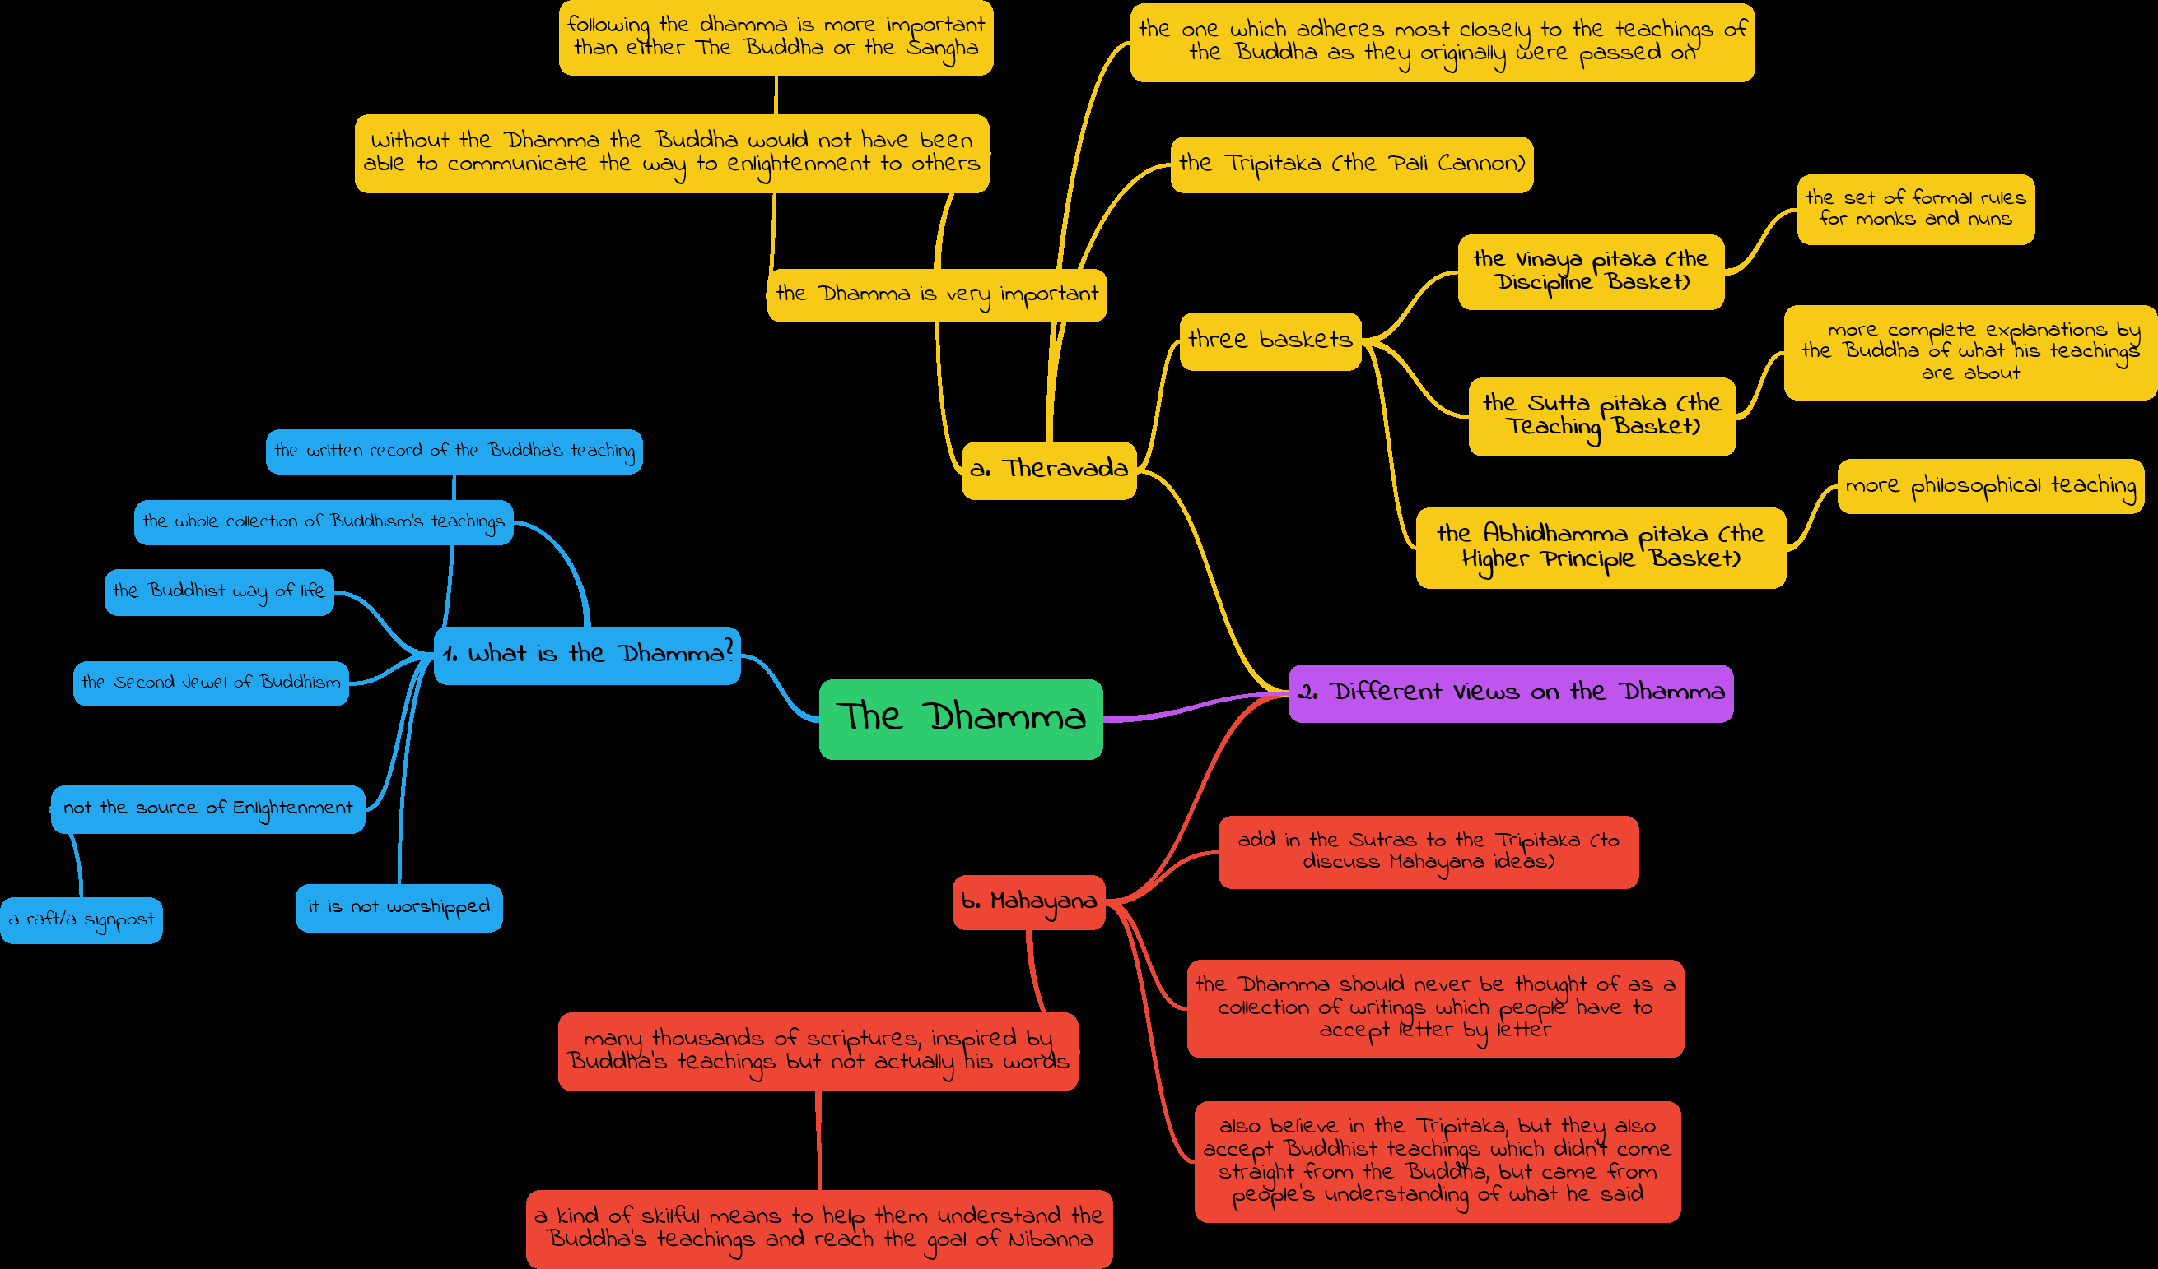
Dharma Extras!

Slide 14
Third Jewel
What is the Sangha?
it means assembly (a group of people)
it describes the community of people who follow the Buddha and his teachings (Dhamma)
part of the 3 Jewels

Slide 15
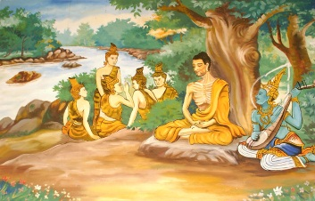
The main groups in the Sangha
Arya Sangha
The Enlightened beings (Bodhisattvas for Mahayans and Arhats for Theravadins)
The ideal Sangha/ the spiritual elite
Others look to them for inspiration

Slide 16
Evaluate:
Why might this group be seen as further on the path to enlightenment?
Which even in the Buddha’s life does the act of rejecting the world and becoming ordained replicate.
What do you think of this event – necessary? Does it raise any issues?
How may this show commitment to cessation of Dukkha and to the search for enlightenment?
The Ordained
Monks and nuns (bhikkus and bhikkunis)
try to live exactly as the Buddha did
Some enter for a short time to experience the disciplined life, others commit for a lifetime
The aim - gain enlightenment
Vihara - monasteries where Buddha’s followers live
The vihara creates the best possible conditions for a person to make spiritual progress

Slide 17
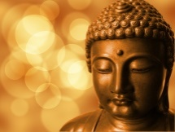
The Buddha said:
"A man who wishes to be my disciple must be willing to give up all direct relations with his family, the social life of the world and all dependence on wealth."
Evaluate:
Is this true?
What types of issues could still being attached in terms of relationships or wealth bring for a Buddhist (links to the Three Poisons and Dukkha)
Is being part of the Vihara necessary or beneficial do you think?
Is this practical for everyone?
Can you raise an ethical issue – links to ‘Clashes of Duty’ Kant?

Slide 18
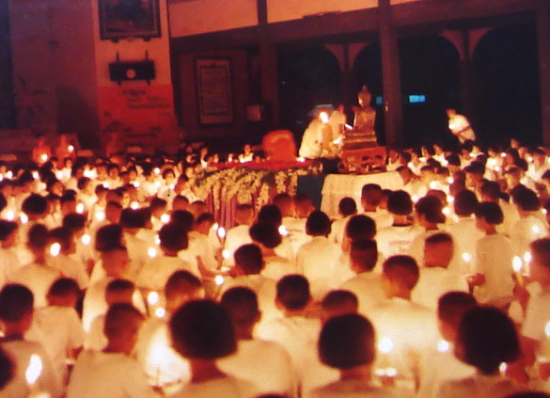
The laity
ordinary people who follow the Buddhist way of life
some may see lay people as inferior in religious status to monks because they cannot devote all their lives to the Dhamma and have to be concerned with more worldly attachments
The Buddha accepted that not all people were ready to detach from all worldly things that induce Dukkha and the Three Poisons.
The lay Sangha can provide community and support when life is challenging.
Evaluate:
Is this more practical and attainable for most people?
How would Buddhism have reached so far with out a Lay following?

Slide 19
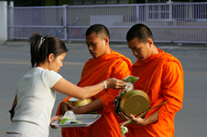
The relationship between monastic and lay Sangha
The relationship between monastics and lay people: one of mutual benefit and mutual dependence
The lay community supports the monastic community with material gifts
They volunteer to clean, cook, do the gardening, go shopping and carry out building maintenance
They can create good karma by supporting the monastic Sangha
The Lay community can receive support and a literal refuge in times of spiritual crisis.

Slide 20
Being part of the Monastic Sangha
They follow 227 rules (The Vinaya Pitaka)
Monks are not allowed to work for money and therefore they rely on the lay community for support
They shave their head and face
Their possessions: orange robes, an offering bowl, a razor, a water strainer, a needle

Slide 21
Becoming part of the Monastic Sangha
Many lay Buddhist families encourage their sons to join the monastic community for a period of time in order to gain good kamma for themselves and the whole family
In order to be admitted to the Sangha, a man must be healthy, unattached, and free from debt
The Making of a Monk:
http://archive.teachfind.com/ttv/www.teachers.tv/videos/making-of-a-monk.html

Slide 22
The role of the Sangha
A vihara is considered to benefit all who live around it
The function of the Sangha was made clear when the Buddha first sent his Bhikkus into the world. "Go out on your journey for the profit of many, out of compassion for the world, for the welfare and bliss of mankind. Proclaim the Dhamma.“
upholding the traditions and practices of the Buddhist religion to the practical benefit of the community
passing on the Dhamma and keeping ancient texts alive
educational role and supporting Buddhists in day to day life.

Slide 23
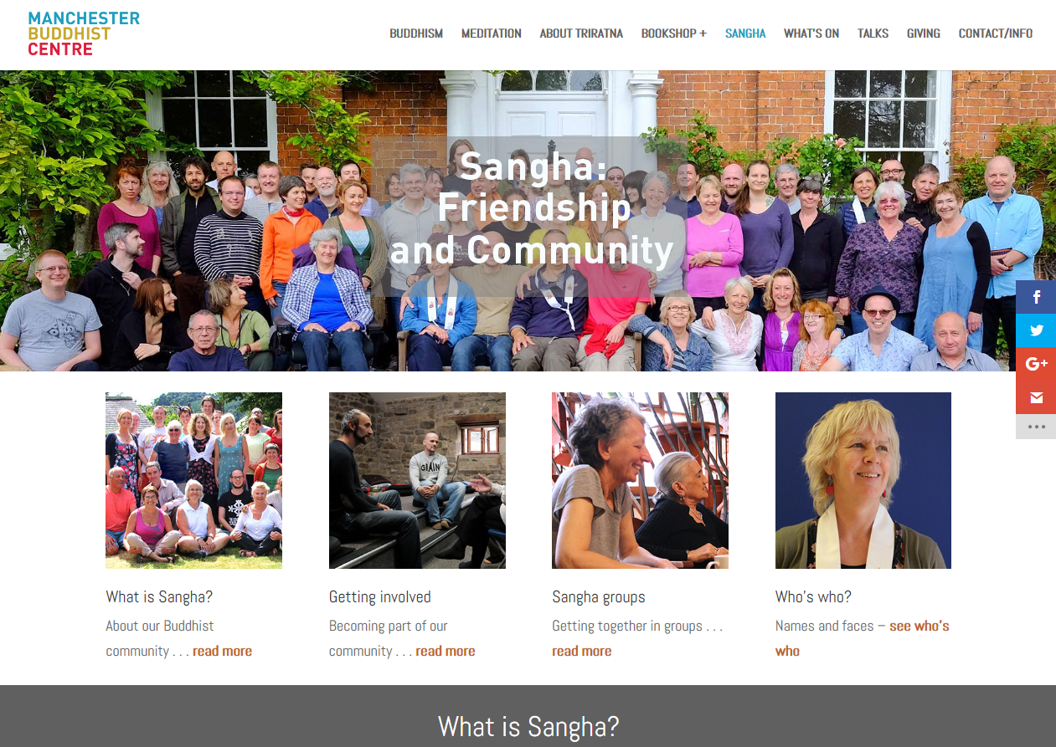
To show extra effort!
Have a look at the Manchester Buddhist Centre's Sangha community
Why is this an important aspect of support and refuge?
Is this useful for a modern Buddhist?
What sort of support do they offer?

Slide 24
Discuss and Explain and Evaluate
Assess which of the Three Jewels is most important in taking refuge

Slide 25
Discuss and Explain reasons for and against
AGREE
DISAGREE
Assess the claim that the Dharma is the only way to truly take refuge from Dukkha

Slide 26
Discuss and Explain reasons for and against
AGREE
DISAGREE
“Taking refuge in The Sangha is the most important aspect of the Triple Gem.”

Slide 27
Discuss and Explain reasons for and against
AGREE
DISAGREE
“Without taking refuge, one cannot really identify as a Buddhist”

Slide 28
Discuss and Explain reasons for and against
AGREE
DISAGREE
“Only Buddhist monks are full practitioners of Buddhism”

