Slide 1
What makes you happy?
Make a list of all the things that you believe are needed in order for you to be happy.
How many of these made your list?
Money
Health
Family
Love
Possessions
Good job
Friends
Holidays
Being pretty/slim
If you got all of these things do you think you would really be happy?

Slide 2
Buddha’s Views on Happiness
The Buddha believed that there were a number of problems with human beliefs about happiness:
Often, we find out the things that we thought would make us happy don’t! This can actually end up making us even more unhappy in the long term! Think of how many celebrities seem to have it all, and yet still seem desperately unhappy!
Human beings naturally always crave more! We believe that a bigger house or a nicer car will make us happy but when we reach this goal we move the goalpost…nothing ever seems to be enough to satisfy our cravings and make us truly happy!
Even if my some miracle we did have everything we desire, then the very impermanent nature of life means that it could all be taken away in an instant which again would leave us more unhappy!
The Buddha did not believe that happiness was an unachievable goal (indeed the purpose of his quest was to find a cure for suffering) but he believed we needed to re-think our beliefs about suffering and happiness.

Slide 3
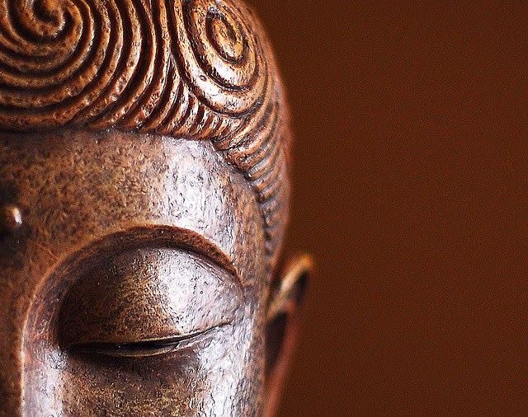
The 4 Noble Truths
Learning Objectives:
Identify each of the 4 Noble truths
Explain how the Buddha believed this explained the problem of suffering
Evaluate whether this solution effectively solves the problem or not.
Key Terms
Dukkha
Desire
Craving
Enlightenment

Slide 4
The Four Noble Truths – Number 1
1. All life is Dukkha
The Buddha explained that happiness can happen in this lifetime (such as when he was in his father’s palace) but the importance of his teachings was that is no happiness is ever permanent, all happiness is ‘tainted’
We have discussed this within the Three Marks of Existence…

Slide 5
The Four Noble Truths – Number 2
2. The cause of suffering is craving or Tanha
At the start of this lesson we talked about what would make us happy.
The things we discussed sums up the second of the Four Noble Truths – as we think that the things we crave in life will make us happy.
The Buddha fundamentally disagreed…
The reason why we find life to be unsatisfactory is because we rely on things to make us happy, when these things are unreliable
Why are these things unreliable?
Anicca – they change
We want things to say the same, but they don’t: they decay and die
Tanha refers to this relationship of reliance of attachment. We crave and are attached to things that we can’t keep.

Slide 6
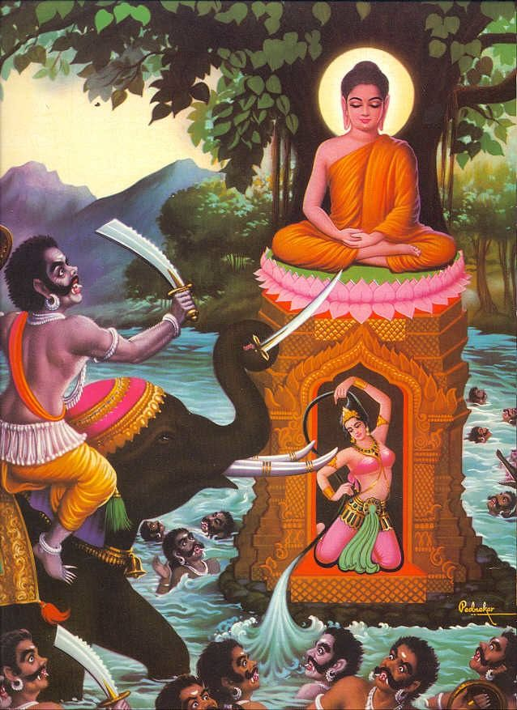
The Four Noble Truths – Number 2
Make links to the temptations of Mara

Slide 7
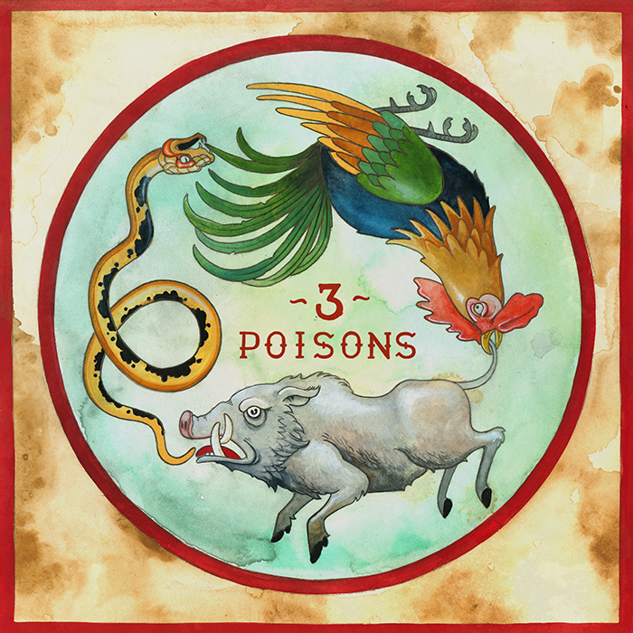
The Four Noble Truths – Number 2
2. The cause of suffering is craving
Greed refers to our desire to possess things and people in the belief that they will improve our lives
Hatred is a powerful emotion that ties us unhappily to others
Ignorance refers to our ignorance or illusion about the way things really are
When our actions are motivated by the Three Poisons, we end up suffering

Slide 8
The Four Noble Truths – Number 2
Tanha and craving will cause us dukkha because our actions are dominated by three poisons:
Greed
Hatred
Ignorant
These are the poisons that cause us to grasp at things – to crave things - Tanha
Is it fair to describe humans like this? Let’s look at this further –
Are humans greedy?
Do humans love to hate?
Are we ignorant? What does ignorance mean in this context?
Discuss:
Is it impossible to not crave – what about family and love?
Is this a pessimistic and depressing way to see life?
Is there a difference between superficial craving and greed and attachment to family and loved ones?
Is total cessation of this really possible?
Do we have to renounce our family ties to achieve this?
Or is it more a state of understanding the impermanence of all things – including family – and appreciating them?
Mustard Seed Parable?

Slide 9
The Four Noble Truths – Number 3
3. The way to overcome dukkha is to overcome Tanha
We must overcome our desires – then we can overcome our frustrations
The problem is that people who feel emotionally empty will want to grasp
Therefore we must discover inner satisfaction and an appreciation of life as it really is, to find happiness inside ourselves instead of relying on other things
Synoptic Link Challenge
Can you explain how Vipassana Meditation might help to overcome Tanha?
What is the link to interbeing and sunyata?

Slide 10
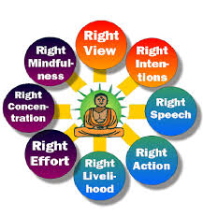
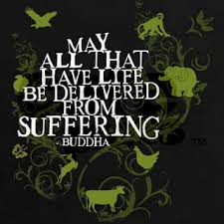
The Four Noble Truths – Number 4
4. The way to overcome tanha is follow the Middle Way
So a life of the Middle way is not only about avoiding extremes of luxury and asceticism, it is about avoiding extremes views about the nature of existence, such as nihilism or eternalism, or whether there is a creator, or whether there is life after death
It seems that the Buddha classed these views as metaphysical speculation
They are speculation because we cannot prove them one way or another, and even if we could, it would not help in the struggle to overcome dukkha
To follow the Middle Way, one will need to follow the Eightfold Path…..
Research the parable of the arrow – what does this mean for nihilism or eternalism?
What do you think?

Slide 11
The Doctor Analogy
When understanding the 4 Noble Truths it is helpful to think of the Buddha as being like a doctor:
You go to the Doctor with a problem
The Doctor diagnoses the reason for your problem
The Doctor explains how to solve the problem
The Doctor writes out a prescription
e.g. You have an upset stomach
e.g. Your stomach upset is because you ate some contaminated food
e.g. The Doctor explains that the ratio of good to bad bacteria in your stomach needs to be rebalanced
e.g. The Doctor prescribes a course of antibiotics

Slide 12
Watch the short video clip
All Life is suffering
We suffer as a result of our desires/cravings
The way to stop suffering is to reduce our cravings
The way to do this is to follow the 8 fold path
Life sucks!
Life sucks because you want stuff!
If you don’t want life to suck you need to stop wanting stuff!
The 8 fold path is the way to stop wanting stuff!
Still struggling?

Slide 13
Do you agree with Buddha’s teachings about suffering?
Can you see any flaws in this argument?
Stretch and Challenge:
How does Buddha use the analogy of the raft to explain the 4 Noble Truths? Do you agree with this analogy?

Slide 14
You will have 1 minute with each partner to discuss the question on the screen. When the timer goes you will need to move on to the next person and the next question.
QUESTIONING

Slide 15
Question 1
Isn’t this a really pessimistic way of looking at the world?

Slide 16
Question 2
Is all suffering really a result of our craving?

Slide 17
Question 3
Does this mean that it is always wrong to crave/want things?

Slide 18
Question 4
Who does the Buddha believe is responsible for solving the problem? How is this different to other religions? Do you agree with him?

Slide 19
Question 5
Why might some people see the Buddha’s view as unsympathetic? Is this a fair judgement?

Slide 20
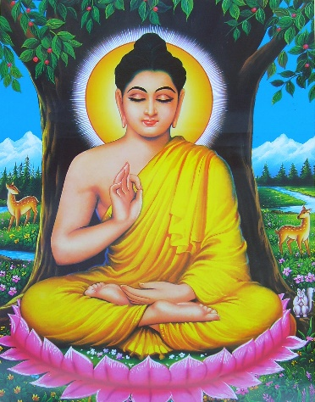
Silent Debate
‘Attachment is the root of suffering.’
Pali Canon
Write down your gut reaction to the statement
In silence, pass your response to someone on your table
If you agree with something put a tick and write why
If you disagree with something put a cross and write why
If you can extend/develop something that someone else has written draw a line to link it to your new development.

