Slide 1
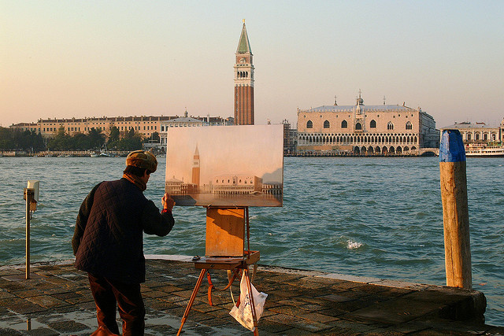
Does this person’s activity have any value?

Slide 2
The Concept of Forms

Slide 3
Learning Outcomes
To able to explain Plato’s theory of forms.
To be able to explain why Plato is a dualist.

Slide 4
What would Plato say?
Plato would say he is wasting his time producing
a pale imitation of beauty.
(like the prisoners in the cave)
Plato rejected art, which is a product of the
senses, preferring instead mathematics, which is
an expression of pure thought that can explain a
pure form.

Slide 5
However.....
Plato would agree that the artist has recognised
that there is beauty in the scene in front of him.
It is true that no matter what culture or nationality
we are, we would all recognise there is some
beauty in this scene.
It is hard to define beauty but we all know it when
we see it.

Slide 6
This led Plato to say...
That there is indeed a Form (which he gives a
capital F) called beauty which we have a dim
recollection of from our prior existence in the
realm of the Forms.
We see something that contains elements of this Form we recognise it beautiful.

Slide 7
Art?
Write a conversation between Plato and an award winning artist whose work has given lots of people pleasure.
Consider:
What would Plato say to him?
How might the artist react?
Stretch yourself:
Add your opinion to the conversation.

Slide 8
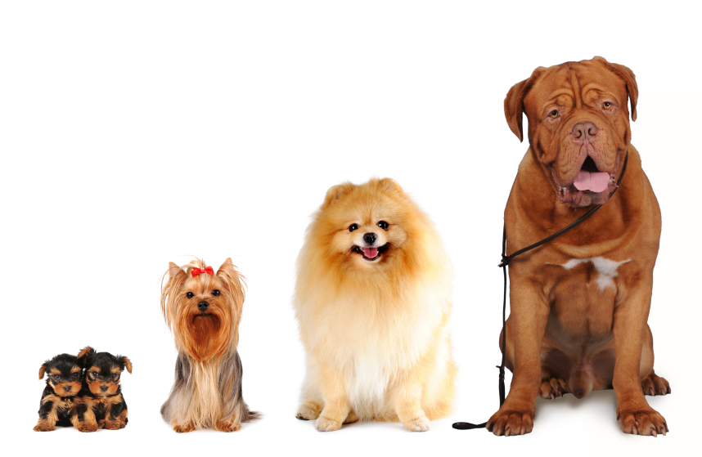
Which one is dog?

Slide 9
The Particulars participate in the Form
The Form is not a shape, it is the essence of the
object, in the case of the dog and all dogs have a
degree of ‘dogginess’ due to participating in this
Form.
This is how we recognise dogs.
Plato used the word particular to describe the objects in our world.

Slide 10
Recognising Forms -anamnesis
Plato said we recognise the Forms because we
are born with a dim recollection of them from
our prior existence in the realms of the Forms.
The inner part of us, you might call it the soul,
that does not change.
It is eternal and, before it became tied down by a
body, it was connected with the real world of the
Forms. It is because we have all seen the Forms
before, that we can recognise them now.

Slide 11
Where does this form exist?
According to Plato the world we live in is a pale
imitation of the (Horaton) real world.
Our world is constantly changing and we rely on
our senses to understand what is going on.
E.g. Can we cross the same stream twice?
This real realm of the forms world (Noeton) is unchanging and eternal.
It is the world of ideas not of senses.
It is where there are perfect forms of the things we know on earth.
e.g. Forms of kindness and Justice

Slide 12
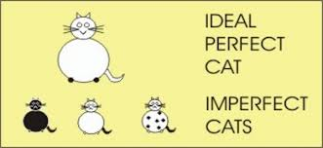
A and B!
A: Describe the qualities of our world.
B: Describe the qualities of the realm of
the forms.

Slide 13
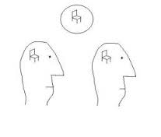
The realm of the forms
Draw your own diagram to show Plato's concept of particulars and the realm of the forms.
Stretch yourself: Research Plato’s form of the good and add it to the diagram.

Slide 14
How would Plato explain this?
Read the article and write an explanation of how Plato would this in your notes.
Stretch yourself:
How would you explain the people’s goodwill.
Answer in your notes.

Slide 15
Dualists?
What would you say to challenge the idea that
the recognition of Form proves we have an
eternal soul?

