Slide 1
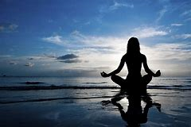
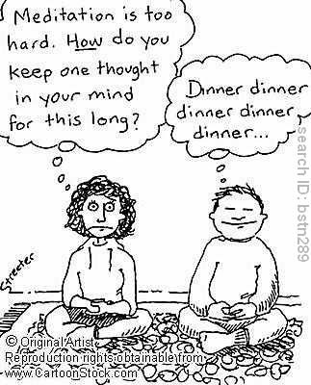
Buddhist Meditation
Samatha and Vipassana

Slide 2
What is meditation?
Freeing the mind from the clutter that fills it every day, in order to free oneself from delusion and craving (unwholesome thoughts)
“cleansing the mind from the three fires”.
The aim of meditation is to help us see life as it truly is: The truth of the 3 marks (Anicca, anatta, dukkha).
Meditation is not focused on an escape from everyday life, not a trace state or yoga or developing mystical powers.

Slide 3
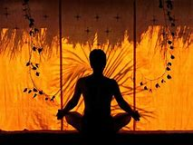
What is meditation?
Meditation is often translated as dhyana (Sanskrit) Chan in Chinese and Zen in Japanese or Jhana (Pali).
Also as bhavana which means cultivating or self-development.
Two forms of meditation:
Samatha calm/ concentration
Vipassana insight meditation

Slide 4
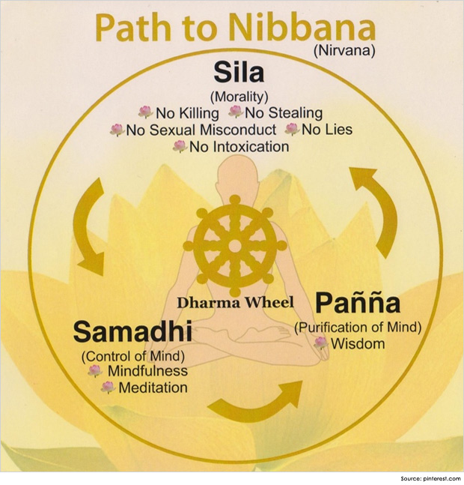
Why does meditation matter?
List reasons for meditation and its benefits:
1
2
3
4

Slide 5
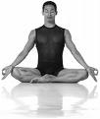
Quotes
Peter Harvey
It is like learning to play an instrument, ‘ you need to tune and play your mind’
‘ one cannot force plants to grow but one can assiduously provide the right conditions’
Damien Keown
‘ the image of the Buddha seated crossed legged in meditation is one of the most poplar themes in Buddhist art’
‘meditation may be likened to prayer in Christianity’
‘meditation generates altered states of consciousness that can accelerate spiritual development’
The Buddha
If your practice does not bring you joy, you are not practicing correctly – ‘ maintain your health. Be joyful. Do not force yourself to do things that you cannot do.’
Buddhism for Dummies
’a method of transforming your view on reality’
Oxford Dictionary
‘deep, continuous thought’
Walpola Sri Rahula
The Buddha’s teaching on meditation,’ aims at producing a state of perfect mental heath, equilbruim and tranquility.’
Thich Nhat Hanh
‘Doing everything mindfully is the practice of meditation, as mindfulness always nourishes concentration and understanding.’

Slide 6
Bhavana
One term used by Buddhists that we translate as ‘meditation’ is bhavana.
It literally means bringing something into existence, producing or cultivating something, applying oneself to something, developing something.
In a Buddhist context it means the bringing about of the states of mind conducive to liberation or nirvana.

Slide 7
Samatha – Mindfulness |  |  |  | Vipassana- Concentration
Right Effort Four states of mind Develop good thoughts Keep good thoughts Stop bad thoughts Keep out bad thoughts 8 Fold Path | Mindfulness Sattipathana sutta 4 objects of mindfulness (body, feeling, state of mind, consciousness) This develops right mindfulness | Anapanasati Breathing (posture and counting) (Bare attention) This develops right mindfulness | Walking Counting steps Awareness | Buddhagosa’s Visuddhimagga 6 fold schema. Single pointed focus to develop higher knowledge. This develops right concentration | Chanting Pure Land “Namu Amida Butsu” Or Tibetan “Om Mani Padme Hum” | Visualisation Tibetan Deity yoga Mandalas Tonglen Pure Land Jewelled tower in the pure land | Rinzai Zen Koan Insight into the nature of sunyata without words | Soto Zen Just sitting You are already a Buddha
Theravada |  |  |  |  | Mahayana Leads to sudden enlightenment

Slide 8
Different ideas about Meditation in Buddhist Schools of Thought
Mindfulness meditation is seem as separate from single pointedness of thought or concentration meditation. In mindfulness a meditator try to become and remain fully aware of their body and mind. Whereas in concentration meditation the meditator tries to focus single mindedly on an object, phrase or concept. Through this a meditator develops more subtle forms of thought. These are described as the four jhanas which show the deeper and deeper levels of thought a meditator develops through their practice and it eventually leads to enlightenment. This is linked to right concentration in the eight fold path. Right mindfulness comes first on the eightfold path because it is seen as a precondition for the development of concentration.
Thanissaro Bhikkhu believes that there is no difference between these two (mindfulness and concentration) because he suggests that the Buddha combined the two forms of meditation in the Anapanasati Sutta, where developing mindfulness of breath also means that you accessing the higher level of concentration. The Sattipathana sutta is the same, is we are mindful of the body then we are fully concentrating (single pointedness of thought).
However, Soto Zen Buddhism does not see that we need to become enlightened because we are already enlightened. All living things have the Buddha embryo (tathagatha) which means that they are already enlightened but need to realise it. Zazen involves just sitting and just being the Buddha.
Notes:
Reading – print

Slide 9
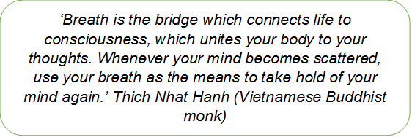
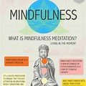
Samatha Meditation
Samatha refers to techniques which assist in the calming of the mind and developing concentration.
One of the principal techniques for this purpose is mindfulness of breathing (ānāpānasati)
Mindfulness of breathing leads the practitioner into concentration (samādhi), the domain of experience wherein the senses are subdued and the mind abides in uninterrupted concentration upon the object
Through the meditative development of calm abiding, one is able to suppress the obscuring five hindrances.

Slide 10
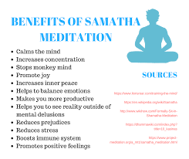
The Purpose of Samatha Mediation
Learning to focus gently on one object helps to develop a calm and concentrated mind. This is in preparation for developing wisdom and understanding of the nature of reality. For this reason, samatha meditation is often seen as a preparation for vipassana meditation.
Buddhists emphasise that distraction is a normal aspect of meditation, and that it is important not to become discouraged or self-critical. There is no question of failure – simply the need to keep practising.

Slide 11
Samatha Meditation

Slide 12
The Five Hindrances
Sensory desire: seeking happiness through the senses.
Ill-will: all kinds of thought related to wanting to reject, feelings of hostility, resentment, hatred and bitterness.
Sloth-torpor: heaviness of body and dullness of mind which drag one down into disabling inertia and thick depression.
Restlessness-worry: the inability to calm the mind.
Doubt: lack of conviction or trust.

Slide 13
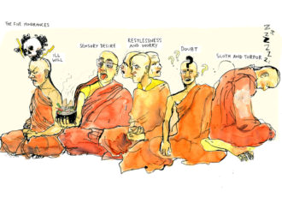
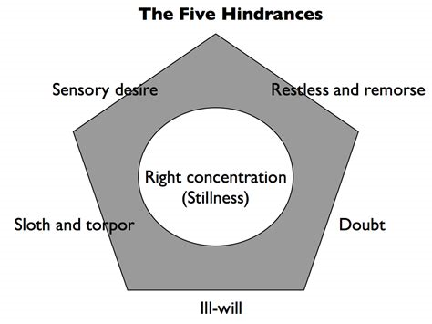
The Five Hindrances

Slide 14
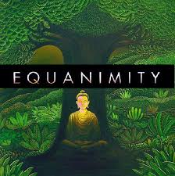
Samatha The Four Brahma Viharas - other things to focus on during meditation
These meditations aim at generating altruistic thoughts towards others and leading one away from erroneous self-motivated thoughts
Metta Bhavana – Loving Kindness ( Thinking thoughts of love towards others)
Karuna Bhavana- Compassion ( generating thoughts of helping others) Then to act this.
Mudita Bhavana- Joy ( Thinking joyously about the good qualities of others)
Upekkha Bhavana – Equanimity ( generating thoughts of how we are all equal)

Slide 15
Jhana – Meditative Absorption
In the Buddha’s enlightenment experience it describes how he entered into 4 Jhanas
Jhana = A higher (deeper) and more concentrated level of mind
The Jhanas were not actually new to the Buddha as he had already mastered them years before he was enlightened as part of meditation
The Four Jhanas
Pleasant Sensations
Joyful Feelings
Contentment
Peacefulness
Thinker:
Edward Conze translates Jhana as ‘trance’ but when you consider that meditation is more about ‘zoning in’ rather than ‘zoning out’ then this would be inappropriate.

Slide 16
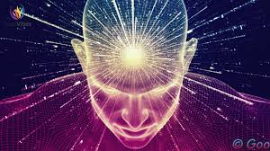
4 Jhanas
Jhana | State of mind or consciousness
First Jhana | Clarity, ability to examine an detach oneself from the world of desire
Second Jhana | Happiness, joy as the mind is calmed
Third Jhana | Joy, equanimity (evenness of mind), composed as the raptures at ones earlier joy fades
Fourth Jhana | Equanimity, clear, calm, peaceful, a state of pure happiness

Slide 17
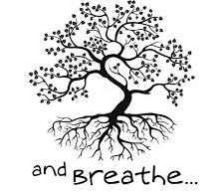
Samatha - Anapanasati
The most common type of meditation is ‘Breath Awareness’. The exact method varies greatly from teacher to teacher but the basic idea is to use one’s breath in order to create a focussed, calm, mind.
It is extremely useful since, unlike most other things, you always have your breath with you and so can meditate on it wherever you are.
Breathing techniques are often the foundation of many meditations and exercises for obvious reasons
‘Breath is the bridge which connects life to consciousness, which unites your body to your thoughts. Whenever your mind becomes scattered, use your breath as the means to take hold of your mind again.’ Thich Nhat Hanh (Vietnamese Buddhist monk)

Slide 18
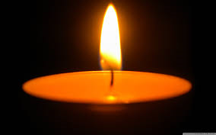
Samatha – objects of focus
Samatha is not particularly unique to Buddhism. Nearly every spiritual tradition has a form of Samatha
Samatha aims at developing one’s mind to work in ways that will help develop the Buddhist path. E.g., concentration and a focussed mind has obvious benefits.
Theravada specifies 42 ‘worthy objects of meditation’. They are ‘worthy’ because they aide concentration without being, in themselves, two distracting. So meditating on a candle might aide concentration but meditating on Rainbow Cookies might be a bit too distracting!

Slide 19
Samatha - Kasina
A ‘Kasina’ refers to a smallish disc that one focusses on as a meditation.
There are 10 Kasinas, such as the ‘Earth’ and ‘Fire’ Kasinas
They are worthy objects of meditation in that they are quite deliberately neutral and unprovocative and unremarkable
However, the category of Kasina itself has its own poetic symbolism: eg. Earth, Water, Fire, Air Kasinas

Slide 20
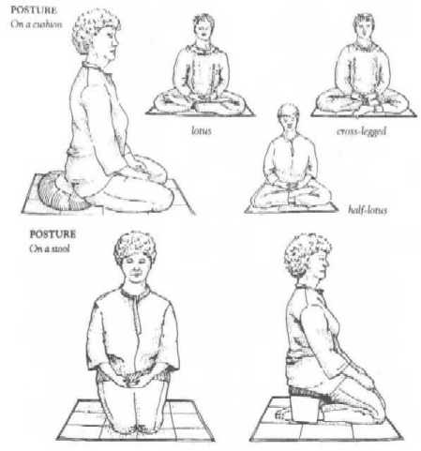
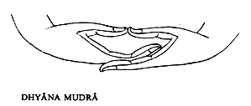
Posture – to help focus and prepare
Try them out!

Slide 21
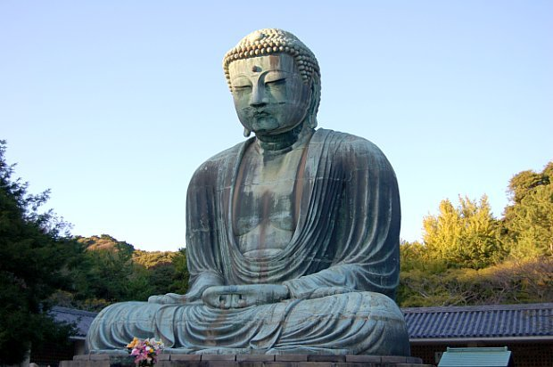
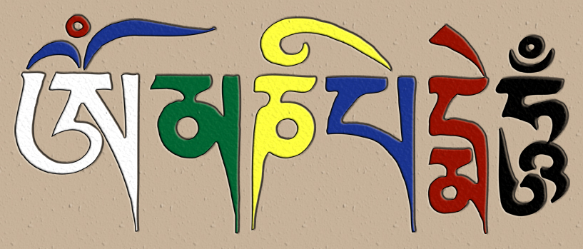
Samatha Meditation: Chanting
Chanting - repeating a phrase over and over again. The phrase will have a specific significance.
The action of chanting focuses the mind just on the words.
Pure Land Buddhists: Namu Amida Butsu (nembutsu)
Tibetan Buddhists: Om Mani Padme Hum

Slide 22
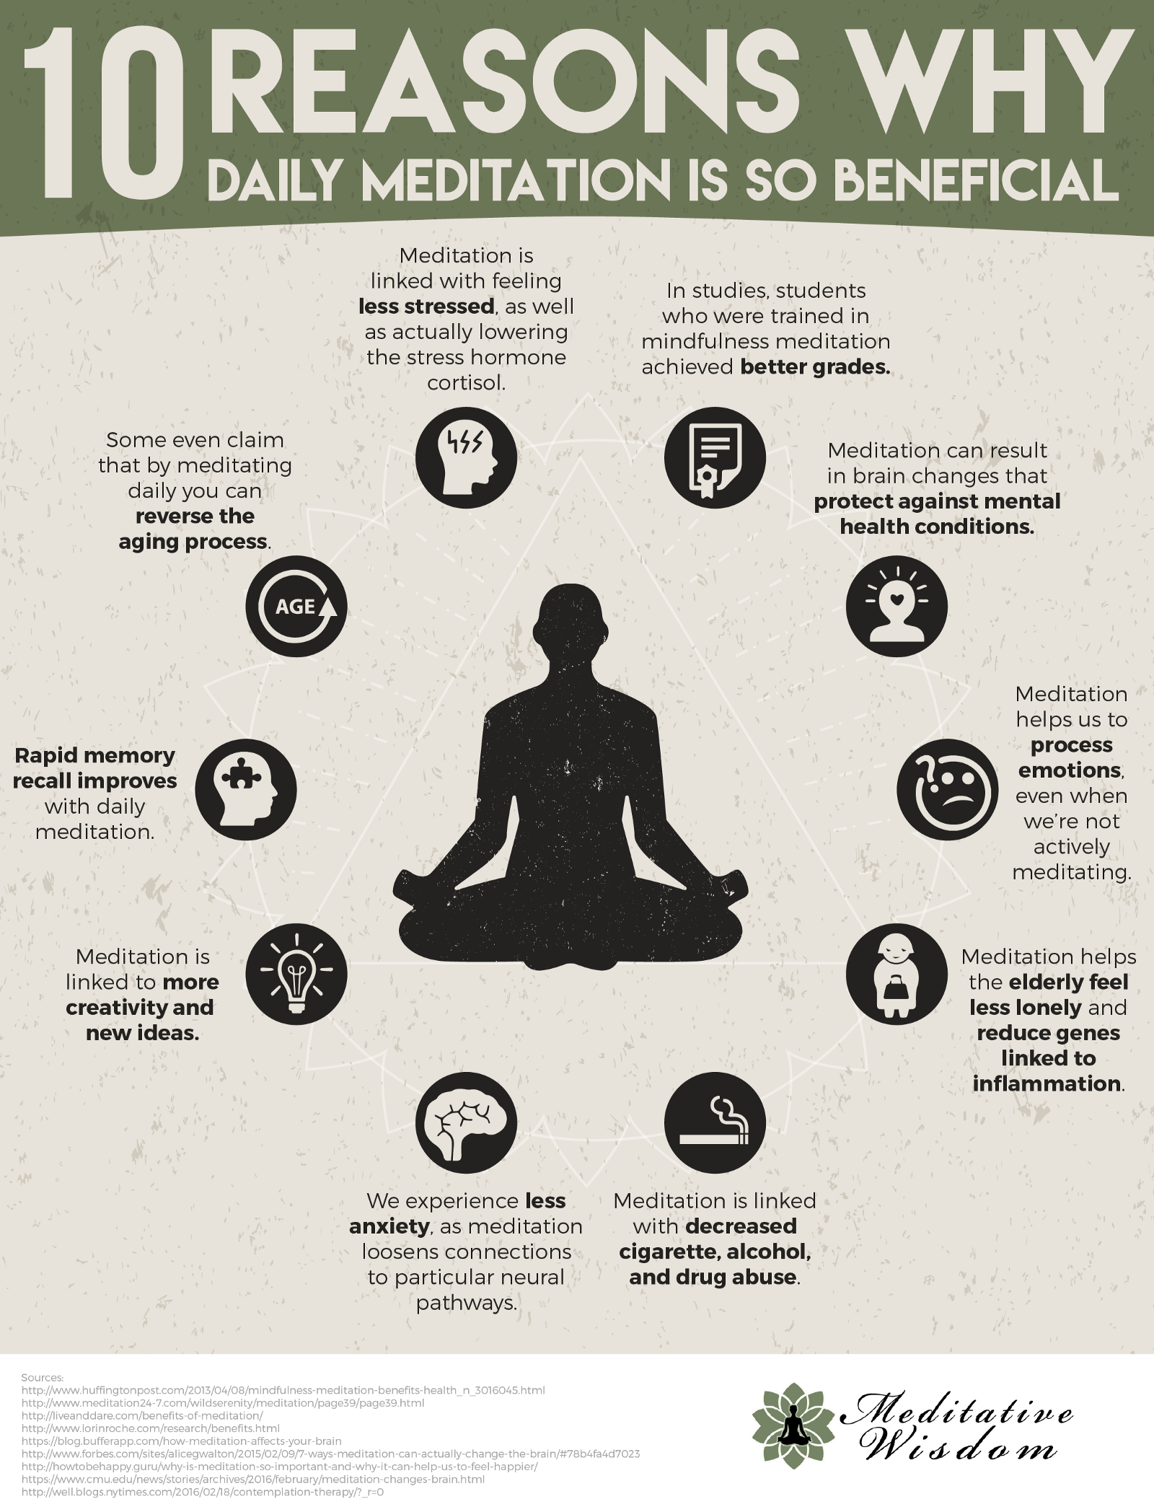
Is Meditation Good For You?
The Dalai Lama has said that Eastern forms of meditation have to be handled carefully: “Westerners who proceed too quickly to deep meditation should learn more about Eastern traditions and get better training than they usually do. Otherwise, certain physical or mental difficulties appear.”

